Slide 1
eCOMMERCE

Slide 2


HorizonBit
MD JEWEL
162-15-8071
MD MOINUL ISLAM
162-15-7779

Slide 3
Contents:
Product Category
Show List
Order in Form
Admin Login
Admin Control
Login Form
SignUp Page
Recovery Password
Customer Page
Profile Photo Change

Slide 4
OUR PROCESS IS EASY
Login
Select & buy
LogOut

Slide 5
Begins with Login Page
1

Slide 6
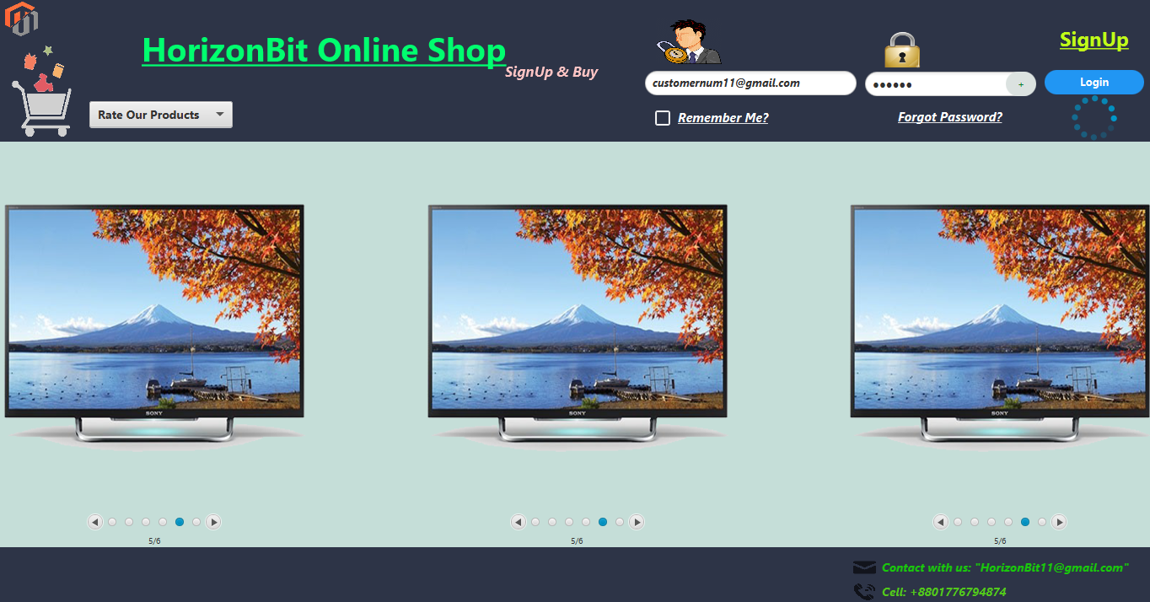
Place your screenshot here
Login Page
Pagination Slider

Slide 7
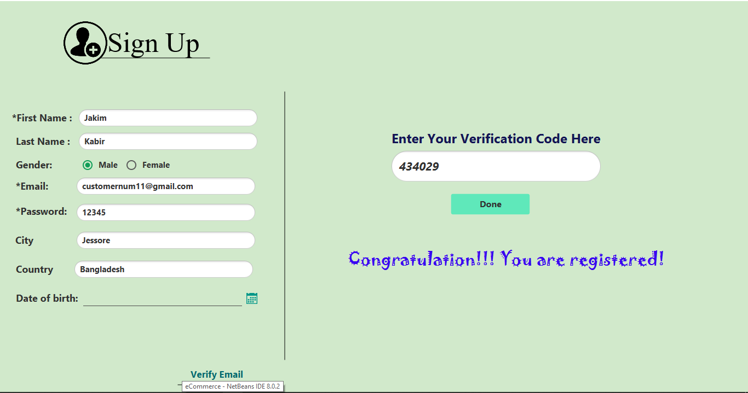
Place your screenshot here
SignUp Page
Signing with email verification

Slide 8
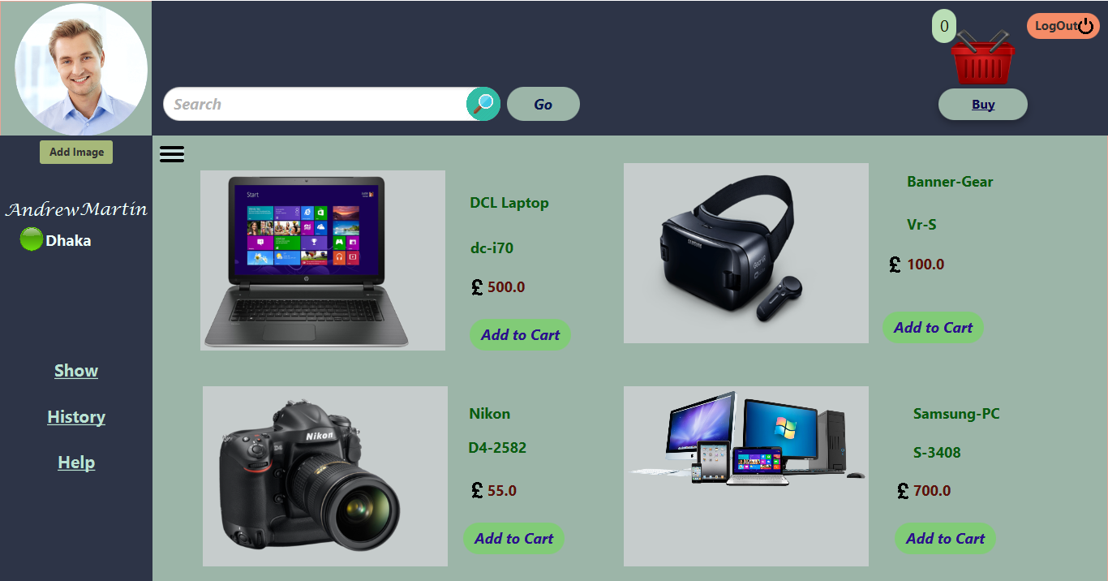
Place your screenshot here
Customer
Default content
Name,City
Empty cart & List

Slide 9
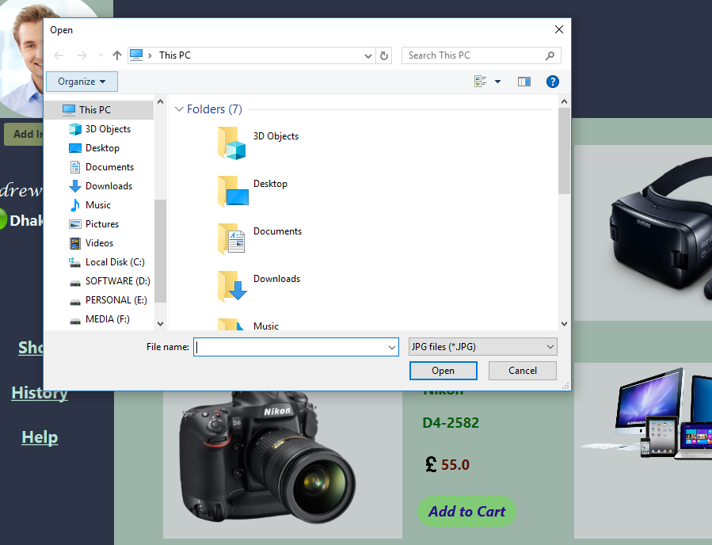
Place your screenshot here
Adding Image
Opening Pc directory
Take’s image of png,jpg format

Slide 10
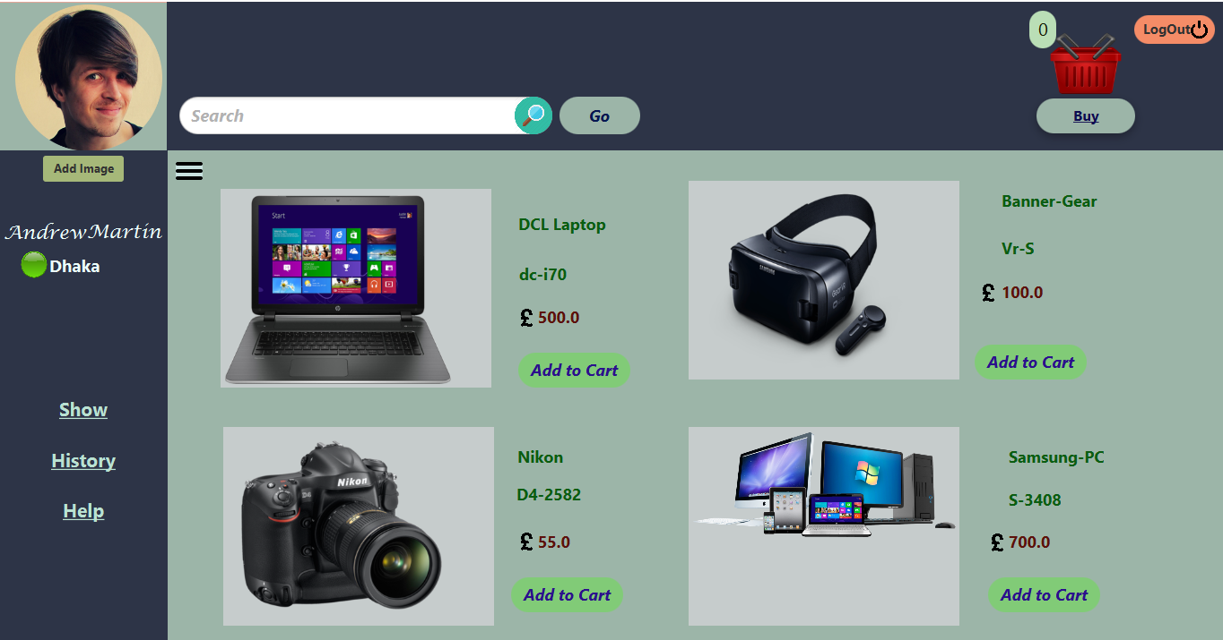
Place your screenshot here
Profile Picture is changed
Focus at the right most corner

Slide 11
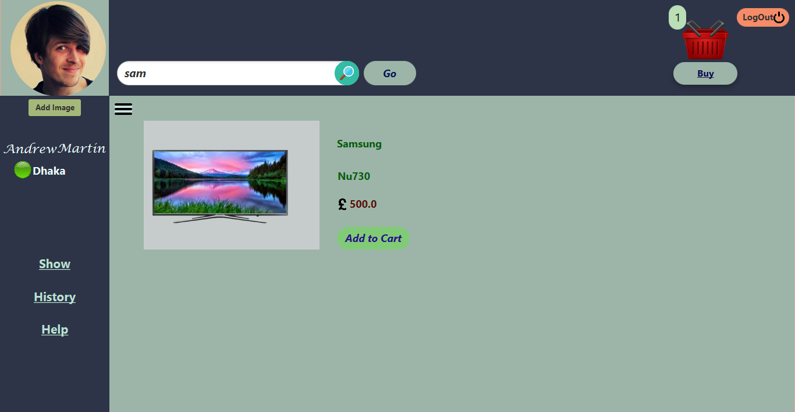
Place your screenshot here
Search Bar
Powerful search bar
Uses ‘REGEXP’ keyword

Slide 12
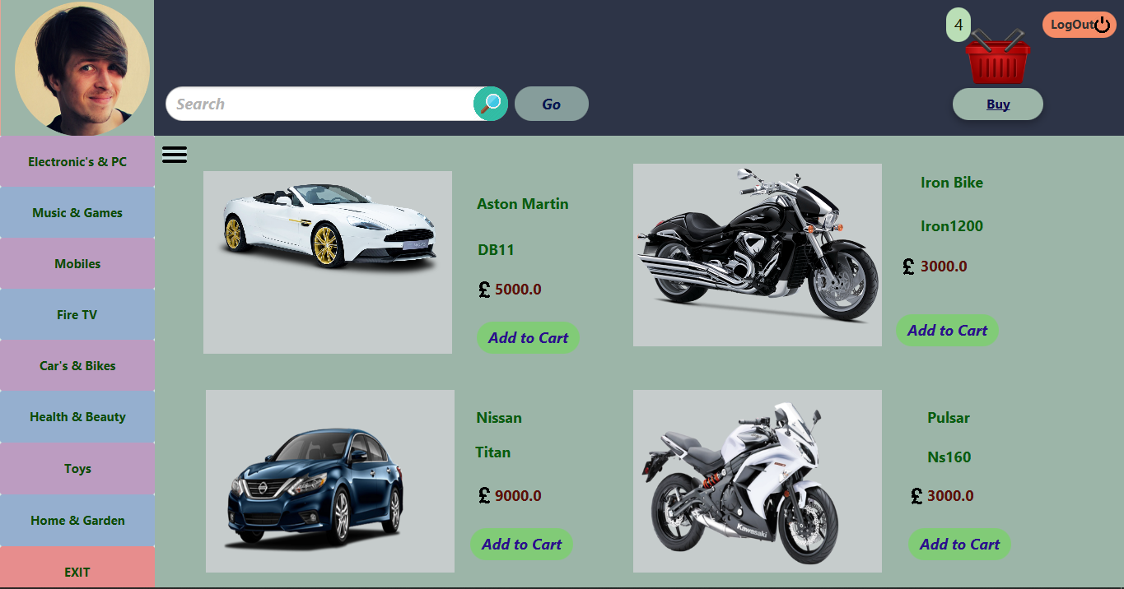
Place your screenshot here
Category
Different lists by selecting hamburger
Adding products to cart

Slide 13
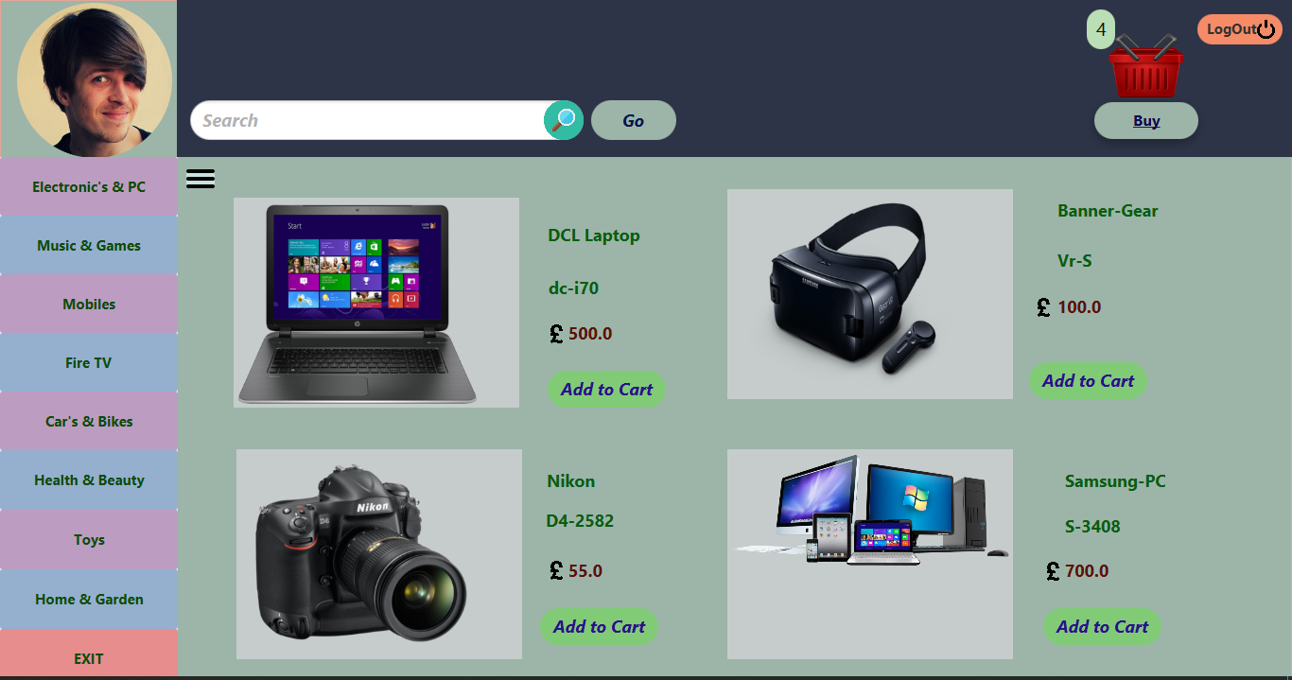
Place your screenshot here
Category
Adding more products

Slide 14
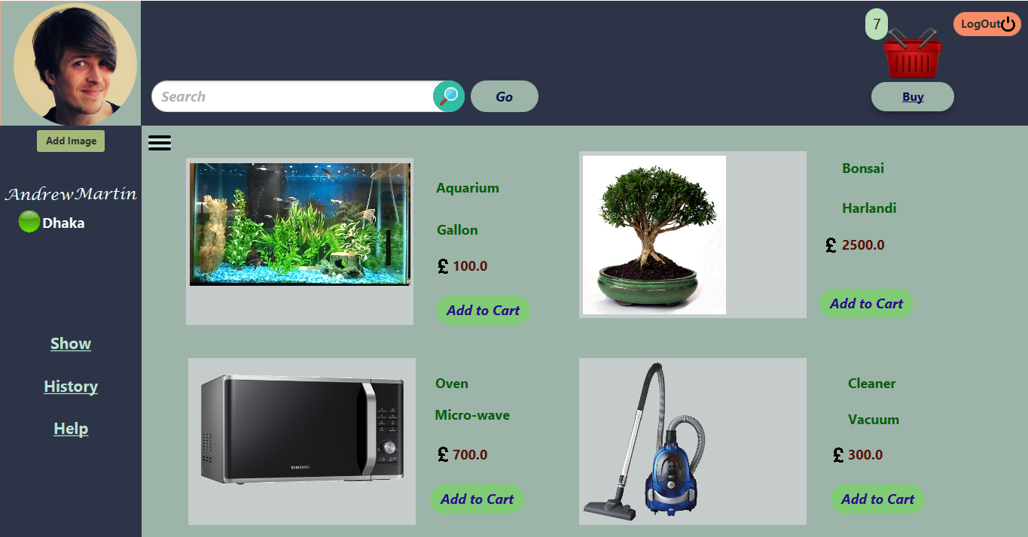
Place your screenshot here
Category
After selection exiting and checking cart number

Slide 15
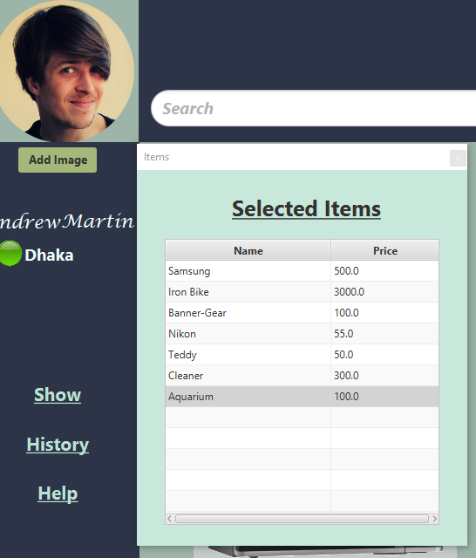
Place your screenshot here
Show
Show button provides all the selected items , added to the cart

Slide 16
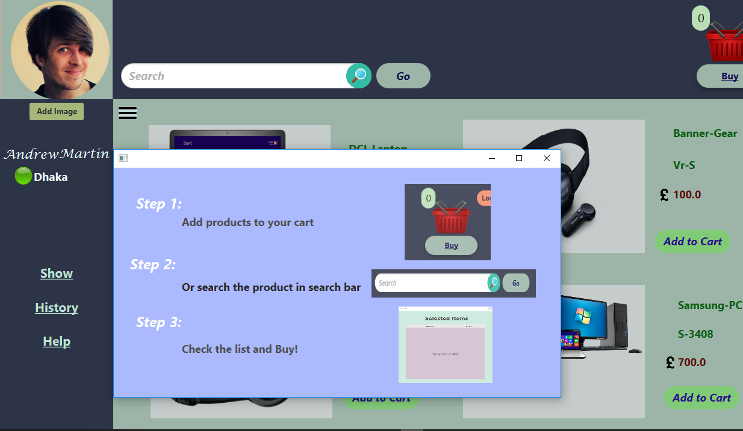
Place your screenshot here
Help
This will direct one the whole procedure

Slide 17
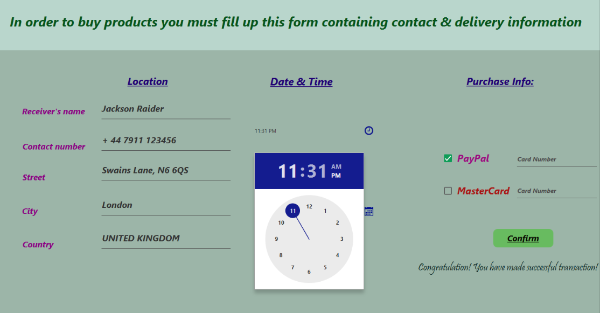
Place your screenshot here
Order Form
Takes all the necessary information for delivery.

Slide 18
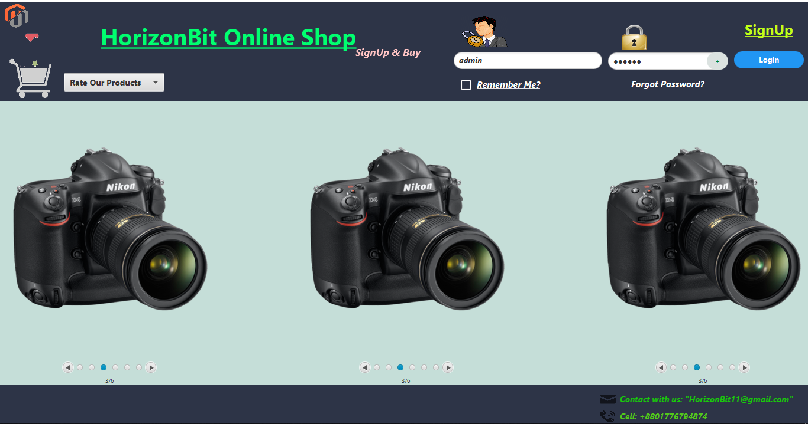
Place your screenshot here
Admin Login
Getting the controller privilege

Slide 19
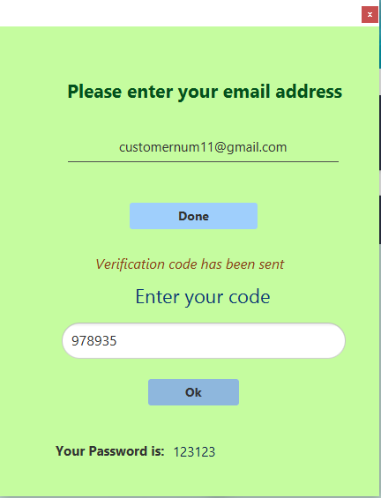
Place your screenshot here
Password Recovery
When the user forgets his/her password

Slide 20
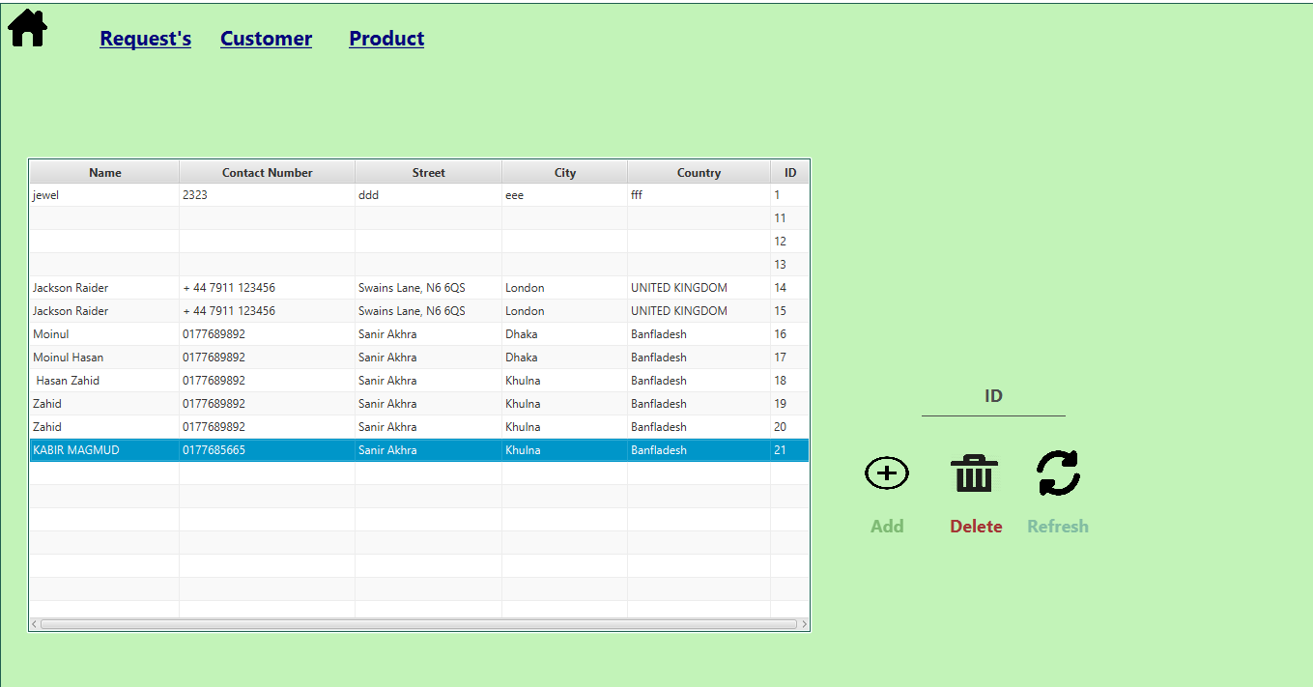
Place your screenshot here
Order’s as default
The requested order gets appeared in this table

Slide 21
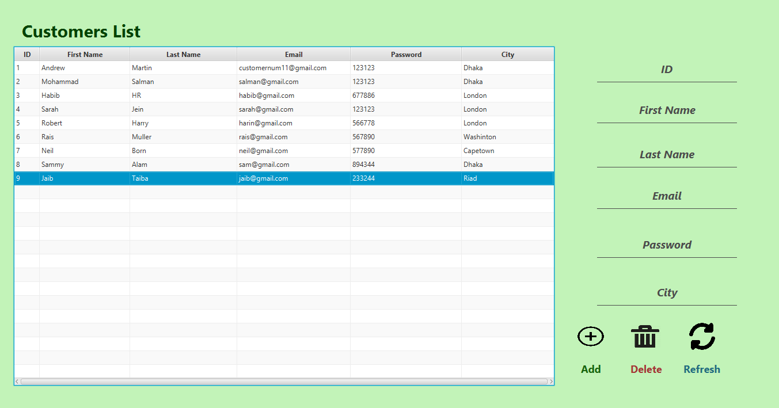
Place your screenshot here
Customer’s details
Customers details with editing facility.

Slide 22
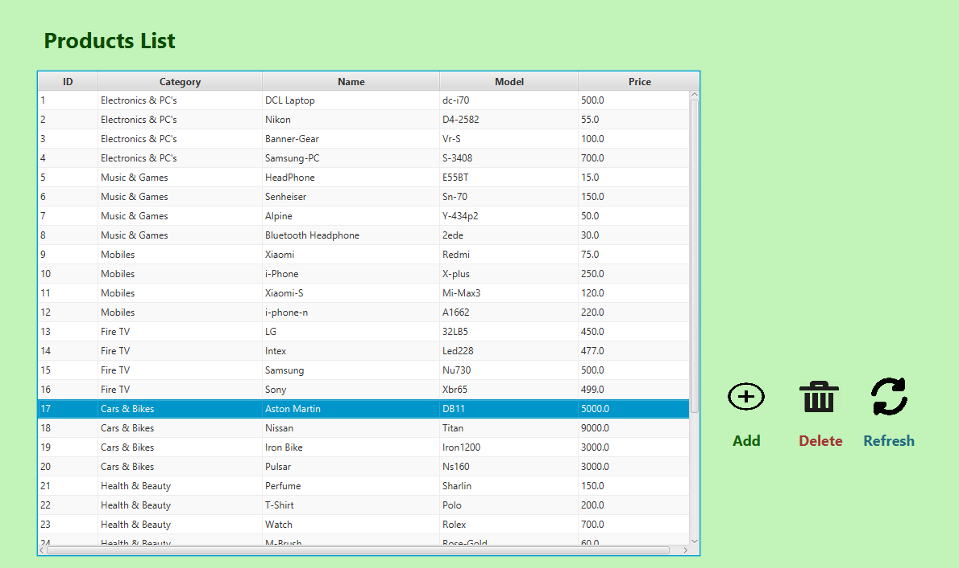
Place your screenshot here
Products List
All the available products are displayed here.

Slide 23
THANKS!
😉
Any questions?

