Slide 1
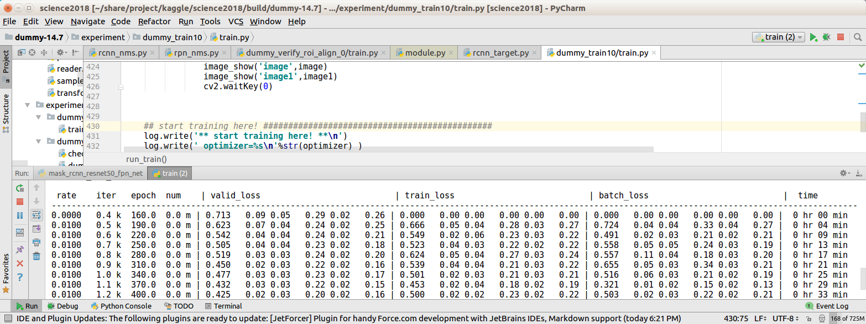
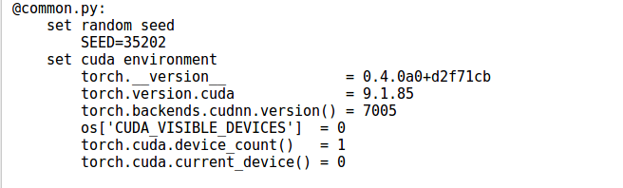
[ software setup ]
⚫ pytorch-0.4.0 / python-3.6
⚫ recommnended python IDE: pycharm
⚫ run "common.py" :
pytorch-0.4.0 must be buildt from the source. It is not available as conda/pip installation yet. 0.4.0 support zero dimension torch tensor array and torch scalar

Slide 2
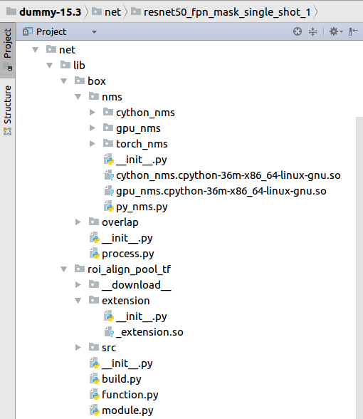
⚫ build torch *.so libraries :
1. lib/box/nms/torch_nms/extension/_extension.so
>> /usr/local/cuda-9.1/bin/nvcc -c -o nms_kernel.cu.o nms_kernel.cu -x cu -Xcompiler -fPIC -arch=sm_52
>> python build
2. lib/roi_align_pool_tf/extension/_extension.so
This is porting of roi align pooling layer from tensorflow implementation. Note that this is not the same as mask-rcnn paper.
>> /usr/local/cuda-9.1/bin/nvcc -c -o crop_and_resize_kernel.cu.o crop_and_resize_kernel.cu -x cu -Xcompiler -fPIC -arch=sm_52
>> python build

Slide 3
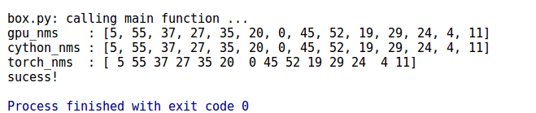
⚫ build cython *.so libraries :
1. lib/box/nms/cython_nms_xxx.so
>> /opt/anaconda3/bin/python3 setup.py build_ext --inplace
2. lib/box/nms/gpu_nms_xxx.so
>> /opt/anaconda3/bin/python3 setup.py build_ext --inplace
To check mns, see "box/process.py" run_check_nms()
3. lib/box/overlap/cython_box_overlap_xxx.so
>> /opt/anaconda3/bin/python3 setup.py build_ext --inplace

Slide 4
[ mask-single-shot net ]
features (multi-scale)
box, label
multi rpn head
rpn nms
input
Resnet50 FPN
crop
mask head
masknms
mask

Slide 5
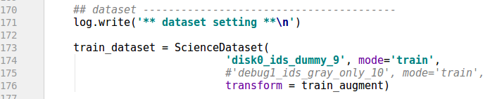
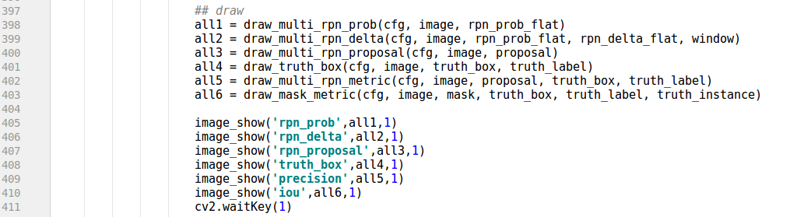
[ example on dummy data ]
⚫ see experiment/fpn_ssd/train_0.py
Dummy data for debugging
Visualisation of training process (see next page)

Slide 6
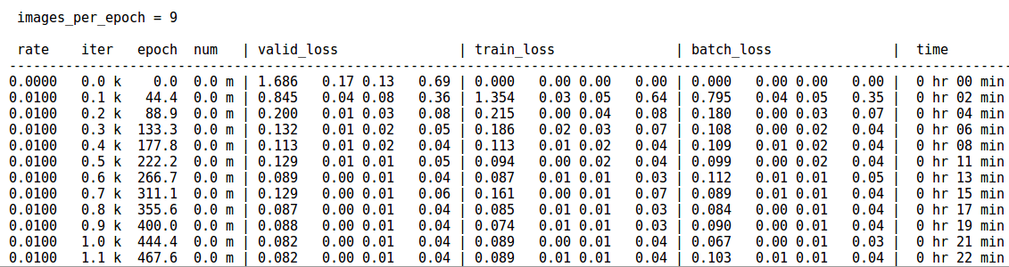
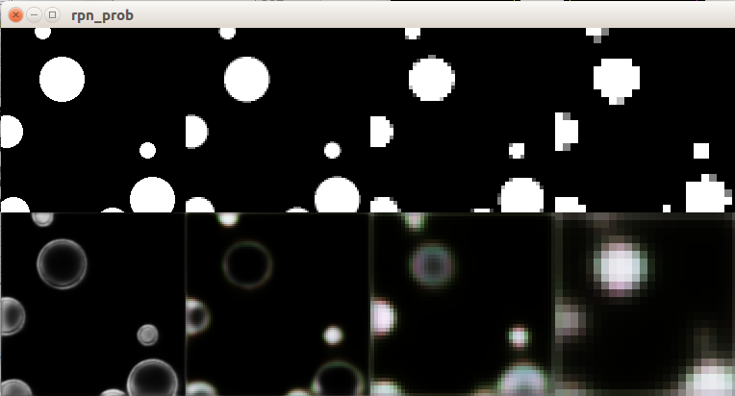
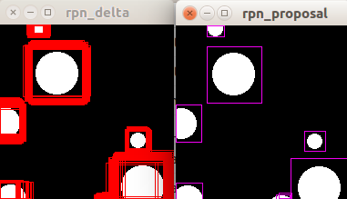
training log
loss : total, rpn_cls, rpn_reg mask_cls
rpn_logits (4 scale level)
rpn_deltas
rpn_proposal (after mns)

Slide 7
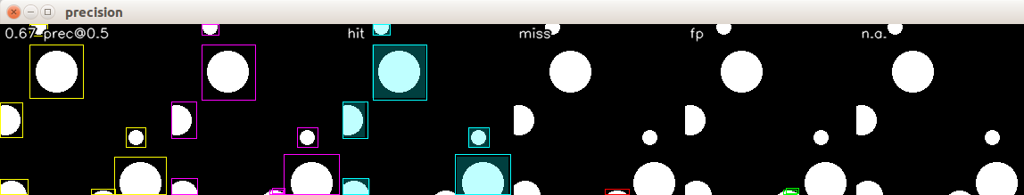
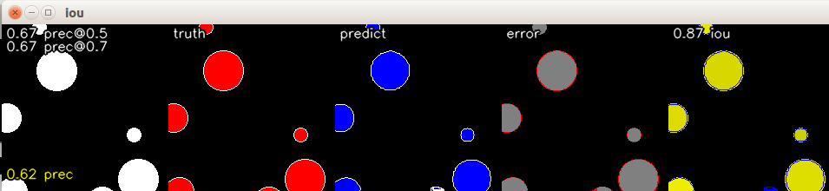
don't care boxes (if any) .e.g. too small or near boundary of image)
precision of rpn proposal
truth
rpn
precision of mask segmentation
red: miss blue: fp
average iou
precision at various iou threshold
average precision (LB metric)
per mask iou (indicated by color intensity)

Slide 8
[ example on small nuclei dataset ]
<to be updated>

