Slide 1
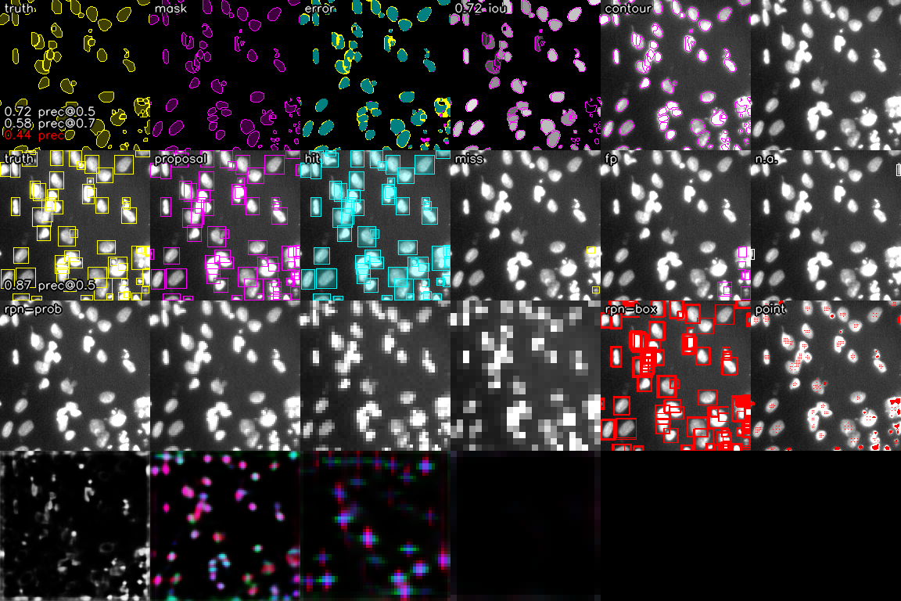
mask metric
proposal metric
rpn prob and delta

