Slide 1
Human Walking Styles
Nguyen THANH
10 Mar 2017
AniAge

Slide 2
Outline
Skeleton support region (1 region ~ 1 joint)
Motion rotation data
Motion blending, retargeting
Distortion
The sparsity of component C

Slide 3
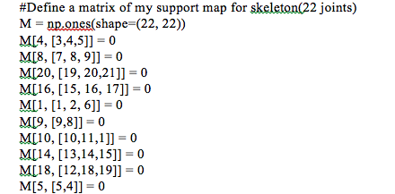
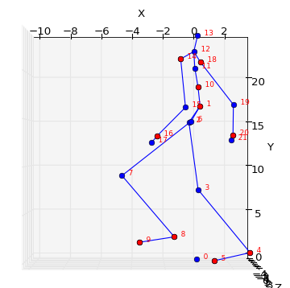
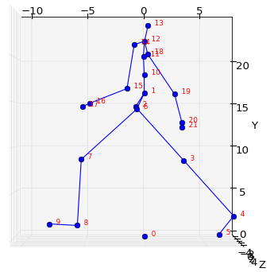
1. Support region
Skeleton support region
Comparison

Slide 4
1. Support region
Force one joint into one support region
22 joints
22 support regions

Slide 5
Motion rotation data
Last week
BVH ->Position data (x,y,z)
This week
BVH -> Translation + Rotation data (angle)

Slide 6
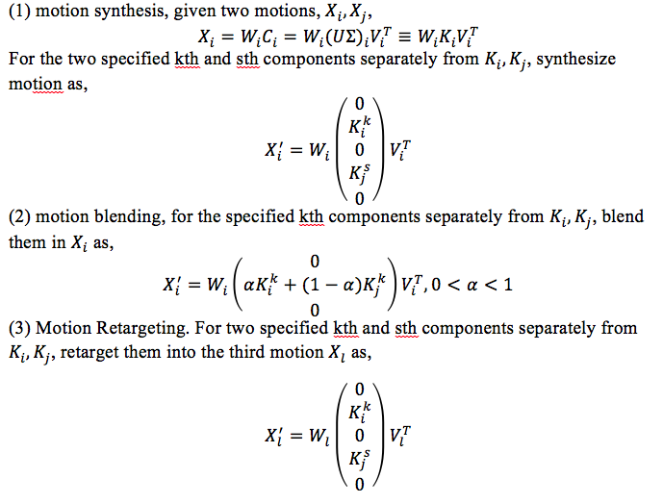
Motion blending, retargeting

Slide 7
Motion blending, retargeting
Implementation

Slide 8
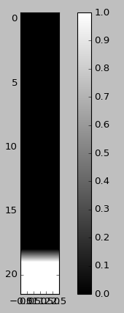
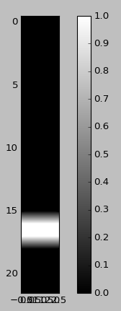
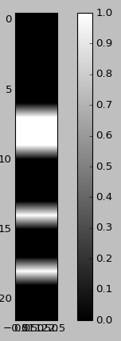
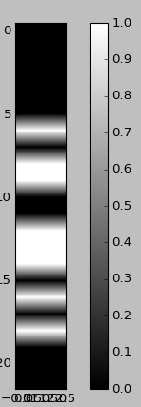
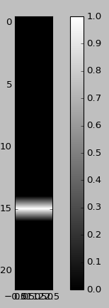
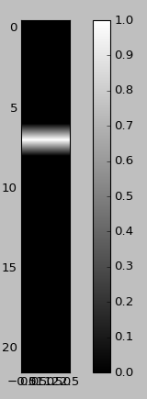
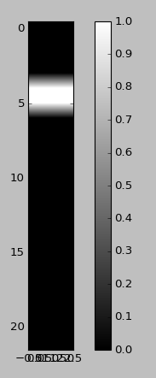
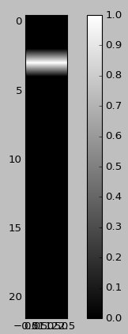
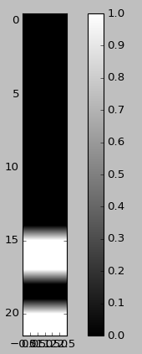
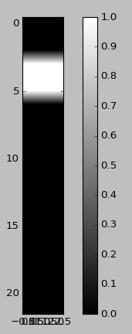
The sparsity of component C using SPLOC

Slide 9
Thanks for listening
Q&A

