Slide 1
Human Walking Styles
Nguyen THANH
30 Mar 2017
AniAge

Slide 2
Outline
Basic motions decomposition
Idea using sparse coding + SPLOC
How to extract one basic motion
Synthesis based on basic motion
Retargeting based on basic motion ??
Motion distortion
Remove distortion using limb length constraints

Slide 3
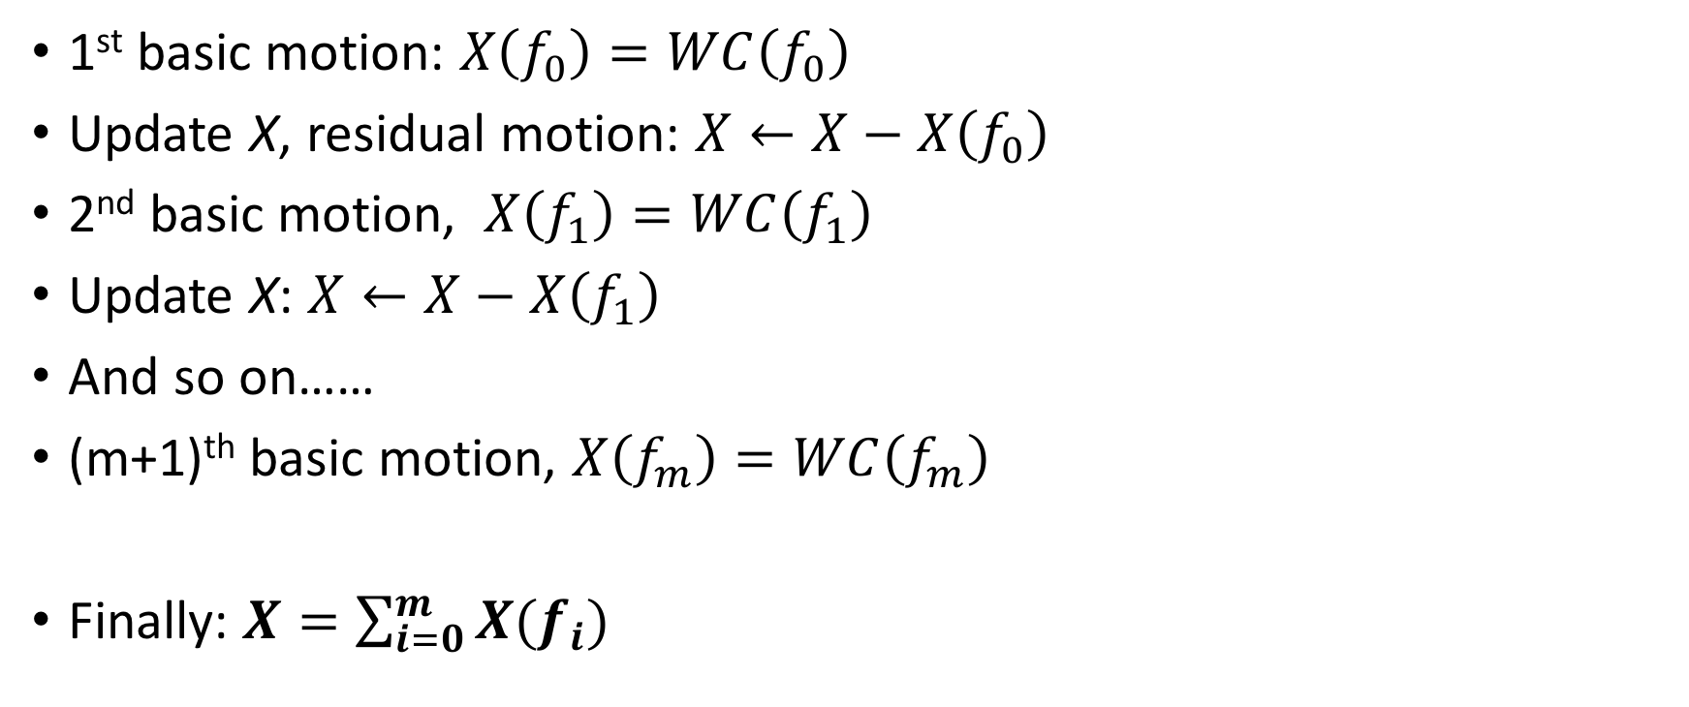
1. Basic motion - idea
1st basic motion: $X\left(f_{0}\right)=WC\left(f_{0}\right)$
Update X, residual motion: $X←X−X\left(f_{0}\right)$
2nd basic motion, $X\left(f_{1}\right)=WC\left(f_{1}\right)$
Update X: $X←X−X\left(f_{1}\right)$
And so on……
(m+1)^{th} basic motion, $X\left(f_{m}\right)=WC\left(f_{m}\right)$
Finally: $X=\sum_{i=0}^{m}{X(f_{i})}$

Slide 4
1. One basic motion decomposition
Give motion X_{FxN}, we want to decompose into W_{Fxk}C_{kxN.} Three main steps of decomposition.
Step 1: Initialization
Reuse SPLOC initialization
Step 2: Optimizing weight W
Reuse SPLOC source code. Fixing the initial component C, optimize W.
Step 3: Optimizing component C
Fix optimized W above, using sparse coding to find sparse components. I reuse your provided Matlab function (calling matlab function from python). Input: sparsity coefficient (% of non zero), weight W and motion X. Output sparse component C.

Slide 5
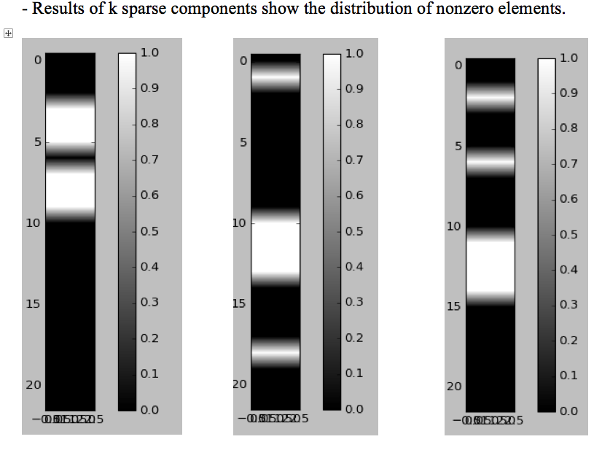
1. One basic motion decomposition

Slide 6
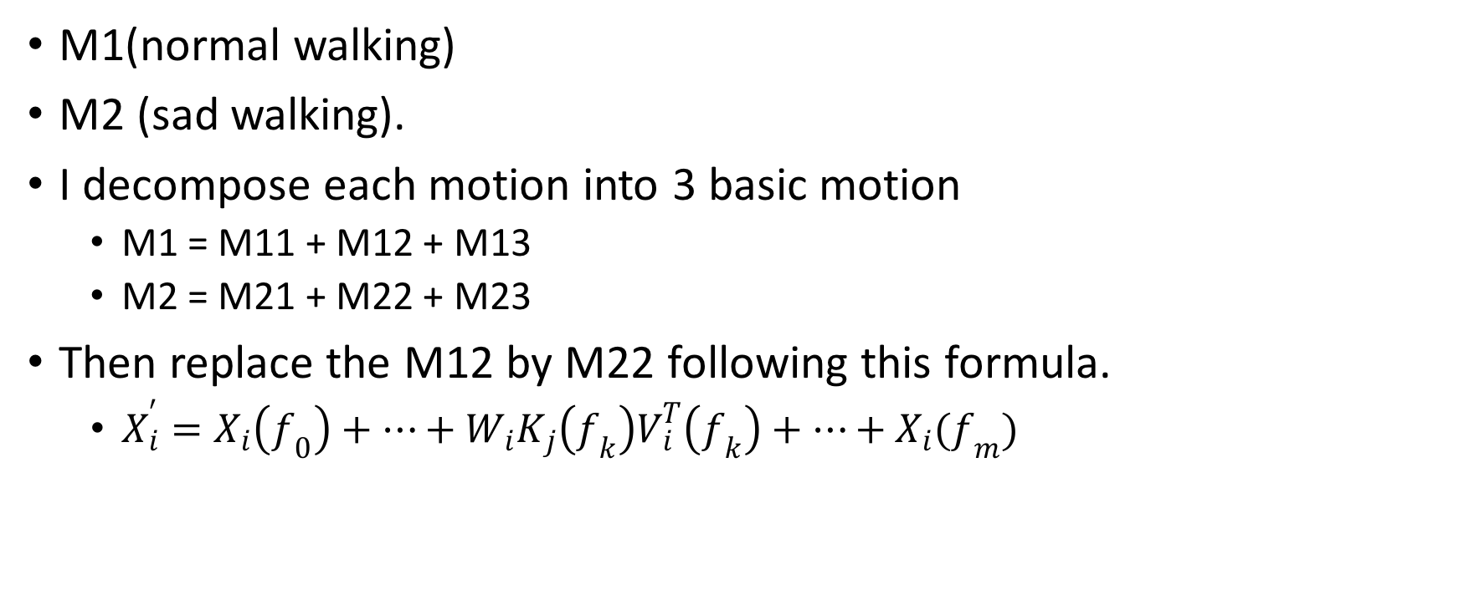
1. Synthesize based on basic motion
M1(normal walking)
M2 (sad walking).
I decompose each motion into 3 basic motion
M1 = M11 + M12 + M13
M2 = M21 + M22 + M23
Then replace the M12 by M22 following this formula.
$X_{i}^{′}=X_{i}\left(f_{0}\right)+…+W_{i}K_{j}\left(f_{k}\right)V_{i}^{T}\left(f_{k}\right)+…+X_{i}(f_{m})$

Slide 7

1. Retargeting based on basic motion
Motion retargeting,
$X_{j}=W_{j}K_{i}V_{j}^{T}$
I wonder if such retargeting really results in any distortion. ????

Slide 8
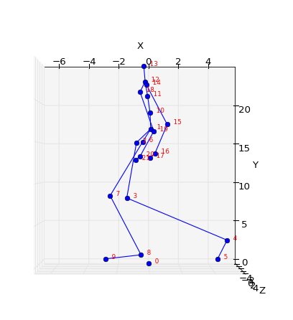
2. Motion distortion
Pre-calculate limb lengths
Apply pre-calculate limbs constraints into synthesized motion
A constraint of D(J3, J4)

Slide 9
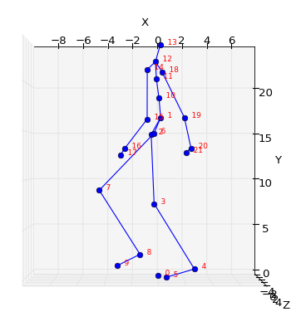
2. Motion distortion
After
Before

Slide 10
Thanks for listening
Q&A

