Slide 1
Emotion Decomposition using Dynamic Time Warping
Nguyen THANH
07 April 2017
AniAge

Slide 2
Outline
Our framework
Dynamic Time Warping
Decomposition Algorithm
Motion post-processing

Slide 3
1. Our framework
Pre-processing
DTW
Decomposition Algorithmn
Post-processing
Distortion Removal
Input motion
Output motion

Slide 4
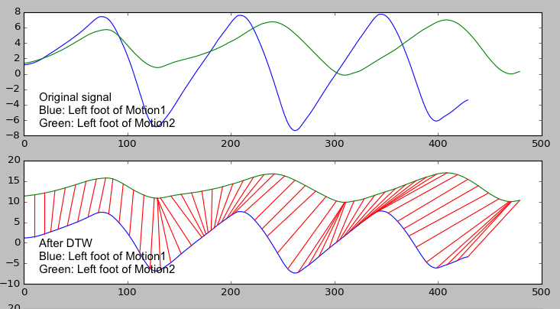
2. Pre-pocessing: Dynamic Time Warping

Slide 5
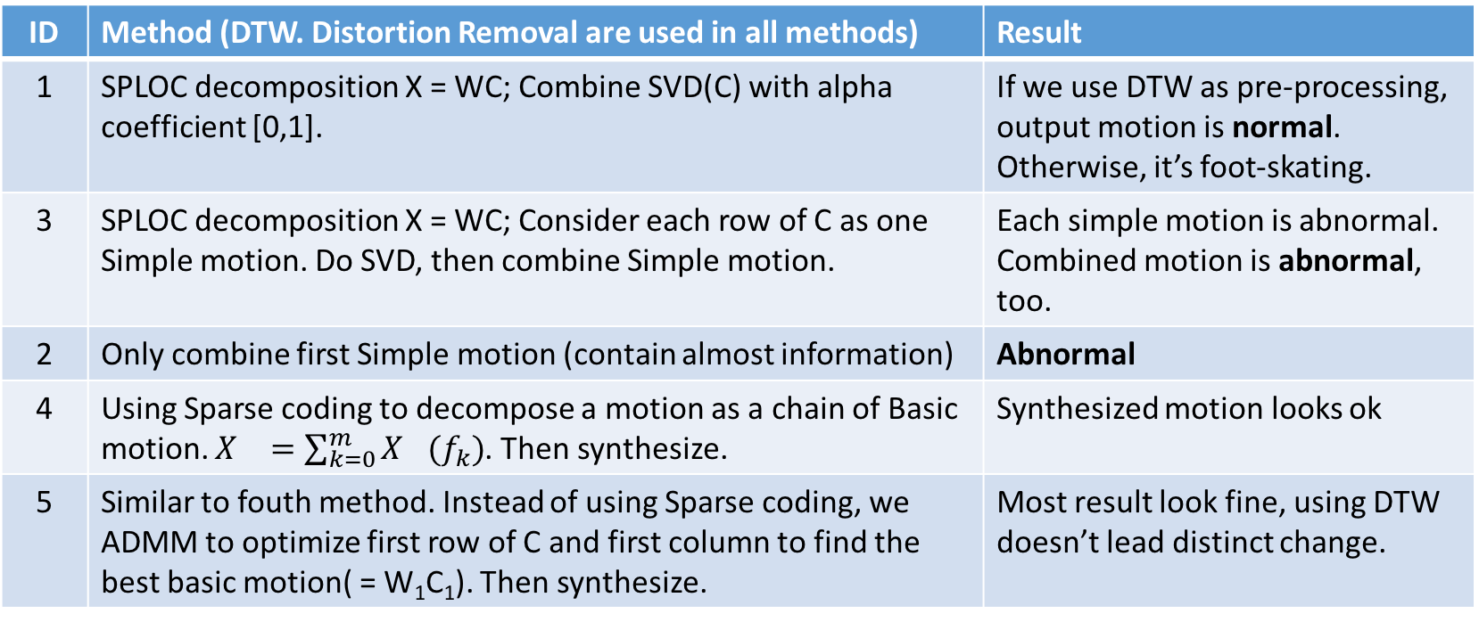
3. Decomposition Algorithm
ID | Method (DTW. Distortion Removal are used in all methods) | Result
1 | SPLOC decomposition X = WC; Combine SVD(C) with alpha coefficient [0,1]. | If we use DTW as pre-processing, output motion is normal. Otherwise, it’s foot-skating.
3 | SPLOC decomposition X = WC; Consider each row of C as one Simple motion. Do SVD, then combine Simple motion. | Each simple motion is abnormal. Combined motion is abnormal, too.
2 | Only combine first Simple motion (contain almost information) | Abnormal
4 | Using Sparse coding to decompose a motion as a chain of Basic motion. $X_{}=\sum_{k=0}^{m}{X_{}(f_{k})}$. Then synthesize. | Synthesized motion looks ok
5 | Similar to fouth method. Instead of using Sparse coding, we ADMM to optimize first row of C and first column to find the best basic motion( = W₁C₁). Then synthesize. | Most result look fine, using DTW doesn’t lead distinct change.

Slide 6
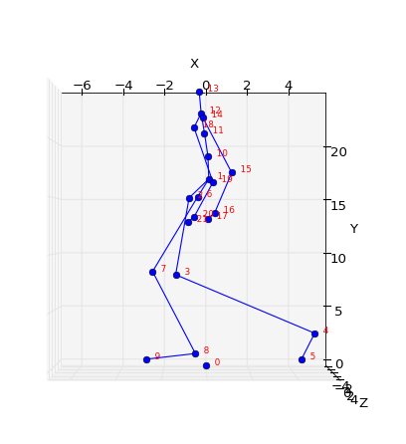
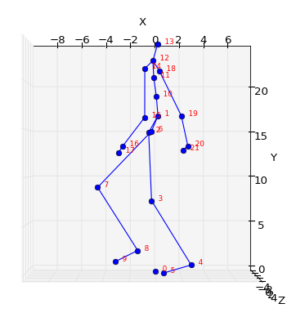
4. Motion post-processing
After
Before

Slide 7
Thanks for listening
Q&A

