Slide 1
Human Walking Styles
Nguyen THANH
17 Mar 2017
AniAge

Slide 2
Outline
Skeleton support region
Motion blending, retargeting
Distortion

Slide 3
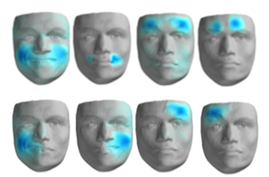

1. Support region
Mesh support region vs Skeleton support region

Slide 4
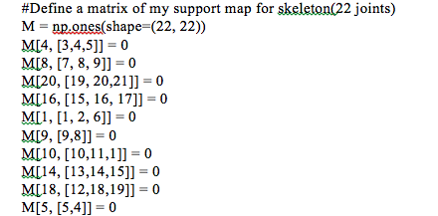
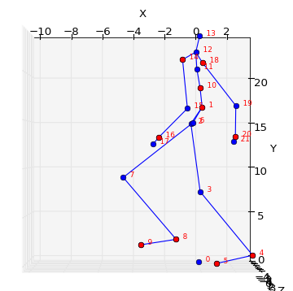
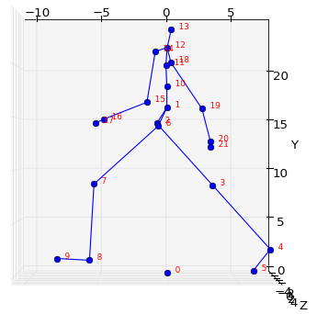
1. Support region
Skeleton support region
Comparison

Slide 5
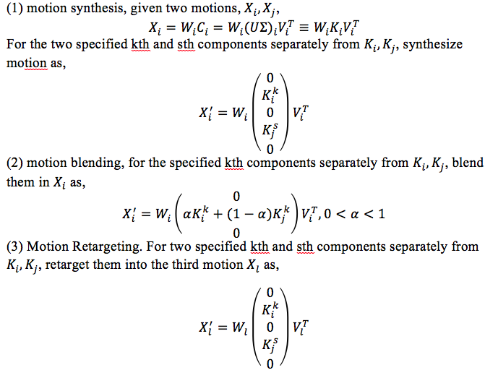
Motion blending, retargeting

Slide 6
Motion blending, retargeting
Implementation

Slide 7
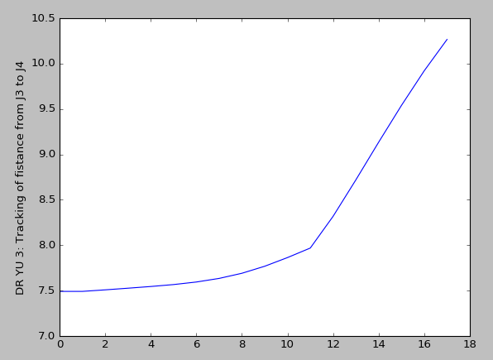
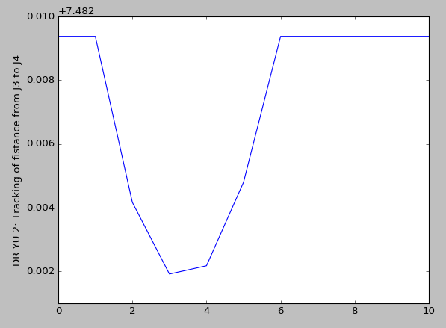
Distortion
Observation of limb length between some joints

Slide 8
Thanks for listening
Q&A

