Slide 1
Spare Representation based Emotion Synthesis and Retargeting
Nguyen THANH
07 April 2017
AniAge

Slide 2
Outline
Motivation
Related Work
Our approach
Sparse representation of basic motion
Motion synthesis
Motion retargeting
Motion distortion
Remove distortion using limb length constraints
Experimental results

Slide 3
1. Motivation
Psychological researches show that bodily expression conveys a significant source of emotion information.
Most of researches mainly focus on facial expression (95%) and voice analysis (~5%)
Capturing high quality emotion
Expensive
Time consuming
Requiring professional MoCap system and actors

Slide 4
1. Motivation
Application
Synthesizing and retargeting: Reproduce emotion through extracting data from real motion.
Human-computer interaction: understanding emotion helps computer interpret human behaviors to respond it accordingly.

Slide 5
2. Related works
Bodily expression variables
2006 Kleinsmith et al. used 24 low-level upper body static features.
2011 Baltrusaitis et al. introduced angle of shoulder.
2013 Min, max, slope, peak duration, etc., were also used by Savva et al.
Based on huge motion dataset
2005 Hsu et al. proposes LTI model, perform a search.
2015 Xia et al. use mixture autoregressive model, perform a search.
2016 Holden et al. use neural network to find styles, perform an optimization.
2016 Yumer et al. transfer style in frequency domain.

Slide 6
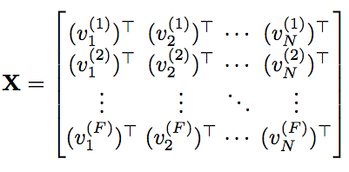

3.1 Sparse Representation of basic motion
Given motion
Suppose that X can be decomposed by
(*)

Slide 7



3.1 Sparse Representation of basic motion
Extracting a basic motion from X by
Set sparsity coefficient fi ~ % of non-zero weight in sparse coding.
Update components C_{fi} using decomposition (*):
Update residual motion:
The idea is representing motion X by a chain of m basic motions iteratively.

Slide 8
3.1 One basic motion decomposition
Give motion X_{FxN}, we want to decompose into W_{Fxk}C_{kxN.}
Step 1: Initialization
Initialize weights and components
Step 2: Optimizing weight W
Fixing the initial component C, optimize W.
Step 3: Optimizing component C
Fix optimized W above, using sparse coding to find sparse components.

Slide 9


3.1 Sparse Representation of basic motion
Step 1:
Calculate Variation matrix
Choose best vertex, then update residual motion
Continues until we obtain K pairs of components and weights.
Not optimal solution, but the components were initialized sparsely.

Slide 10
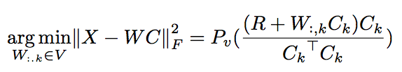

3.1 Sparse Representation of basic motion
Step 2:

Slide 11
3.1 Sparse Representation of basic motion
Step 3:
Set sparsity coefficient (% non-zero)
Fix optimized W, using sparse coding to estimate C sparsely.

Slide 12
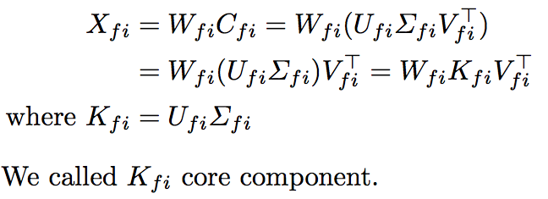
3.2 Motion Synthesis
Given a basic motion, we firstly apply SVD on a component as below,

Slide 13
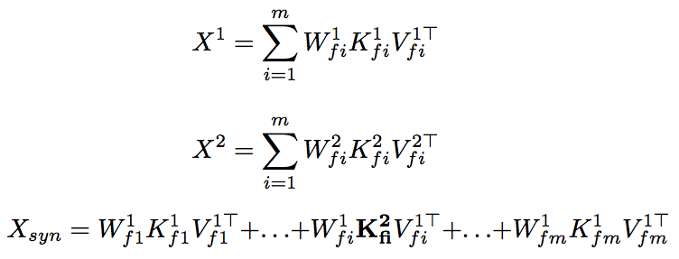
3.2 Motion Synthesis
The idea of emotion synthesis is replacing core component K_{fi} of one motion to another as below,

Slide 14
3.3 Motion Retargeting (On-going)
Emotion synthesis formula
Emotion retargeting formula

Slide 15
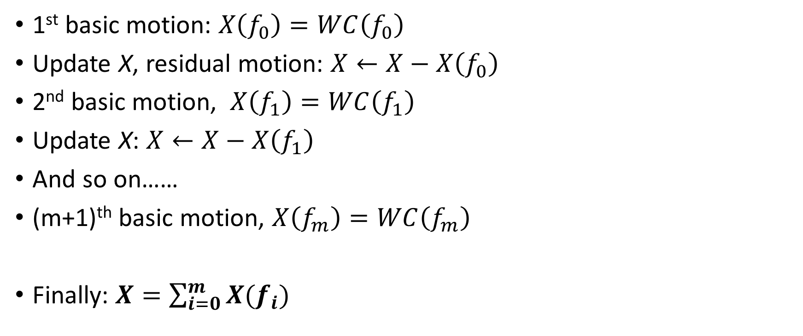
1. Basic motion - idea
1st basic motion: $X\left(f_{0}\right)=WC\left(f_{0}\right)$
Update X, residual motion: $X←X−X\left(f_{0}\right)$
2nd basic motion, $X\left(f_{1}\right)=WC\left(f_{1}\right)$
Update X: $X←X−X\left(f_{1}\right)$
And so on……
(m+1)^{th} basic motion, $X\left(f_{m}\right)=WC\left(f_{m}\right)$
Finally: $X=\sum_{i=0}^{m}{X(f_{i})}$

Slide 16
1. One basic motion decomposition
Give motion X_{FxN}, we want to decompose into W_{Fxk}C_{kxN.} Three main steps of decomposition.
Step 1: Initialization
Reuse SPLOC initialization
Step 2: Optimizing weight W
Reuse SPLOC source code. Fixing the initial component C, optimize W.
Step 3: Optimizing component C
Fix optimized W above, using sparse coding to find sparse components. I reuse your provided Matlab function (calling matlab function from python). Input: sparsity coefficient (% of non zero), weight W and motion X. Output sparse component C.

Slide 17
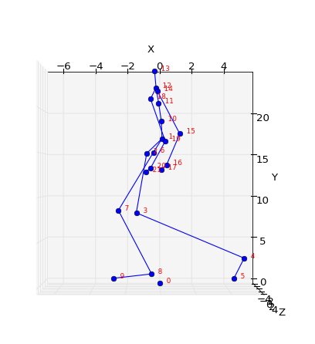
4. Motion distortion
Pre-calculate limb lengths
Apply pre-calculate limbs constraints into synthesized motion
A constraint of D(J3, J4)

Slide 18
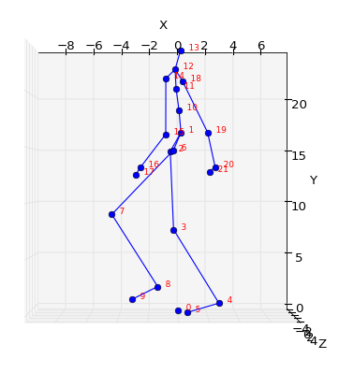
4. Motion distortion
After
Before

Slide 19
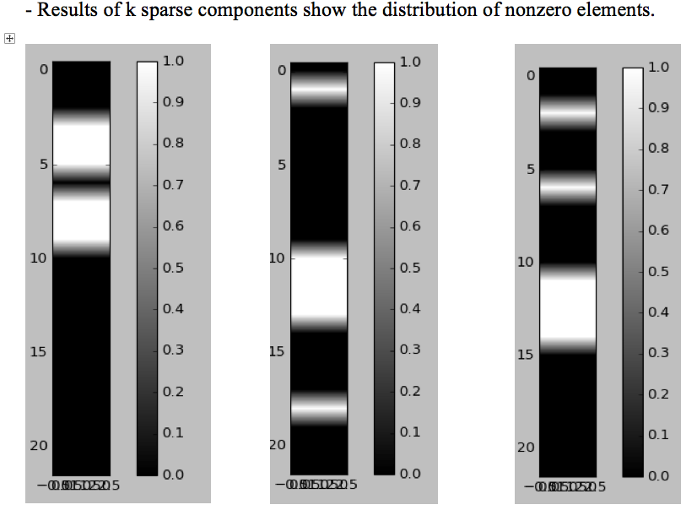
5. Result: One basic motion decomposition

Slide 20
5. Result Demo

Slide 21
Thanks for listening
Q&A

