Slide 1
FFT-CNN
Nguyen THANH
16 Dec 2016
AniAge

Slide 2
Outline
FFT Band pass filter
FFT-CNN
Human motion extraction from image

Slide 3
FFT Band pass filter
fft2: forward transform
Shift zero frequency to center
Select band pass filter by defining range (f1, f2)
Ifft2: Inverse transform

Slide 4

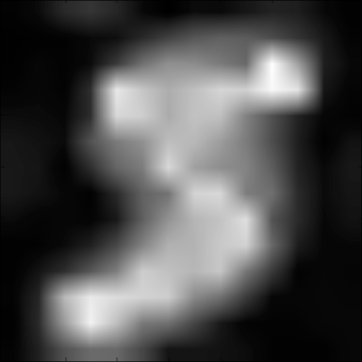
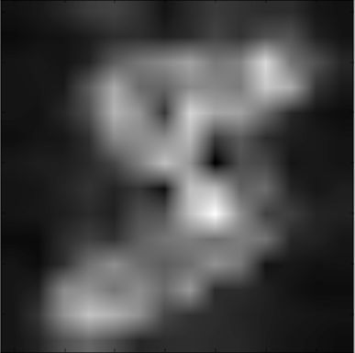
FFT Band pass filter

Slide 5
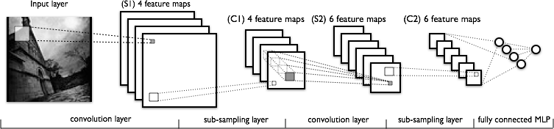
FFT-CNN Idea
FFT replaces CNN layers: avoid training
FFT output feature, then classified by fully connected MLP

Slide 6
FFT-CNN Implementation
Mr. Sam
Edit Theano’s convolutional layer
Avoid updating filter’s parameter
Error ~4% after 1000 iteration
Original CNN ~2% after 1000 iteration

Slide 7
FFT-CNN Implementation
Mine
Implement FFT independently
Extracting feature using FFT, then push to MLP layers.
Error ~15% after 1000 iteration

Slide 8
Implementation result
Original CNN + MLP: ~2% after 1000 iter, 0.9% after 16 000 iter
Raw image + MLP : ~ 6% error after 1000 iter. 1.69% after 2*10^6 iter
Mr. Sam FFT-MLP: ~4%
Mine: FFT-MLP ~15%
Checking both implementations

Slide 9
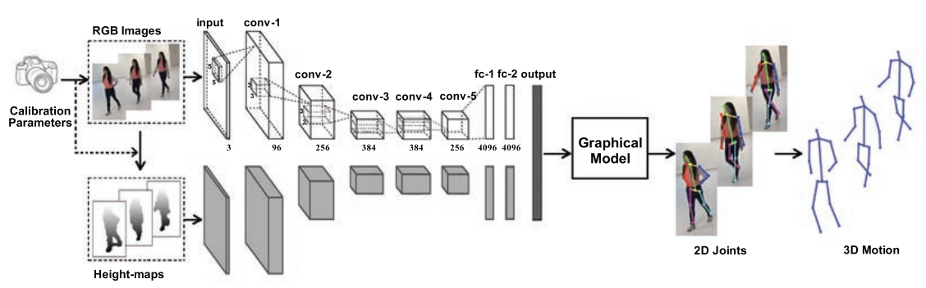
Human motion extraction from image
- Replacing CNN layers by FFT, avoid training
- Graphical model, no parameter, no training as well

Slide 11
Thanks for listening
Q&A

