Slide 1
Motion Synthesis based on Motion Decomposition
Thanh Nguyen & H. Yu
June 2017
AniAge

Slide 2
Outline
System overview
Dynamic Time Warping for Motion
Motion Decomposition
Sparse representation of basic motion
Motion synthesis
Motion Distortion Clean-up
Experimental results

Slide 3
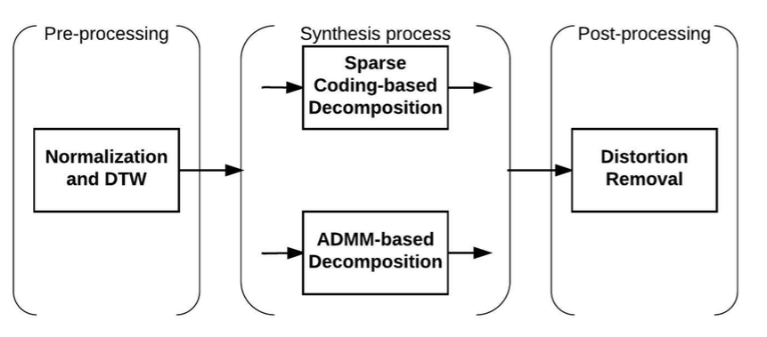
1. System overview

Slide 4
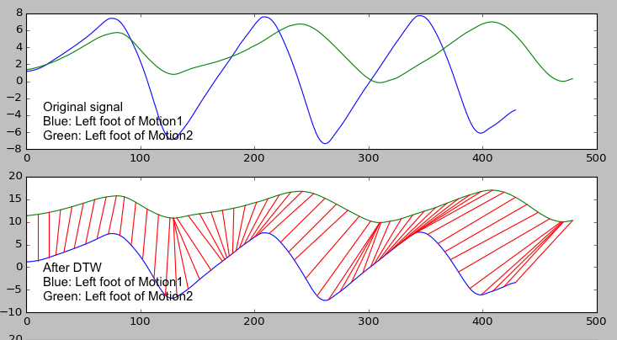
2. DTW for motion
Synchronize two motions by warping their foot signals.

Slide 5
3. Motion Decomposition

Slide 6
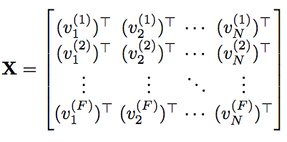

3.1 Sparse Representation of basic motion
Given motion
Suppose that X can be decomposed by
(*)

Slide 7



3.1 Sparse Representation of basic motion
Extracting a basic motion from X by
Set sparsity coefficient fi ~ % of non-zero weight in sparse coding.
Update components C_{fi} using decomposition (*):
Update residual motion:
The idea is representing motion X by a chain of m basic motions iteratively.

Slide 8
3.1 One basic motion decomposition
Give motion X_{FxN}, we want to decompose into W_{Fxk}C_{kxN.}
Step 1: Initialization
Initialize weights and components
Step 2: Optimizing weight W
Fixing the initial component C, optimize W.
Step 3: Optimizing component C
Fix optimized W above, using sparse coding to find sparse components.

Slide 9


3.1 Sparse Representation of basic motion
Step 1:
Calculate Variation matrix
Choose best vertex, then update residual motion
Continues until we obtain K pairs of components and weights.
Not optimal solution, but the components were initialized sparsely.

Slide 10
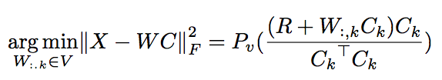

3.1 Sparse Representation of basic motion
Step 2:

Slide 11
3.1 Sparse Representation of basic motion
Step 3:
Set sparsity coefficient (% non-zero)
Fix optimized W, using sparse coding to estimate C sparsely.

Slide 12
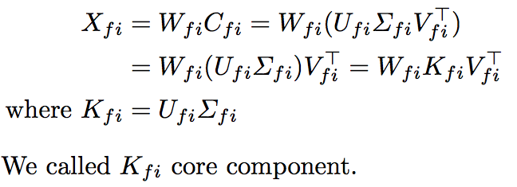
3.2 Motion Synthesis
Given a basic motion, we firstly apply SVD on a component as below,

Slide 13
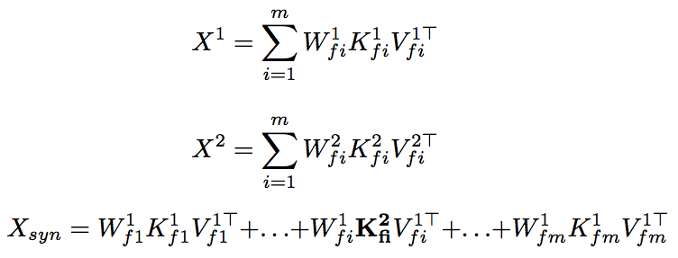
3.2 Motion Synthesis
The idea of emotion synthesis is replacing core component K_{fi} of one motion to another as below,

Slide 14
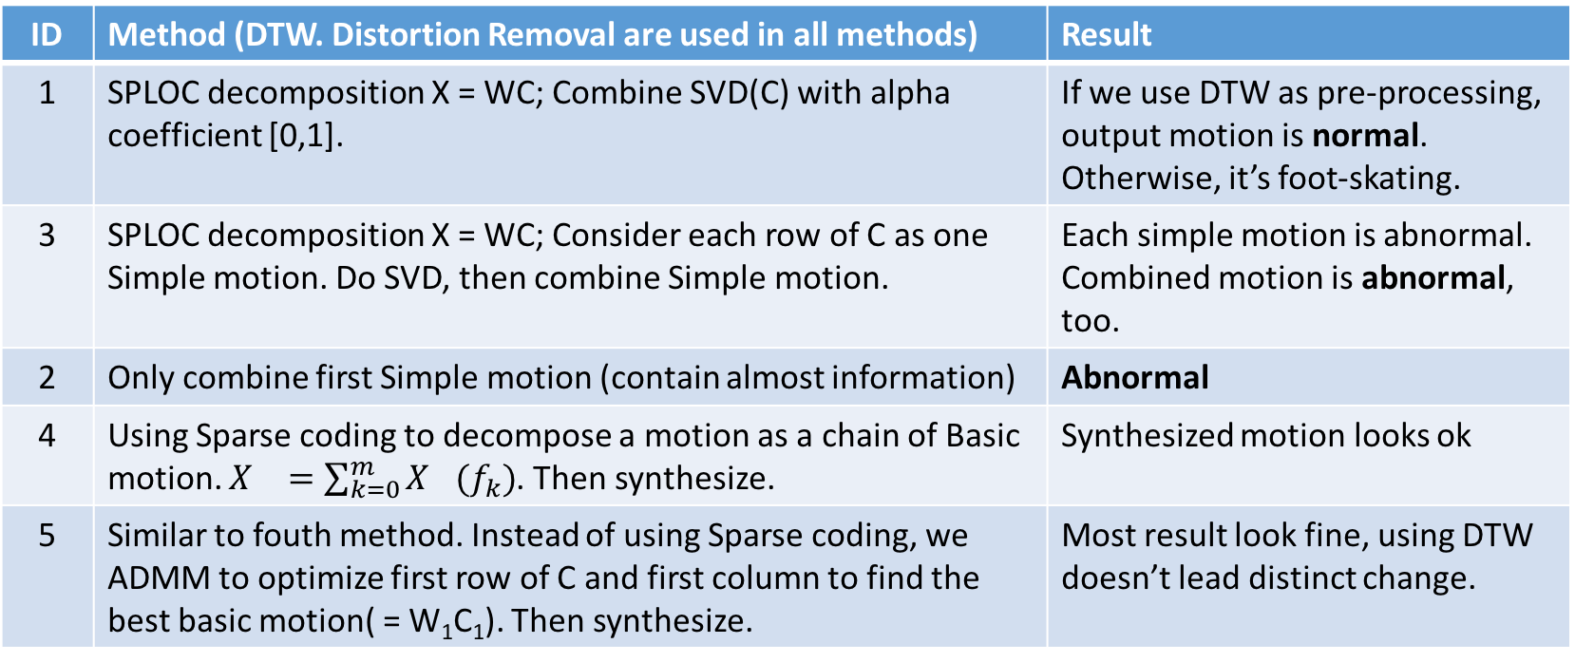
3.3. Decomposition Algorithm
ID | Method (DTW. Distortion Removal are used in all methods) | Result
1 | SPLOC decomposition X = WC; Combine SVD(C) with alpha coefficient [0,1]. | If we use DTW as pre-processing, output motion is normal. Otherwise, it’s foot-skating.
3 | SPLOC decomposition X = WC; Consider each row of C as one Simple motion. Do SVD, then combine Simple motion. | Each simple motion is abnormal. Combined motion is abnormal, too.
2 | Only combine first Simple motion (contain almost information) | Abnormal
4 | Using Sparse coding to decompose a motion as a chain of Basic motion. $X_{}=\sum_{k=0}^{m}{X_{}(f_{k})}$. Then synthesize. | Synthesized motion looks ok
5 | Similar to fouth method. Instead of using Sparse coding, we ADMM to optimize first row of C and first column to find the best basic motion( = W₁C₁). Then synthesize. | Most result look fine, using DTW doesn’t lead distinct change.

Slide 15
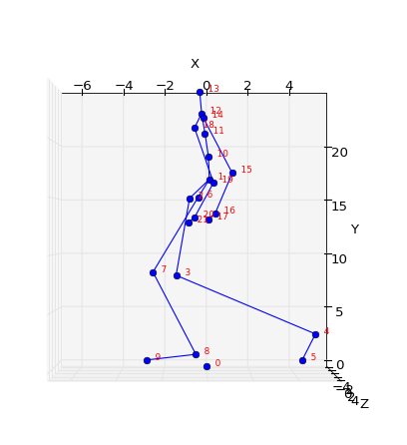
4. Motion distortion clean-up
Pre-calculate limb lengths
Apply pre-calculate limbs constraints into synthesized motion
A constraint of D(J3, J4)

Slide 16
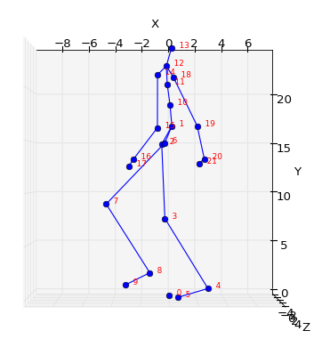
4. Motion distortion clean-up
After
Before

Slide 17
5. Results
Show some demo videos.

Slide 18
Thanks for listening
Q&A

