Slide 1
Convolutional Neural Networks (LeNet)
Nguyen THANH, 06 Oct 2016
AniAge

Slide 2
Outline
Sparse connectivity
Shared weight
Convolutional layers
Max-pooling
CNN Full Model
Lenet – A CNN Model

Slide 3
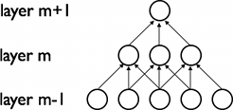
Sparse Connectivity
CNN
MLP
Why: CNNs wants to exploit spatially-local correlation by enforcing a local connectivity pattern between neurons of adjacent layers

Slide 4
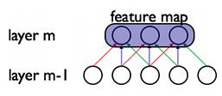
Shared Weight
Each filter h_{i} is replicated across the entire visual field
These replicated units share the same parameterization (weight vector and bias) and form a feature map.
Why?
Allows for features to be detected regardless of their position.
Greatly reducing the number of free parameters being learnt

Slide 5
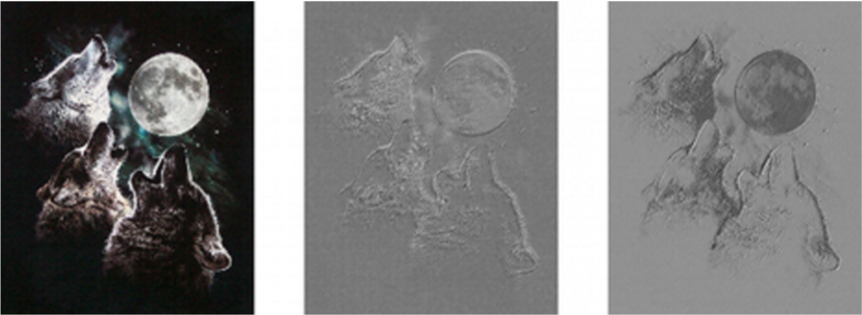
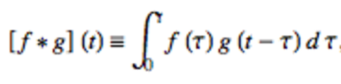
Convolutional Operator
Mathematically, a convolution is an integral that expresses the amount of overlap of one function g as it is shifted over another function f

Slide 6

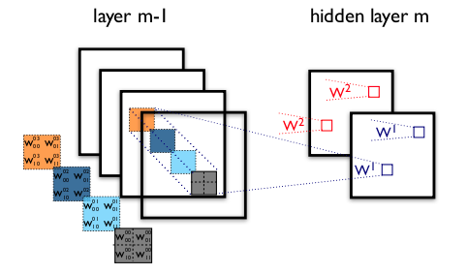
Convolutional Layers
Denote the k^{th} feature map at a given layer as h^{k}, whose filters = { W^{k} , b_{k}}, then the feature map h^{k} is obtained as follows
To form a richer representation of the data, each hidden layer is composed of multiple feature maps: { h^{k}, k=0..K}

Slide 7
Max-pooling
A non-linear down-sampling
First, partitions the input image into a set of non-overlapping rectangles
Then, for each such sub-region, outputs the maximum value.
Why Max-pooling is useful in vision
Reducing the dimensionality of representations.
By eliminating non-maximal values, it reduces computation for upper layers.

Slide 8
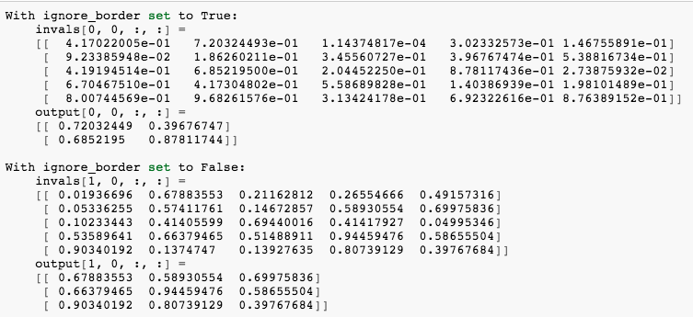
Max-pooling

Slide 9
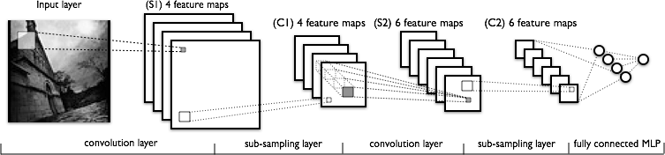
CNN Full Model
The lower-layers are composed to alternating convolution and max-pooling layers
The upper-layers however are fully-connected and correspond to a traditional MLP (hidden layer + logistic regression)

Slide 10
Lenet – A handwriting digits classification by LeCun
http://yann.lecun.com/exdb/lenet/

Slide 11
Thanks for listening
Q&A

