Slide 1
PCA-CNN
Nguyen THANH
27 Oct 2016
AniAge

Slide 2
Outline
Idea: CNN + PCA
Implementation: Mine vs. Lenet5

Slide 3
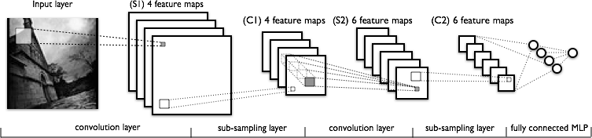
CNN Model
The lower-layers are composed to alternating convolution and max-pooling layers
The upper-layers however are fully-connected and correspond to a traditional MLP (hidden layer + logistic regression)

Slide 4
Pooling
Left: In this example, the input volume of size [224x224x64] is pooled with filter size 2, stride 2 into output volume of size [112x112x64]. Notice that the volume depth is preserved.
Right: The most common downsampling operation is max, giving rise to max pooling, here shown with a stride of 2. That is, each max is taken over 4 numbers (little 2x2 square).

Slide 5
Idea
PCA 1
PCA 2
PCA is better than Pooling in terms of preserving data
Idea: Replacing Pooling layer by PCA

Slide 6
Implementation 1
Problem: Hand writing digits classification
State of the art method: Lenet5 – using CNN
Our implementation: CNN + PCA
Dataset: MNIST (Mixed National Institute of Standards and Technology database)
Training set of 60,000 images + labels (greyscale 28*28)
Test set of 10,000 images + labels (greyscale 28*28)
Sub MNIST dataset
500 images + labels (28*28) for training
100 images + labels for testing

Slide 7
Implementation 2
500 images
500*28*28
20 filters
Shape (5*5)
500*20 feature
maps
500*20*24*24
PCA-1
Keep w/2, h/2
500*20 maps
500*20*12*12
50 filters
Shape (5*5)
500*50 maps
500*50*12*12
PCA-2
Keep w/2, h/2
500*50 maps
500*50*4*4
Output: CNN parameters + PCA1 + PCA2 of best model

Slide 8
Implementation 3 – PCA1
Training
Input: 500*20 = 10.000 images (size 24*24)
Flattening images: input -> 10.000 images of 1*576
Train PCA on 10.000 samples (576 dimensional), keep 576/4 dimension Save the P_{PCA} parameters
Apply P_{PCA} on 10.000 images (1*576) -> 10.000 images of (1*144)
Unflattening images: (1*144) -> (12*12)
Output: 10.000 images of (12*12) and P_{PCA}
Testing
Using saved P_{PCA}

Slide 9
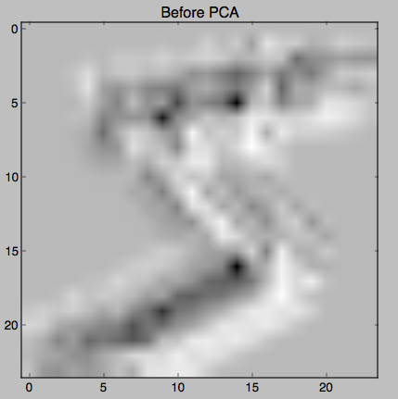
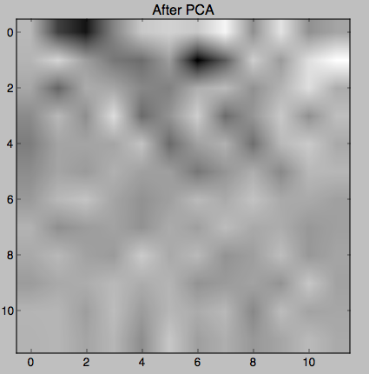
Implementation-4
PCA visualization

Slide 10
Testing
Output: Model = CNN parameters + PCA1 + PCA2
Test:
Pass images to best Model
Compare classified class and ground truth => % error

Slide 11
Testing
MINE: epoch 200, minibatch 5/5, validation error 32.200000 % Optimization complete. Best validation score of 32.000000 % obtained at iteration 510, with test performance 34.000000 % The code for file pca_convolutional_mlp.py ran for 20.68m
LENET5: epoch 200, minibatch 5/5, validation error 12.000000 % Optimization complete. Best validation score of 12.000000 % obtained at iteration 910, with test performance 10.400000 % The code for file ori_convolutional_mlp.py ran for 2.85m

Slide 12
Thanks for listening
Q&A

