Slide 1
Sathyajit g a
FOOTBALL ANALYSIS
Data Analyst

Slide 2
Problem objective
Absence of structured analysis on players, teams, manager influence and contracts from football data.
Hence, leading to ineffective decisions and business models in competitions.
Identify key factors for success. Especially, within areas such as:
Performance analysis
Player profile and market value
Team comparison
Attendance and stadium analysis
Referee
Event
Contract analysis
Player attributes and demographics.

Slide 3
DATA DESCRIPTION
DATA DICTIONARY
This dataset is a cleaned and merged compilation of professional football (soccer) data, designed to support machine learning models and statistical hypothesis testing for in-depth insights into the sport.
DOMAIN
Professional football (soccer), covering match statistics, player performance, team metrics, and stadium attendance.
DATASET SCOPE
Size: 4,199 rows x 43 columns (after merging and cleaning 5 raw data files).
Time Period: Covers several seasons, with data at both match and player levels.
Key Areas Covered: Performance Analysis, Player Market Value, Team Comparison, and Stadium Attendance.
DATA PREPROCESSING
Merged: Individual data files were merged using common keys (game_id, player_id).
Cleaned: Redundant columns were removed, and null values were treated (e.g., imputed missing values).
Final Output: Saved as Football_data_merged_cleaned.csv.

Slide 4
BUSINESS OBJECTIVE WISE QUESTIONS
PERFORMANCE ANALYSIS
Evaluate player performance based on goals, assists, minutes_played, yellow_cards
Assess team performance in terms of home and away goals, club positions, and manager influence.
PLAYER PROFILE AND MARKET VALUE
How do player performance metrics (goals, assists, fouls/cards) correlate with their age?
What is the relationship between player age and their market value (both current and peak)?
TEAM COMPARISON
How have different teams performed over time based on average goals scored and league positions?
How have managerial changes affected team performance across seasons?
ATTENDANCE AND STADIUM ANALYSIS
How does match attendance vary by competition type and season?
Which stadiums consistently draw higher attendance, and what verdicts or outcomes are associated with those games?

Slide 5
BUSINESS OBJECTIVE WISE QUESTIONS
REFEREE ANALYSIS
Evaluate player performance based on goals, assists, minutes_played, yellow_cards
Assess team performance in terms of home and away goals, club positions, and manager influence.
SUBSTITUTION PATTERNS
What is the average number of substitutions per match across different leagues?
At what times during matches are substitutions most commonly made, and how do they relate to current goal scores?
COMPETITION ANALYSIS
How many teams and players participate in each competition over time?
What is the average number of games and events per competition?
PLAYER ATTRIBUTES AND DEMOGRAPHICS
What are the key physical and skill attributes of players in top competitions?
What is the geographical distribution of players across leagues and teams?

Slide 6
BUSINESS OBJECTIVE WISE QUESTIONS
CONTRACT MANAGEMENT
How many active contracts exist per team and competition?
What is the average contract expiration date, and how long is the notice period before expiry?

Slide 7
Pre-processing
technology
Cleaning the dataset
Null Value Treatment
Excel - Viewing and adding extra columns for analysis (Age).
MySQL – Storing and Querying of data.
Python – For statistical modelling and machine learning models.
Tableau – For descriptive analysis and visualizations.

Slide 8
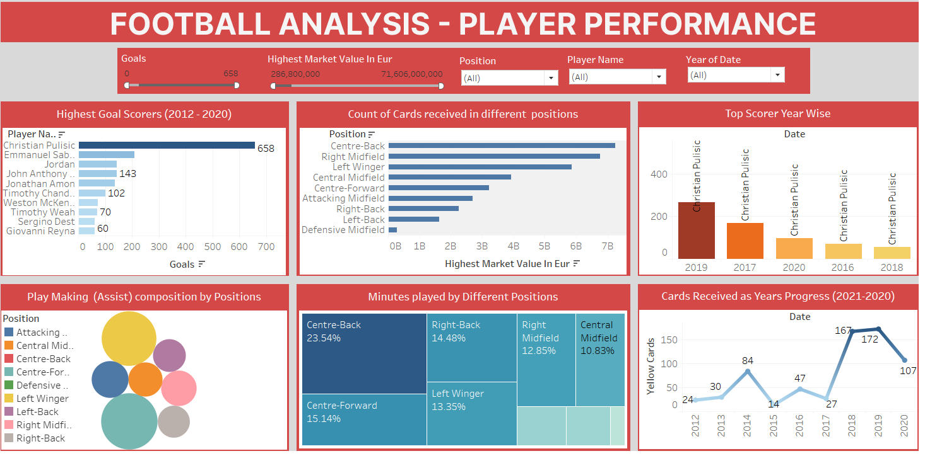
PLAYER PERFORMANcE ANALYSIS
OBSERAVATION
Top Scorer Dominance: The player with 658 goals significantly outscores all others, with the next highest having only 143 goals. This indicates one highly prolific individual in the dataset.
Midfield Card Accumulation:Centre-backs, attacking midfielders, and central midfielders show the highest number of cards received, suggesting these positions are frequently involved in card-worthy infractions.

Slide 9
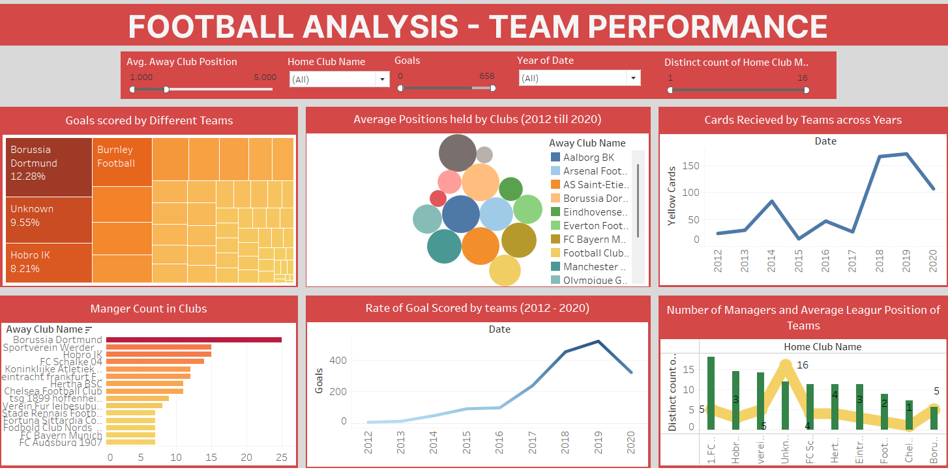
TEAM PERFORMANCE ANALYSIS
OBSERAVATION
Dortmund's Scoring Prowess: Borussia Dortmund stands out as a leading team in terms of "Goals Scored by Different Teams," indicating strong offensive performance.
Rising Scoring Trend: The "Rate of Goal Scored by teams" shows a general upward trend from 2012 to 2019, suggesting an increase in overall scoring activity over these years.

Slide 10
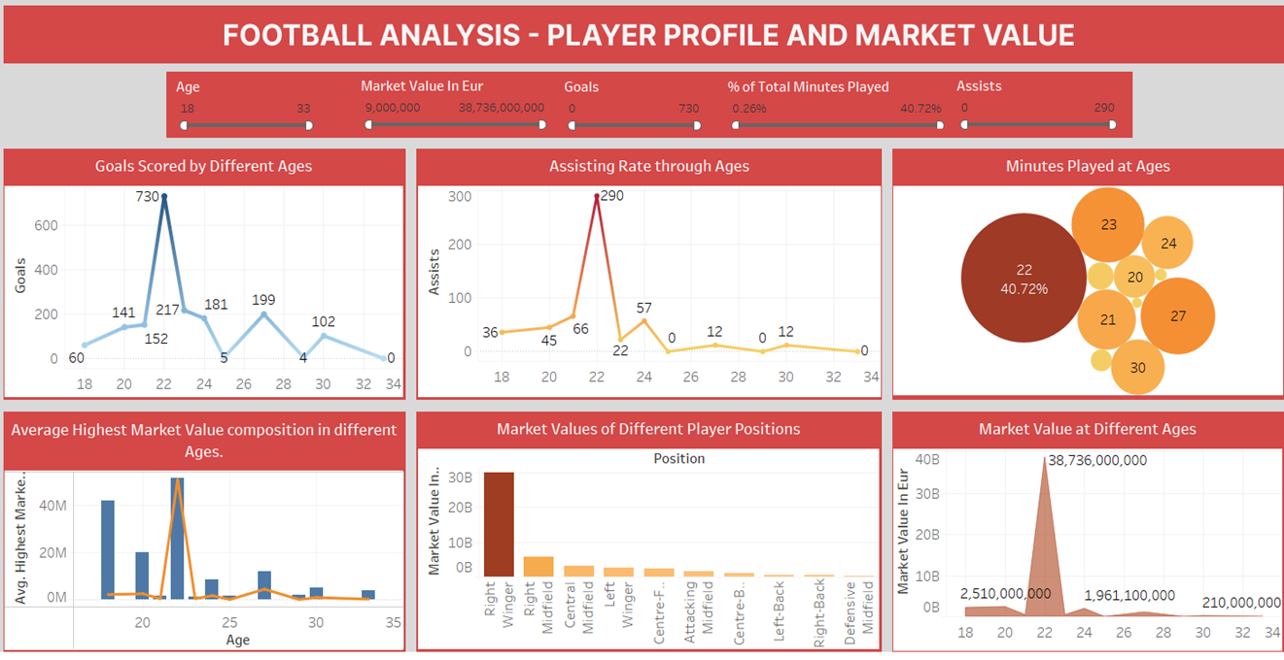
PLAYER PROFILE AND MARKET VALUE
OBSERAVATION
Peak Performance at Age 22: Both "Goals Scored by Different Ages" and "Assisting Rate through Ages" show a significant peak around age 22, indicating this is a prime age for offensive output in players.
Right Midfielders' High Market Value: "Market Values of Different Player Positions" clearly shows "Right Midfield" as having a substantially higher market value compared to all other positions, suggesting they are the most valuable player type in this dataset.

Slide 11
summary
Christian Pulisic emerges as a clear outlier, scoring 658 goals, far ahead of peers – consistently topping year-wise charts.
Centre-Backs have the highest yellow card count, suggesting aggressive defensive play and frequent game disruptions.
Playmaking is dominated by Central and Attacking Midfielders, contributing the majority of assists, highlighting their pivotal role in goal creation.
Players peak at age 22, with the highest combined goals, assists, and a market value of €38.7 Billion, marking it as the most critical age for performance and valuation.
Centre-Backs logged the most minutes played (23.5%), emphasizing their strategic importance and squad dependability.
Borussia Dortmund led in goal contributions, accounting for 12.3% of total team goals, reflecting superior attacking capabilities.
Disciplinary actions peaked in 2019, with 172 yellow cards, indicating increased match intensity and possibly aggressive tactics during this period.

Slide 12
conclusion
Recruitment should target players around age 22, as this is the clear peak for performance and valuation – crucial for long-term ROI.
Christian Pulisic’s consistency and output make him a high-value asset, suitable for leadership or central roles.
Midfielders must be prioritized for development, as they drive both assists and transitions, critical to match outcomes.
Defensive positions require better discipline training, especially Centre-Backs, to reduce card-related disruptions.
Clubs with stable managerial structures (e.g., Bayern, Chelsea) tend to have better average league performance – indicating value in leadership consistency.
Team and player analytics can significantly optimize transfer decisions, squad rotation, and tactical planning.

Slide 13
Business implementation / suggestion
Data-Driven Talent Acquisition Prioritize signing players aged 21–23, especially in high-value positions like Right Winger and Central Midfield, to maximize ROI in both performance and transfer value.
Injury & Fatigue Management Implement rotation strategies for high-minute positions (e.g., Centre-Backs, Midfielders) to reduce injury risks and card incidents — saving costs on suspensions and maintaining availability.
Asset Monetization Strategy Use performance + market value trends to optimize contract renewals, promotions, or transfers — offload aging or underperforming players before value depreciation (typically post age 27).
Leadership & Staff Stability Limit managerial churn to fewer than 5 changes per 5 years to promote team consistency, reduce adaptation time, and improve long-term performance metrics.
Fan Engagement & Match Promotion Promote matches with high attendance–excitement clusters using dynamic pricing, special campaigns, or merchandise bundles to increase revenue.

Slide 14
Goal & Assist scoring – player probability
Can we predict then goal scoring probability of each player and note them?
GOAL LIST
ASSIST LIST
Player Id
Prob_score
Player Id
Prob_score
Player_id 370846 has a chance of 66.6% to score a goal in next match. Followed by 504215. They have the highest probability among the rest making them clutch players.
370846 0.667
504215 0.600
336160 0.562
537467 0.500
315779 0.389
542776 0.357
161204 0.333
361104 0.500
504215 0.400
537467 0.250
315779 0.208
393325 0.167
542776 0.143
Can we predict then assist making probability of each player and note them?
504215 has moderately high probability compared to the rest for assisting a player in match. Facilitating the lineups accordingly will be beneficial to the team.

Slide 15
Performance analysis – hypothesis tests
Do forwards score significantly more than defenders?
Not statistically significant: No strong evidence forwards score more.
Do home team goals are greater than away team goals in matches?
Not statistically significant: No strong evidence home team score more.

Slide 16
Performance prediction – logistic regression
Predict whether a player will score a goal or provide an assist in a match.
Recall: 59% —The model identifies 59.1% of actual full-match players. It misses about 41% of them.
Precision: 57% —Out of all players predicted to play the full match, 57.8% actually did. So false positives exist, but not too high.
Accuracy (60.2%)-The model predicts correctly around 60% of the time. Decent for a baseline in classification.
F1 Score (58.4%)—A balanced score showing the model is doing fairly well on both precision and recall, without being biased to one.
Business Insight: Useful for identifying potential attacking contributors across the squad but requires further tuning for high-stakes decisions like contract renewals or transfer targeting.
Logistic Model Performance:
Accuracy : 0.6021
Precision : 0.57
Recall : 0.59
F1-score : 0.584
Model is Average. XGBoost / Random Forest can provide better performance.

Slide 17
Business implementation / suggestion
Targeted Attacker Development
Use model recall to identify players likely to contribute goals or assists, even if they are not regular starters.
Offer specialized offensive drills and positioning training to boost real-match impact.
Scouting & Youth Academy Funnel
Prioritize youth and second-team players flagged by the model for skill-based progression or loan deals.
Highlight those with low current market value but high predicted contribution rate.
Tactical Planning
Adjust in-game substitutions and line-up rotations using predictions of who is likely to assist or score in specific match contexts (home vs away, position-based).
Contract & Transfer Market Value Strategy
Inform contract extensions or renewals based on predicted goal involvement instead of just raw stats.
Detect undervalued players in other leagues for efficient recruitment.
Performance Incentives & KPI Tracking
Define performance-based bonuses or KPIs aligned with model-predicted output to improve motivation and fairness.

Slide 18
Market value prediction – linear regression
Can we predict a player’s highest market value using current performance, age, and physical profile?
Player position significantly influences market value – encoded positional data (like your 'position' variable) added meaningful predictive power, indicating that certain roles inherently command higher market values.
Age and height, while relevant, are not strong standalone predictors – their effect on market value is modest compared to performance metrics like goals, assists, and minutes played, suggesting their influence is more nuanced or indirect.
Performance metrics are crucial but not exhaustive – while goals, assists, and minutes played are strong indicators, market value is also significantly impacted by factors like a player's perceived "brand," club reputation, and international exposure (e.g., national team appearances), which might not be fully captured by your current performance variables.
Multiple Linear Model Performance:
R² Score: 0.9711 MAE: 2739446.136 MSE : 16679604443048.652 RMSE: 4084067.14477
Model is average and needs improvement.

Slide 19
Business implementation / suggestion
Data-Driven Transfer Strategy: Use model predictions to estimate fair market value for players before buying/selling, preventing overpaying or missing undervalued assets.
Talent Scouting & Investment: Prioritize young players with strong performance and physical attributes who are projected to reach high peak market values.
Squad Financial Planning: Leverage highest market value predictions for squad valuation, salary negotiations, and strategically timing contract renewals or player sales.
Player Development ROI Analysis: Measure the impact of player development on projected market value and align resources with high-potential growth players.
Commercial Partnerships: Utilize market value forecasts to inform sponsorship pricing, player branding deals, and media appearances.

Slide 20
Attendance classification – knn
Predict whether a football match had high or low attendance using match and club-related features.
KNN Performance: Accuracy: 0.98 Precision: 0.99 Recall: 0.97 F1-Score: 0.98
MODEL PERFORMANCE
The model achieved 98% accuracy, meaning it correctly predicted the attendance class for most matches.
Precision and recall are both high for both classes, indicating strong performance in identifying both high and low attendance matches.
Only 15 out of 840 predictions were incorrect, showing the model generalizes well on unseen data.
Features like home/away club, stadium, and competition type strongly influence match attendance.
The low number of false positives and false negatives suggests the model is reliable for real-world use like crowd planning or marketing.
This model can be a valuable tool for ticketing strategy, stadium management, and predicting match popularity in advance.
Model is business-ready as metrics show a good performance.

Slide 21
Business implementation / suggestion
Dynamic Ticket Pricing Strategy
Use clusters to assign variable ticket prices: Raise prices for high-attendance matches, offer deals for low-demand games.
Targeted Marketing Campaigns
Promote medium/low attendance matches more aggressively (discounts, school outreach, bundle offers).
Match Scheduling Optimization
Schedule low-attendance-prone matches on weekends or holidays to boost engagement.
Stadium & Resource Allocation
Assign more staff, security, and merchandise booths to high-attendance games for better crowd management and revenue capture.
Sponsorship & Advertisement Planning
Offer premium ad slots or sponsor packages on high-cluster matches to justify higher fees and visibility.

Slide 22
Player clusterification – k-means
Can we segment players into distinct profiles based on their physical attributes, playtime, and performance potential for smarter scouting and squad planning?
K-Means Performance: Inertia : 6336.561 Silhouette Score: 0.4604 Calinski-Harabasz Score: 2308.157 Davies-Bouldin Score: 0.967
INSIGHTS
The model successfully distinguishes between player profiles using a balanced combination of demographic and performance features.
Though clusters show moderate overlap, separation is sufficient to guide player recruitment, development, and contract decisions.
Recommended for use in strategic planning, scouting, and marketing segmentation.
Model is moderately good. Improvement is needed. Tips: More data on player attributes would give better performance.

Slide 23
Business implementation / suggestion
Targeted Scouting & Recruitment: Focus scouting efforts on acquiring high-potential young players (Cluster 0) for future core roles and developing talents (Cluster 2) for long-term value.
Training & Development Planning: Implement tailored training programs for each cluster, e.g., advanced skill coaching for Cluster 0, and injury prevention/load management for Clusters 1 and 3.
Contract Strategy: Secure long-term contracts for rising stars (Cluster 0) early, and carefully review/manage contracts for older or less impactful players (Clusters 1 and 3).
Commercial & Branding Opportunities: Actively promote young, high-potential players (Cluster 0) as key brand ambassadors for the club.
Squad Composition Planning: Strategically balance the squad with a mix of experienced veterans (Clusters 1 & 3) and promising youth (Clusters 0 & 2) to ensure depth and future success.

Slide 24
Event analysis – hypothesis test
Is there a statistically significant difference in the number of goals scored in the first half vs second half of matches?
Not statistically significant: No strong evidence home team score more.

Slide 25
Limitations
Limited Feature Scope Relies on a small subset of features (e.g., age, height, minutes played, market value, and encoded position). May miss other performance indicators like passes, tackles, or xG.
Position Encoding Simplification Categorical encoding (One-Hot) may not fully capture hierarchical or tactical relationships between positions.
Fixed Number of Clusters (K) K-Means requires predefining K. True optimal segmentation may need more advanced methods (e.g., DBSCAN, hierarchical clustering).
Sensitivity to Scaling & Outliers Clustering results can shift significantly due to outliers or poor scaling. K-Means assumes spherical, equally sized clusters.
No Temporal Tracking The model is static — it does not track how players evolve over seasons or within different clubs/systems.

Slide 26
Future scope
Incorporate Advanced Performance Metrics Include goals, assists, cards, passing accuracy, defensive actions, and fitness metrics for deeper clustering.
Apply Temporal Clustering Extend to longitudinal analysis to observe how player clusters change over time (e.g., season-on-season development).
Use Dimensionality Reduction Techniques Apply t-SNE, or UMAP for better cluster separation and visualization in higher-dimensional data.
Integrate Scouting & Salary Data Merge external data like scouting reports, wage info, injury history for more holistic cluster insights.
Dynamic Segmentation Models Test hierarchical or density-based clustering to automatically find optimal groups without fixing K.
Deploy as Decision Tool Build an interactive dashboard that allows management to filter by cluster, view players, and make recruitment decisions in real time.

Slide 27
THANK YOU

