Slide 1
Advanced Programming in Java
Dilip Kumar Shrestha

Slide 2
About me
Love problem solving and software architecting

Slide 3
My Rules
No mobile
No side talks while I am talking
One chair and one desk for one student
For some genuine reason, you don’t want to be in class please ask politely
Be patient - I am not here because I know everything, may be together learn anything new

Slide 4
Expectation vs Reality
AI, Hacking, Game Design ………

Slide 5

One Paper cannot decide my future
If you have skill you don’t need degree
Padheko ta enterprise(real world) ma kam nae lagdaina
Padhera Hatti thulo bhako ho ra?
Outdated syllabus, latest programming languages and technologies should be taught

Slide 6
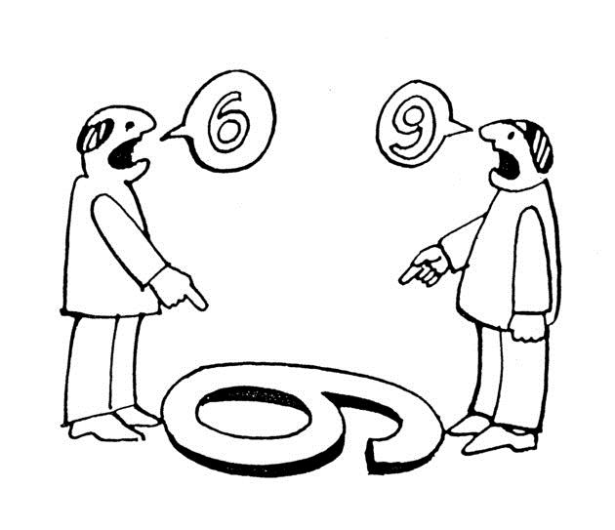
How to start?
Change of perception
Heard of half filled glass
Gym of Brain
Be Disciplined
Enterprise framework – is discipline
Programming Quality – is discipline

Slide 7
Caution
In this journey your expectations will be hurt, but don’t get demotivated your perception of SOFTWARE ENGINEERING is going to change or most probably has already started to. Accept and embrace it, Trust me you are going to be one of the best software engineers.

Slide 8
Sad but truth
Computer engineering is Mathematics
Example internet speed…….

Slide 9
Want to ask anything?

Slide 10
Introduction to Subject
Engineer vs Developer

Slide 11
Prerequisite
Very good understanding of C++ (concept level – object oriented programming)
Basic knowledge to use terminal(command prompt)
cd
ls
absolute and relative paths
Terminologies like compiling, linking and loading

Slide 12
Example Program
Make a program
Store it in some directory
Add it to class path
Run it from any location

