Slide 1
Plagiarism Detector
Minor II Project Defence
Gandaki College of Engineering and Science
Bachelor of Engineering in Software Engineering
Neon Neupane (22180031)
Bishal Acharya (22180018)
Nabin Giri (22180030)
Supervisor: Er. Prativa Nyaupane
Shrawan 25, 2083

Slide 2
Objective
To detect copied text by comparing what sentences mean, not which words they use.
Compare a batch of documents against each other, and report for every pair how close they are and which sentences are the copied ones.
Check any single document against public web pages.
Read the formats students actually submit: PDF, DOCX, TXT and scanned images through OCR, in English and in Nepali.
Prove the gain by measuring the model against a TF-IDF baseline we wrote ourselves.
Keep it free, with no login, and store no uploaded file at any point.

Slide 3
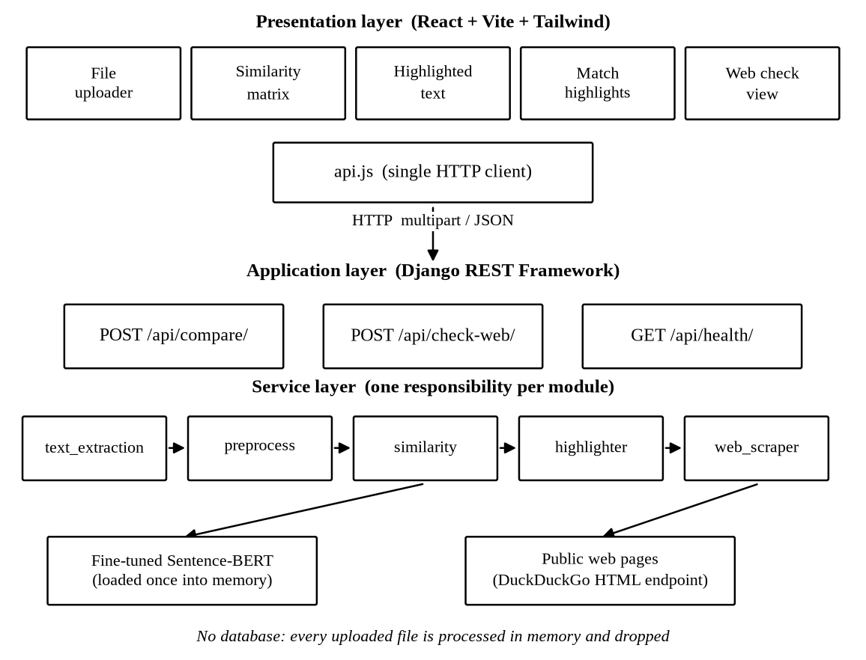
System Diagram
React frontend, one API module, three endpoints, five services, no database.

Slide 4
Step 1 — TF-IDF
A = "The student copied the report." B = "The student wrote the report."
Drop the stopwords, then weigh every remaining word twice:
TF, how often the word appears in this document, divided by the document length.
IDF = log((1+N) / (1+df)) + 1. A word in every document tells you nothing. A rare word tells you a lot.
The weight of a word is TF x IDF. The document becomes one vector.
word | TF in A | TF in B | df | IDF | A | B
student | 1/3 | 1/3 | 2 | 1.2877 | 0.4292 | 0.4292
copied | 1/3 | — | 1 | 1.6931 | 0.5644 | 0
report | 1/3 | 1/3 | 2 | 1.2877 | 0.4292 | 0.4292
wrote | — | 1/3 | 1 | 1.6931 | 0 | 0.5644
N = 3 documents in this batch. The last two columns are the TF-IDF vectors.

Slide 5
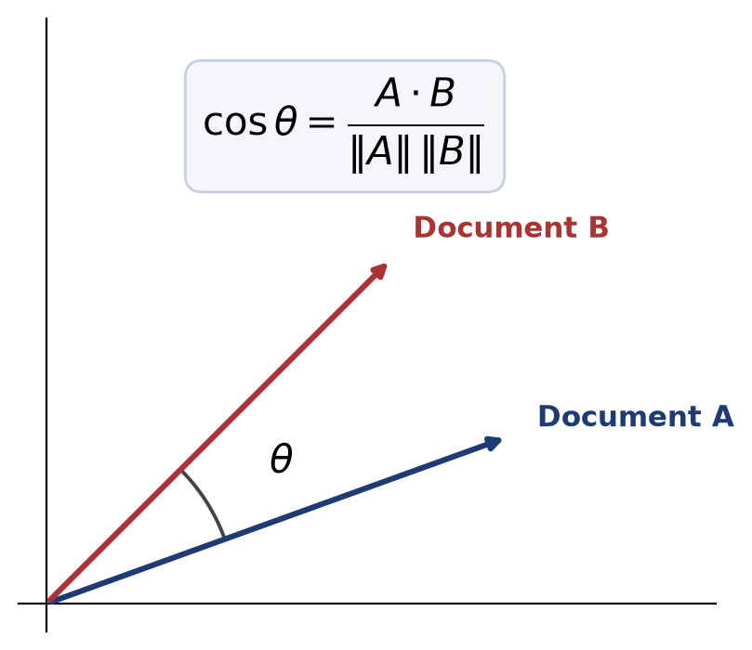
Step 2 — Cosine similarity
Compare the two vectors by the angle between them, not by their length. A long document and a short one can still match.
A · B = 0.4292x0.4292 + 0.4292x0.4292 = 0.3684
||A|| = ||B|| = 0.8288
cos = 0.3684 / 0.6869 = 0.5363
A and B share two content words out of three, so they land at 0.54.
1.0 is the same direction. 0 is nothing in common.

Slide 6
Where TF-IDF Fails, and Why We Trained a Model
C = "The pupil duplicated the document."
C says exactly what A says, and shares not one content word with it.
TF-IDF(A, C) = 0.0000
The two vectors have no component in common, so the cosine is exactly zero. The method cannot see the paraphrase, and no threshold can rescue it.
Sentence-BERT(A, C) = 0.4590
Same cosine, different vectors. The vector now comes from a transformer trained so that sentences meaning the same thing land near each other.
On 2000 labelled pairs, the baseline recovers 25.6 percent of the reworded pairs and our fine tuned model 73.7 percent.

Slide 7
Demo
Upload three documents: an original, a paraphrase of it, and an unrelated passage.
Read the similarity matrix, then open the flagged pair to see which sentences match and the percentage copied.
Switch the engine to TF-IDF and compare the same batch again.
Move the threshold slider and watch what gets flagged change.
Run the web check on a passage taken from a public page.
Upload a Nepali document and a scanned image to show OCR and Devanagari.

Slide 8
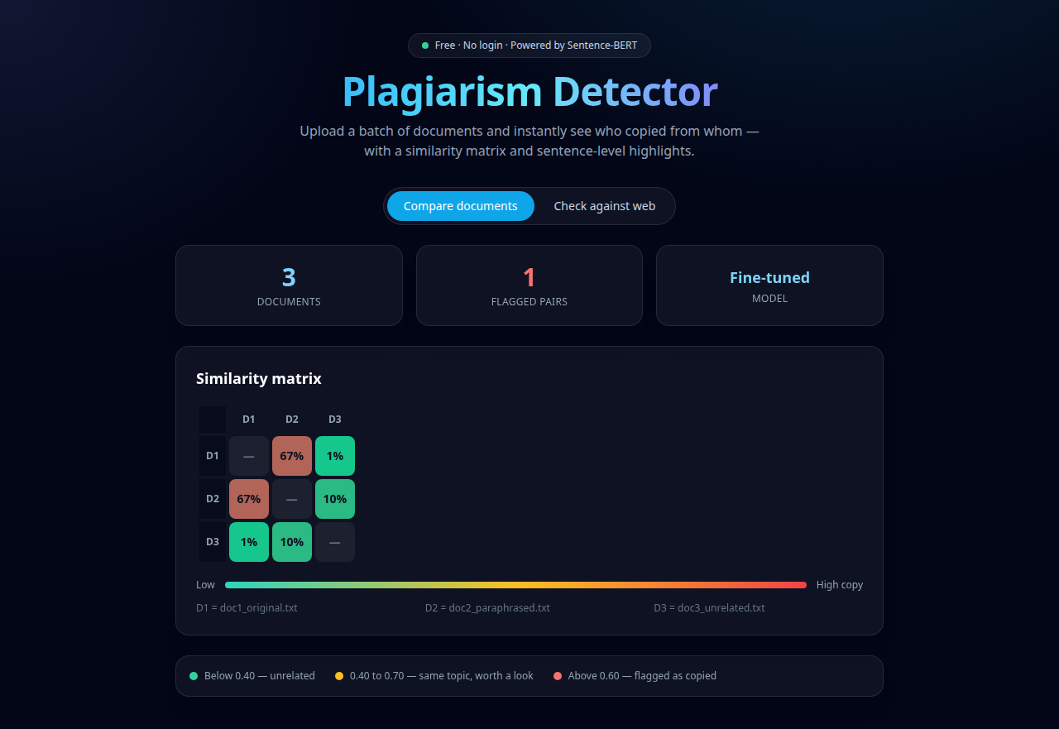
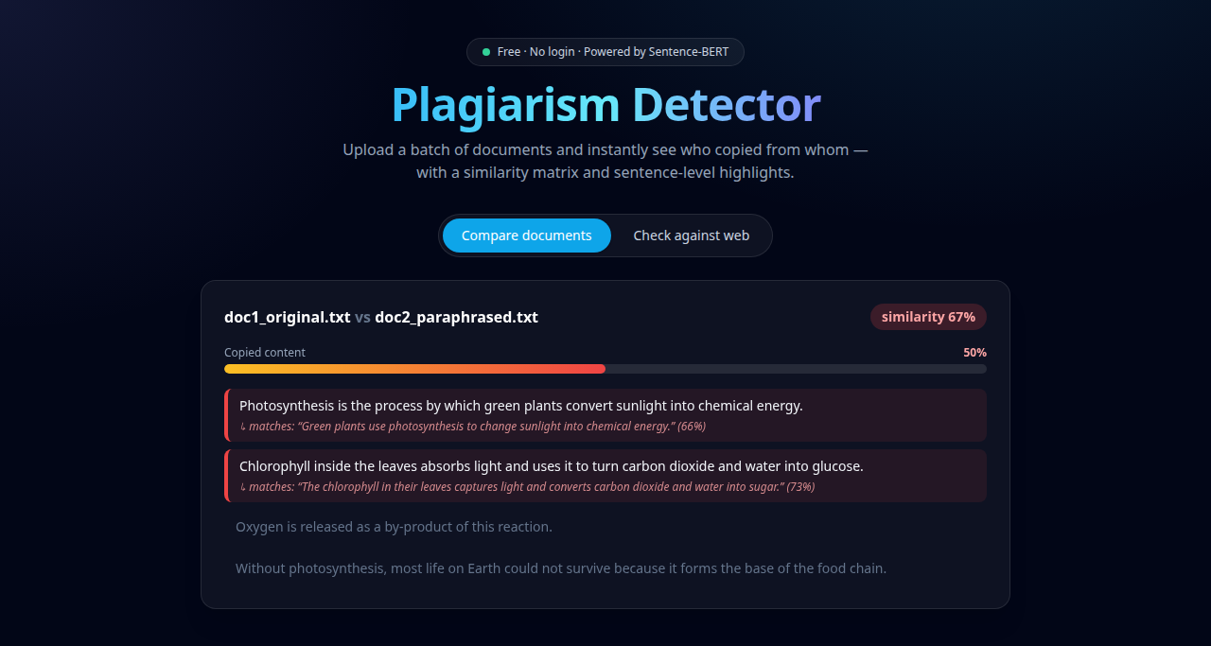
Demo — Backup Screenshots
The similarity matrix, and the copied sentences marked inside the document.

Slide 9
Thank You
Questions and Feedback

