Slide 1
Plagiarism Detector
Minor II Project Completion Presentation
Gandaki College of Engineering and Science
Presented by:
Neon Neupane
Bishal Acharya
Nabin Giri
Date: Shrawan 25, 2083

Slide 2
The Problem
Free checkers compare words, not meaning.
Reword four words in a sentence and the reported similarity collapses.
The tools that do it properly are out of reach.
Turnitin sells to institutions; Quetext and Copyleaks give a small free quota, then ask for a card.
Three problems nobody solves for a Nepali college:
A large share of what is submitted is scanned, not typed.
Devanagari is thrown away before the comparison even starts.
The free services keep a copy of every file you hand them.

Slide 3
Objectives, and Where They Ended Up
1. Compare a batch of documents against each other
Done: n x n matrix, percentage copied and the matched sentences for every flagged pair.
2. Check a document against public web pages
Done: keyword search, page fetch, sentence level comparison.
3. Catch paraphrase, and measure it against our own baseline
Done: 0.826 accuracy fine tuned against 0.666 for the TF-IDF baseline.
4. Read PDF, DOCX, TXT and scans, in English and Nepali
Done: OCR for images and for scanned PDFs; Devanagari handled throughout.
5. Free, no login, nothing kept
Done: no uploaded file is written to disk or to a database at any point.

Slide 4
What the Finished System Does
Upload PDF, Word, text or images. A scanned PDF with no text layer is detected and sent to OCR automatically.
Every document is compared against every other one and the result is drawn as a similarity matrix.
Each flagged pair carries a percentage copied and the sentences that match, marked inside the text.
Any one document can be checked against public web pages.
The engine and the threshold are controls in the interface, not constants in the code.
Nothing is stored. The answer is returned and the file is gone.

Slide 5
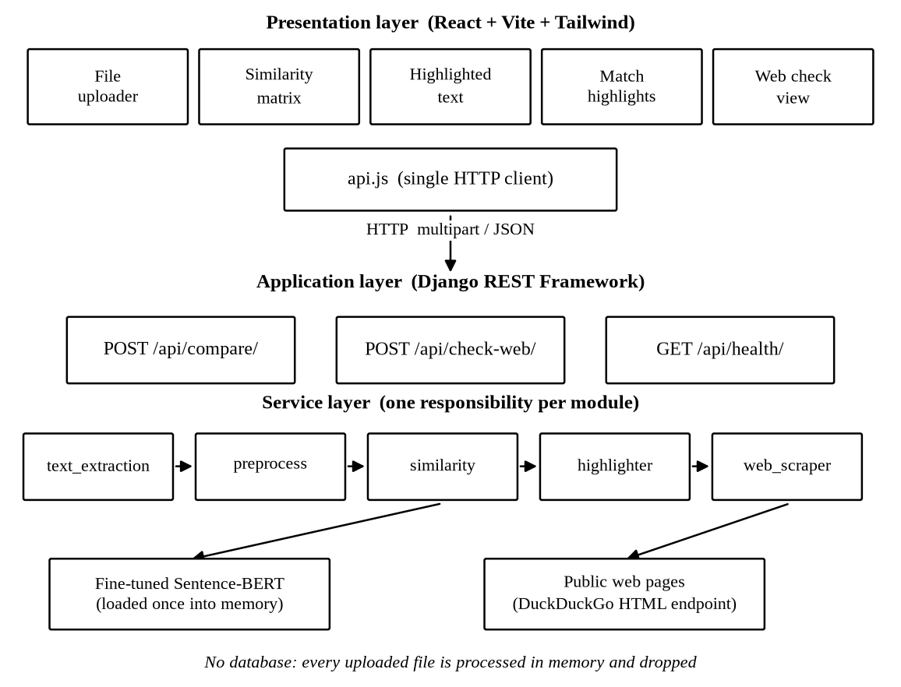
System Architecture
React frontend, Django REST backend, five independent services.

Slide 6
How a Comparison Runs
1. Read the document
TXT and DOCX directly, PDF through a parser, images through Tesseract. No text layer means OCR.
2. Prepare the text
Clean, normalise the spacing, split into sentences at the full stop, the question mark or the danda.
3. Compare every pair
One vector per document, cosine against every other, which produces the matrix.
4. Check against the web
Frequent words become a query, pages are fetched and stripped, then compared.
5. Show the result
Matrix, percentage copied and matched sentences, returned as JSON and drawn by React.

Slide 7
The Model: Sentence-BERT, Fine Tuned
Base model: all-MiniLM-L6-v2, a distilled six layer transformer that runs on the laptops we own.
Siamese architecture:
Two copies of one network share their weights.
Each side turns a sentence into a fixed vector.
Training pulls a matching pair together and pushes a non-matching pair apart.
Encode each sentence once, then compare any two with a cosine. A batch costs one encoding pass, not one pass per pair.
Training data: 30,000 labelled pairs from the Quora Question Pairs corpus.
27,000 for training against 3,000 held back. One epoch, batch size 32, cosine similarity loss.
Evaluated on a second corpus (MRPC) the model had never seen.

Slide 8
The Baseline We Wrote Ourselves
TF-IDF with cosine similarity, built from scratch with PyTorch tensors rather than imported from a library.
Both engines then run on the same tensors and the same cosine, so any difference between them belongs to the model and not to somebody else’s optimised library code.
It stayed inside the shipped system instead of being deleted once the trained model worked, and it is a switch in the interface.
Without it, the claim that our model detects paraphrase would rest on nothing anyone could check.

Slide 9
Checking Against the Web
Keyword extraction
The six most frequent content words become the search query, after the stopwords are dropped.
Search and fetch
The DuckDuckGo HTML endpoint, no API key and no account, returns up to ten URLs.
Each page is fetched and the script, style, navigation, header and footer are removed, leaving the paragraph text.
Compare
The page is scored against the document and its matching sentences are listed.
A page that is blocked or slow is skipped, so one dead link never breaks the check.

Slide 10
Handling Devanagari
Nepali is not English in a different alphabet. Three things had to change.
A Devanagari sentence closes with the danda, and often with no space after it. The splitter now ends a sentence on that character either way.
The baseline tokenizer matched Latin letters and digits only, so it returned an empty list for Nepali and reported a similarity of zero for two identical Nepali documents. The pattern now covers the Devanagari range.
Common Nepali function words were added to the stopword list.
Tesseract uses the Nepali training data when the machine has it and falls back to English when it does not. The check runs once and is remembered.

Slide 11
Accuracy of the Three Engines
Evaluation set | Engine | Accuracy | Precision | Recall | F1
Quora validation (2000 pairs) | TF-IDF baseline | 0.6665 | 0.5380 | 0.2558 | 0.3467
 | SBERT pretrained | 0.7430 | 0.5800 | 0.9321 | 0.7151
 | SBERT fine tuned | 0.8260 | 0.7544 | 0.7370 | 0.7456
MRPC validation (408 pairs, unseen) | TF-IDF baseline | 0.5049 | 0.9326 | 0.2975 | 0.4511
 | SBERT pretrained | 0.7475 | 0.7733 | 0.8925 | 0.8286
 | SBERT fine tuned | 0.6691 | 0.8077 | 0.6774 | 0.7368
Both sets scored at the fixed threshold of 0.70.
The second corpus is the honest test: a plagiarism checker meets text it was not trained on every single time somebody uses it.

Slide 12
What Those Numbers Say
Fine tuning worked.
On the corpus it trained on, accuracy went from 0.7430 to 0.8260, a gain of 8.3 points.
The word based baseline fails at the one job this project exists to do.
Its recall on paraphrased pairs is 0.2558. Roughly three reworded passages in every four walk straight past it.
The classes separated further apart.
The distance between the average paraphrased score and the average unrelated score widened from 0.310 to 0.448. That is what gives a threshold room to sit in.
We chose the cautious model.
The pretrained model produces 467 false positives, ours 166. A false positive is an accusation aimed at a student who did nothing wrong.

Slide 13
The Finding That Changed the Product
Fine tuning does not simply lift every number on the page. It moves the scale the model scores on.
On the corpus we trained on, the best threshold for our model is 0.70, the value already in the code.
On the corpus it had never seen, the same model wants 0.45. Held at 0.70 it scores 0.6691 there, against 0.7328 once the threshold is tuned.
So a threshold fixed against one corpus is quietly wrong for another. We only saw it because we evaluated on a corpus the model had never met.
The threshold left the source code and became a slider in the interface, and the value actually used is printed beside every result.

Slide 14
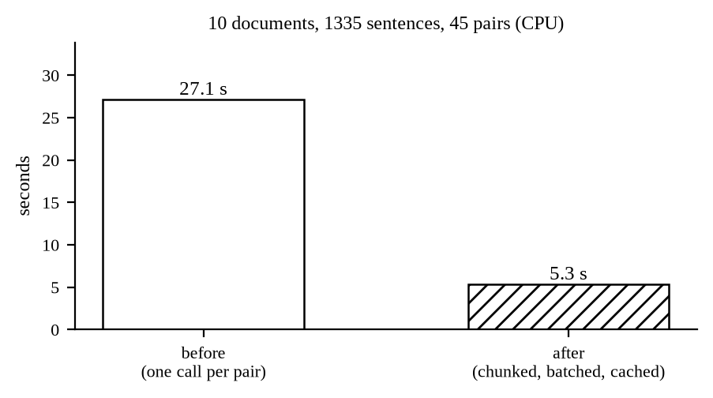
Speed: 5.1 Times Faster
10 documents, about 2628 words each, 1335 sentences, all 45 pairs highlighted, on the processor.
Before: 27.1 seconds
The whole document in one call, and its sentences encoded again for every pair it appeared in.
After: 5.3 seconds
Chunks of five sentences, pushed through in batches, every encoded sentence cached.
It also uncovered a defect. The model truncates anything longer than its input window, so the tail of a long document was never being compared and nothing in the output said so.

Slide 15
Testing
Twenty four unit tests, all passing.
preprocess 9, text_extraction 7, similarity 8.
None of them start Django and none of them load the trained model, so the suite finishes in well under a second and we ran it after every change.
A functional walk through of the whole system.
Every supported format, and every failure case: no file, one file, unsupported type, empty file, corrupt DOCX, unreadable scan, a web page that refuses to answer.
A document compared with itself returns exactly 1.00, and an unrelated pair sits near zero.
User testing.
Classmates and teachers used the finished application on their own work, which is where the most useful criticism came from.

Slide 16
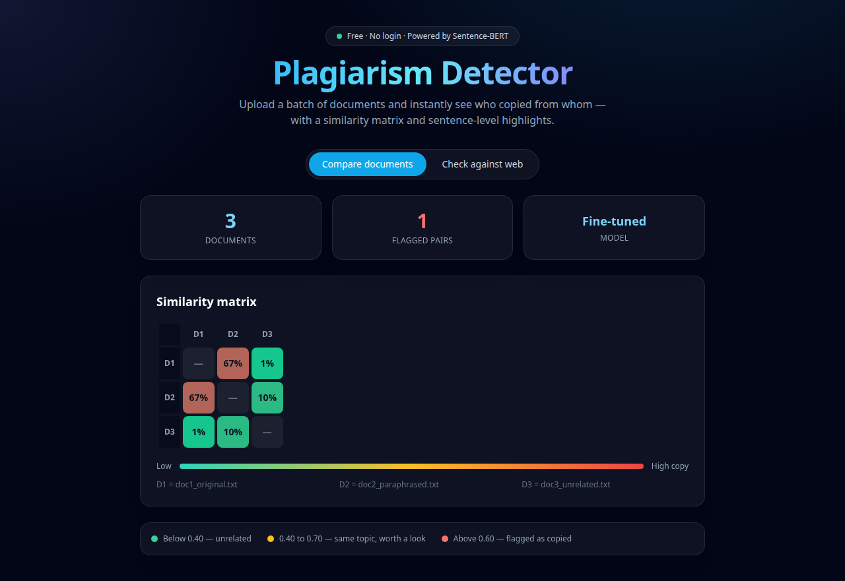
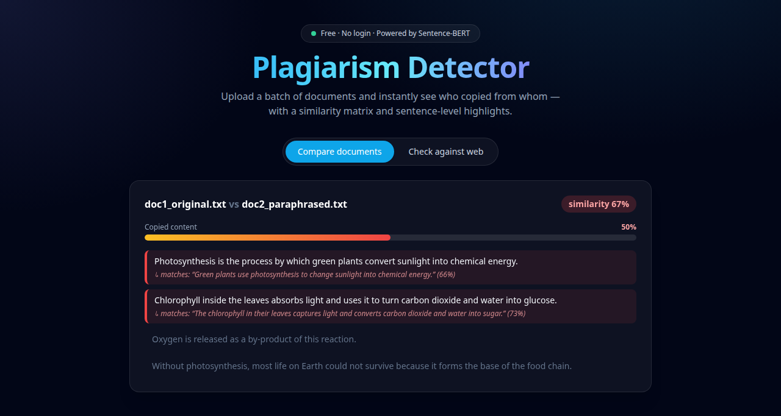
The Finished Application
The similarity matrix over the batch, and the copied sentences marked inside the document.

Slide 17
Limitations
Nepali accuracy sits below English accuracy. We adapted the text handling for Devanagari but not the model, which learned from English pairs only.
The best threshold for one kind of text is not the best for another. We put the control in the interface, but the user still has to understand what they are moving.
The web check only sees what it can reach at that moment, so it is never exhaustive.
A poor scan gives poor text out of the recognition step, and no model quality downstream can repair that.
There is no archive of past submissions, so a paragraph lifted from a report handed in three years ago goes straight through.
Source code, mathematical notation and figures are not handled at all.

Slide 18
Conclusion and Future Work
We set out to build a free plagiarism detector that compares meaning instead of words. That is done, and it has been measured rather than asserted.
Future work
Train on a corpus of real student work, so the model sees the copying that actually happens in assignments.
Fine tune a multilingual model on Nepali paraphrase pairs, so Devanagari accuracy matches English.
Add an archive of past submissions for a department.
Add support for source code, where plagiarism is detected by comparing structure rather than text.
Add optional accounts for teachers who want to keep reports, with the anonymous mode staying the default.

Slide 19
Thank You
Questions and Feedback

