Slide 1

Supervised and Unsupervised Learning
Presented by
Student’s name: Gaurish Ninnekar
USN: 1cr16ee026
Semester: 8th
Under the Guidance of Mrs.Lokasree B S
Designation-Assistant Professor
Electrical & Electronics Engineering Department
Date -30/07/2021

Slide 2
OUTLINE OF THE PRESENTATION
Introduction
About the Company
Objectives
Methodology (Supervised Learning)
Methodology (Unsupervised Learning)
Advantages of Supervised Learning
Disadvantages of Supervised Learning
Advantages of Unsupervised Learning
Disadvantages of Unsupervised Learning
Applications
Conclusion
Futures Work
References
Certificates of Internship (Scanned Copy)
Electrical & Electronics Engineering Department

Slide 3
ABOUT THE COMPANY
PV GROUP
We provide Website Design & Development, App development , ERP software development and maintenance. We offers best website designing & app development with interactive UI that has better user experience & make sure you stand out to give an edge over competitors, lesser bounce rates, less loading time and load handling, mobile friendly websites and apps & have that standout factor that will compile your visitors to become customers.
We will study Supervised and Unsupervised learning, which are two types of Machine Learning. We can now easily understand the fundamentals behind most machine learning projects after learning these two topics. The Industry Experts teach us these two things, so we are quite updated with latest tech of Industry

Slide 4
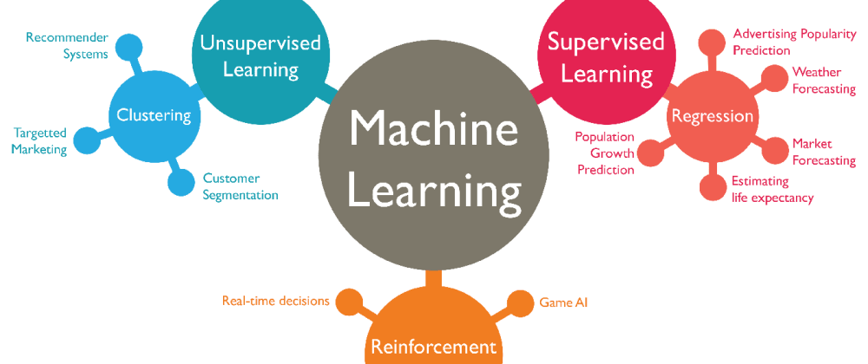
INTRODUCTION
What is Machine Learning?
Machine learning is the core of much futuristic technological
advancement in our world, today you can see various
examples or implementation of machine learning around
us such as Apple series, Tesla’s self-driving car,
Sophia AI robot and many more are there.
So what exactly is Machine Learning?
“Machine Learning is a subset of artificial intelligence.
It focuses mainly on the designing of systems,
thereby allowing them to learn and make predictions based on some set of matrices in machines”.
Electrical & Electronics Engineering Department

Slide 5
INTRODUCTION
How does Machine Learning work?
The ML algorithm is trained again and again within an augmented training data set, this was just a high-level example as there are other steps involved in it. Let’s move on and quickly parse through Machine learning into different types, see how each of them are, how they worked and how each of them is used in various fields.
Types of Machine Learning-
1. Supervised Learning 2. Unsupervised Learning 3. Reinforcement Learning
Electrical & Electronics Engineering Department

Slide 6
OBJECTIVES
Study on types of machine learning :
Supervised machine learning
Unsupervised machine learning
Electrical & Electronics Engineering Department

Slide 7
METHODOLOGY
Supervised Learning
Supervised learning is the machine learning task of inferring a function from labeled training data. The training data consist of a set of training examples.
In supervised learning, each example is a pair consisting of an input object (typically a vector) and a desired output value.
A supervised learning algorithm analyses the training data and produces an inferred function, which can be used for mapping new examples.
An optimal scenario will allow for the algorithm to correctly determine the class labels for unseen instances. This requires the learning algorithm to generalize from the training data to unseen situations in a "reasonable" way.
Electrical & Electronics Engineering Department

Slide 8
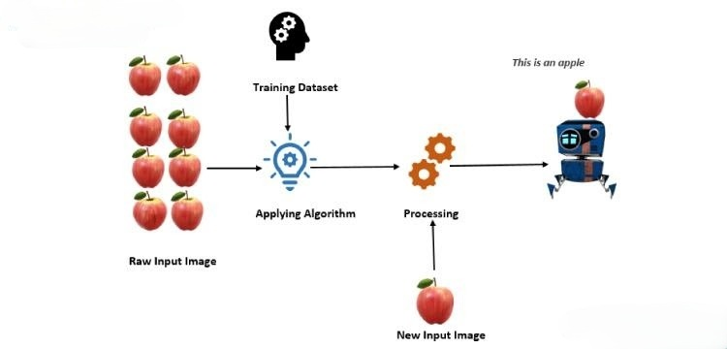
METHODOLOGY
Supervised Learning
Electrical & Electronics Engineering Department

Slide 9
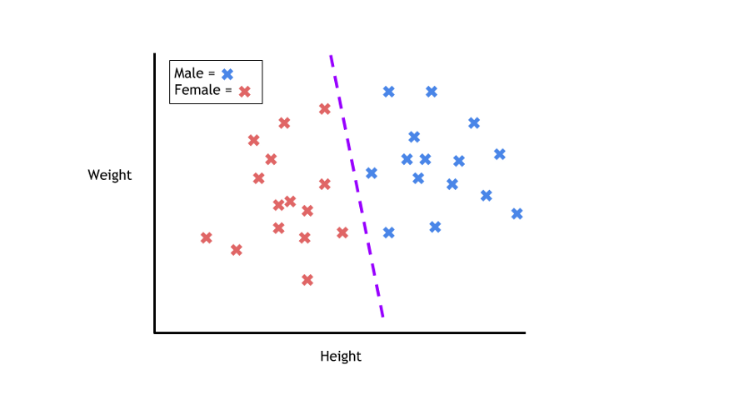
METHODOLOGY
Supervised learning can be split into two subcategories: Classification and Regression .
Classification
During training, a classification algorithm will be given data points with an assigned category. The job of a classification algorithm is to then take an input value and assign it a class, or category, that it fits into based on the training data provided.
Electrical & Electronics Engineering Department

Slide 10
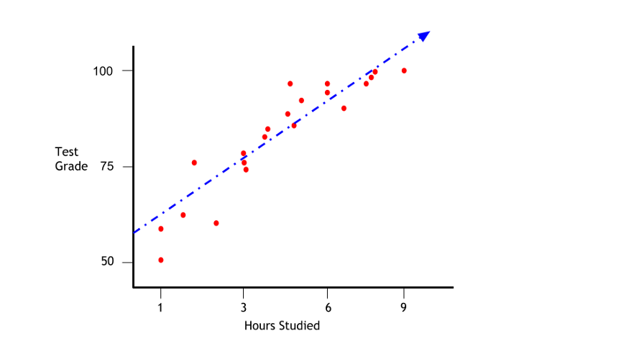
METHODOLOGY
2. Regression
Regression is another type of supervised learning method
that uses an algorithm to understand the
relationship between dependent and independent variables.
Regression models are helpful for predicting
numerical values based on different data points,
such as sales revenue projections for a given business.
Some popular regression algorithms are linear regression, logistic regression and polynomial regression.
Electrical & Electronics Engineering Department

Slide 11
METHODOLOGY
There are many different types of regression algorithms. The three most common are listed below:
Linear Regression
Logistic Regression
Polynomial Regression
Electrical & Electronics Engineering Department

Slide 12
METHODOLOGY
Unsupervised Learning
Unsupervised learning is the machine learning task of inferring a function to describe hidden structure from "unlabelled" data (a classification or categorization is not included in the observations).
Since the examples given to the learner are unlabelled, there is no evaluation of the accuracy of the structure that is output by the relevant algorithm—which is one way of distinguishing unsupervised learning from supervised learning and reinforcement learning.
A central case of unsupervised learning is the problem of density estimation in statistics, though unsupervised learning encompasses many other problems (and solutions) involving summarizing and explaining key features of the data.
Electrical & Electronics Engineering Department

Slide 13
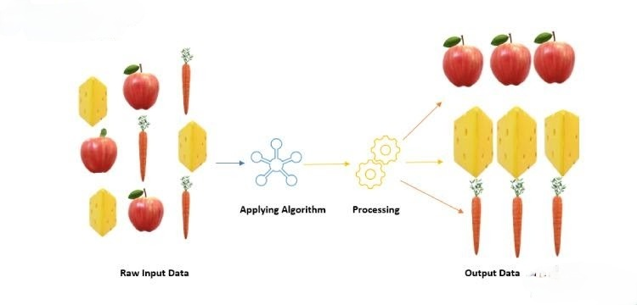
METHODOLOGY
Unsupervised Learning
Electrical & Electronics Engineering Department

Slide 14
METHODOLOGY
Issues with Unsupervised Learning:
Unsupervised Learning is harder as compared to Supervised Learning tasks..
How do we know if results are meaningful since no answer labels are available?
Let the expert look at the results (external evaluation)
Define an objective function on clustering (internal evaluation)
Why Unsupervised Learning is needed despite of these issues?
Annotating large datasets is very costly and hence we can label only a few examples manually. Example: Speech Recognition
There may be cases where we don’t know how many/what classes is the data divided into. Example: Data Mining
We may want to use clustering to gain some insight into the structure of the data before designing a classifier.
Electrical & Electronics Engineering Department

Slide 15
METHODOLOGY
Some algorithms available for unsupervised learning are
Principal Component Analysis Algorithm
K-means Algorithm
Singular Value Decomposition Algorithm
Electrical & Electronics Engineering Department

Slide 16
ADVANTAGES
Advantages of Supervised Learning
Supervised learning in Machine Learning allows you to collect data or produce a data output from the previous experience
Helps you to optimize performance criteria using experience
Supervised machine learning helps you to solve various types of real-world computation problems.
Electrical & Electronics Engineering Department

Slide 17
DISADVANTAGES
Disadvantages of Supervised Learning
Below are the disadvantages of Supervised Machine learning:
Decision boundary might be overtrained if your training set which doesn't have examples that you want to have in a class
You need to select lots of good examples from each class while you are training the classifier.
Classifying big data can be a real challenge.
Training for supervised learning needs a lot of computation time.
Electrical & Electronics Engineering Department

Slide 18
ADVANTAGES
Advantages of Unsupervised Learning
Labeling of data demands a lot of manual work and expenses. Unsupervised learning solves the problem by learning the data and classifying it without any labels.
The labels can be added after the data has been classified which is much easier.
It is very helpful in finding patterns in data, which are not possible to find using normal methods.
Dimensionality reduction can be easily accomplished using unsupervised learning.
This is the perfect tool for data scientists, as unsupervised learning can help to understand raw data.
We can also find up to what degree the data are similar. This can be accomplished with probabilistic methods.
This type of learning is similar to human intelligence in some way as the model learns slowly and then calculates the result.
Electrical & Electronics Engineering Department

Slide 19
DISADVANTAGES
Disadvantages of Unsupervised Learning
The result might be less accurate as we do not have any input data to train from.
The model is learning from raw data without any prior knowledge.
It is also a time-consuming process. The learning phase of the algorithm might take a lot of time, as it analyses and calculates all possibilities.
For some projects involving live data, it might require continuous feeding of data to the model, which will result in both inaccurate and time-consuming results.
The more the features, the more the complexity increases.
Electrical & Electronics Engineering Department

Slide 20
APPLICATIONS
Applications of Unsupervised Machine Learning Algorithm
It is mainly useful in fraud detection in credit cards.
Useful for genome analyzing.
Useful in data preprocessing.
Applications of supervised Machine Learning Algorithm
Sentiment Analysis: It is a natural language processing technique in which we analyze and categorize some meaning out of the given text data.
Recommendations: Every e-Commerce site or media, all of them use the recommendation system to recommend their products and new releases to their customers or users on the basis of their activities.
Filtration: Detecting spam emails is indeed a very helpful tool, this filtration techniques can easily detect any sort of virus, malware or even harmful URLs.
Electrical & Electronics Engineering Department

Slide 21
CONCLUSION
Supervised learning is the simplest subcategory of machine learning and serves as an introduction to machine learning to many machine learning practitioners. Supervised learning is the most commonly used form of machine learning, and has proven to be an excellent tool in many fields.
Finally, in this article, we learned about what unsupervised learning is, how it works, what are its pros and cons, it’s types and applications. This learning methodology has great significance. Although it does not have that many applications, it can be very helpful in research. It is very useful especially for data scientists who analyze data constantly.
Electrical & Electronics Engineering Department

Slide 22
FUTURE WORK
Future of Machine Learning
Machine Learning can be a competitive advantage to any company be it a top MNC or a startup as things that are currently being done manually will be done tomorrow by machines. Machine Learning revolution will stay with us for long and so will be the future of Machine Learning.
Machine Learning for Day Trading
Autoregressive Integrated Moving Average (ARIMA) model is used to predict time-series data based on the assumption that data points are correlated with each other.
Deep Neural Network model used in when traders use historical data along with technical indicators to predict stock movement, they look for familiar patterns.
Electrical & Electronics Engineering Department

Slide 23
REFERENCES
For Supervised Learning – Followed Blog by Aidan Wilson
(https://towardsdatascience.com/a-brief-introduction-to-supervised-learning-54a3e3932590) (https://www.analyticssteps.com/blogs/introduction-machine-learning-supervised-and-unsupervised-learning)
For Unsupervised Learning – Followed Blog by Sanatan Mishra
(https://towardsdatascience.com/unsupervised-learning-and-data-clustering-eeecb78b422a)
Followed Tech vidvan Tutorials
(https://techvidvan.com/tutorials/unsupervised-learning/)
Electrical & Electronics Engineering Department

Slide 24
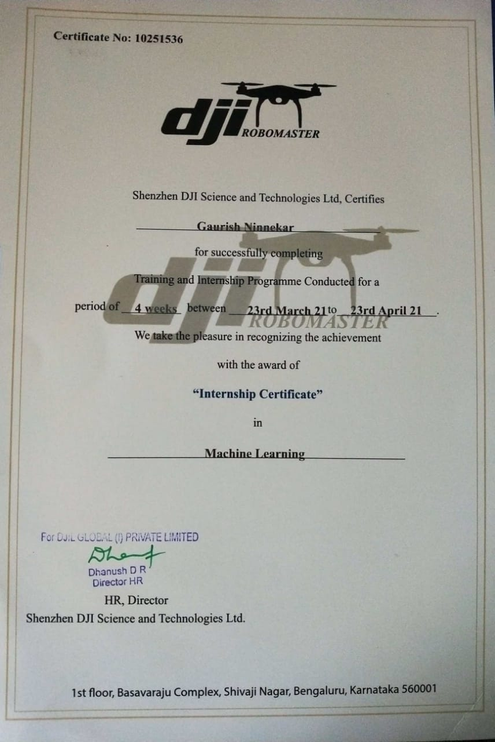
CERTIFICATE OF INTERNSHIP(scanned copy)

Slide 25
THANK YOU !

