Slide 1
Hotel Room Resale System

Slide 2
System Overview
The whole system is composed of Data Collection System, Room Inventory Management System, Customer Information Management System, Main Service.

Slide 3
System Overview
The data collection system uses the data source as the data management of the latter two systems.
The main idea of Inventory Management is catching the data send the date to service to show the item if is available or not.

Slide 4
System Overview
For Customer Relationship Management is identify user information send information to service.
The main server checks with the hotel system, and then needs to obtain data from the two systems and update the data.

Slide 5
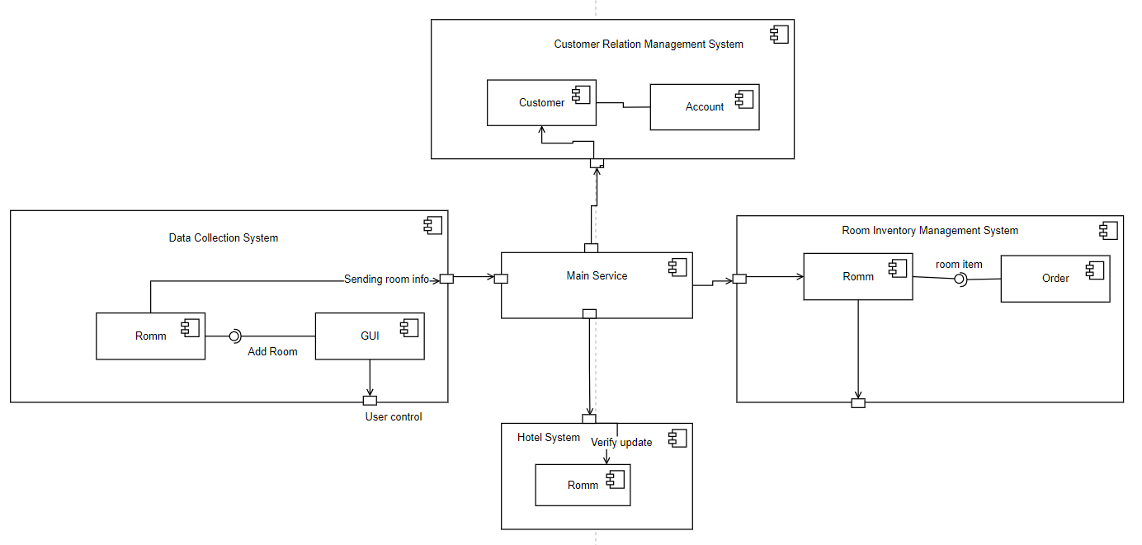
System Diagram

Slide 6
Actor Identification
Customers can add and resell their own rooms in the system.
Buyers interact with room searching method and payment method.
Main Service Confirm room and Upload room info method interact with System.
Data Collection System interact with data source such as room info or user info.

Slide 7
Architectural Style
The system will use the client-server architecture.
the server: is responsible for providing services to other subsystems, such as the database server to provide data storage and management services.
Client: Request service from the server. Clients are usually independent subsystems. In a certain period of time, there may be multiple client programs running concurrently, such as data collection systems, inventory systems, and customer relationship management systems.

Slide 8
Architectural Style
The advantage of C/S is that it can give full play to the processing capabilities of the client, and a lot of work can be submitted to the server after being processed by the client. Make the client's response speed fast, can reduce the pressure on the server, and have higher security and stability.

Slide 9
Design Pattern(s)
MVC pattern: The MVC mode separates the interface data and operations of the system, which is more conducive to the development of each module.
Observer Pattern: When the user successfully pays for the house, it will automatically notify the hotel and the person who resells the room.

Slide 10
Framework
Non-modifiable framework code:
The framework code, in general, is not supposed to be modified, while accepting user-implemented extensions. In other words, users can extend the framework, but cannot modify its code. The program will use java as program language and using a .csv file to store all the room information, as a database.

Slide 11
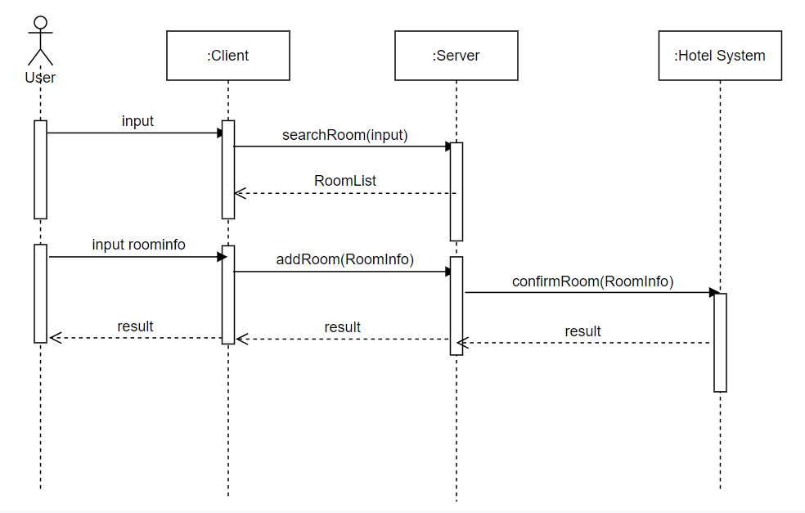
Sequence diagram

Slide 12
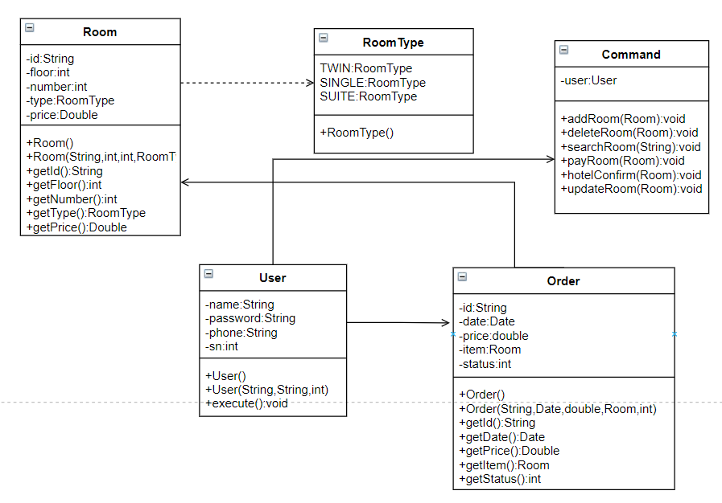
Class diagram

