Slide 1
Hotel room resell application
Presenter: Dongyan Zhou, Jiayuan Zhou, Wenxin Cao

Slide 2

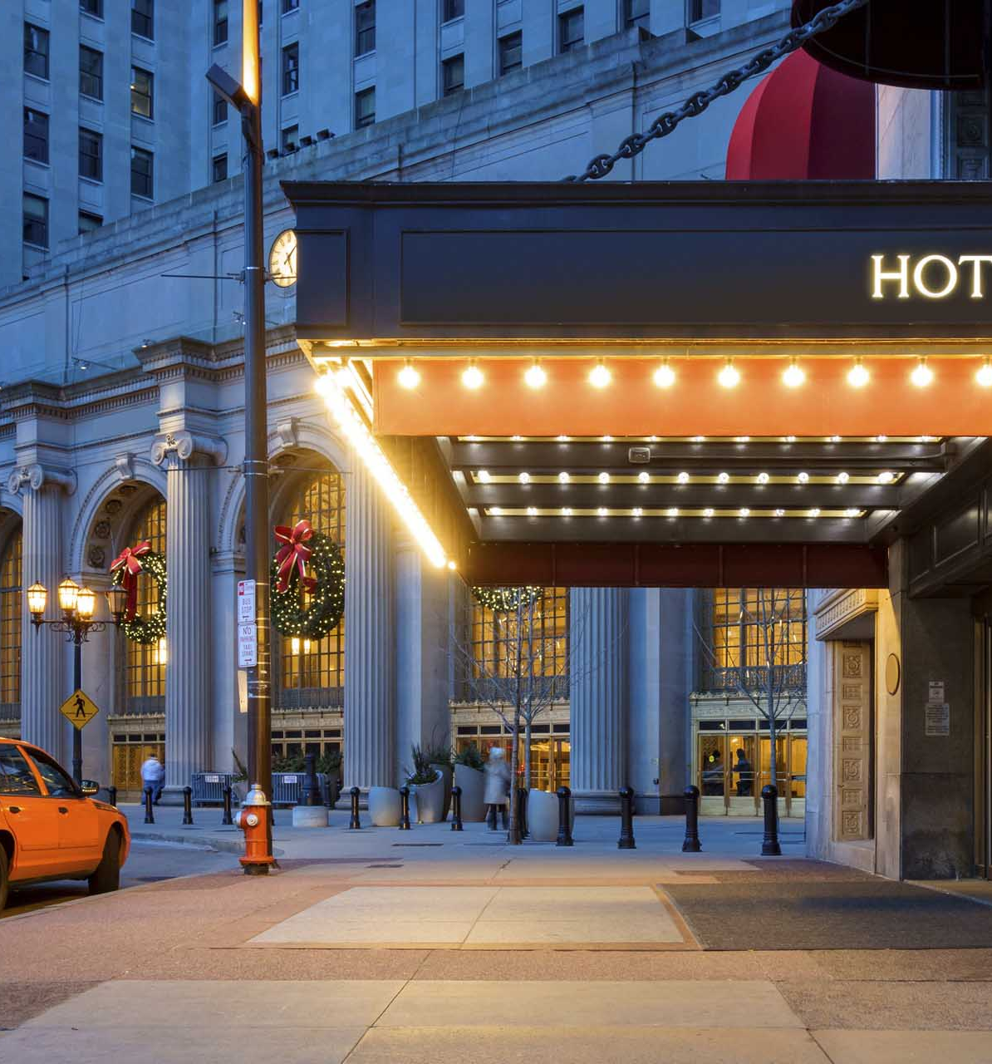
Project description
Function of the software is to allow those who have booked a hotel room to resell the room to someone else if they are unable to go to the room and thus avoid high cancellation fees.
It also help hotels to avoid room cancellation and reduce the empty-room rate.

Slide 3
FUNCTIONAL REQUIREMENTS
Description | The customer needs to sell the room that has been booked in the hotel for some reason
Precondition | Customer booked a hotel room Customer unable to go to the hotel
Basic Flow | Step1:Customer sends room information to our system Step2:Our software confirms the room with hotel Step3:After successful verification, uploads the room information to our published website. Step4:Waiting for buyer to buy
Postcondition | If someone buys it, then there is no cancellation fee, otherwise it still has to be paid
Selling System
The system should provide the function of selling rooms, allowing users to enter the room information that needs to be sold, verify the authenticity of the room information after the user enters the room information, and publish it after the verification is passed.

Slide 4
FUNCTIONAL REQUIREMENTS
Description | The buyer browses the hotel room information in the system and finds the room he needs to pay for the reservation.
Precondition | Some one list a room The room hasn’t been booked by someone else yet
Basic Flow | Step1:The buyer browses the system and chooses the hotel room he wants to live in Step2:Buyer pays to the system Step3:The system automatically modifies the reservation information Step4:The system informs the hotel and the reseller that the room has been sold Step5: Buyer gets the room
Postcondition | If the buyer successfully pays, then the room will be obtained,and the reseller will not have to pay the cancellation fee.
Buying System
The system should provide room information query and payment function for those who need to book a room, and notify the hotel and the seller that the room has been sold after the booking is completed.

Slide 5
NON-FUNCTIONAL REQUIREMENTS
Response time
The response time of the system should be very fast, the response time should not exceed 1.5 seconds during the general period and 4 seconds during the peak period.

Slide 6
NON-FUNCTIONAL REQUIREMENTS
Data Security
The personal information of system users should not be disclosed, and the use of such information requires user authorization.

Slide 7
NON-FUNCTIONAL REQUIREMENTS
Reliability
The system is robust and should be able to deal with various abnormal situations that occur during system operation, such as: human operation errors, illegal data input, hardware device failures, etc. The system should be able to handle them correctly and avoid them appropriately.

Slide 8
NON-FUNCTIONAL REQUIREMENTS
Maintainability
After receiving the modification request, the general modification should be completed within 1 to 2 days; for the major requirement or design modification after the evaluation, it should be completed within 1 week.

Slide 9
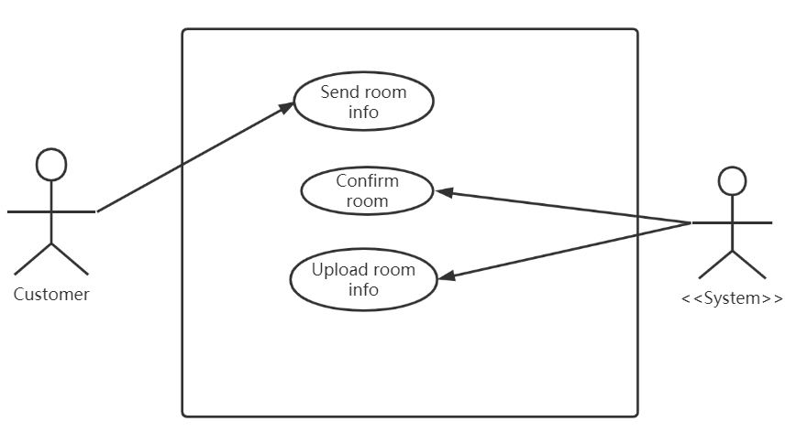
USE CASES AND USE CASE DIAGRAM
Use Case:
Send room info
Confirm room
Upload room info

Slide 10
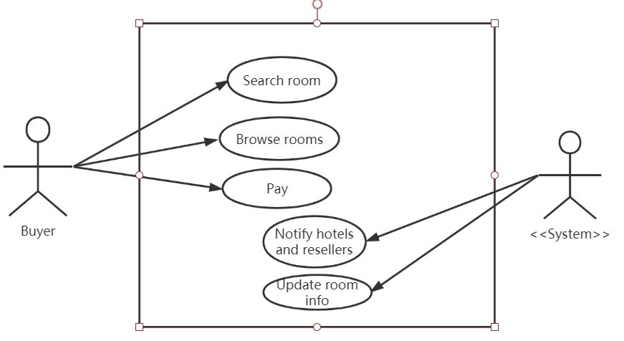
USE CASES AND USE CASE DIAGRAM
Use Case:
Search room
Browse rooms
Pay
Notify hotels and resellers
Update room info

Slide 11
SYSTEM CONSTRAINTS
Tool Constraints：
Amazon Web Services (AWS) is the world's most comprehensive and widely used cloud platform, providing more than 200 full-featured services from global data centers.
Language Constraints：
The software system is developed using java or python and deployed using Amazon servers.

Slide 12
SYSTEM CONSTRAINTS
Platform Constraints：
The system should provide mobile phones and computer platforms, which can be used by users at any time.
Hardware Constraints:
Use windows 10 operating system to write programs.

Slide 13
SYSTEM CONSTRAINTS
Network Constraints：
The network should be stable and reliable, and the user response time should not exceed 1.4 seconds under normal circumstances, and should not exceed 4 seconds during peak periods.
Deployment Constraints:
This deployment method is suitable for complex business logic, our two systems and the central server.

Slide 14
SYSTEM CONSTRAINTS
Transition & Support Constraints：
There is a backup server in the system, which can be used after the main server node is down.
Budget & Schedule Constraints:
In the early stage, it is necessary to pull sponsor investment funds for hardware purchase and personnel development, and the system is expected to be completed in 3 months.

Slide 15
SYSTEM CONSTRAINTS
Miscellaneous Constraints：
The development team needs 20 people, of which 10 are responsible for the back-end, five are responsible for the front, 3 are responsible for testing, and 2 are responsible for operation and maintenance.

