Slide 1
Image Processing (CSC332)
Course Overview
Semester: V

Slide 2
Course Description:
This course covers the investigation, creation and manipulation of digital images by computer.
The course consists of theoretical material introducing the mathematics of images and imaging.
Topics include representation of two-dimensional data, time and frequency domain representations, filtering and enhancement, the Fourier transform, convolution, interpolation.
The student will become familiar with Image Enhancement, Image Restoration, Image Compression, Morphological Image Processing, Image Segmentation, Representation and Description, and Object Recognition.

Slide 3
Course Objectives:
The objective of this course is to make students able to:
develop a theoretical foundation of Digital Image Processing concepts.
provide mathematical foundations for digital manipulation of images; image acquisition; preprocessing; segmentation; Fourier domain processing; and compression.
gain experience and practical techniques to write programs for digital manipulation of images; image acquisition; pre-processing; segmentation; Fourier domain processing; and compression.

Slide 4
Topics
Introduction(5hrs)
Image Enhancement and Filter in Spatial Domain (8hrs)
Image Enhancement in the Frequency Domain (8hrs)
Image Restoration and Compression (8hrs)
Introduction to Morphological Image Processing (2hrs)
Image Segmentation (8hrs)
Representations, Description and Recognition (5hrs)

Slide 5
Laboratory Works:
Students are required to develop programs in related topics using suitable programming languages such as MatLab or Python or other similar programming languages.
Text Books:
1. Rafael C. Gonzalez and Richard E. Woods, “Digital Image Processing”, Pearson Edition, Latest Edition.
Reference Books:
I. Pitas, "Digital Image Processing Algorithms", Prentice Hall, Latest Edition.
A. K. Jain, “Fundamental of Digital Image processing”, Prentice Hall of India Pvt. Ltd., Latest Edition.
K. Castlemann, “Digital image processing”, Prentice Hall of India Pvt. Ltd., Latest Edition.
P. Monique and M. Dekker, “Fundamentals of Pattern recognition”, Latest Edition.

Slide 6
Image Processing Basics
Computer Graphics: Rendering, Geometry, and Image Manipulation, Previous Semester
Imaging
Image: a visual representation in form of a function f(x,y) where f is related to the brightness (or color) at point (x,y)
Most images are defined over a rectangle
Continuous in amplitude and space

Slide 7
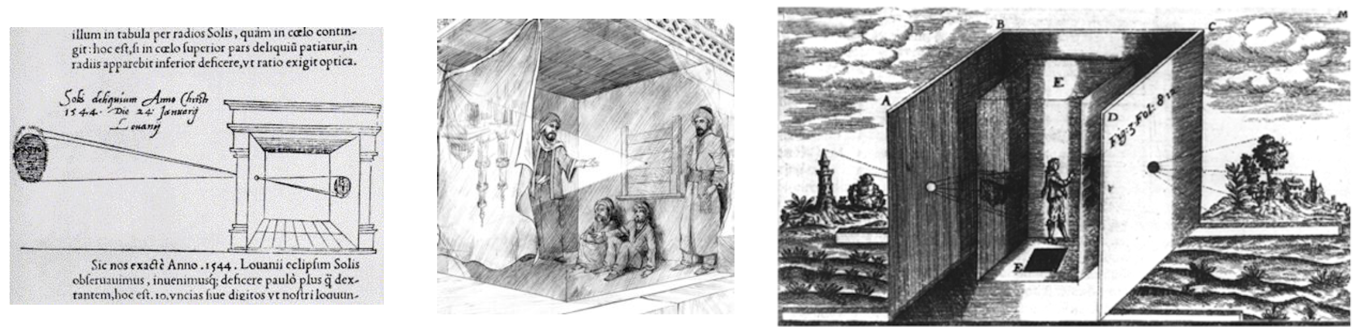
Imaging
Dark chamber with lenses [Kircher 1646]

Slide 8
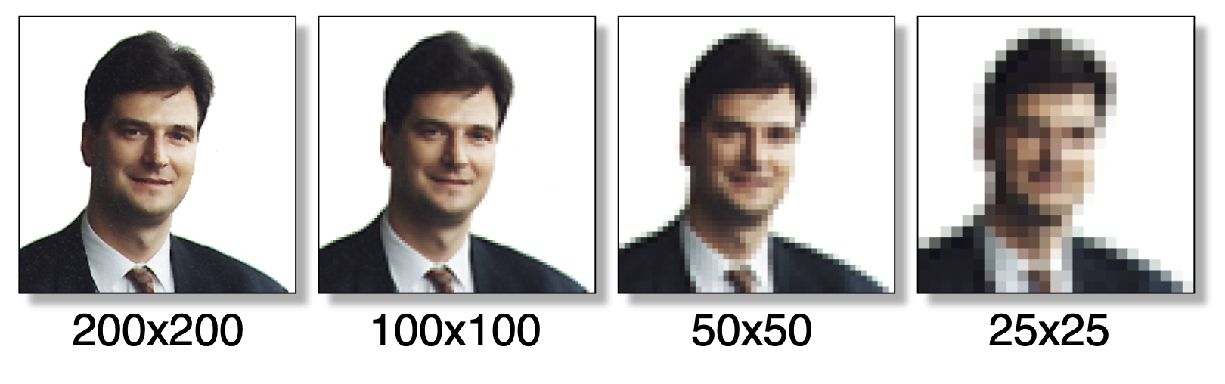
Digital Images and Pixels
Digital image: discrete samples f [x,y] representing continuous image f (x,y)
Each element of the 2-d array f [x,y] is called a pixel or pel (from “picture element“)

Slide 9
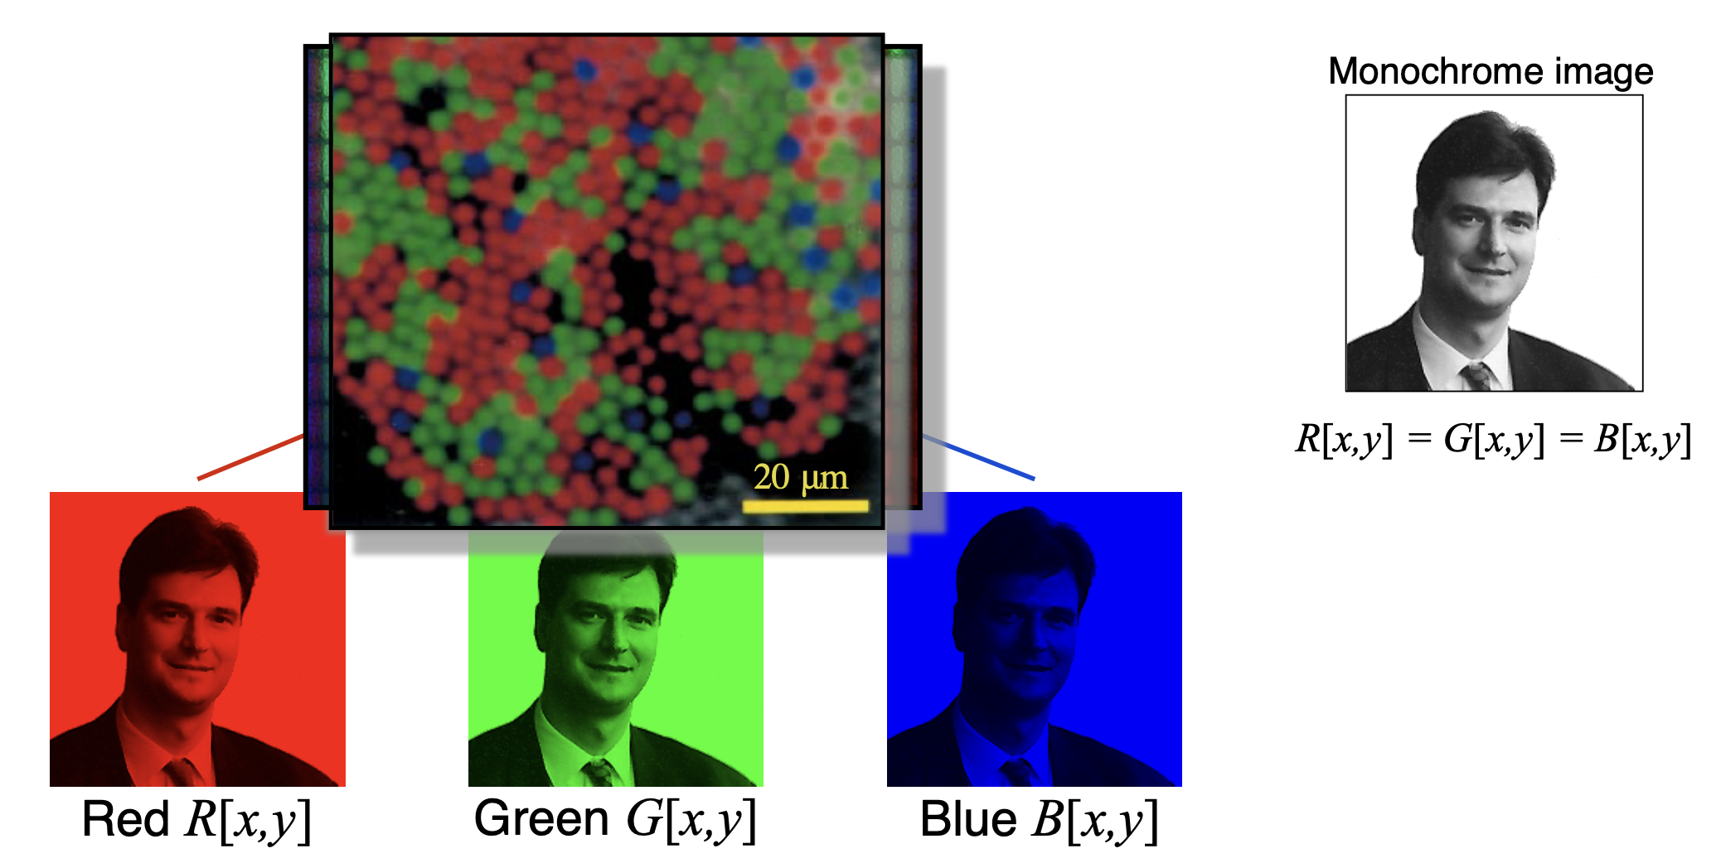
Color Components

Slide 10
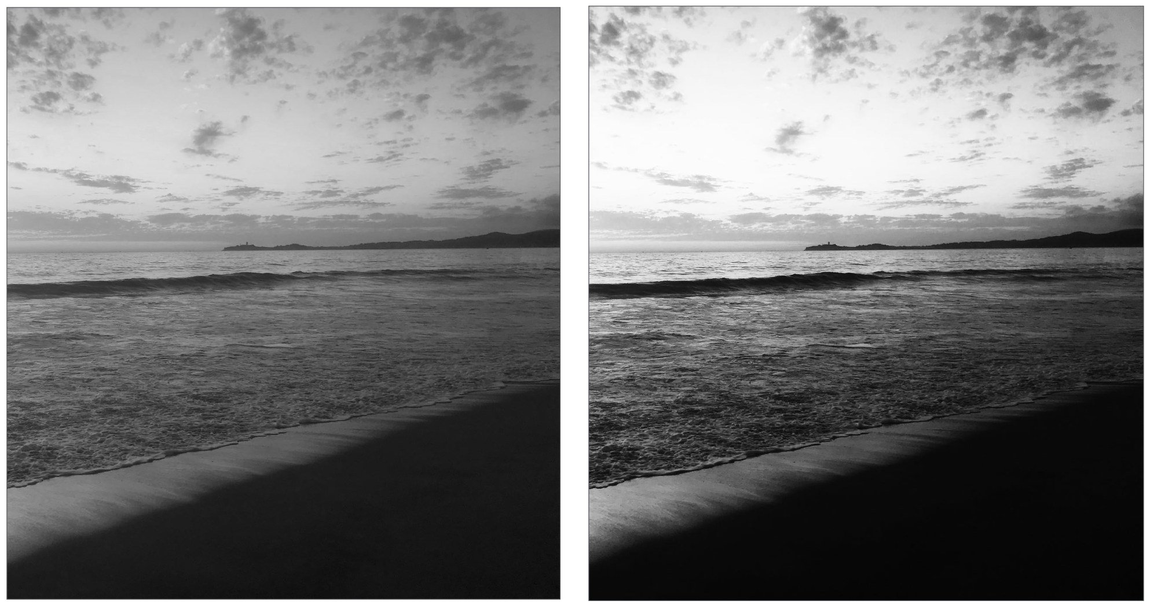
Example image processing operations
Increase contrast

Slide 11
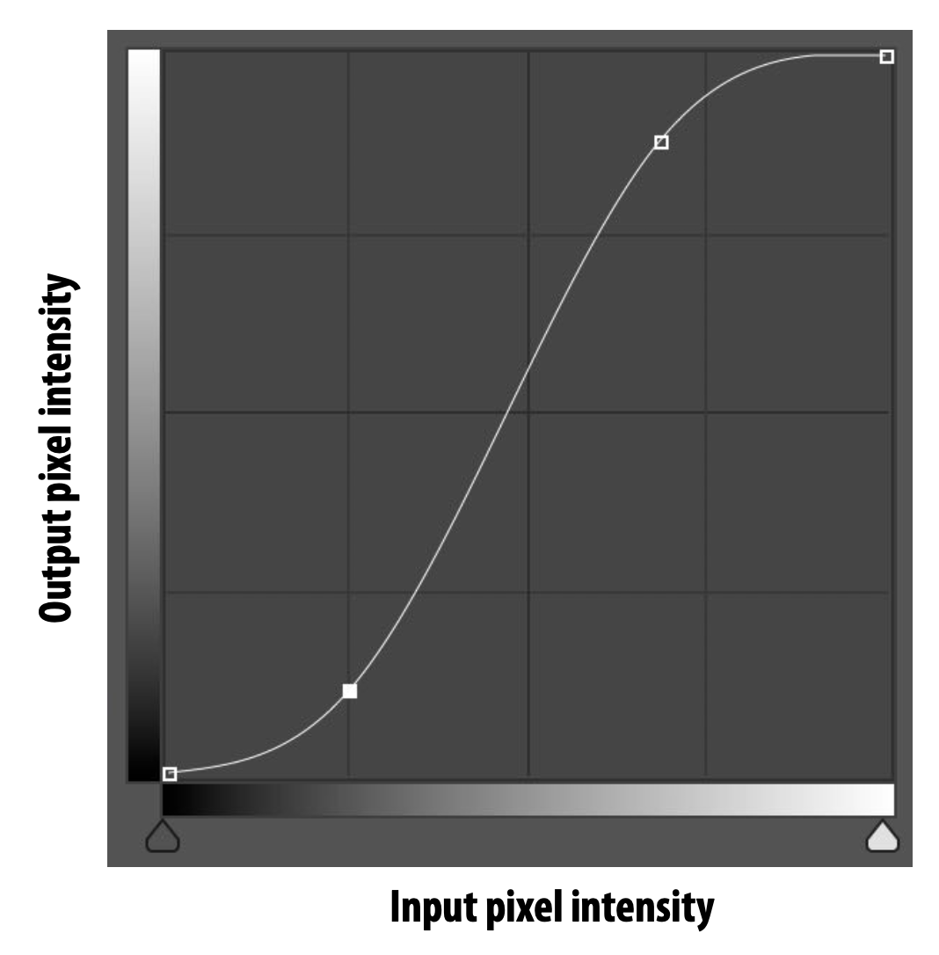
Increasing contrast with “S curve”
Per-pixel operation: output(x,y) = f(input(x,y))

Slide 12
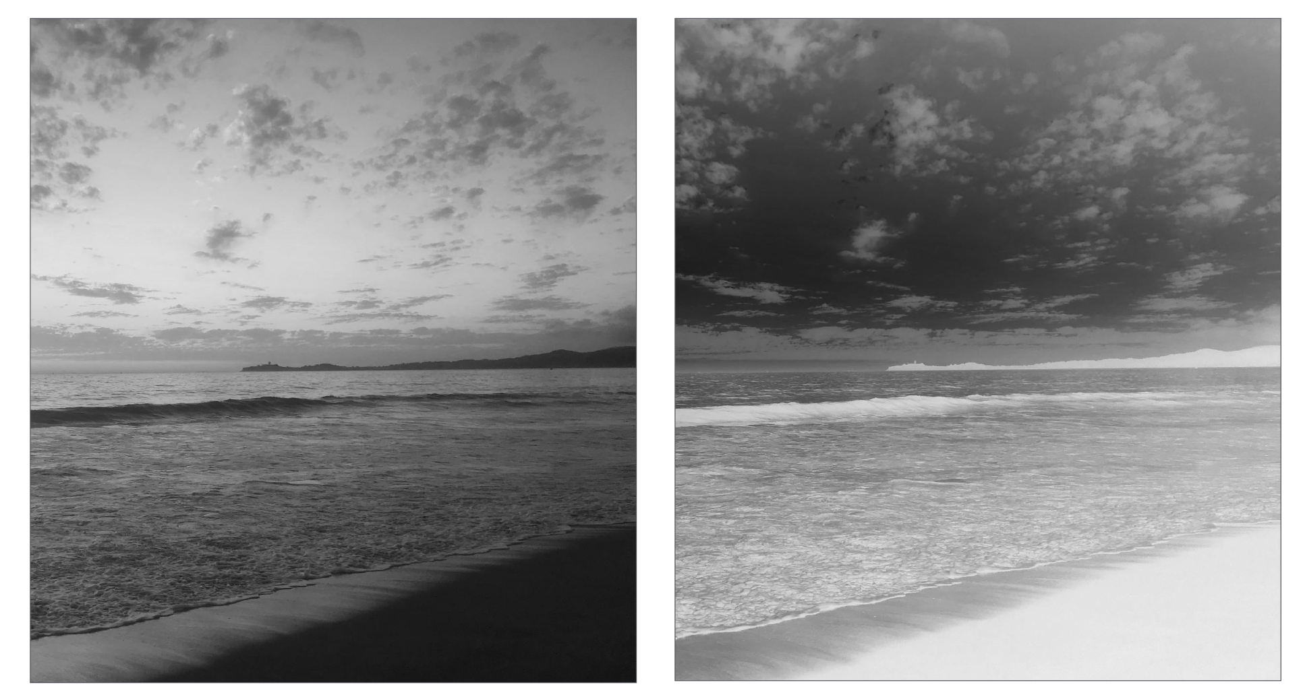
Invert
out(x,y) = 1 - in(x,y)

Slide 13
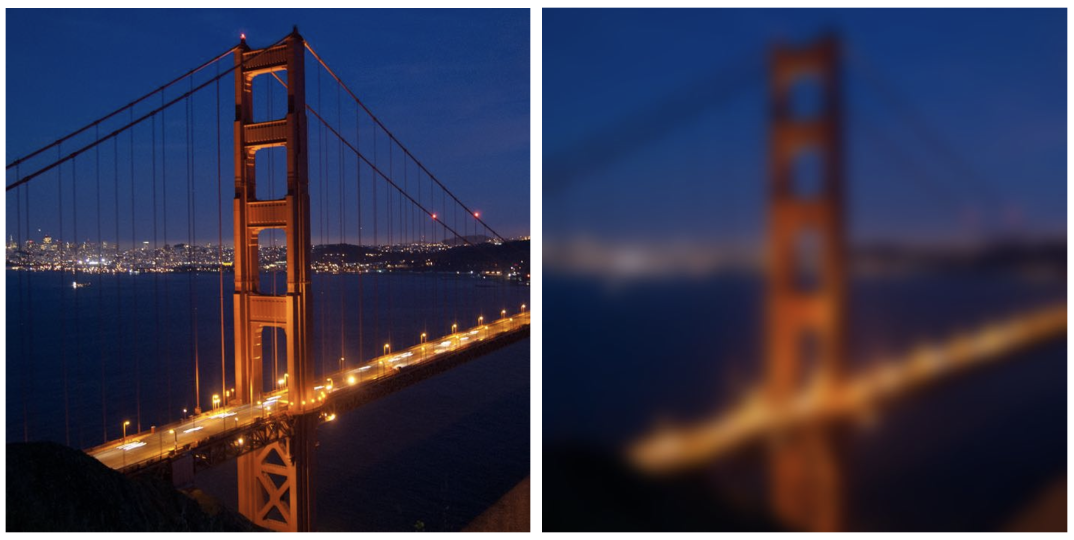
Blur

Slide 14
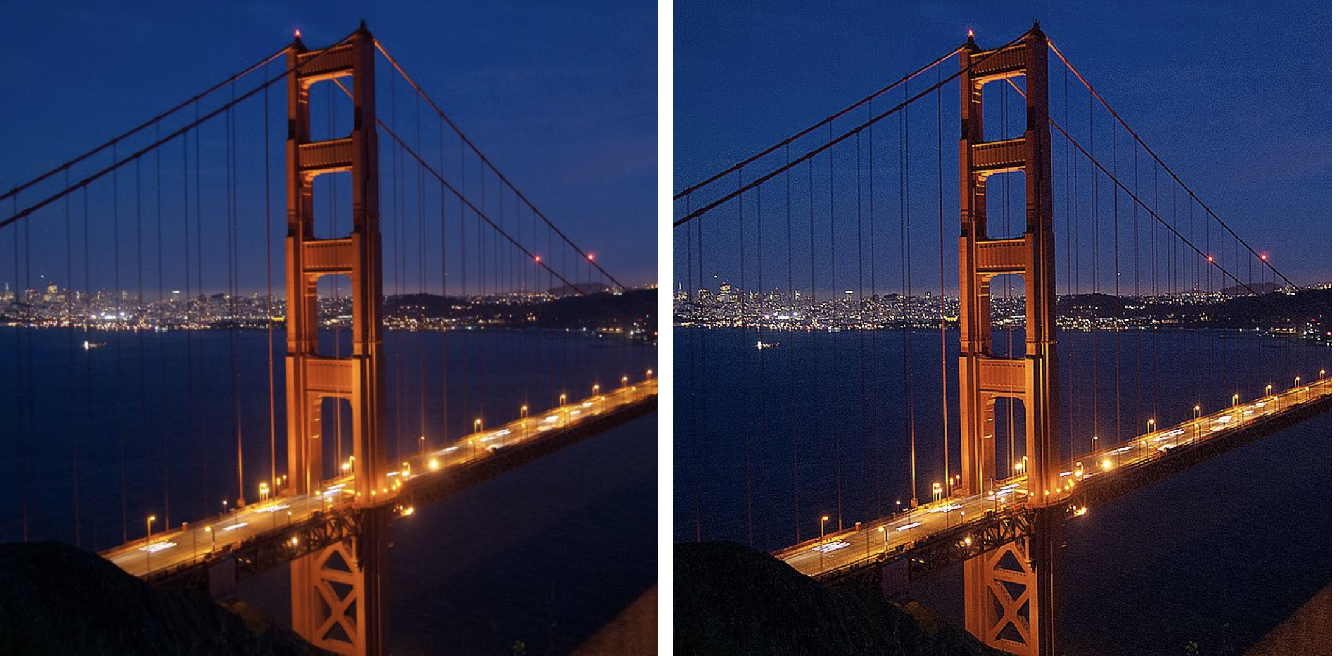
Sharpen

Slide 15
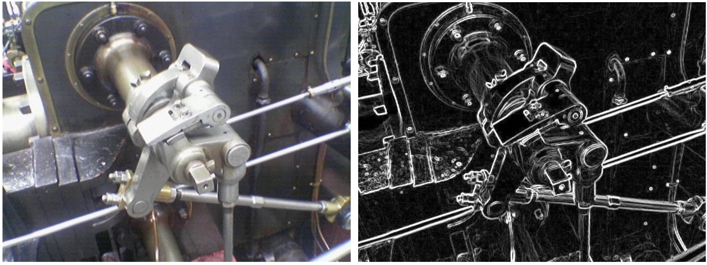
Edge detection

Slide 16
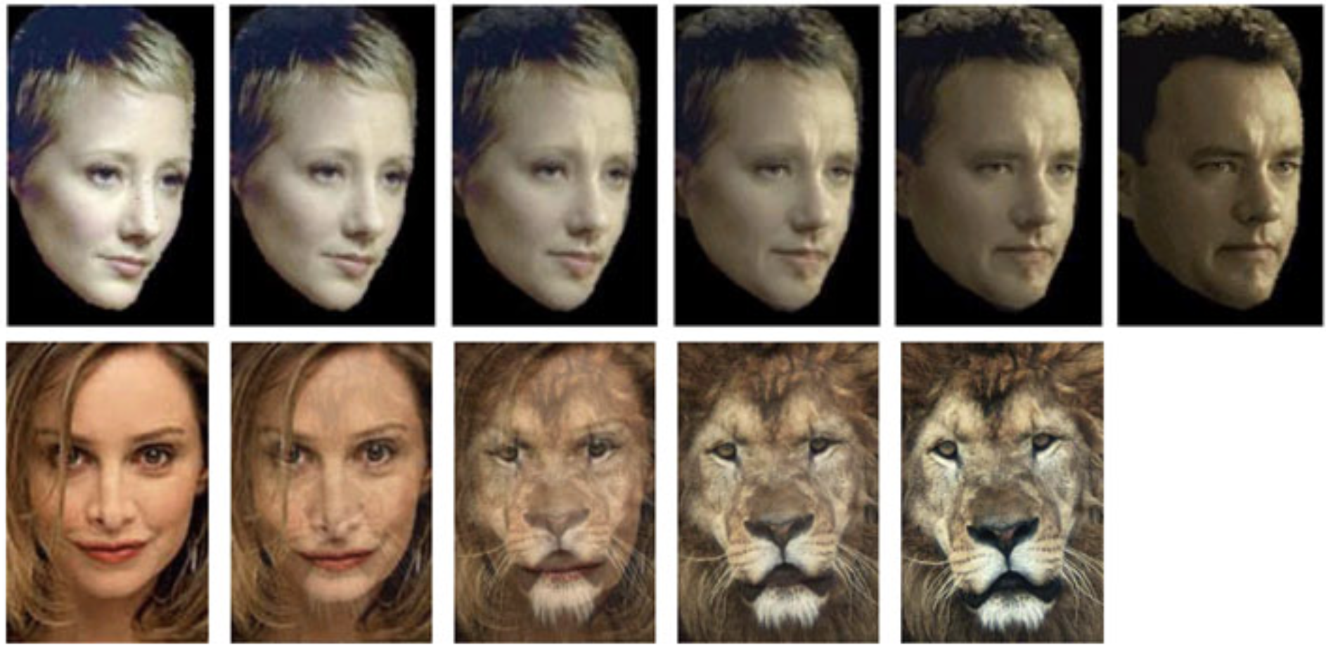
Face morphing

Slide 17
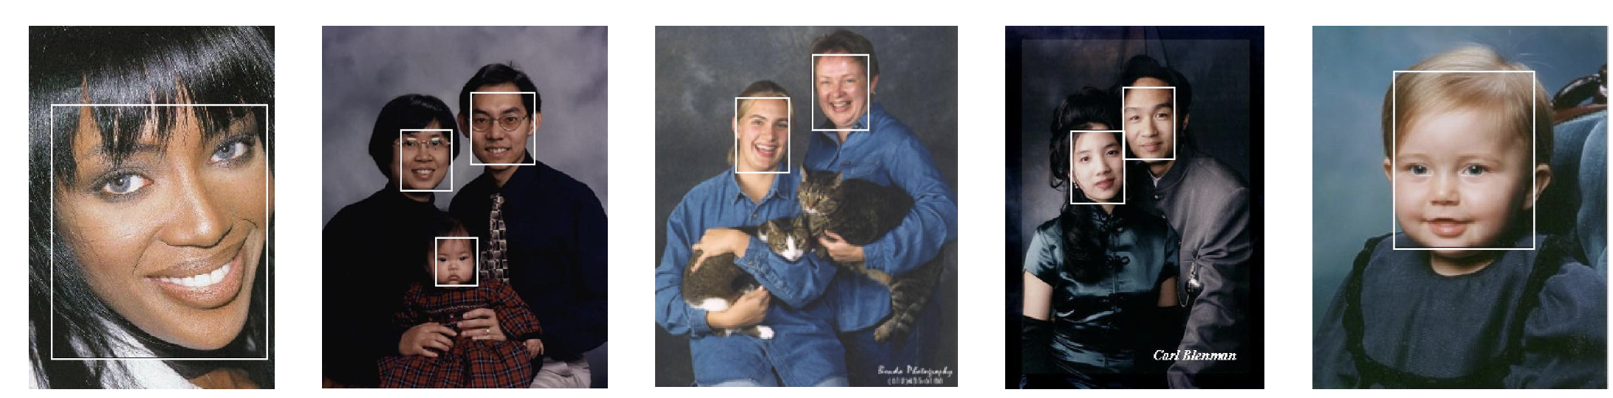
Face Detection
source: Henry Chang, Ulises Robles, EE368 class project, spring 2000.

Slide 18
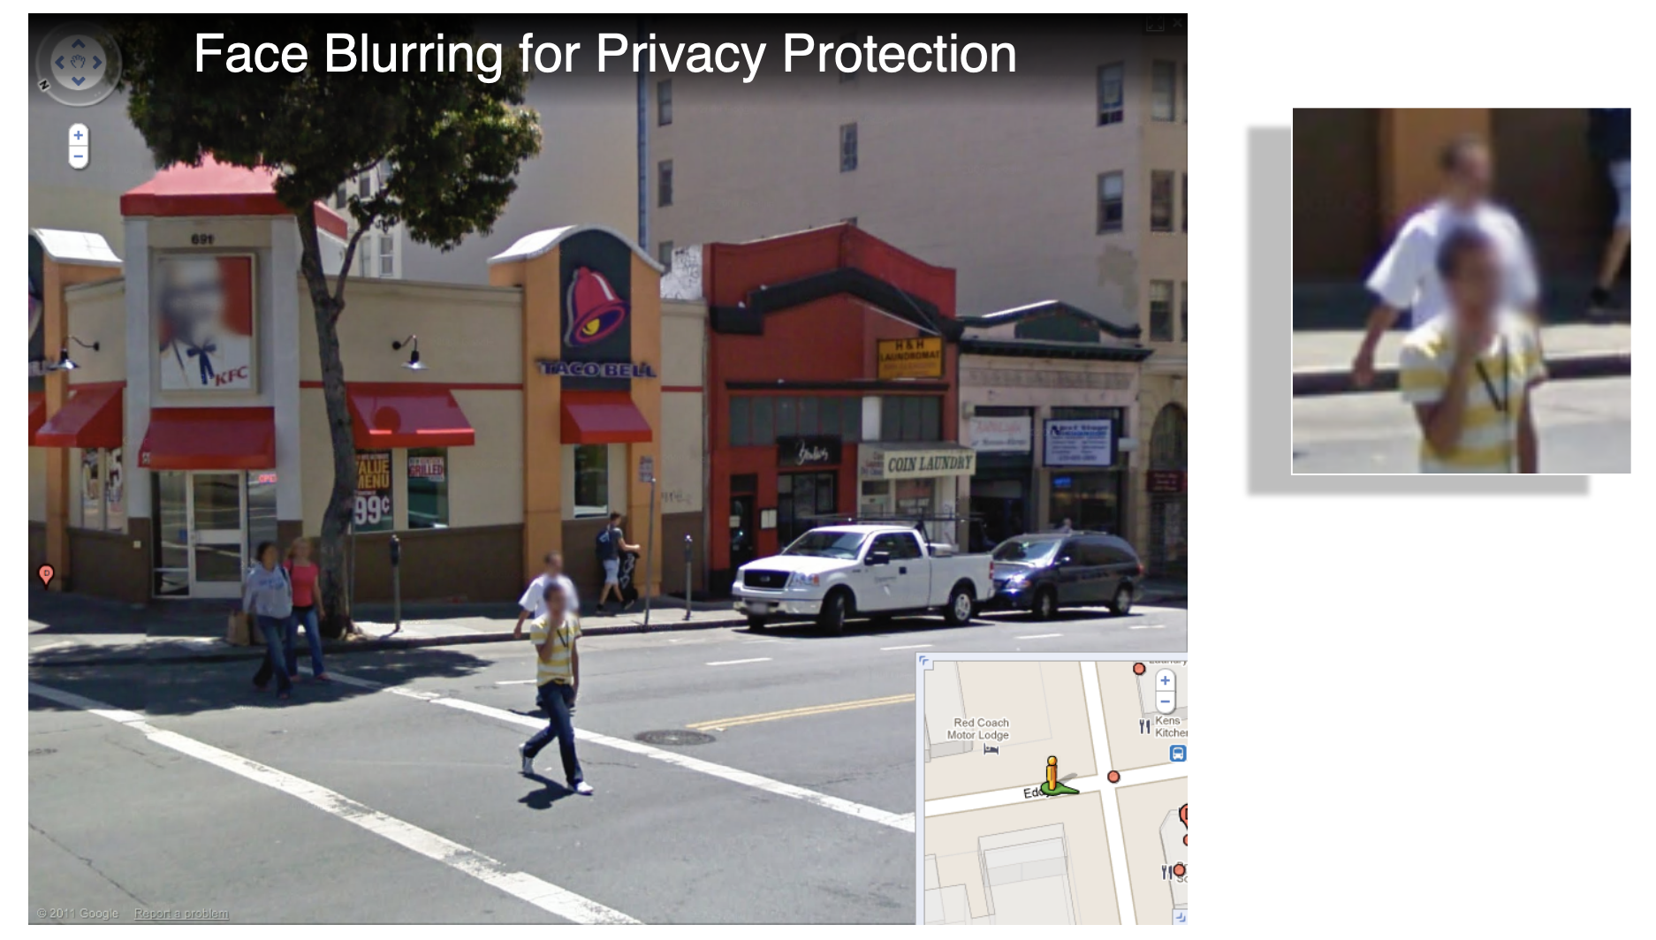
Digital Image Processing: Bernd Girod, © 2013-2015 Stanford University

Slide 19
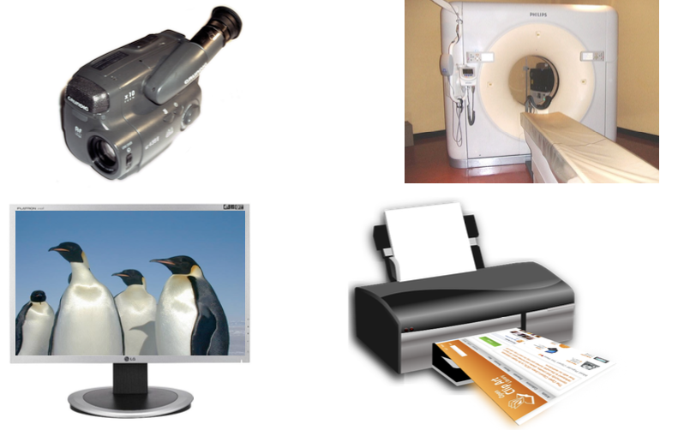
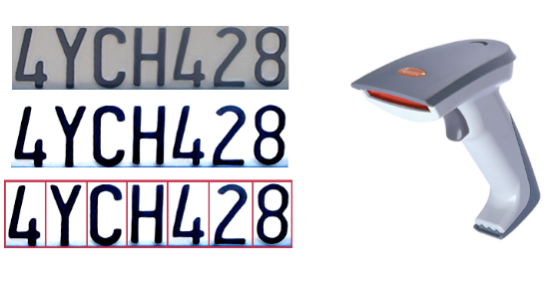
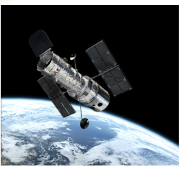
Why do we process images?
Acquire an image!
Correct aperture and color balance
Reconstruct image from projections
Prepare for display or printing!
Adjust image size
Color mapping, gamma-correction, halftoning
Facilitate picture storage and transmission!
Efficiently store an image in a digital camera
Send an image from space
Enhance and restore images!
Touch up personal photos
Color enhancement for security screening
Extract information from images!
Read 2-d bar codes
Character recognition
Many more ... image processing is ubiquitous

Slide 20
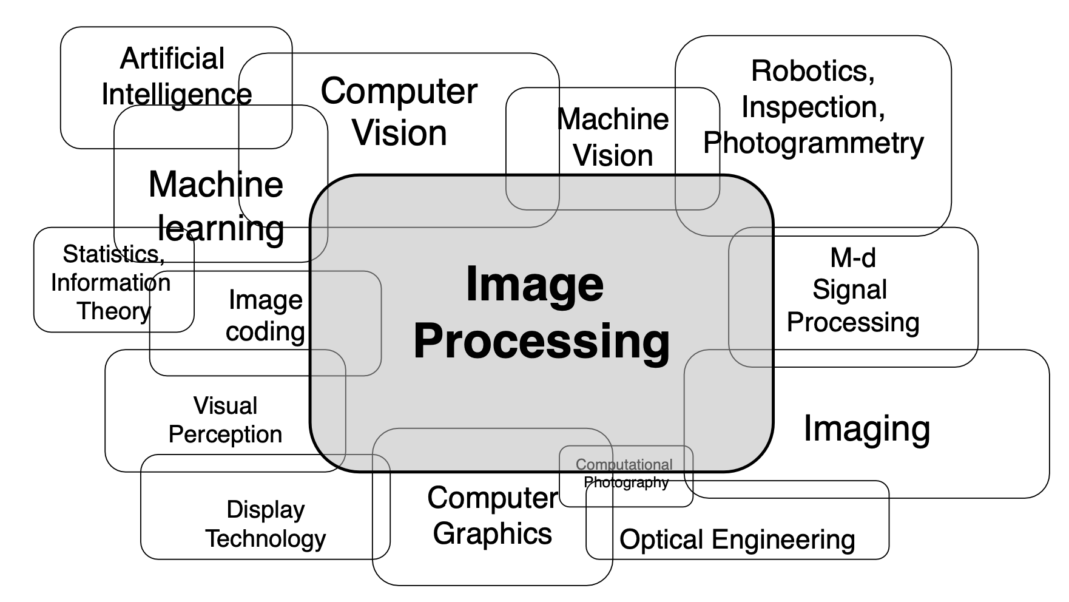
Image Processing and Related Fields

Slide 21
Thank You!!!

