Slide 1
MUTUAL FUND
ANALYTICS PLATFORM
DATA → ANALYTICS → DECISION
NAV
ETL
An end-to-end financial data analytics & investment intelligence system
AUM
DB
TXNS
INSIGHT
Lakshay Negi
BI
FUNDS
B.Tech CSE (AI & ML) • Dronacharya College of Engineering, Gurugram
Bluestock Fintech Data Analytics Internship Program
DECISION
Mentor: Yash Kale
A unified workflow from raw financial data to decision support.
Notes:
Use a slow, subtle fade-in. Let the data nodes appear before the title settles. No flashy motion.

Slide 2
Why Mutual Fund Analytics?
The problem is not lack of data. It is turning fragmented financial data into usable insight.
THE PROBLEM
RAW DATA
COMPLEXITY
MANUAL ANALYSIS
LIMITED INSIGHT
NAV • AUM •
transactions
Many sources
+ formats
Spreadsheets
+ static reports
Slow comparison
+ weak automation
THE PROJECT RESPONDS TO FIVE CORE FRICTIONS
Scattered financial information
Limited portfolio optimization
Manual data processing
Manual recurring reporting
Difficult fund comparison
Notes:
Fade each problem stage left-to-right. Keep the point: the challenge is workflow fragmentation, not data scarcity.

Slide 3
From Fragmented Data to Investment Intelligence
A single platform connecting engineering, analytics, visualization, optimization, and automation.
01
02
03
04
05
06
07
COLLECT
CLEAN
STORE
ANALYZE
VISUALIZE
OPTIMIZE
AUTOMATE
PROJECT OBJECTIVE
Build an integrated mutual fund analytics platform that transforms raw financial datasets into interactive, risk-aware, and automatically delivered insights.
Centralize data using SQLite
10
6
Enable interactive analysis through Streamlit
source datasets
core DB tables
Optimize portfolios using Monte Carlo Simulation
Automate HTML report generation and email delivery
Notes:
Use Morph-style sequence: one stage unlocks the next. The final “AUTOMATE” box should glow subtly.

Slide 4
End-to-End System Architecture
Six layers connect the data pipeline to decision support and automated delivery.
DATA SOURCES
Fund master • NAV • AUM • transactions • holdings
ETL / PROCESSING
Clean • validate • transform • prepare
SQLITE DATABASE
dim_fund • dim_date • 4 fact tables
ANALYTICS LAYER
KPIs • performance • risk • portfolio metrics
STREAMLIT DASHBOARD
Interactive exploration • filters • visual analytics
AUTOMATION
HTML reports • Gmail SMTP • Task Scheduler
INTEGRATION LAYERS
DATA ENGINEERING
DATABASE
BI / DASHBOARD
FINANCIAL ANALYTICS
AUTOMATION
Notes:
Reveal each layer top-to-bottom. Use a subtle wipe and keep connectors static.

Slide 5
Turning Raw Financial Data into Reliable Analytics
The ETL pipeline is the backbone of the platform.
ETL PIPELINE
EXTRACT
Load raw CSV datasets
SOURCE DATASET MAP
Fund Master
Industry Folio Count
TRANSFORM
Standardize, clean, map, aggregate
NAV History
Scheme Performance
AUM
Investor Transactions
VALIDATE
Remove errors, duplicates, invalid NAVs
Monthly SIP Inflows
Portfolio Holdings
Category Inflows
Benchmark Indices
LOAD
Store analysis-ready data in SQLite
Data quality operations
MISSING VALUES
DUPLICATE REMOVAL
DATE STANDARDIZATION
INVALID NAV HANDLING
TRANSACTION CATEGORIES
Notes:
Reveal Extract → Transform → Validate → Load. Then reveal the dataset list as a supporting “source map.”

Slide 6
The Data Foundation: SQLite Star Schema
A compact relational foundation keeps analytical queries organized and reusable.
dim_fund
dim_date
fund master
time dimension
ANALYTICS CORE
fact_nav
fact_aum
historical NAV
asset growth
fact_transactions
fact_performance
investor behavior
returns + expense ratio
CENTRALIZED STORAGE
REDUCED REDUNDANCY
EFFICIENT QUERYING
SCALABLE ANALYTICS
DASHBOARD-READY
Notes:
Reveal dimensions first, then fact tables, then the central analytical core. Use gentle fade between groups.

Slide 7
Technology Stack Behind the Platform
The stack is intentionally lightweight, practical, and tightly integrated.
Pandas + NumPy
Python
Data processing
SQLite
Core programming
Database
MUTUAL
FUND
ANALYTICS
Plotly
Gmail SMTP
Visualization
Report delivery
Streamlit
Git + GitHub
Dashboard
Version control
VS Code
Development
Notes:
Use radial build: center first, then technologies appear around it. Keep motion subtle.

Slide 8
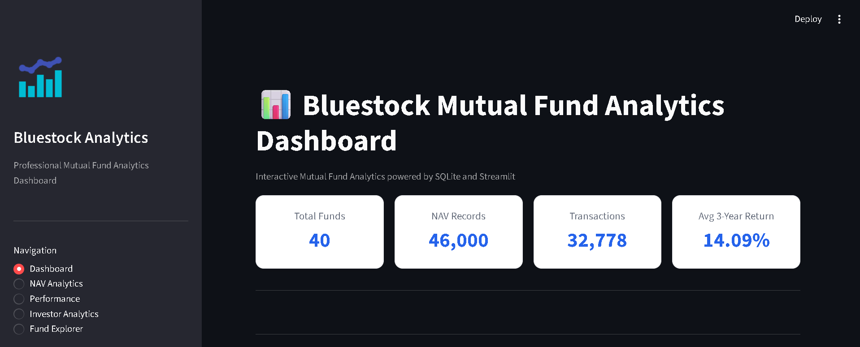
From Data to Interactive Financial Intelligence
A Streamlit dashboard brings the analytical modules together in one interface.
PRODUCT SHOWCASE
MODULE ECOSYSTEM
Home Dashboard
Fund Performance
Portfolio Optimizer
Investor Analytics
Fund Explorer
Data Visualization
Report Generation
Core UX
Filters • KPI cards • dynamic charts • responsive navigation
Notes:
Treat this like a product demo. A very subtle zoom-in on the dashboard image works well.

Slide 9
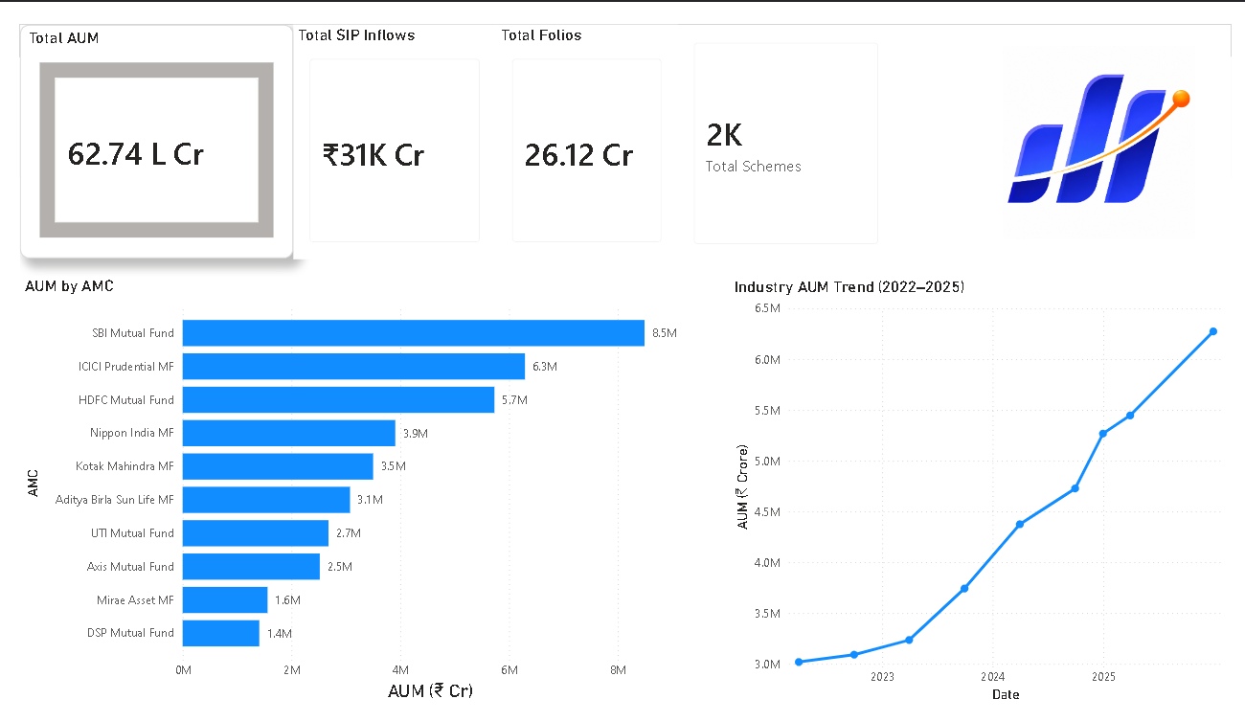
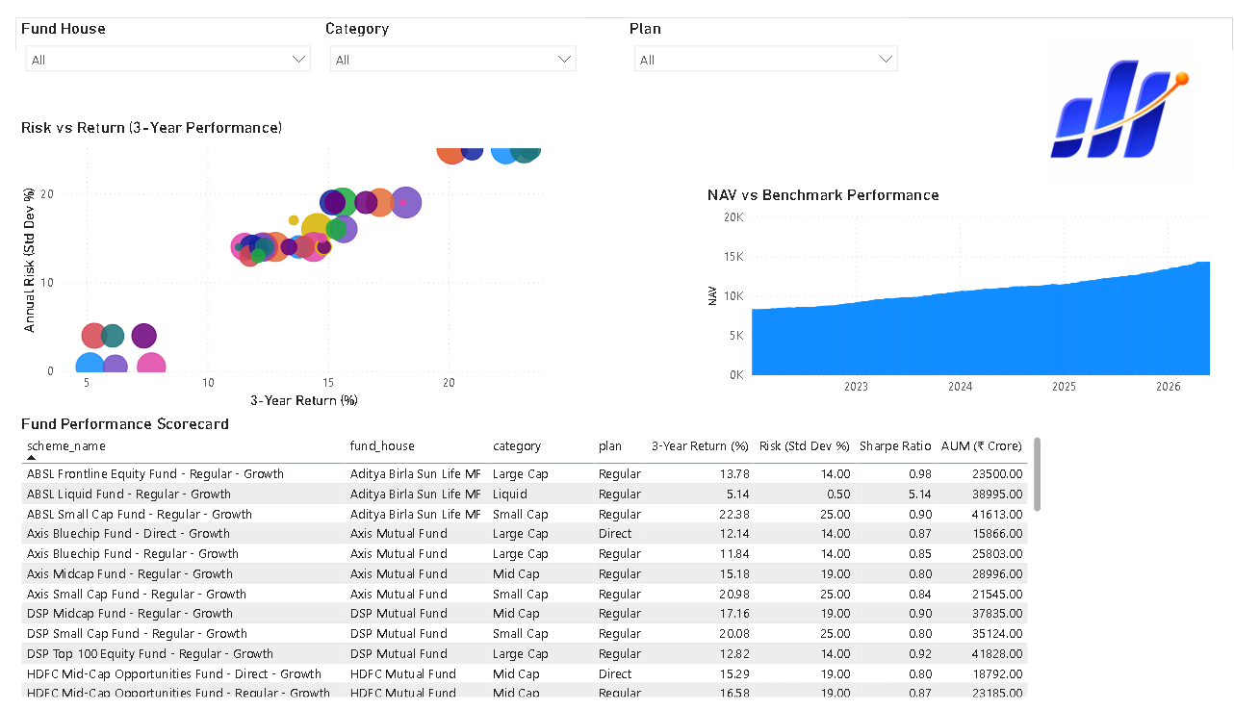
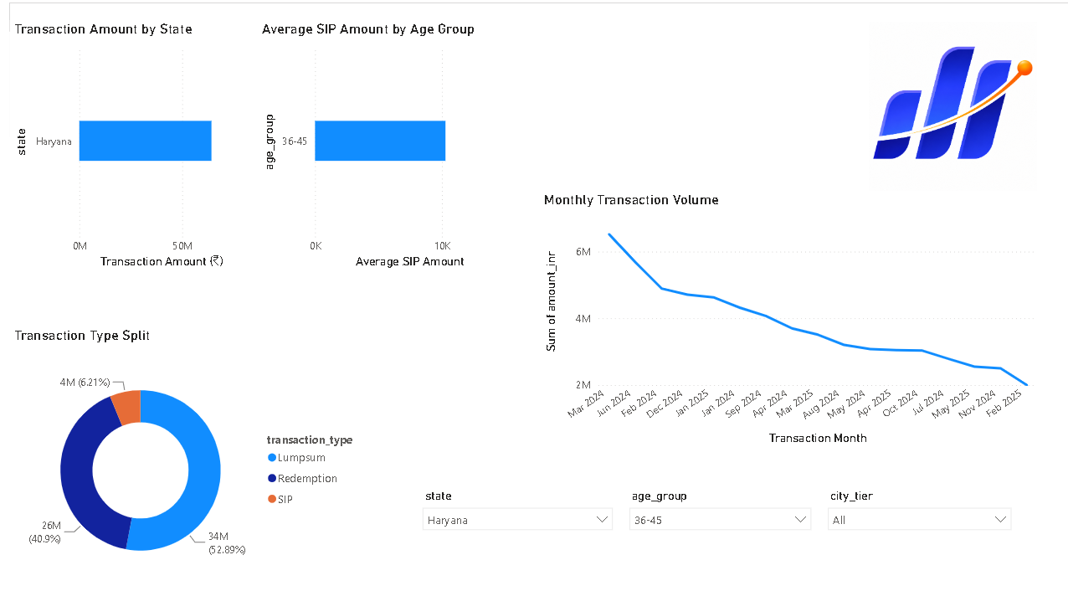
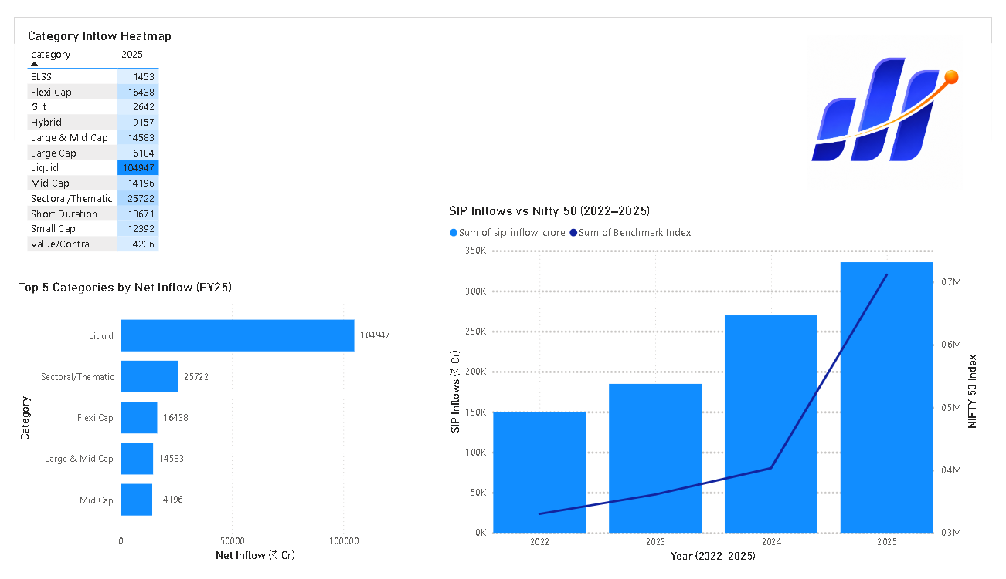
What the Platform Can Reveal
The dashboard is not just a front end — it is a multi-angle analytical workspace.
TREND
COMPARISON
NAV / performance movement
Fund and category perspective
INVESTOR BEHAVIOUR
INDUSTRY VIEW
Transactions and demographics
AUM / SIP / inflows
Visual reasoning replaces manual scanning: trend → comparison → behavior → industry context.
Notes:
Bring the four analytical lenses in from opposite corners. Keep the charts static and legible.

Slide 10
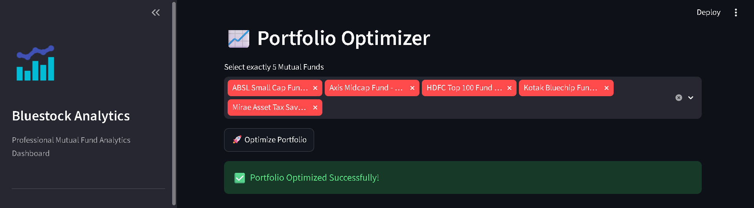
Portfolio Optimization: Moving from Analysis to Decision
Historical fund data becomes a risk-aware allocation decision.
01
02
03
04
05
06
HISTORICAL
FUND DATA
RETURN +
VOLATILITY
RANDOM
PORTFOLIOS
RISK / RETURN
EVALUATION
SHARPE
RATIO
OPTIMAL
ALLOCATION
PORTFOLIO OUTPUT
Return
Risk
Sharpe
expected return
volatility
risk-adjusted
The optimizer selects the portfolio with the strongest risk-adjusted performance based on the Sharpe Ratio.
Notes:
Use a sequential reveal. The “Optimal Allocation” node should only appear after Sharpe Ratio.

Slide 11
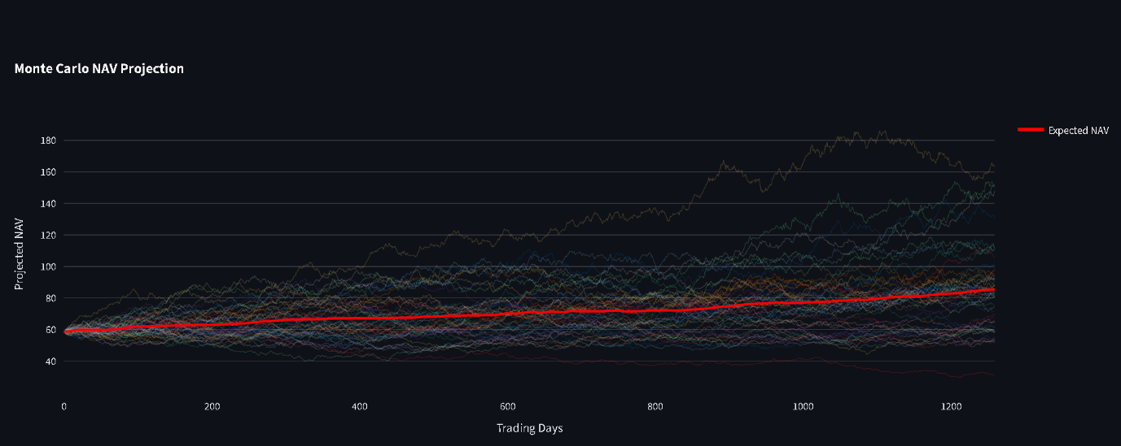
Monte Carlo Simulation: Exploring Thousands of Possibilities
Thousands of candidate portfolios reveal the trade-off between expected return and risk.
THREE METRICS DRIVE THE SEARCH
Return
expected return
MAX SHARPE
Risk
portfolio volatility
Sharpe
risk-adjusted return
Notes:
Reveal the simulation scatter first; then add the MAX SHARPE label and the three metrics. A gentle fade is enough.

Slide 12
Analytics That Deliver Themselves
Reporting is automated from dashboard insight to scheduled email delivery.
DASHBOARD
ANALYTICS
HTML REPORT
GENERATION
GMAIL
SMTP
EMAIL
DELIVERY
TASK
SCHEDULER
WEEKLY HTML REPORT CONTENT
PERFORMANCE SUMMARY
PORTFOLIO INSIGHTS
AUM / NAV ANALYSIS
CHARTS + KEY OBSERVATIONS
OUTCOME
Less manual effort • consistent delivery • scheduled execution
Notes:
Use sequential wipe from Dashboard → HTML → SMTP → Email → Scheduler. The final node should glow lightly.

Slide 13
What Was Successfully Delivered
The project reached a complete end-to-end implementation across engineering, analytics, and automation.
ETL Pipeline
✓
Monte Carlo Simulation
✓
SQLite Database
✓
Weekly HTML Reports
✓
Interactive Dashboard
✓
Gmail SMTP Automation
✓
Financial Visualization
✓
Windows Task Scheduler
✓
Portfolio Optimization
✓
RAW DATA
RELIABLE ANALYTICS
INTERACTIVE DECISION SUPPORT
AUTOMATED DELIVERY
Notes:
Reveal capabilities in two columns. Close with the end-to-end outcome bar.

Slide 14
From Challenges to Capabilities
The build process exposed real engineering constraints — and turned them into practical learning.
CHALLENGES
LEARNED
FUTURE
Data quality issues
Data engineering
Real-time APIs
Multi-source integration
Financial analytics
ML-based prediction
Optimization complexity
SQL + schema design
AI recommendations
Dashboard usability
Streamlit + visualization
Cloud deployment
Email authentication
Automation + Git/GitHub
Real-time portfolio tracking
CHALLENGE
LEARNING
FUTURE CAPABILITY
Notes:
Reveal the three columns in order. The bottom progression arrow should appear last.

Slide 15
Mutual Fund Analytics Platform — From Data to Decisions
A unified system that connects data engineering, financial analytics, visualization, optimization, and automation.
DATA
ENGINEERING
ANALYTICS
VISUALIZATION
OPTIMIZATION
AUTOMATION
DECISION SUPPORT
“The platform turns scattered mutual fund data into a repeatable analytical workflow — and then automates the final mile.”
THANK YOU
Notes:
Use a minimal closing fade. No additional animation. Let the final statement sit on screen.

