Slide 1
Multiplication & Division Using LPM Modules
Self Check Lab
Anthony Ramos
CSC 342/43

Slide 2
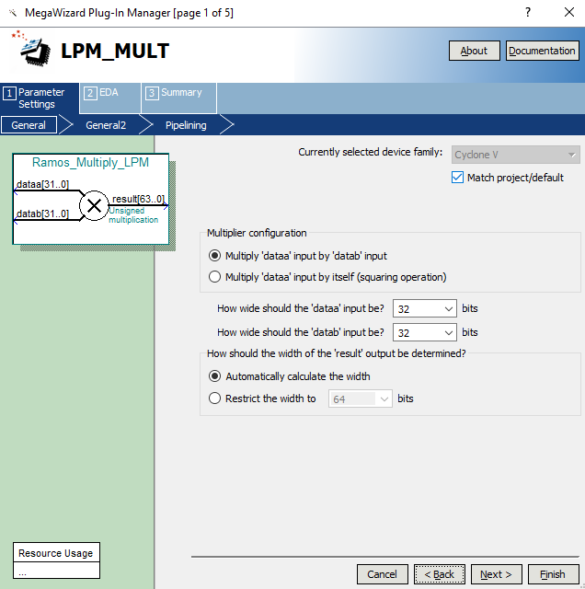
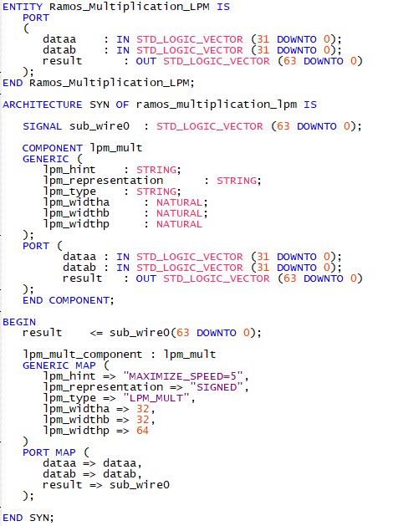
Multiplication LPM

Slide 3
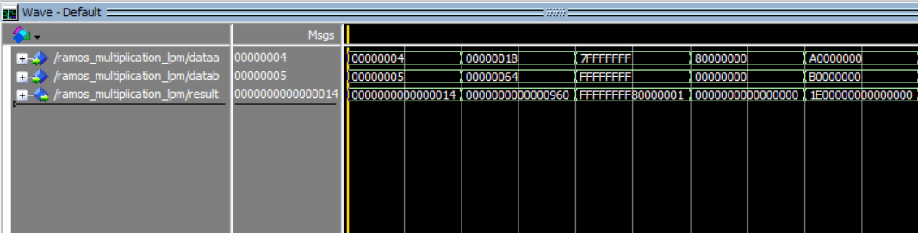





Multiplication LPM (Simulation)
A B C D E
$4$
$$×5$$
------------
$$+20$$
$$24$$
$$×100$$
--------------
$$+2400$$
$${+(2}^{31}−1)$$
$$×−1$$
----------------
$−{(2}^{31}$+1)
$${+2}^{31}$$
$$×0$$
----------------
$$0$$
$$−1610612736$$
$$×−$$
----------------
$$+21617…$$
The simulation above shows multiplication results for several cases. In each case, the result is stored using 64-Bits. The first two cases multiply two positive integers and output two positive results. The next case multiplies a positive and negative integer which outputs a negative result as expected. Next, we multiply by 0 which results in 0. Lastly, we multiply two negative integers which outputs a positive result as expected. In verifying the results by hand, we can confirm that the correct behavior is obtained.

Slide 4
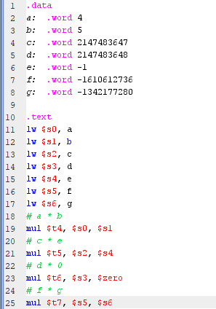
Multiplication (Comparison with MIPS)

Slide 5
Multiplication (Comparison with MIPS)
A
Upper 32-Bits
Lower 32-Bits
C
D
E

Slide 6
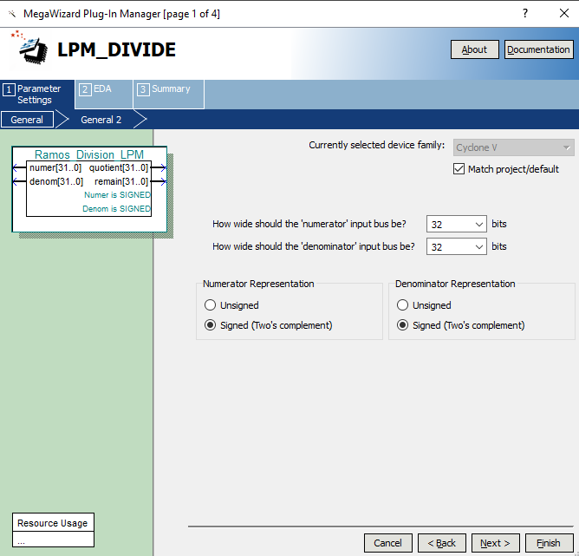
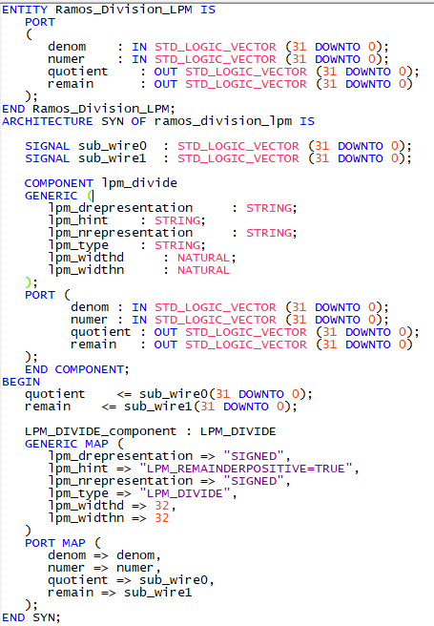
Division Using LPM

Slide 7
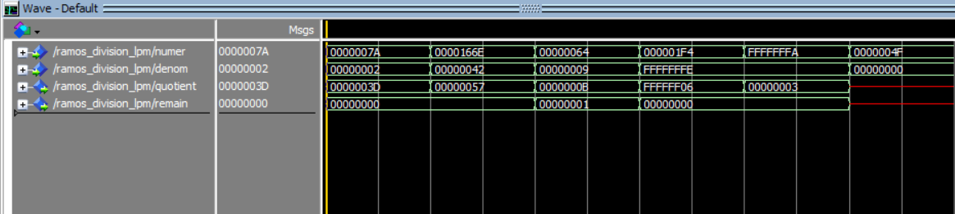






Division Using LPM (Simulation)
A B C D E F
$$\frac{122}{2}=61$$
Rem = 0
$$\frac{5742}{66}=87$$
Rem = 0
$$\frac{100}{9}=11$$
Rem = 1
$$\frac{+500}{−2}=−250$$
Rem = 0
$$\frac{−6}{−2}=+3$$
Rem = 0
$$\frac{79}{0}=U$$
Rem = U
The simulation above shows some division results for several cases. In each case, the result (quotient) is stored using 32-Bits. In addition, the remainder (if any) is stored using another 32-Bits. The first two cases divide two positive integers and output two positive results. The next case also divides two positive integers but results in some remainder as well. The remainder is the result of a modulo (%) operation. Next, we divide a positive integer by a negative integer which results in a negative result as expected. Next, we divide two negative integers which outputs a positive result as expected. Lastly we divide by 0 which results in an undefined (U) result. In verifying the results by hand, we can confirm that the correct behavior is obtained.

Slide 8
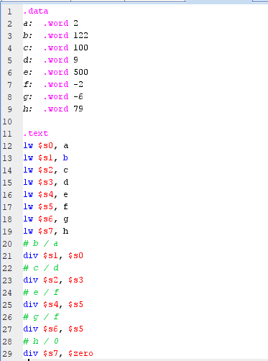
Division (Comparison with MIPS)

Slide 9
Division (Comparison with MIPS)
A
Remainder
Quotient
C
D
E
F
No Change
Why?

Slide 10
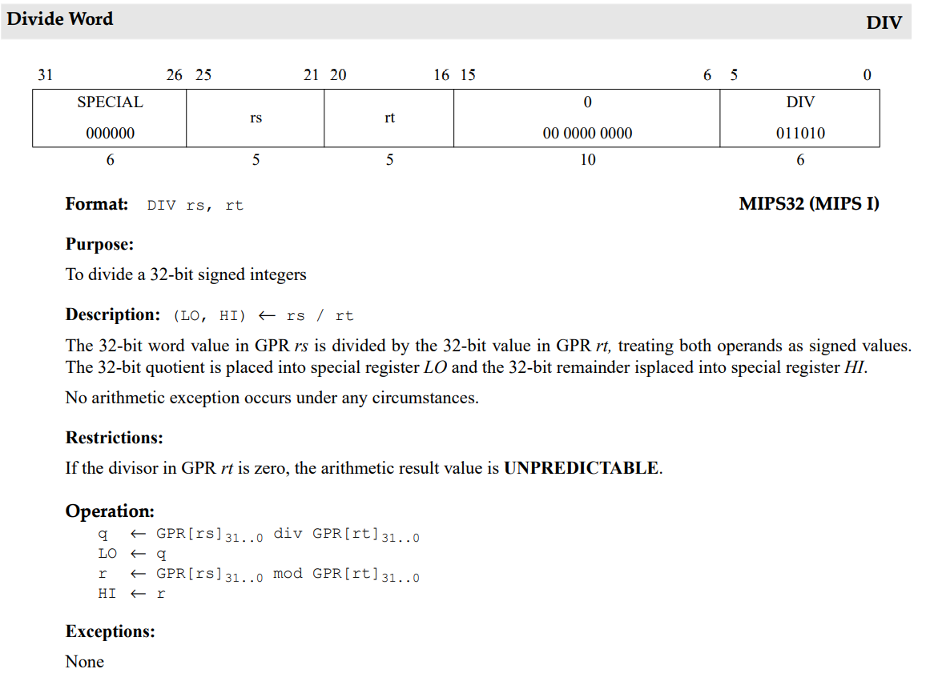
Division By Zero In MIPS
No “divide by zero” exception
http://www.cs.cornell.edu/courses/cs3410/2008fa/MIPS_Vol2.pdf

Slide 11
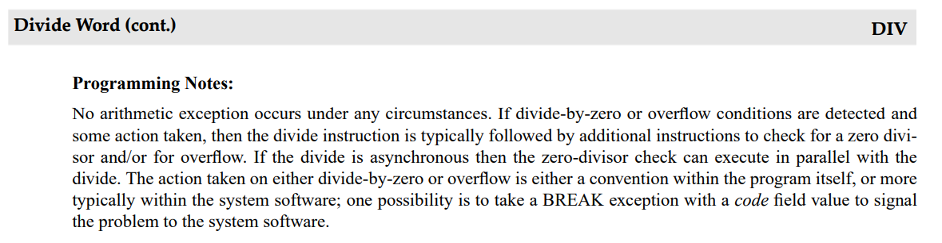
Division By Zero In MIPS (Cont.)
http://www.cs.cornell.edu/courses/cs3410/2008fa/MIPS_Vol2.pdf

