Slide 1

Take Home Test 1
CSC342 – Spring 2021
Prof. Izidor Gertner
Anthony Ramos

Slide 2
Objective
Explore and demonstrate understanding of assembly code and machine instruction operations in three sets of architecture: MIPS instruction set architecture, Intel x86 ISA via MS Visual Studio 32-Bit compiler and debugger, and Intel X86 64-bit running Linux platform via GDB
Study C topics (e.g. loops, arrays, condition statements, static/local variables)

Slide 3
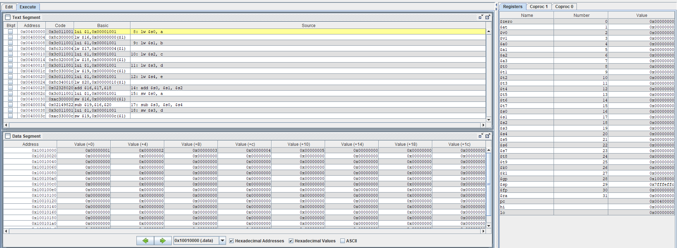
GUI Environments
Text Segment: Assembly Instructions
Registers:
Register Contents
Data Segment:
Memory Contents
Figure 1: MARS Simulator GUI environment

Slide 4
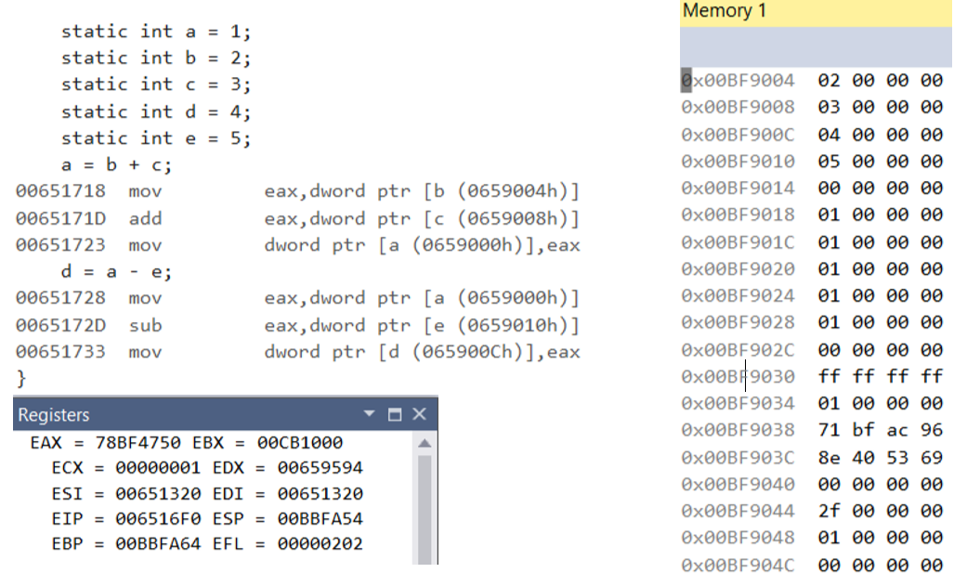
GUI Environments
Disassembly: Assembly Instructions
Registers:
Register Contents
Memory:
Memory Contents
Figure 2: MS Visual Studio GUI environment

Slide 5
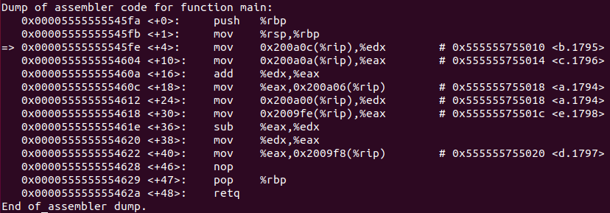

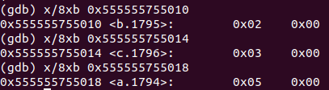
GUI Environments
Figure 3: Linux GDB Terminal

Slide 6
Operand Syntax
target, source
target, source
source, target
Figure 4: Operand Syntax

Slide 7

Arithmetic
3 operands
2 operands
2 operands
Registers
Register, Memory
Registers
Figure 5: Addition in MIPS, Intel x86 (32-Bit), Linux GDB

Slide 8

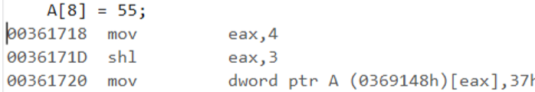
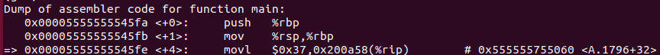
Arrays
Figure 6: Arrays (Extracted from 2-3_1.c)

Slide 9
Conditionals (If-Else + Loops)
Figure 7: Conditionals (Extracted from If_Else.c)

Slide 10



Static Variables and Local Variables
Static
Local
Figure 9: Declaration of static and local variables

Slide 11

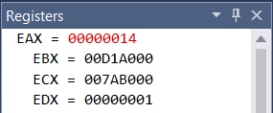

Registers
Same across all platforms
Figure 10: Register Contents (Extracted from If_Else.c)

Slide 12


Memory
lw, sw
Big Endian
mov
Little Endian
mov
Figure 11: Memory Contents (Extracted from WhileLoop.c)

Slide 13
THANK YOU

