Slide 1


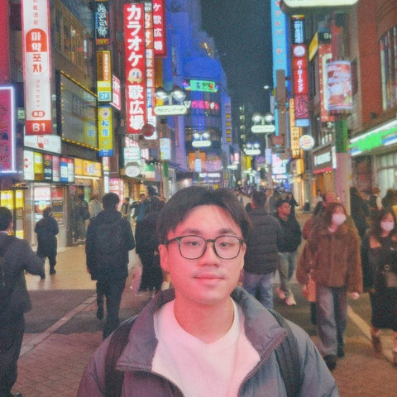
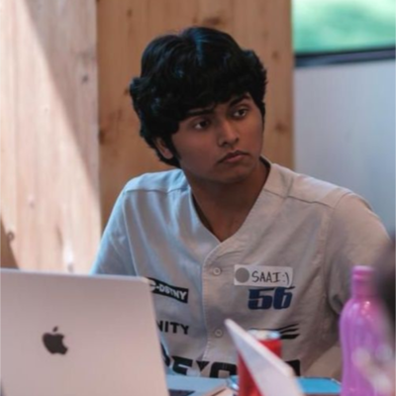

Mira
Evidence-backed research
for internal audit
Nathaniel Sim,
Y2 SUTD CS
Ewen Chai,
Y3 SMU IS
Saai,
Y3 SMU CS
Project prototype for DBS | November 2026
01
Notes:
HK$16.2 million. In July 2025, that’s how much Hong Kong’s Monetary Authority fined three banks for anti-money laundering compliance failures. For auditors, keeping up with industry developments helps you spot risks that could change what the audit covers. That’s why we built Mira: to help internal audit teams stay informed about emerging risks for financial institutions and trace each finding to its source.
[Source: HKMA, 22 July 2025, https://www.hkma.gov.hk/eng/news-and-media/press-releases/2025/07/20250722-4]

Slide 2

Contents
01
Background
02
Can AI Agents Help?
03
Demo
04
How Mira works
05
Considerations and controls
06
Evaluation
07
Limitations, scale and roadmap
08
Summary: Mira vs traditional
09
Q&A
02
Notes:
I’ll show how a new industry development can change audit scope, then walk through how Mira helps an auditor find it, understand it and check the source.
We’ll finish with the controls, what we measured and what it would take to scale.

Slide 3
01
The problem
03
Notes:
Before an audit begins, the team needs to answer two questions: what changed in our markets, and does it change what we should examine?

Slide 4
Audit research informs what auditors examine
Find
Missed developments can leave gaps in audit scope
Interpret
Guidance and obligations require different responses
Verify
Auditors need sources they can check and challenge
04
Notes:
If you miss a development, you might leave a risk out of the audit. Once you find it, you still need to tell whether it’s guidance or an obligation and show where that interpretation came from. That’s the job we built Mira to support.

Slide 5

The audit research problem
Research is repeated across sources,
markets and reporting periods
For auditors, doing this manually is slow, hard to scale, and makes it easy to miss important information
05
Notes:
The more markets and sources you cover, the harder it is to keep up. Auditors repeat the same work each reporting period: find new documents, read them and check the details that could change their audit scope.

Slide 6
02
Can AI Agents Help?
06
Notes:
Could an AI agent keep auditors informed about new risks and give them the evidence they need to decide what matters?

Slide 7
Can AI research remain traceable through review?
Project scope: Hong Kong · AML/CFT and Cybersecurity · Nov 2025–Nov 2026
Demo evidence: regulators and legislation · Selected news outlets scoped for context
01
02
03
04
Brief
Research
Verify & draft
Review
Planner agent turns the brief into a source plan.
Regulatory Scout and Industry Scout agents find publications.
Analyst agent proposes claims. Verifier agent checks them.
Review findings
and approve the report.
Coverage checker flags gaps. Corroboration checks separate sources. Writer agent orders findings in full research runs.
07
Notes:
Our project focused on Hong Kong, from November 2025 to November 2026, covering anti-money laundering, countering the financing of terrorism, and cybersecurity. The demo draws on regulators and legislation. We also scoped selected news outlets for industry context.
The auditor sets the brief. The Planner agent turns it into a source plan. The Regulatory Scout agent looks for official publications, and the Industry Scout agent looks for developments from approved industry sources. The coverage checker flags gaps. The Analyst agent proposes findings, and the Verifier agent checks whether the source passages support them. A separate corroboration step looks for another source. In a full research run, the Writer agent orders the verified findings. Today’s demo assembles the draft from saved findings, and the auditor decides what matters and signs off.

Slide 8
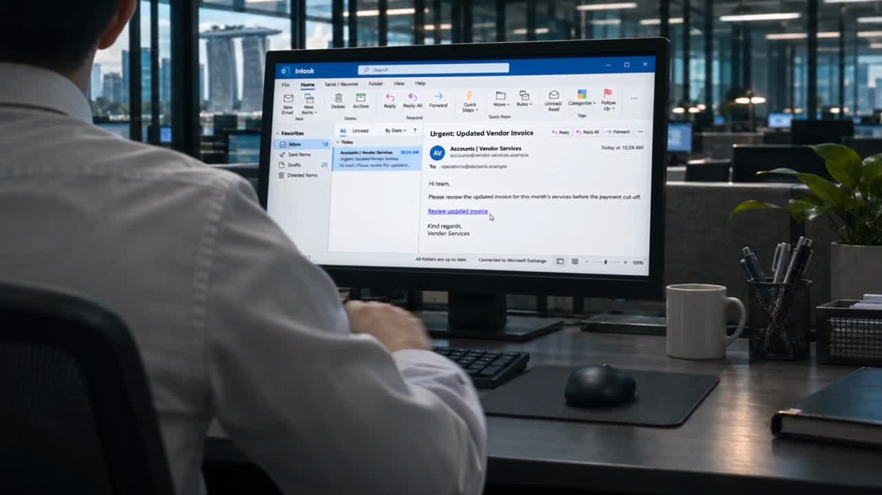
Follow the evidence
09
Notes:
Here’s how an auditor can check what changed. Open the citation and read the exact passage. That’s where you can see whether the regulator is giving guidance or setting an obligation.

Slide 9
04
How Mira works
10
Notes:
To keep auditors informed without making them wait for a new search each time, Mira collects and checks sources ahead of time. It builds each draft from that saved evidence.

Slide 10
How Mira prepares evidence
Mira checks source documents before reports are requested
1 · Start refresh
2 · Collect
3 · Propose
4 · Check
5 · Compare
6 · Save
A schedule or an operator starts a refresh
Saves approved source documents and extracts their text
Proposes claims and links each to a source passage
Checks quotes, numbers and dates. AI tests claim support
Looks for a separate source for the same claim
Saves checked findings, source passages and check results
AUTOMATIC
AUTOMATIC
AI
AUTOMATIC + AI
AI
AUTOMATIC
fails a check
Set aside
Example: the Hong Kong SFC update took about 31 minutes and US$5.80 in model charges.
Verification audit trail
Each check stores its verdict and a SHA-256 hash
of the exact claim and source passages it checked.
Reviewer decisions are appended against that evidence.
Excluded from the draft
Human
AI
Automatic
Notes:
[Start refresh → Collect → Propose] The refresh starts, Scout agents collect approved publications, and the Analyst links proposed findings to passages.
[Check → red arrow] The Verifier tests support. Claims that fail go to Set aside.
[Compare → Save] Mira looks for a separate source, then saves the checked findings, passages and results as an evidence version.
[Audit trail] Each verdict is stored with a SHA-256 fingerprint of the evidence checked.

Slide 11
How Mira generates a report
When evidence is ready, Mira builds a draft without a new AI call
1 · Request
2 · Show gaps
3 · Record
4 · Build draft
5 · Cite
6 · Review draft
An analyst picks the market, topic and dates
Shows gaps in checked evidence for the request
Records the exact evidence versions used in the draft
Builds the draft from saved, checked findings
Shows quotes, source links and review status
Accepts or rejects findings, requests corrections and signs off
HUMAN
AUTOMATIC
AUTOMATIC
AUTOMATIC
AUTOMATIC
HUMAN
Evidence missing
Gap shown
In a test, 20 concurrent browser sessions opened drafts in 0.8–2.7 seconds.
Wait for new evidence or choose dates with evidence
Human
AI
Automatic
Notes:
[Request → Show gaps] Pick the market, topic and dates. Follow the grey arrow if evidence is missing: wait for the refresh or change the dates.
[Record → Build draft] Mira records the exact evidence versions and builds the draft from saved findings without a new AI call.
[Cite → Review draft] The reviewer follows the quotes and source links, then accepts, rejects or requests corrections before signing off.

Slide 12
Mira Overall Workflow
EVIDENCE PREPARATION
1 · Start refresh
2 · Collect
3 · Propose
4 · Check
5 · Compare
6 · Save
Schedule or operator
Approved sources
Claims linked to passages
Quote, date, number and AI checks
Separate source for the claim
Findings, passages and checks
AUTOMATIC
AUTOMATIC
AI
AUTOMATIC + AI
AI
AUTOMATIC
Draft records exact evidence versions
REPORT GENERATION
1 · Request
2 · Show gaps
3 · Record
4 · Build draft
5 · Cite
6 · Review draft
Market, topic, dates
Shows missing evidence
Records versions used
Saved findings, no new AI call
Quotes and source links
Accept, reject or request corrections
HUMAN
AUTOMATIC
AUTOMATIC
AUTOMATIC
AUTOMATIC
HUMAN
11 Nov Hong Kong run (8dcdcc8b)
Evidence preparation: 19 min 7 sec · US$2.98 estimated charges + US$0.43 reserve
Draft assembly: 0.196 sec once evidence was ready · US$0 in new AI model charges
Human
AI
Automatic
Notes:
[Top row → red arrow → bottom row] Mira prepares and saves the evidence first. The red arrow shows which evidence versions the draft records. From there, follow Build draft, Cite and Review draft.
[Point to the figures] In the 11 November Hong Kong run, preparation took 19 min 7 sec, with US$2.98 in estimated charges and a US$0.43 reserve. Draft assembly took 0.196 sec once the evidence was ready, with zero new AI model charges.

Slide 13

Mira Operations Plan
1st of every month
On request
Data ingestion starts automatically.
Mira collects new publications from
approved sources and checks the evidence.
Report generation is asynchronous.
Analysts can request a report at any time.
If the required evidence is still being
prepared, Mira queues the request and
builds the draft when the evidence is ready.
↓
11 Nov Hong Kong run (8dcdcc8b)
Evidence preparation: 19 min 7 sec
US$2.98 estimated charges + US$0.43 reserve
Draft assembly: 0.196 sec once evidence was ready
US$0 in new AI model charges
1st
Notes:
[Left column → calendar] Ingestion starts on the first of each month.
[Right column] Analysts can request reports anytime. If their evidence is still being prepared, Mira queues the request and builds the draft when it’s ready.
[Optional, point to the figures] In the Hong Kong run, preparation took 19 min 7 sec, with US$2.98 in estimated charges and a US$0.43 reserve. Assembly took 0.196 sec once ready, with zero new AI model charges.

Slide 14
03
Demo
08
Notes:
In the demo, watch what happens when we open a citation in the draft.

Slide 15
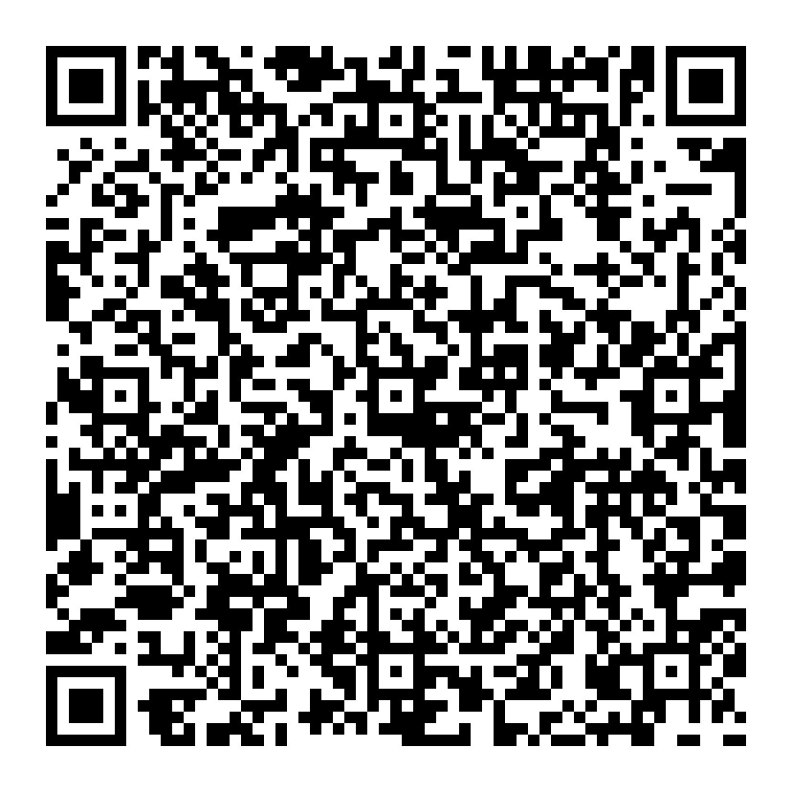
Demo
[Insert QR Code]
Scan the
QR Code!!
Notes:
If you’d like to try Mira, scan the QR code and open a report. Pick a finding and follow its citation back to the source.

Slide 16
05
Considerations and Controls
16

Slide 17
Cost vs Accuracy Trade-off
Evidence preparation runs once a month. Reports then read saved evidence: US$0 in model charges.
MONTHLY PREPARATION · MEASURED HONG KONG RUN
Budget caps trade coverage for cost
US$3.41 per run
19 minutes · 30 documents · US$10 cap
Each run has hard limits on tokens, cost, time and documents, so it cannot overspend. The measured run stopped analysing at 24 of 382 passages; the rest wait for later runs.
PER YEAR
About US$41
12 monthly runs at the measured cost
FULL FIRST BUILD · HK + SG · ESTIMATE
US$9–29
Every in-scope passage analysed · about 1–3.5 hours
Other costs: Exa search at US$0.007 per query (six per run). News publisher licences: quote pending.
20
Notes:
Per run: the 11 Nov scheduled Hong Kong preparation run (8dcdcc8b) took 19 minutes 7 seconds, saved 30 document versions and 382 passages, and accounted for US$3.41 of its US$10 cap: US$2.98 in estimated known charges plus US$0.43 reserved for uncertain usage. These are provider-price estimates, not an invoice. It produced 14 supported facts.
Per year: 12 x US$3.41 = about US$41. That run analysed only 24 of 382 passages before its per-run analysis limit (21 analysed, 3 failed, 358 deferred), so a month that analyses everything will cost more.
Full first build: our estimate for official Hong Kong and Singapore banking AML/CFT over 12 months is 97 to 198 analysis batches, US$9 to 29 in model charges and about 1 to 3.5 hours of model processing at four concurrent calls. It is an estimate, not a measurement.
For reference, the SFC update to the Hong Kong draft (40 passages) cost US$5.80 and took about 31 minutes.
Reports: once evidence is prepared, a report uses no model calls, so its model cost is zero. Exa costs US$0.007 per search; a run uses up to six. News publisher licence fees are quote pending and separate from API costs.

Slide 18

Control by design
Mira prepares evidence that people can check.
Grounding, verification and human review sit beneath every report claim.
A report remains unsigned until the reviewer records a decision.
Sign-Off
ACCEPT
Auditor
AMEND
REJECT

Slide 19
Grounded claims are reviewable
SOURCE RECORD
01
Page, issuer and version
A fact is only usable when its origin and the exact supporting passage travel with it.
EVIDENCE RECORD
02
Verbatim passage retained
Mira retains the context that makes a finding reviewable.
REVIEW RECORD
03
Match and support test
18

Slide 20

Two checks before reporting
Verifier’s Reliability Checks
01
Quote match
The cited wording must appear in the saved evidence.
02
Support check
An independent verifier tests whether the evidence supports the full claim.
19

Slide 21

Safe source access
Mira works only with permitted or manually imported text.
01
APPROVED SOURCE
The domain is on the permitted source list.
02
REDIRECT VERIFIED
The final destination is checked before use.
03
RESTRICTED PAGE STOPPED
A blocked page is reported; access is never bypassed.
21

Slide 22
Traceability preserves the review trail
A reviewer can travel from a report sentence back to its original evidence.
SOURCE
SNAPSHOT
RESEARCH
PLAN
FINDING
REPORT
VERSION
Original page
Scope defined
Evidence checked
Decision recorded
Traceability turns a sentence into evidence, so that a reviewer can inspect.
22

Slide 23
06
Evaluation
23

Slide 24

Coverage (Recall)
89%
Benchmark of 18 publications that a Hong Kong AML auditor would expect to see for the past year
recall rate
16 of 18 cited, including all 14 from regulators
The 2 misses are Wolfsberg guidance that Mira may not store. Added as reviewed links, the hosted report cites 18/18.
16 cited by Mira
2 missed
24
Notes:
Benchmark: 18 Hong Kong AML/CFT publications from 4 Nov 2025 to 4 Nov 2026, compiled by our team. 14 are from Hong Kong regulators (HKMA, SFC, FSTB). 4 are international: two FATF statements and two Wolfsberg guidance notes.
Mira's prepared Hong Kong draft cites 16 of 18, including all 14 regulator publications. The two FATF statements are matched through the SFC circulars that relay them in Hong Kong; we corrected the benchmark on 12 Nov to use those Hong Kong references.
The 2 misses are Wolfsberg guidance. Mira only has permission to record their metadata, not to store or analyse the text. We added them to the hosted report as two human-reviewed paraphrases with official links, so the hosted report cites 18/18, but Mira itself found 16.
Progress: earlier live research runs cited 1 to 11 of 18. The prepared draft first cited 10; adding six SFC publications brought it to 16.
Caveat: a cited URL is a recall proxy. It shows Mira found and cited the publication, not that it summarised it fully.

Slide 25
Precision
21 claims from one Hong Kong report, each labelled by a team member who had not seen Mira's verdicts.
4 / 21
17 / 21
Partially Supported*
Fully Supported
Of the 21 claims, 0 were made up or contradicted
25
**The 4 partials overstated a source's hedges, scope, addressee or attribution
Notes:
Measured on the 7 Nov Hong Kong run (29a153bb), the only run with human precision labels so far. One team member labelled all 21 claims in its draft report without seeing Mira's verifier verdicts.
Example:
HKMA report shows “growing adoption” of a holistic approach
An increasing number of banks are “adopting or exploring” it Hedge dropped. “Exploring” became “adopting”.
0 of 21 were unsupported or contradicted.
17 of 21 were fully supported when each document's recorded publication date counts as date evidence. On the passage text alone, 7 of 21 were fully supported.
That is 81%, below our 95% target. The 4 partials overstated a source's hedges, scope, addressee or attribution, and all four passed Mira's semantic check. Tightening that check is the next accuracy fix.
Caveats: one run, one labeller, Haiku models on older code. The current 139-finding Hong Kong draft is machine-checked against exact passages but has not been human-labelled yet.

Slide 26
07
Limitations & Future Work
27

Slide 27
Current limits and deployment boundaries
Website Access affects Coverage
Limited List of Websites
Most misses are blocked or uncitable, some websites prevent automated access or are paywalled
This MVP can only find information from a select list of approved sources. Trade-off between control and coverage
Accuracy
Value
While Mira supports research, it does not replace a real auditor’s judgement.
Time savings and the benefit of multiple agents are not yet measured.
29

Slide 28
Future Work
Future Work 1
Future Work 2
Future Work 3
Wider ingestion, Broader Coverage
Run A Pilot
Prove Consistency
Compare Mira with manual research on the same brief, measuring time spent, items found and review effort
Running the ingestion over several runs to measure the range of coverage
Full Coverage for UAE, Australia, and Singapore Expansion of Topics
31
Notes:
We estimate about US$550 in model charges to prepare a full year of material for all three markets and the three topics, from November 2025 to now.

Slide 29
08
Summary
34

Slide 30
Auditor’s workflow: Manual vs Mira
Stage | Manual workflow | With Mira
Research | Check websites and collect documents | Set a dated brief; search approved sources against the plan
Synthesis | Reconcile changes and draft the report | Review a cited draft and visible gaps
Assurance | Reopen sources to check each statement | Compare passages with claims; accept, amend or reject
Refresh | Repeat the research and comparison | Rerun a saved brief and inspect changes
Scope | Any source that the auditor can open | Approved sources only; unreachable ones are flagged
35

Slide 31
10
Q&A
Demo link
36

Slide 32
Appendix
37

