Slide 1

Diamond
Price Analysis
By Kenneth Alaba
Notes:
Good afternoon everyone, I will be presenting my data science project which analyses the price of several natural diamonds with respect to its properties. The data is scraped from the available diamonds from online stores.

Slide 2
Objectives
01
Discourage buyers from purchasing overly expensive diamonds.
02
Help buyers determine the diamond that will give them the best value by analyzing the available data.
03
Create a deep learning model that can predict the price based on its image.
04
Make suggestions of cuts to diamond cutters to maximize their gain by creating a supervised machine learning model to predict the total price of a piece of a diamond.
Notes:
Data science is not only for businesses that can afford the services of a data scientist.
With this project to optimize their business but it can also be used by individuals in making data driven decisions,
This prediction can help set a base number to which buyers can compare the actual price of a diamond they are looking at and help them decide if the price is good or too high.

Slide 3
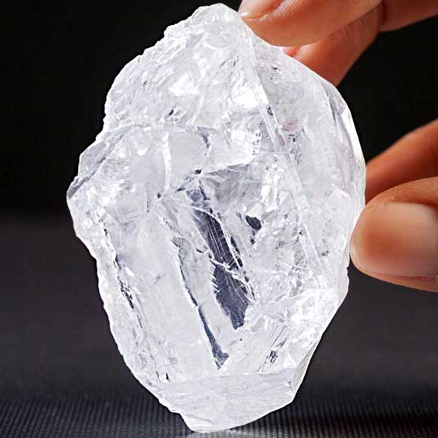
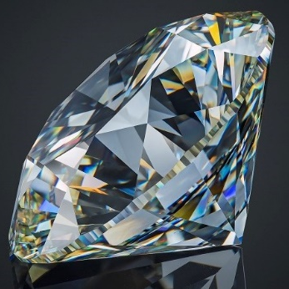
Diamonds
Diamonds are among the most popular and most expensive gemstones.
Raw Diamonds
Polished Diamonds
Price is determined by: (Intrinsic Properties)
Fluorescence
Color Grade
Clarity
Price is determined by:
Dimensions and Weight
Shape
Cut
Polish
Symmetry
Properties can be classified into different grades. Higher grades are believed to be rarer and results to a higher price.
Notes:
It often symbolizes love and wealth. It is usually worn as an accessory, given as a gift to a special someone, or bought as investment, similar to gold.
Intrinsic properties depends on the diamond itself
Additional properties, depend on the skills and decisions of the gem cutter.

Slide 4
Problem with Diamond Pricing
Too expensive with an average price of 2,500 USD or 3,500 USD per carat.
Majority is paid to ‘false scarcity’ of diamonds that only benefits cartels.
Diamond industry is considered by some to be one of the most successful cartels in history.
Through a series of campaigns, consumers are tricked to believe that it is valuable inducing demand, and by controlling the supply, customers are led to believe they are rare especially for the higher grade diamonds, bumping up the prices.
Notes:
Not to mention the environmental impact mining diamond causes and the unfair and unethical labor practices towards miners which is composed mostly of children.
Unknown to many,
As with any other product, high demand with low supply is always followed by a higher price.

Slide 5
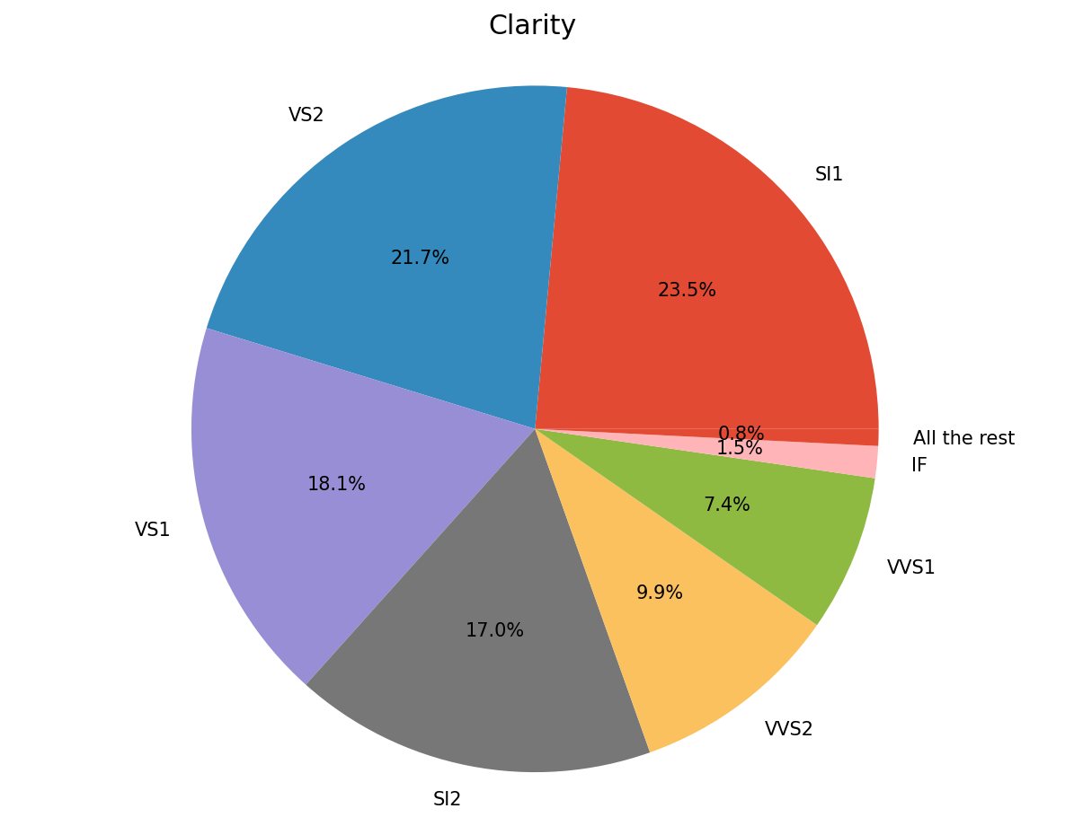
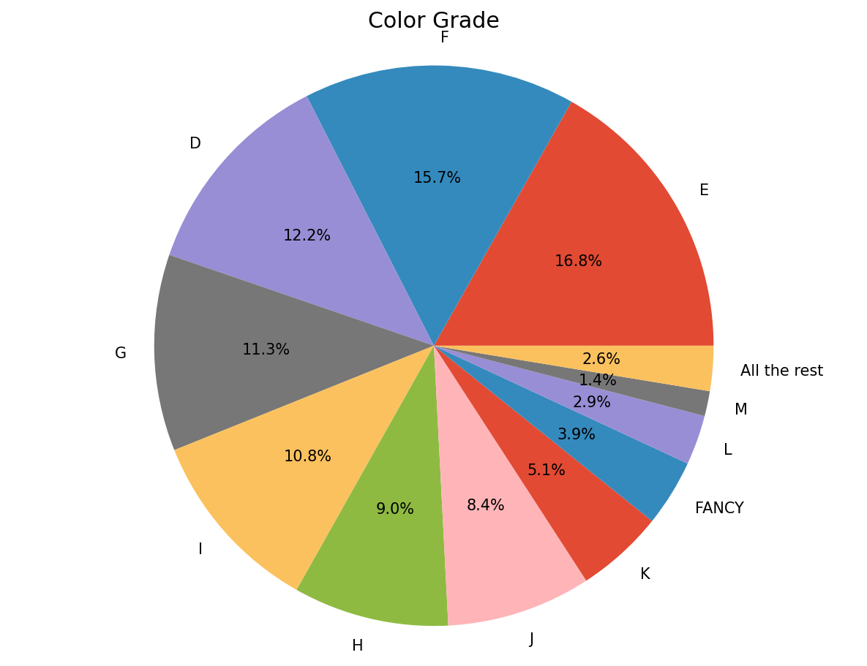
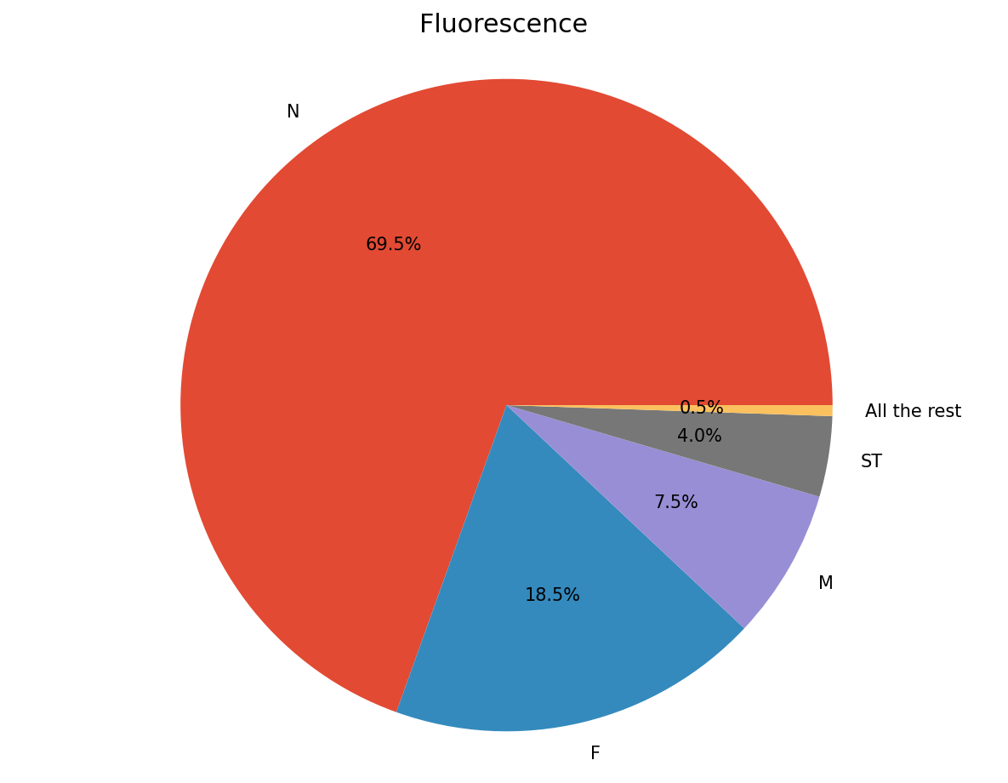
Shares of Different Intrinsic Properties of Diamonds
If diamonds are rare, higher grade diamonds should also be rare which also contributes to the higher price of high grade diamonds
These graphs show that higher grade diamonds are more common since majority of the available diamonds are high grade.
Notes:
This is also true for other properties of diamonds

Slide 6
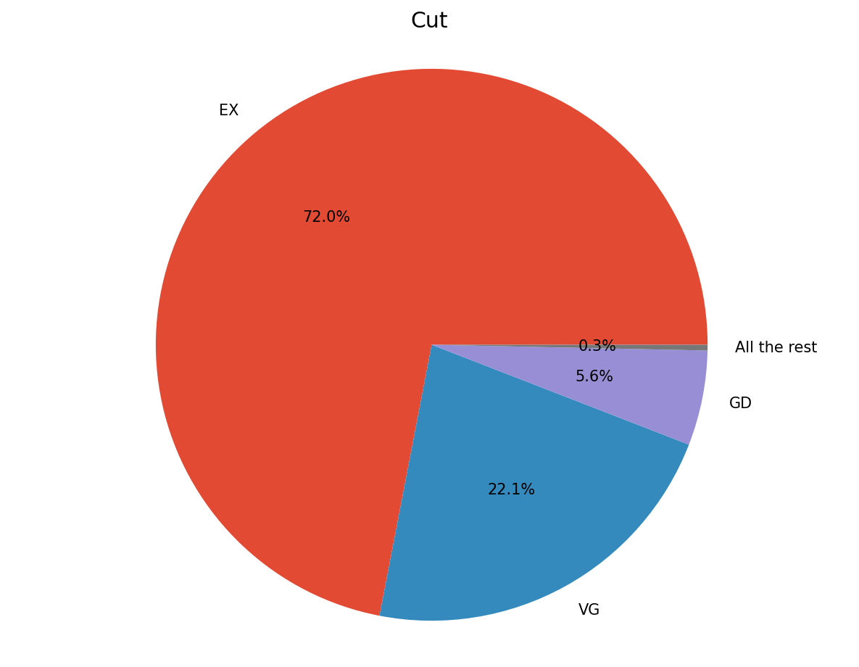
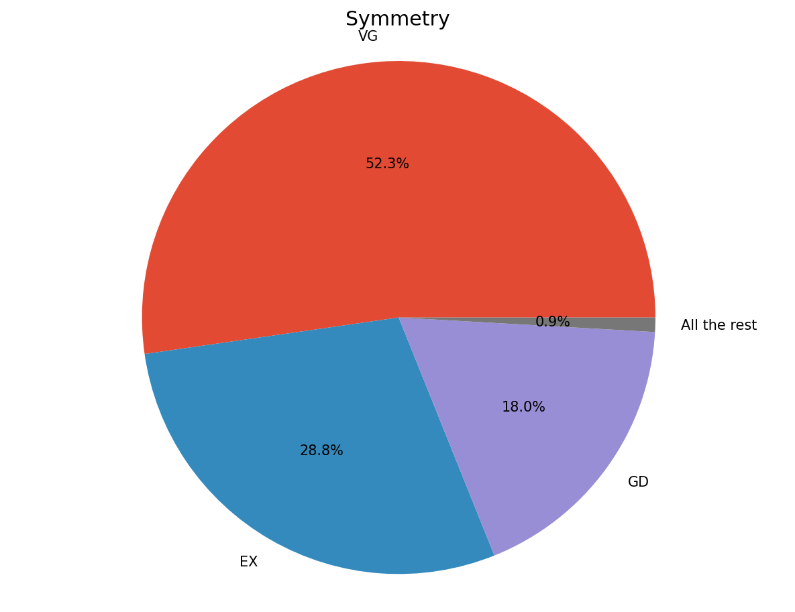
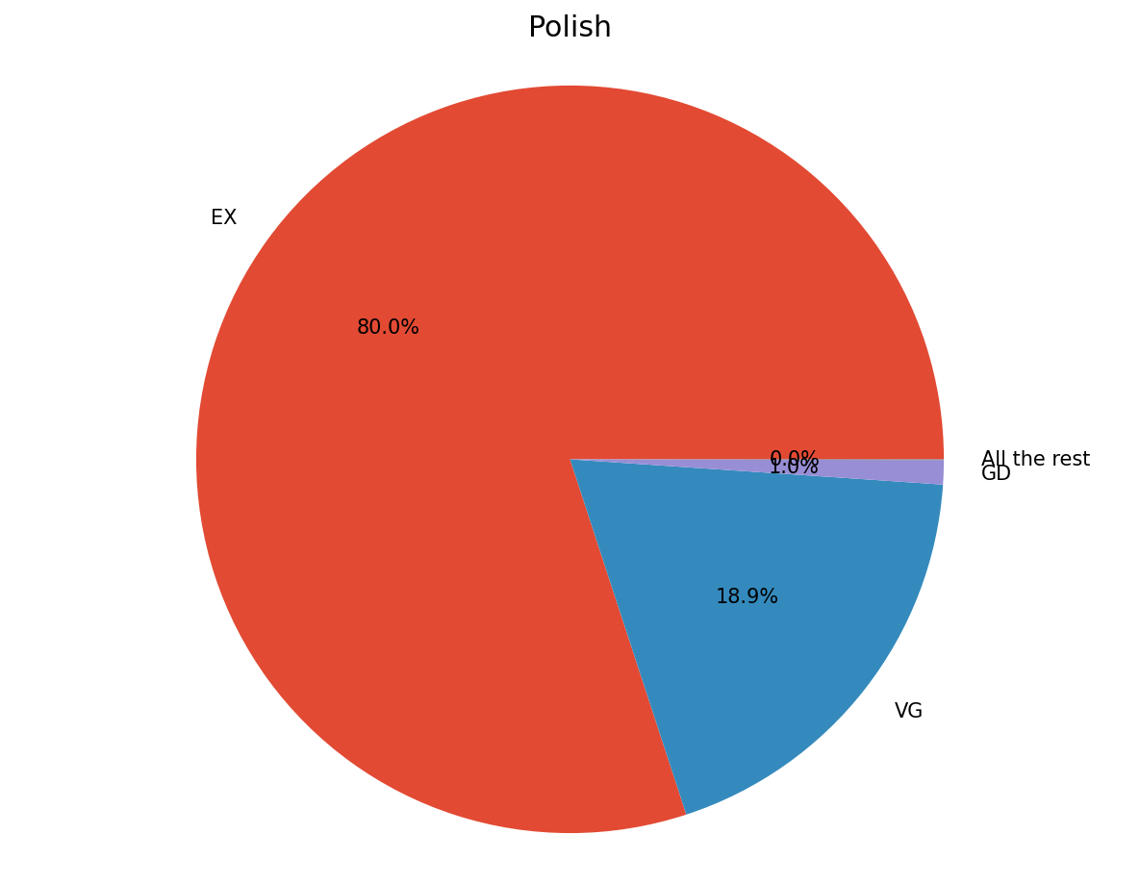
Shares of Different Intrinsic Properties of Diamonds
Higher grade for these properties are more common disproving the myth that diamonds are rare as a gem and consumers shouldn’t get tricked into buying expensive higher grade diamonds just because of their false rarity.
A possible counterargument is that retailers are just simply not selling low grade diamonds. However, even the lowest grade diamonds sell for around 1,500 USD per carat which is still a significant amount, making it less likely.
Notes:
assuming that the dataset is a good representation of all the available polished diamonds in the market, this shows that those diamonds are actually not that rare.

Slide 7
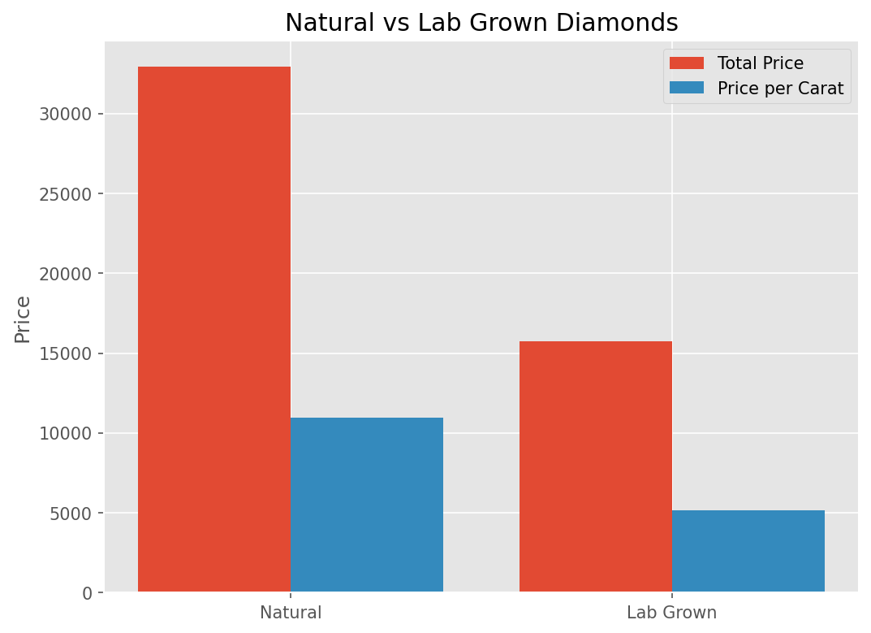
Lab Grown Diamonds
Alternative to Natural Diamonds
No difference between natural diamonds aside from their source
In a comparison between a high-grade natural diamond and a slightly higher-grade lab grown diamond, lab grown is almost 50% cheaper in terms of total price and price per carat
Only downside is that lab grown diamonds doesn’t resell well.
Notes:
Unless you look at its certificate or you’re a gemologists with lab equipments or
Because I don’t have a dataset about lab grown diamonds, we can compare a sample natural and lab grown diamond
Natural diamonds are considered to be both ethical and eco friendly
Because of the way they are grown, they typically have higher grades compared to natural diamonds
Unless buying for investment, hoping that the price increase, lab grown diamonds are a good alternative to natural diamonds

Slide 8
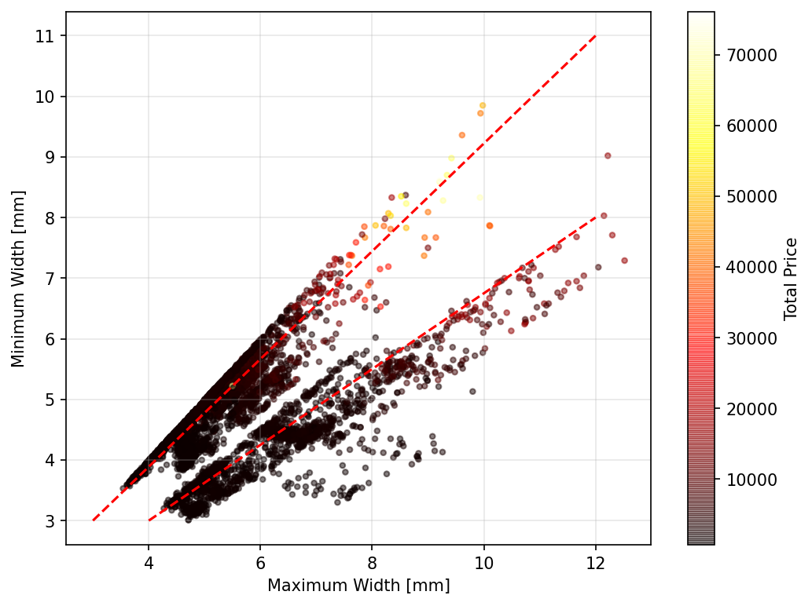
Dimensions and Total Price
Polished diamonds follow 2 general ratios for the dimensions
Total Price Increases as the dimensions
increases
Notes:
No valuable insights. It is already expected that the price increases as the diamond increases

Slide 9
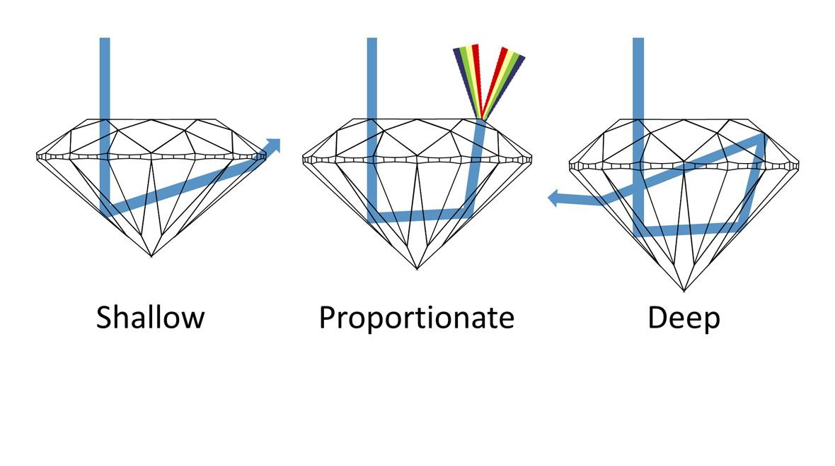
Dimensions and Total Price
Diamonds are cut to maximize refraction of light.
Notes:
and if you are a gem cutter, it is known that gems, including diamonds, are cut in such a way that maximizes light refraction.

Slide 10
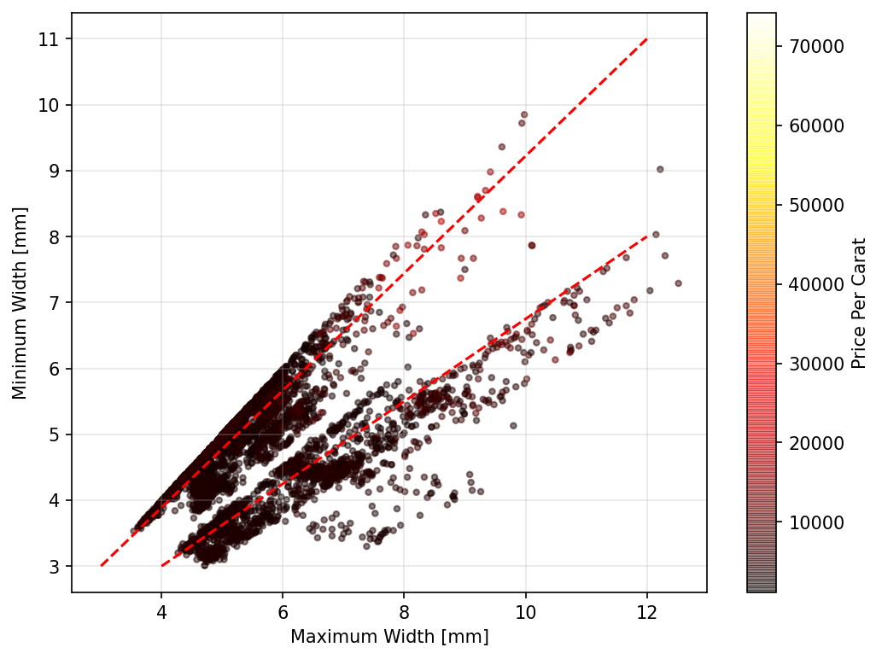
Dimensions and Price per Carat
Average Price per Carat does not change with dimensions indicated by the low variation in colors.
Notes:
Unless you look at its certificate or you’re a gemologists with lab equipments or
Because I don’t have a dataset about lab grown diamonds, we can compare a sample natural and lab grown diamond
On average, small and big diamonds should roughly cost the same per carat.

Slide 11
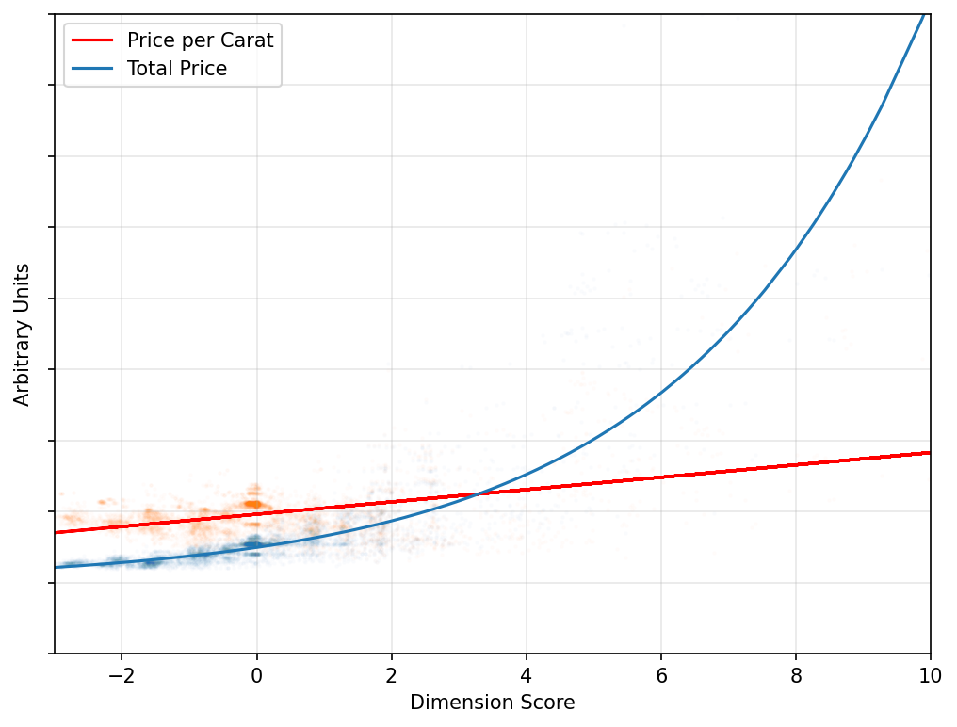
Dimension Score and Price
Assign a single score based on the dimensions and weight.
The price per carat has a low correlation with the dimension score compared to the total price.
This means that the price per carat does not change with the dimension.
Notes:
Unless you look at its certificate or you’re a gemologists with lab equipments or
Because I don’t have a dataset about lab grown diamonds, we can compare a sample natural and lab grown diamond

Slide 12
Price per Carat Estimate based on the Image
It is difficult to determine actual dimensions and weight from images, but since the price per carat of diamonds has low correlation with these, a model that predicts the price per carat based on the image using Deep Learning and Convolutional Neural Network.
Notes:
For example, I am a customer looking for a diamond jewelry and I am not sure if the price of the piece I am looking at is reasonable. Since I am an ordinary customer, chances are, I don’t know anything about the properties of diamonds. But with this predictive model, I can estimate the price per carat of the diamond and multiply it by the weight indicated. This will give me a number to compare to the indicated price which can help me decide whether the jewelry is overpriced and look for another one.

Slide 13
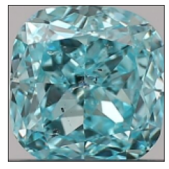
Price per Carat Estimate based on the Image
One of the most accurate predictions: Actual: 2,216.58 USD per carat Predicted: 2,222.54 USD per carat
Notes:
Unfortunately, I don’t have the metrics for my models since my models are not yet optimal due to the limitations on computing resources. However, on average, these predictions are off by a few hundred dollars

Slide 14
Selling Price Estimate
Using supervised Machine Learning, we can predict the price of a diamond given its known features.
Helpful for diamond cutters to predict how much will they be able to sell the diamonds they polished or make suggestions on how to cut diamonds which will maximize the gain.
Example, after cutting, the diamond has properties:
Actual price: 2,179.46 USD Predicted price: 2,145.42 USD

Slide 15
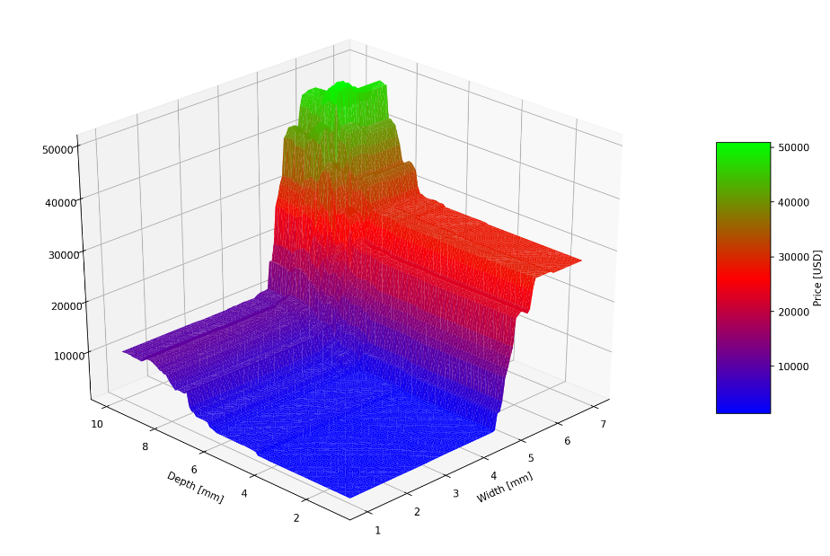
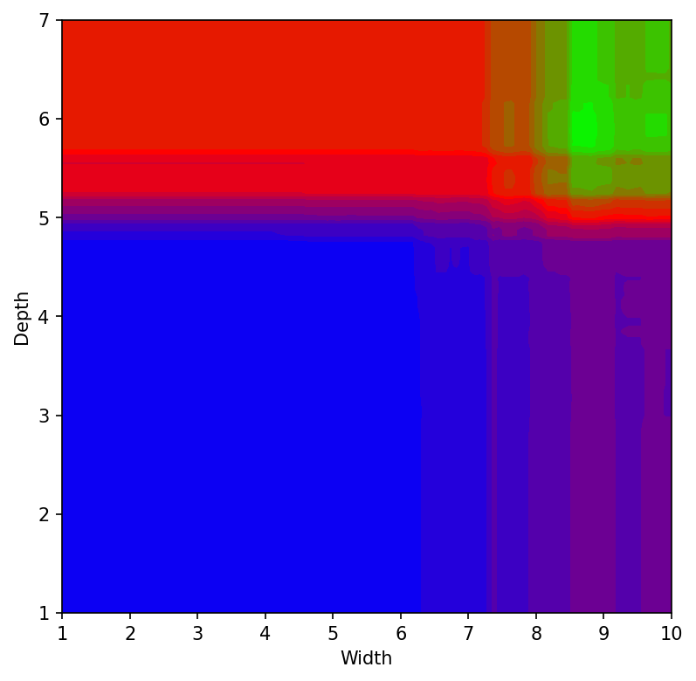
Selling Price Estimate
Price prediction using the same rough diamond, with known intrinsic properties, cut into different dimensions. Can be generated before cutting the diamond.
Local peaks correspond to dimensions that will give the optimal selling price.
Notes:
For example, I have an odd shaped raw diamond, with this model, it can help me identify how to ideally divide it into smaller pieces.
In polishing diamonds, it is grinded and mistakes are irreversible. Using this model can also help assess risks associated with certain dimensions
Since slopes surrounding these peaks correspond to the change in price of the diamond when a mistake is made.
For example I am a new gem cutter without much skills, I can aim for peaks surrounded by gentler slopes where mistakes won’t result to large loss.

