Slide 1



Visualizing Dynamic Network Structure by interactively slicing data on time-dimension
Yichen Wang
Supervised by
prof. Roger Leenders
prof. Claudia Zucca

Slide 2
Continuous-time
A network structure used to model Relations between Entities
which exists from the certain time of START until the time of END
The structure dynamically varies over time
Relations may crash and recover. Entities may come and go.
The structure is affected by time
Relations and Entities influenced from the past. ^{[1]}
Existence of Relations and Entities could be continuous in time
[1] Snijders, T. (2005). Models for longitudinal network data.Models and Methods in SocialNetwork Analysis.
2

Slide 3
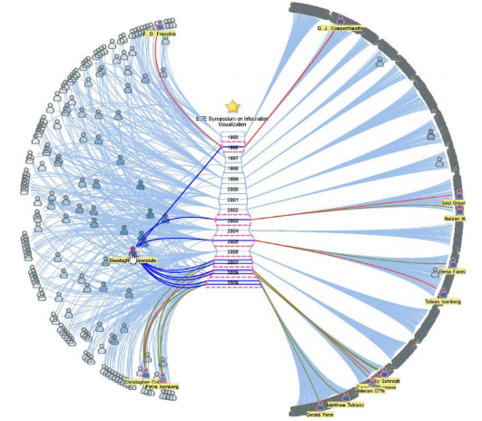
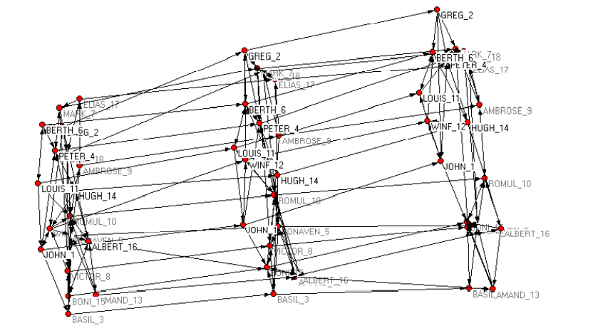
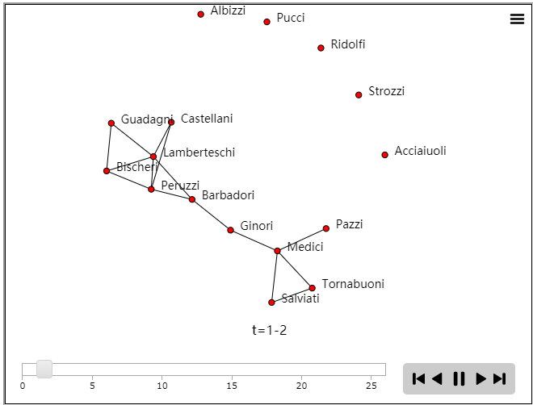
Visualization review
Reduce Structure
Reduce Time
Animation
Fig-1: Dynamic Network Visualization in 1.5D ^{[2]}
Fig-2: Pajek Simultaneous Drawing^{[3]}
Fig-3: R programming by ndtv library^{[4]}
Disadvantage:
Information loss ^{(Fig-1)}
Limited by size: data, timespan, canvas ^{(Fig-2)}
Fixed temporal resolution. Comparison only between two adjacent frames ^{(Fig-3)}
Difficult to read
[2] Shi, L., Wang, C. & Wen, Z. (2011). Dynamic network visualization in 1.5D doi: 10.1109/PACIFICVIS.2011.5742388
[3] Everton, S. (2004). A guide for the visually perplexed: Visually representing socialnetworks, by Stanford University
[4] Katherine Ognyanova (2019) Static and dynamic network visualization with R from http://kateto.net/network-visualization
3

Slide 4
Specialized Data Based
Background:
Time:
Location:
Entities:
Entity features:
Method:
Measurement:
Research Objective:
Primary school activity during H1N1 pandemic^{[5]}
1st ~ 2nd Oct 2009
Lyon, France
232 Students and 10 Teachers
class, gender
Using wearable proximity sensor, detect the face-to-face contacts with a 20-seconds temporal resolution
3100 point-in-time with 125,773 records of relations
Simulate and analyze the spread of infectious diseases in campus that involve the targeted closure of school classes or grades.
Characteristics of dataset
Time series
High temporal resolution
Bidirectional relationship
Sparse network
Structure changes frequently
Goals of deliverable
Continuous-time with flexible time-span
Reveal information (current / before / after)
Appropriate metrics of network
[5] Gemmetto, V., Barrat, A. & Cattuto, C. (2014). Mitigation of infectious disease at school:Targeted class closure vs school closure.
4

Slide 5
Network Merging
G _{i}
G _{i+1}
G _{i+2}
G = ( G _{i} ∪ G _{i+1} ∪ G _{i+2} )
G’ = ( G _{i} ∩ G _{i+1} ∩ G _{i+2} )
G” = ( G \ G⁻ )
…
…
…
Relations | Weight
… | …
R_{ab} | 0.67
R_{bc} | 1
R_{ad} | 0.33
… | …
Relations | Weight
… | …
… | …
R_{bc} | 1
… | …
… | …
Relations | Weight
… | …
R_{ab} | 0.67
… | …
R_{ad} | 0.33
… | …
R_{ab}
R_{ab}
R_{bc}
R_{bc}
R_{bc}
R_{bc}
R_{ad}
R_{ad}
…
…
…
Entities
… a b c d …
Entities
… a b c …
Entities
… a d …
T _{i-1}
T _{i}
T _{i+1}
T _{i+2}
Reveal information:
Total existences of entities and relationships within a time-span
Duration of existences
Existences throughout a time-span
Newly raised / dying out existences
5

Slide 6
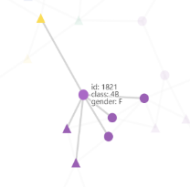
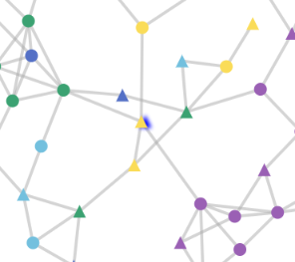
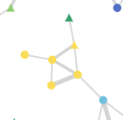
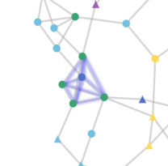
Network Measures
Local metrics
Degree of vertex:
likelihood to spread or be exposed to infection
Betweenness centrality:
critical role to mediate the spread
Weight of edge:
likelihood of infection per-contact
Maximum clique:
close-knit group with high potential of infection
Global metrics
Network density:
aggregation of entities
Disconnected subgraphs:
naturally blocked of transmission
Communities:
patterns that nodes are tightly joined
6

Slide 7

Application Architecture
Font-Back-separation
Modularity
Client
HTML
CSS
JS
dn.js -- data structure, algorithms, metrics,
vis.js – visualization components
(dependencies: echarts.js , nouislider.js , yc.js )
data_preview.py – raw data process
Data upload
Preview
Feature selection
Computation
Visualization
Server
HTTP / JSON
App Route / Validation
Data preprocessor
Temporary folder
7

Slide 8
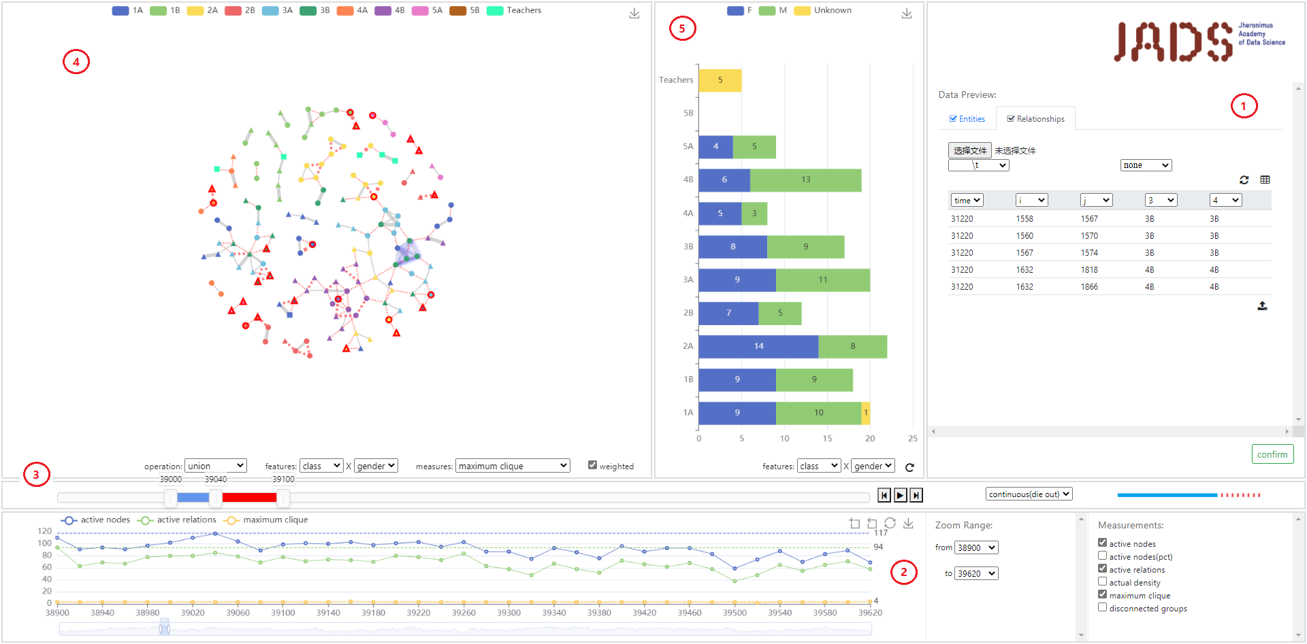
GUI
1. Data upload & preview 2. Time-based summary 3. Sliding window 4. Node-edge network 5. Statistics of network
8

Slide 9
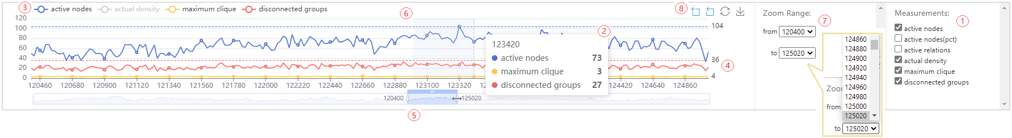
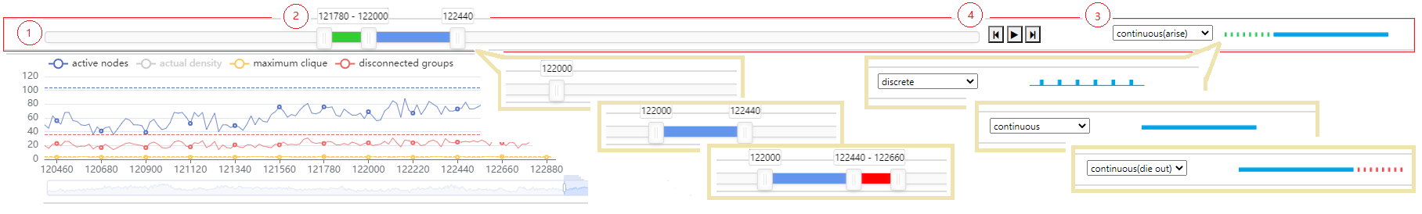
Visualization Components
^{Time-based summary}
1. Metrics 2. Tooltip box 3. Selectable legend 4. Global maximum value 5. Draggable data zoom 6. Data brush
7. Drop-down range select 8. Toolbox
^{Sliding window}
1. Range slider 2. Sliding handles 3. Merge mode select 4. Animation buttons
9

Slide 10
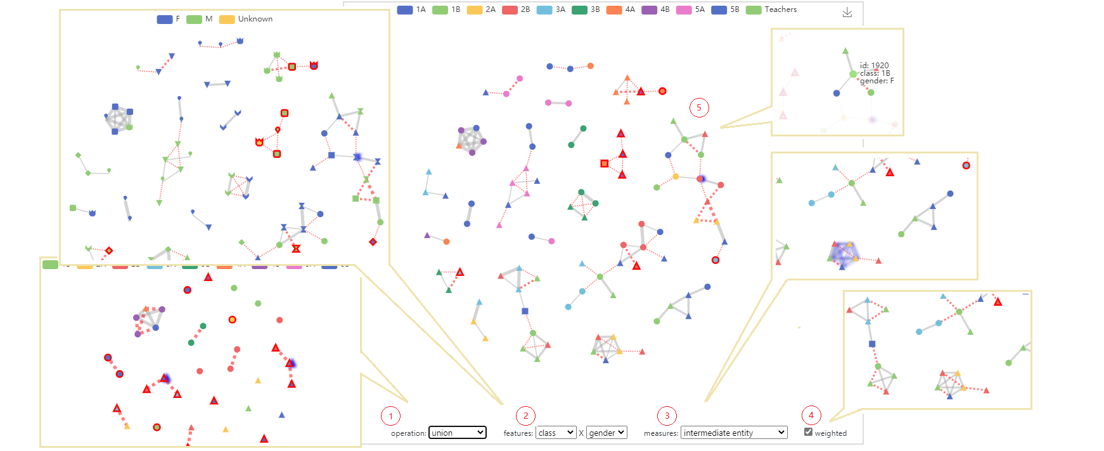
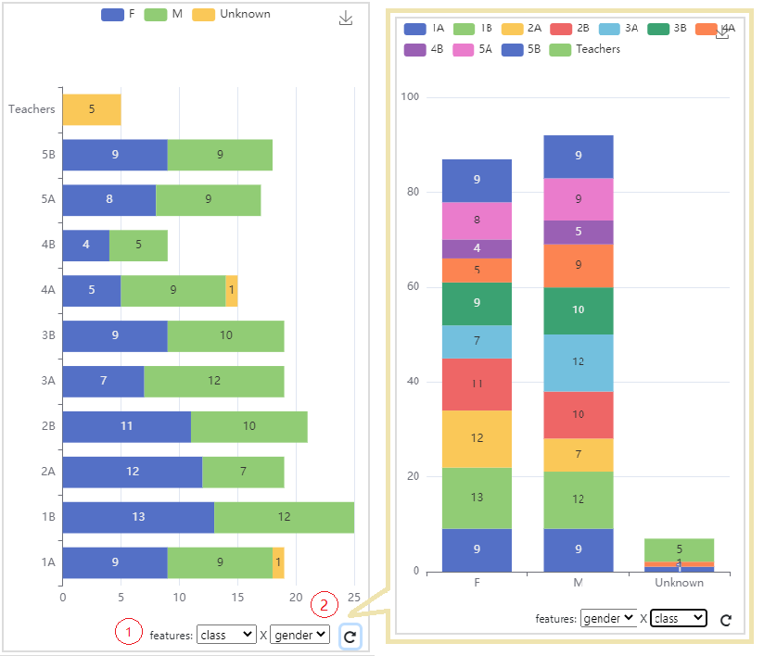
Visualization components
^{Node-edge network}
^{Statistics of network}
1. Union/intersection select 2. Feature select 3. Metrics select 4. Weighted edge
1. Feature select 2. Orient switch
10

Slide 11
ANY QUESTIONS ?
Github Repo: NeosWang/BEP: Flask/JavaScript/Eventdata (github.com)

