Slide 1



Visualizing Dynamic Network Structure by interactively slicing data on time-dimension
Yichen Wang
Supervised by
prof. Roger Leenders
prof. Claudia Zucca

Slide 2
Network
A structure used to model Relations between Entities. ^{[1]}
Relation: The state of being connected: Monodirectional or Bidirectional
Entity: Distinct existence
Continuous-time based observation
The structure dynamically varies over time
Relations may crash and recover. Entities may come and go.
The structure is affected by time
Relations and Entities influenced from the past with Markov process. ^{[2]}
Existence of Relations and Entities could be continuous in time
[1] Wikipedia contributors. (2021, March 30). Graph theory. In Wikipedia, The Free Encyclopedia. Retrieved 11:03, April 21, 2021, from https://en.wikipedia.org/w/index.php?title=Graph_theory&oldid=1015066354
[2] Snijders, T. (2005). Models for longitudinal network data.Models and Methods in SocialNetwork Analysis.
2

Slide 3
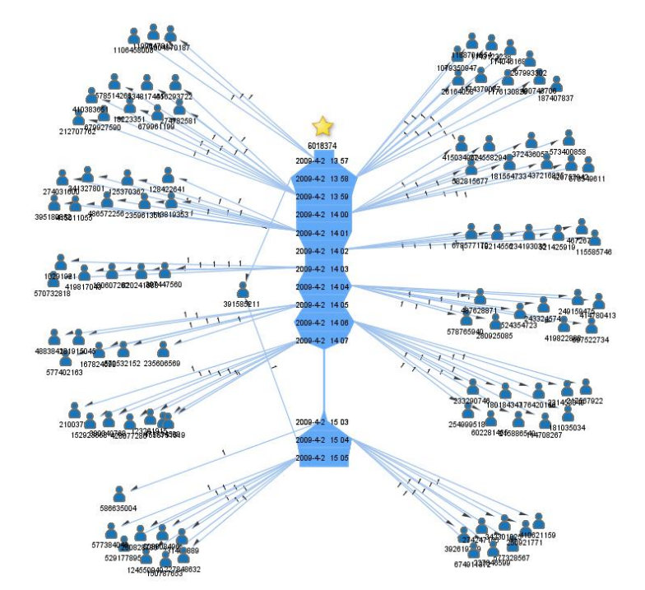
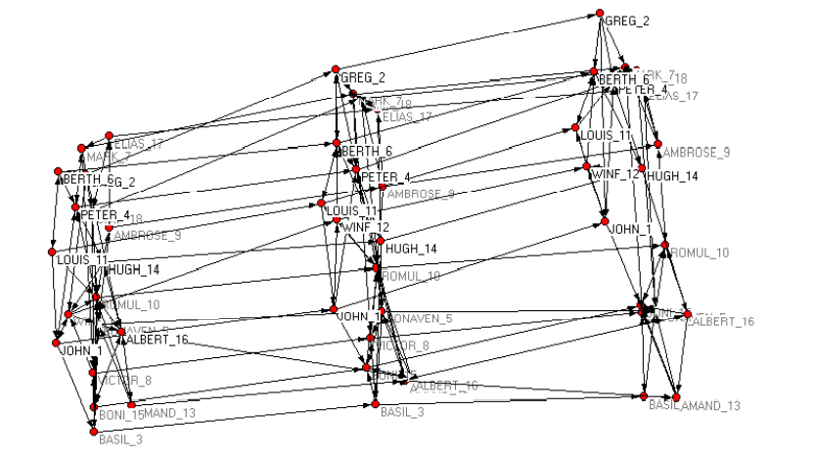
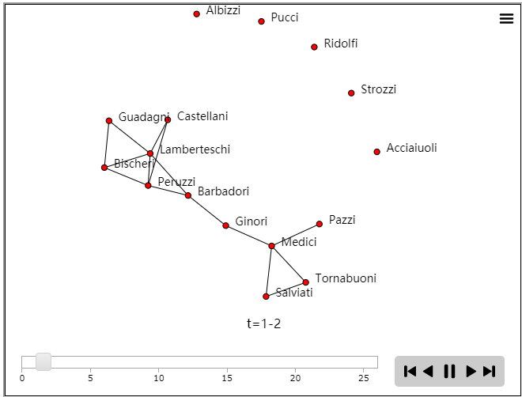
Visualization review
Discretizing the continuous-time, then plotting networks by node-link-graph separately on discrete-time
Fig-1: Dynamic Network Visualization in 1.5D ^{[3]}
Fig-2: Pajek Simultaneous Drawing^{[4]}
Fig-3: R programming by ndtv library^{[5]}
Not very sophisticated and informative
The changes over time are merely displayed ^{(Fig-1)}
High demand of reading skills. Interface elements grow exponentially over time. ^{(Fig-2)}
Animation has worse readability than static image. Comparison only between two adjacent frames ^{(Fig-3)}
Neither general nor specialized
[3] Shi, L., Wang, C. & Wen, Z. (2011). Dynamic network visualization in 1.5D doi: 10.1109/PACIFICVIS.2011.5742388
[4] Everton, S. (2004). A guide for the visually perplexed: Visually representing socialnetworks, by Stanford University
[5] Katherine Ognyanova (2019) Static and dynamic network visualization with R from http://kateto.net/network-visualization
3

Slide 4
Specialized Data Based
Background:
Time:
Location:
Entities:
Entity features:
Method:
Measurement:
Research Objective:
Primary school activity during H1N1 pandemic^{[6]}
1st ~ 2nd Oct 2009
Lyon, France
232 Students and 10 Teachers
class, gender
Using wearable proximity sensor, detect the face-to-face contacts with a 20-seconds temporal resolution
125,773 records of relations
Simulate and analyze the spread of infectious diseases in campus that involve the targeted closure of school classes or grades.
Studies of Epidemiology and Virology:
Population density
Close contact
Cluster infections
Route of transmission
Summary statistics over time
Practical significance:
Covid-19 pandemic
Campus / restaurant closure
[6] Gemmetto, V., Barrat, A. & Cattuto, C. (2014). Mitigation of infectious disease at school:Targeted class closure vs school closure.
4

Slide 5
DynamicNetwork
Data Structure
+ relationships: { time : Graph }
Time Discretization:
Time | Relation
T₀ | R_{0,0}
T₀ | R_{0,1}
…
T₀ | R_{0,m0}
T₁ | R_{1,0}
…
T_{n} | R_{n,mn}
Time | Relation
T₀ | R_{0,0}
 | …
 | R_{0,m0}
…
T_{n} | R_{n,0}
 | …
 | R_{n,mn}
Time | Graph
T₀ | G₀
T₁ | G₁
…
T_{n} | G_{n}
1
1
*
*
Graph
Node
+ edges: { Node.id : [Node.id] }
+ directed: bool
+ id: int
+ other features …
Vast number of discrete time point (3100)
Relations sparse per undirected graph
Adjacency List ✔
5

Slide 6
DynamicNetwork
Measurements
+ relationships: { time : Graph }
Summary Statistics:
Number of active entities
Number of contacts
Density of network
Cluster infections (Bron-Kerbosch algorithm)
Critical entity and relation on spreading (Dijkstra, Girvan–Newman algorithm)
+ unionGraph(time, time): Graph
+ intersectionGraph(time, time): Graph
+ differenceGraph(Graph, Graph): Graph
1
1
*
*
Graph
Node
+ edges: { Node.id : [Node.id] }
+ directed: bool
+ id: int
+ other features …
Merging Graph:
Total relations from T_{i} to T_{i+n :} G’ = G_{i} ∪ G_{i+1} ∪…∪ G_{i+n}
Throughout relations from T_{i} to T_{i+n} : G’ = G_{i} ∩ G_{i+1} ∩…∩ G_{i+n}
For the network G which over
a certain period of time, what are
the new relations (not in G⁻) or
what are the relations will die out (not in G⁺), G’ = G - G⁻ or G’ = G - G⁺
+ countNodes(): int
+ countEdges(): int
+ density(): float
+ maximalCliques(): [[int]]
+ dijkstra():[[int]]
+ nodeBetweenness():[float]
+ edgeBetweenness():[float]
+ union(Graph): Graph
+ intersection(Graph): Graph
+ difference(Graph):Graph
6

Slide 7
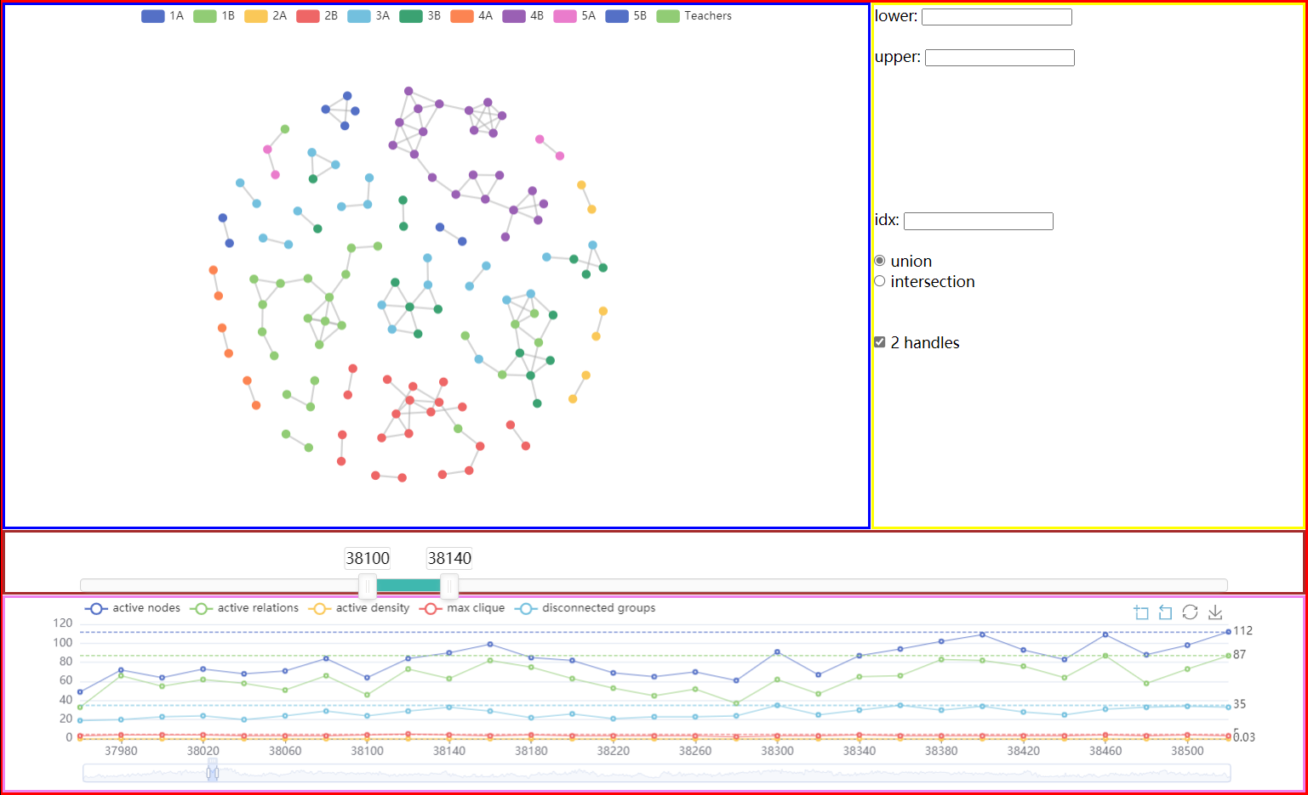
Draft Deliverable
Web-based application
Browser
Server (Flask)
Future work
Data parsing & preprocessing
7

Slide 8
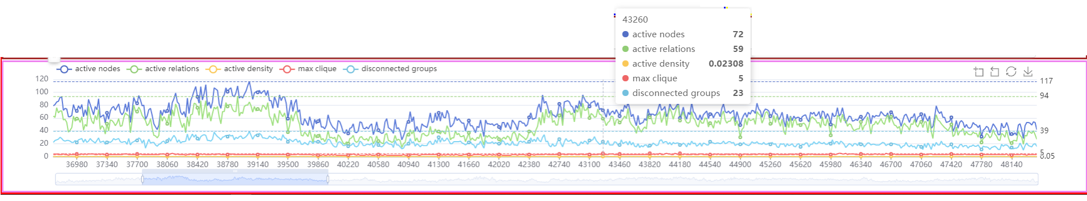
Visualization Components
Summary Statistics:
Optional measurements
Brush
Local max
Data zoom
Slider:
Range changed by Data zoom
Multiple handlers for Union / Intersection / Difference operation,
Dragable as range window
8

Slide 9
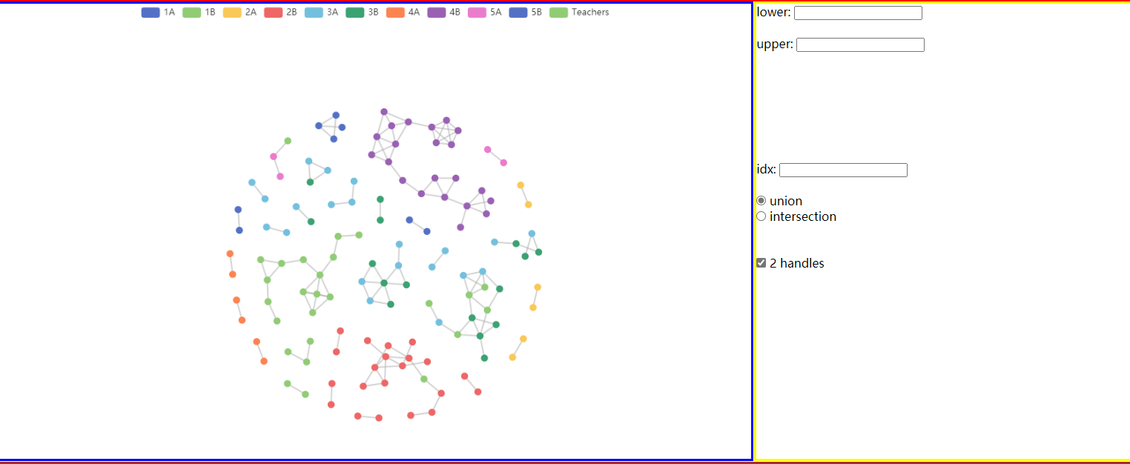
Visualization Components
Network plot
Input panel
Category selection
Options and manually input
Future Work
Display more entities features (e.g., node shape for gender)
Edge coloring base on needs (e.g., maximum clique)
Labeling for high centrality nodes or edges
Complete all functions for multiple handlers
Extension of Input panel
9

Slide 10
ANY QUESTIONS ?

