Slide 1
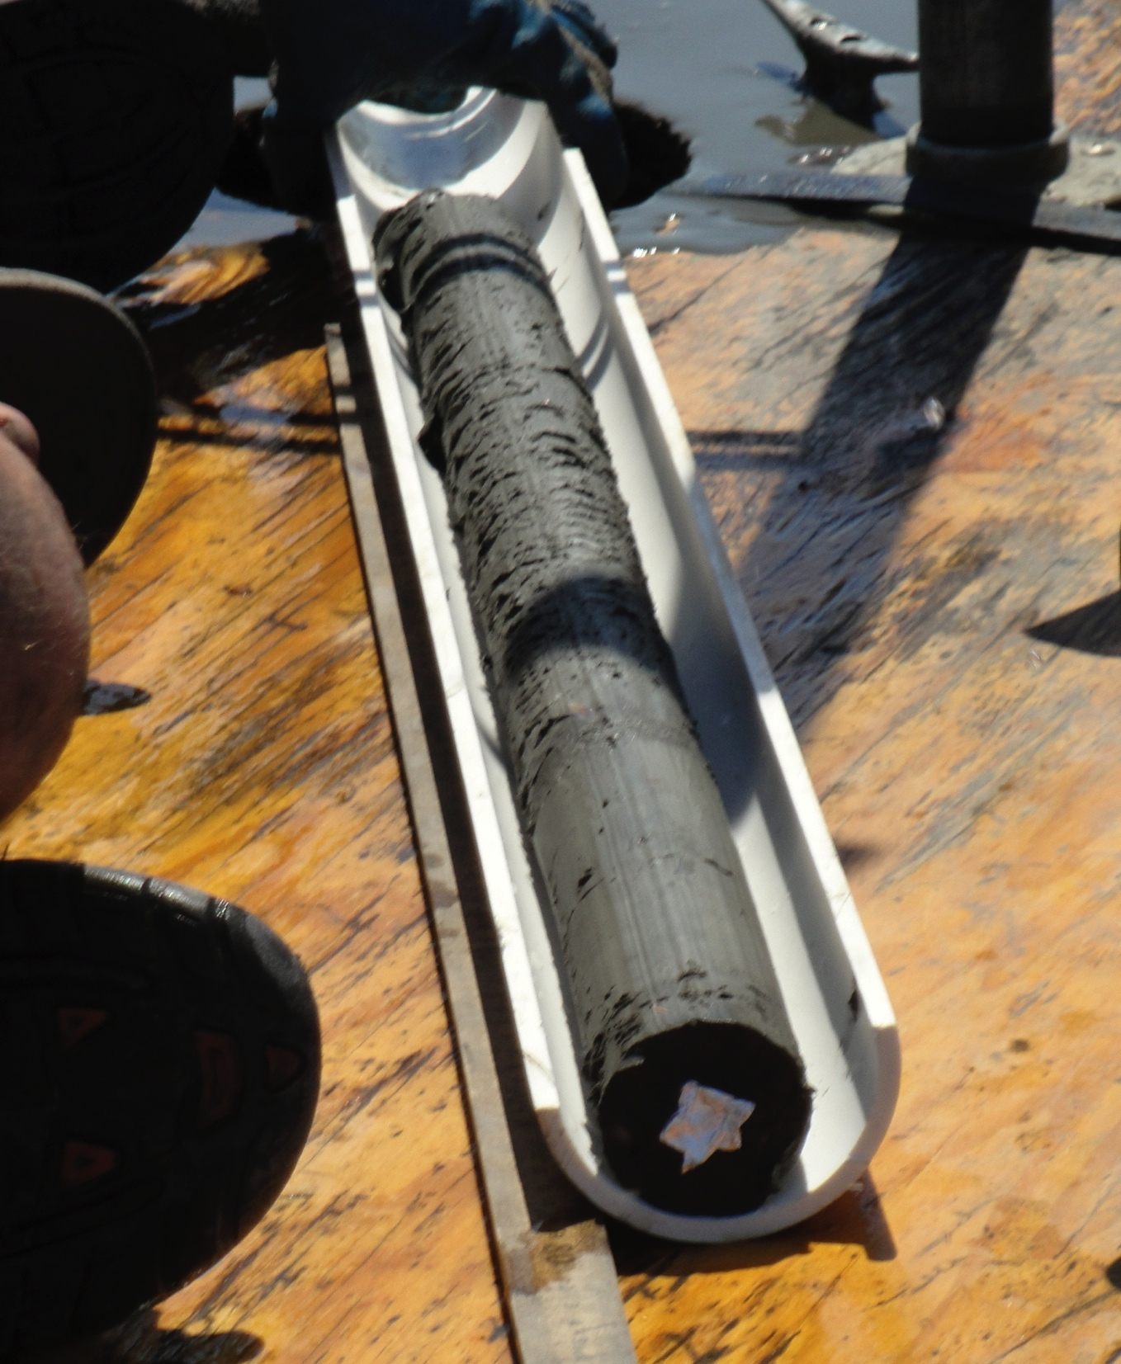

Fossil pollen from lake sediments
Notes:
Study system.
Core from Horseshoe Lake, IL.

