Slide 1

COMP5400 Coursework 2
-
MATLAB Code Implementation of Reinforcement Learning in 2D Maze Exploration Q-LEARNING Versus SARSA.
Yuheng Huo¹
COMP5400 April 2022

Slide 2
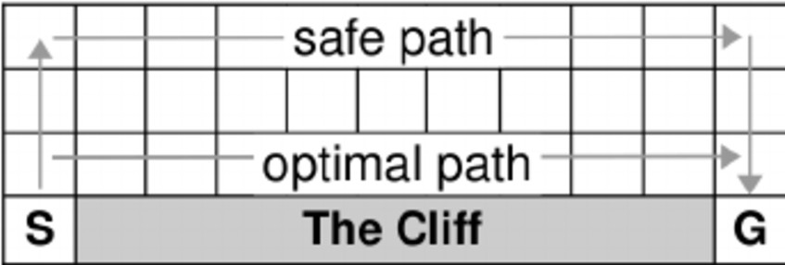
2D Maze Exploration Game
COMP5400 Coursework 2 Problem Introduction
▶ Agent explores the maze to arrive the Goal without getting through the Traps.
▶ This is ispired by the Cliff Walking by Sutton and Barto. (Tokic, Michel Palm, Gu¨nther. (2011). Lecture Notes in Computer Science. 335-346. 10.1007/978-3-642-24455-1₃3.)
Figure 1: Map of Maze

Slide 3
COMP5400 Coursework 2 Reinforcement Learning
Introduction
What is Reinforcement Learning?
▶ Reinforcement Learning (RL) is a kind of Machine Learning.
▶ Interaction with Environment.
▶ Strategies to accomplish a specific purpose or maximize benefits.

Slide 4
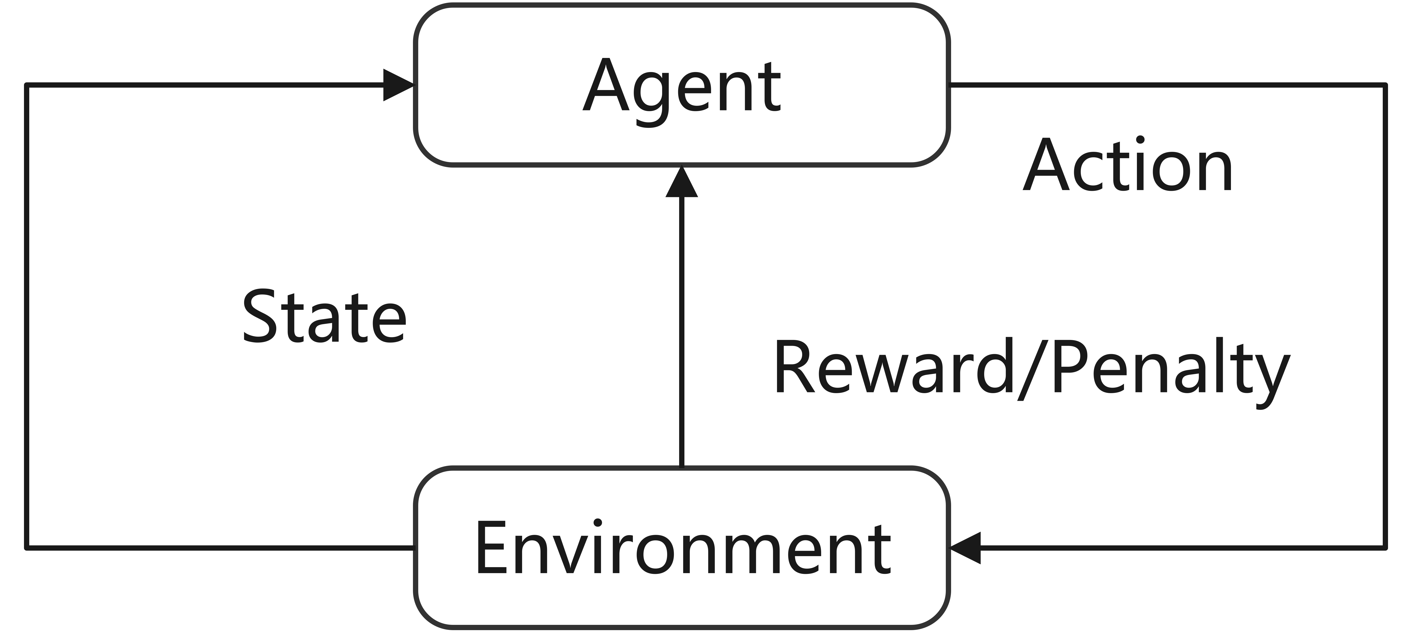
COMP5400 Coursework 2 Reinforcement Learning
Introduction
Is RL Bioinspired?
▶ RL was inspired by Behaviourist Theories in Psychology.
▶ Learning is the process of creating a direct link between
Stimulus and Response through conditioning.
Figure 2: Process of Reinforcement Learning

Slide 5

COMP5400 Coursework 2 Introduction
Application Example of Reinforcement Learning
Examples
Figure 3: Reinforcement Learning Applications in Games

Slide 6
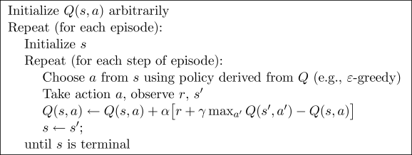
COMP5400 Coursework 2 Introduction
Q-Learning
Introduction
▶ Q-Table.
▶ Choose Action.
▶ Feedback from environment.
▶ Update Q-Table
Figure 4: Process of Q-Learning

Slide 7
COMP5400 Coursework 2 Introduction
Q-Learning
Q-Table
▶ Q-Table is the Code of Conduct.
▶ Q-Table is Updated in each episode.
 | State 1 | State 2
Action 1 | (S₁, A₁) | (S₂, A₁)
Action 2 | (S₁, A₂) | (S₂, A₂)
Action 3 | (S₁, A₃) | (S₂, A₃)
Action 4 | (S₁, A₄) | (S₂, A₄)
Table 1: Example of Q-Table.

Slide 8
COMP5400 Coursework 2 Introduction
Q-Learning
Choose Action
▶ Q-Learning is Value Base.
▶ Epsilon Greedy ε is introduced to make random decision.
 | State 1 | State 2
Action 1 | 1 | 4
Action 2 | 2 | 3
Action 3 | 3 | 2
Action 4 | 4 | 1
Table 2: Example of Q-Table.

Slide 9
COMP5400 Coursework 2 Introduction
Q-Learning
Q-Table Update
Q_{(S,A)} = Q_{(S,A)} + α ∗ Reward + γ ∗ max_{a}′ Q_{(S}′_{,A}′₎ − Q_{(S,A)}
▶ NewQ = OldQ + α ∗ (Actual − Estimation).
▶ A is the action chosen in state S .
▶ S′ is the state after action A.
▶ α is the learning rate, deciding how much of the error is to be learned this time.
▶ γ is the attenuation rate to future rewards.
▶ Reward is reward from environment after action A.
▶ max_{a}′ Q_{(S}′_{,A}′₎ is the maximum action value in state S′.

Slide 10
COMP5400 Coursework 2 Introduction
SARSA
Introduction
▶ SARSA or State-Action-Reward-State’-Action’ is also using
Q-Table to store action values.
▶ The Decision Making or choosing action process is same as Q-Learning.
Figure 5: Process of SARSA

Slide 11
COMP5400 Coursework 2 Introduction
SARSA
Q-Table Update
^{Q}(S,A) ^{= Q}(S,A) ^{+ α ∗ Reward + γ ∗ Q}(S′,A′) ^{− Q}(S,A)
▶ SARSA chooses the corresponding Action in next state, but Q-Learning does not choose it at this state.
▶ Q_{(S,A)} is updated based on the Q_{(S}′_{,A}′₎, but Q-Learning is based on max_{a}′ Q_{(S}′_{,A}′₎.

Slide 12
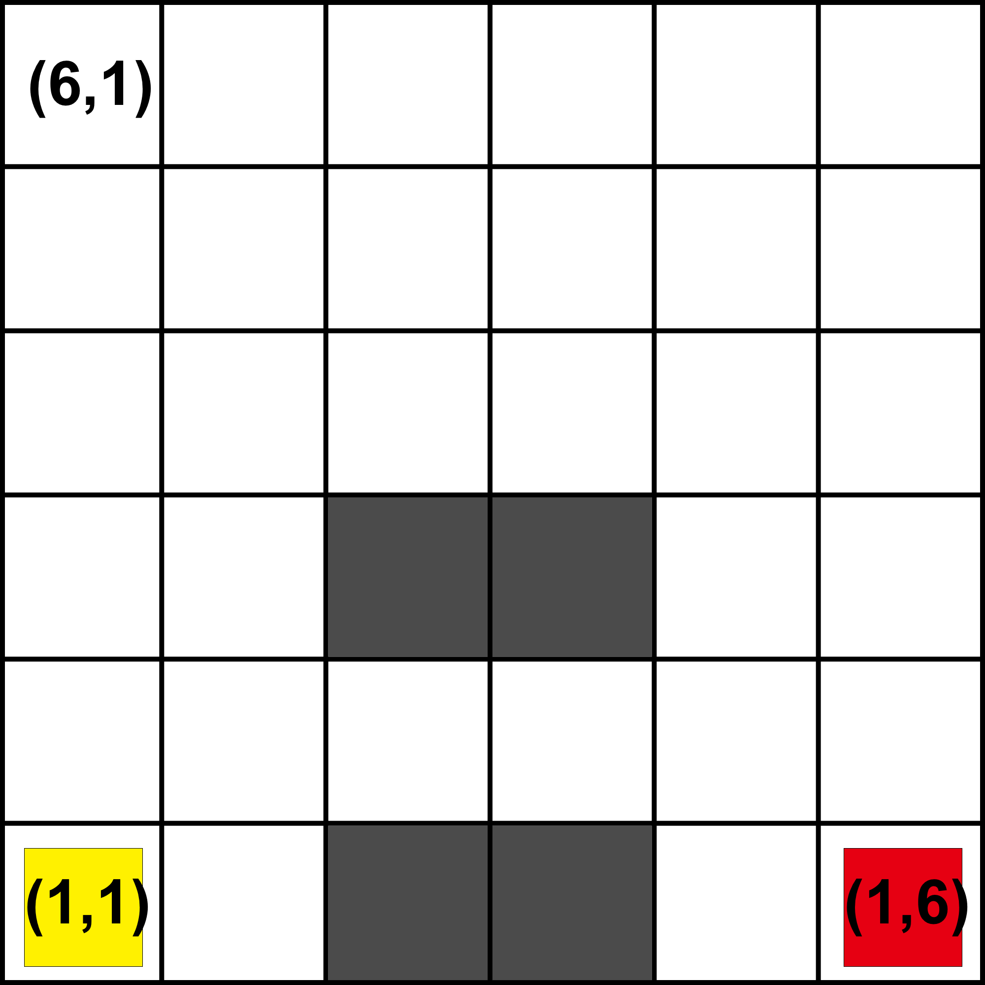
COMP5400 Coursework 2 Introduction
Simulation Environment
Simulation Enviroment
▶ Explorer can move Up, Right, Down and Left.
▶ When explorer reaches Traps (Grey Blocks), the simulation in this episode will end immediately, and the Reward value is −1.
▶
When explorer reaches Goal (Red Blocks), the simulation in this episode will end immediately, and the Reward value is 1.
Figure 6: Map of Maze

Slide 13
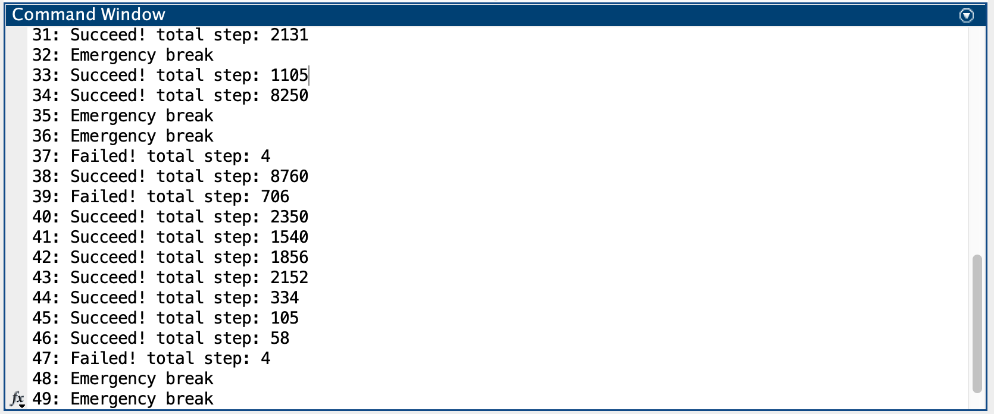
COMP5400 Coursework 2 Simulation Result Analysis
Training Process
Training Process
▶ Emergency Break means the number of steps in a single episode is greater than 10000.
▶ In Q-Learning case, it has run for more than 50 times, the emergency break never happened.
▶ In SARSA, emergency break usually happened during the learning process. Once the Q-Table is trained good enough, the emergency break rarely happened. .
Figure 7: Convergence Speed

Slide 14
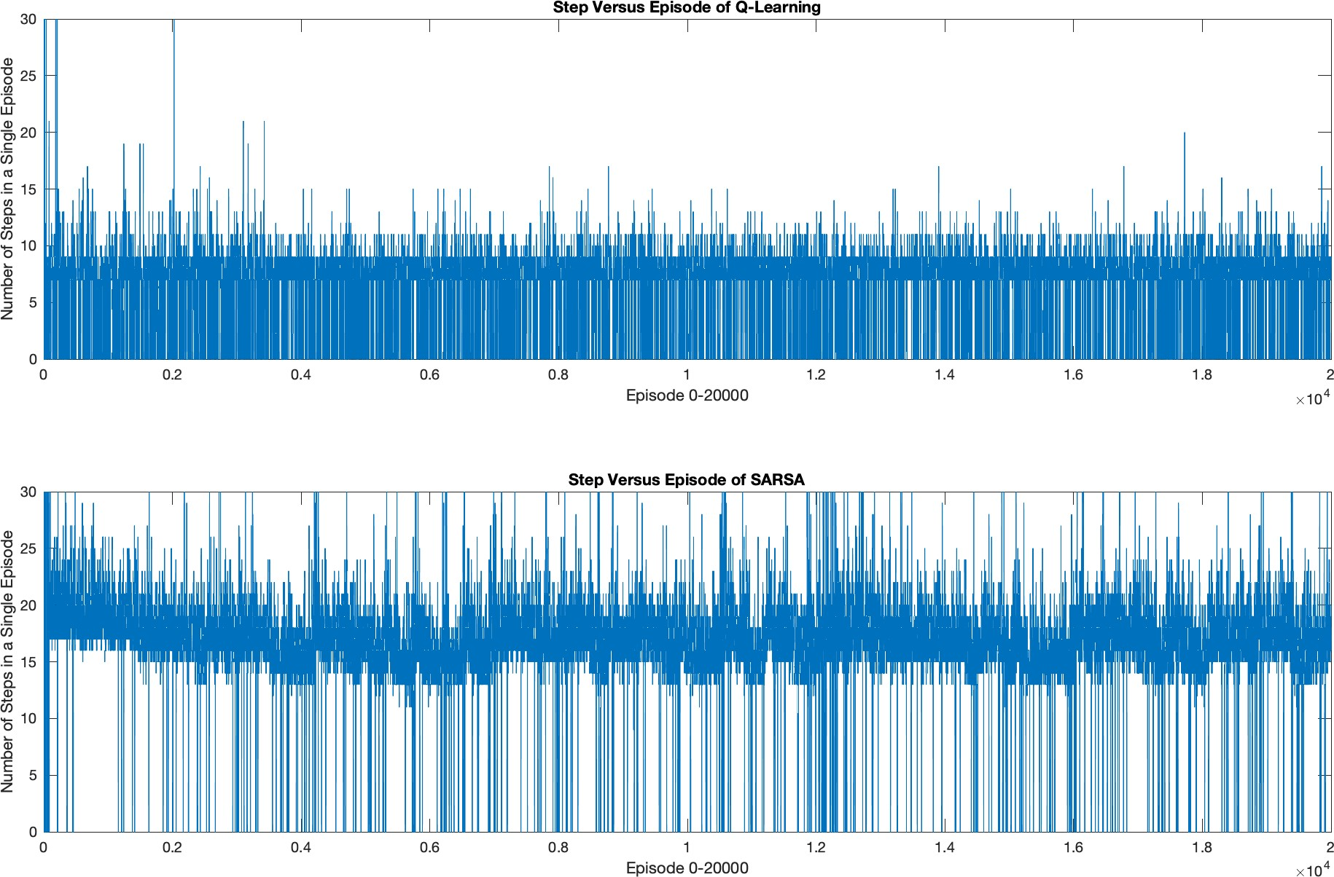
COMP5400 Coursework 2 Simulation Result Analysis
Convergence Speed
Convergence Speed
▶ The speed of convergence of Q-Learning is Faster than SARSA.
Figure 8: Emergency Break

Slide 15
COMP5400 Coursework 2 Simulation Result Analysis
Final Performance
Fail Rate and Number of Steps
▶ In a typical case, the Fail Rate of the Q-Learning after convergence is 23.84%, and for SARSA this number is 2.22%.
▶ After convergence, the Average Number Steps of Q-Learning is less than SARSA.

Slide 16
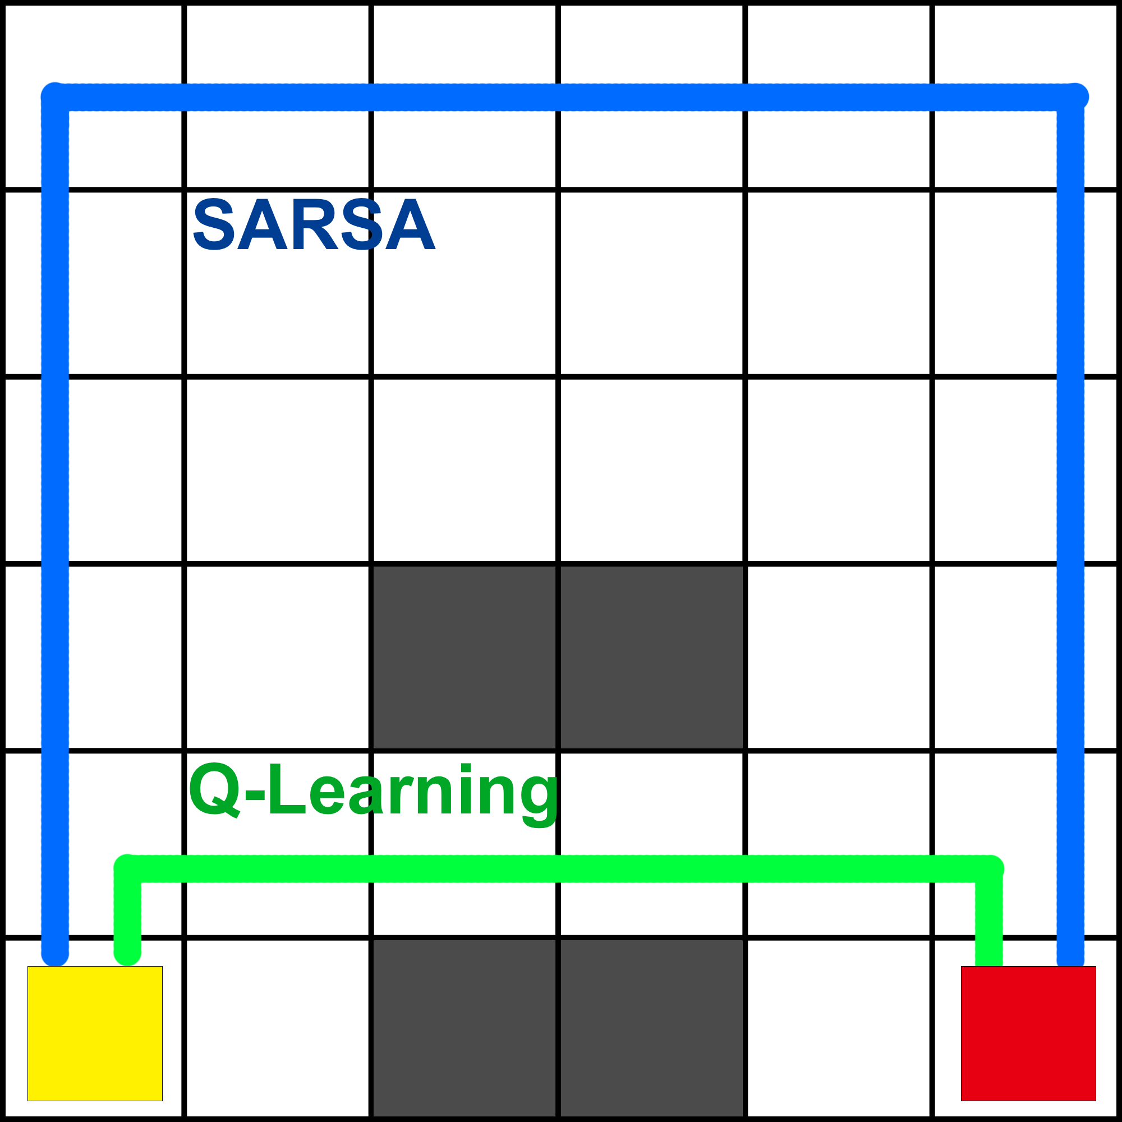
COMP5400 Coursework 2 Simulation Result Analysis
Final Performance
Routes
Figure 9: Routes Compare

Slide 17
Conclusion
COMP5400 Coursework 2 Conclusion
▶ SARSA prefer the Safer path, Q-Learning prefer the Optimal
path.
▶ SARSAR’s Convergence Speed is slower than Q-Learning.
▶ SARSAR’s Fail Rate is less than Q-Learning.

Slide 18
Conclusion and Discussion
COMP5400 Coursework 2 Conclusion
▶ Using table to store the value of states is fine in this case, but when meeting more complex problems or game the storage and memory is not enough. The Q-Value can be generated from Neural Network, and the Neural Network updated in each episode.

Slide 19
Reinforcement Learning and Genetic Algorithm
COMP5400 Coursework 2 Conclusion
▶ Fitness Function ≈ Reward Function?
▶ Agents in GA does not have a dynamic learning process during its own lifetime. Only problems where the strategy space is sufficiently small or can be easily structured are suitable for genetic algorithms.
▶ RL is more focused on the interaction with environment and sequence of strategies.
▶ From my own point of view, GA like the DNA we born with, and RL like the Knowledge and Moral Code we acquire in our lifetime.

