Slide 1















Graphic assets
Add info
Add info
Add info
Add info
When you need two rows
Add info
Add info
When you need two rows
Use this outline if you want to highlight something in a chart
Use this outline if you want to highlight something in a chart
recommends!
Add info
Add info
Add info
Add info
Add info
Add info
Add info
Add info
Add info
Add info
Add info
Add info

Slide 2
























Flags – to add in upper right corner if multi country study
Austria
Croatia
Czech Republic
Denmark
Estonia
Finland
France
Germany
Greece
Iceland
Italy
Latvia
Lithuania
Netherlands
Norway
Poland
Portugal
Spain
Sweden
Switzerland
Turkey
United Kingdom
India
United States

Slide 3
Background and purpose
Project specifications
Add a project description
Field period | Add date
Market | Add market
Method | Online panel sampling
Length of interview | XX min
Number of respondents | XXXX respondents in total
Target groups | Target group 1: XXX IP Target group 1: XXX IP
Sample | Men and women 18-74
Screening | Description of screener. Remove row if no screener

Slide 4
Importance performance+ 1 comment box
Comments
Importance performance matrix
Possible overkill
Less important drivers where brand performs above average
Keep
Important drivers where brand performs above average
Performance
Low priority
Less important drivers where brand performs below average
Improve
Important drivers where brand performs below average
Importance
Notes:
Vertical axis:
Share of respondents who associate the brand with a certain attribute or driver.
Attributes above the horizontal gridline means the brand is performing above average
Horizontal axis:
How strong a driver/attribute is correlates to a certain KPI (consideration, liking, etc.)
The further to the right, the more important the driver or attribute is to drive the KPI. Attributes located to the right of the vertical gridline means that the importance is above average

Slide 5
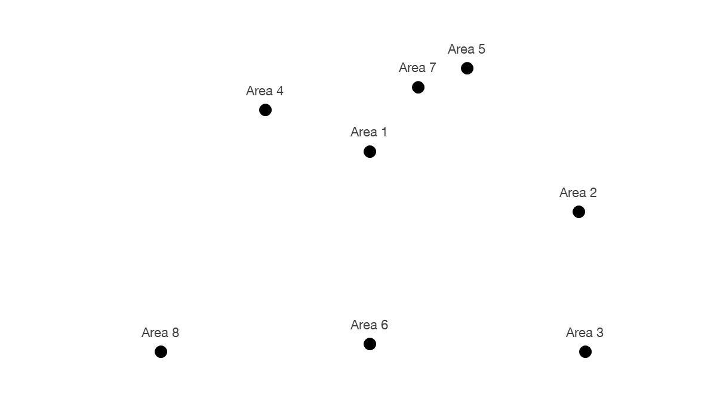
Cluster analysis + 1 comment box
Comments
Area description
Area description
Area description
Area description

Slide 6
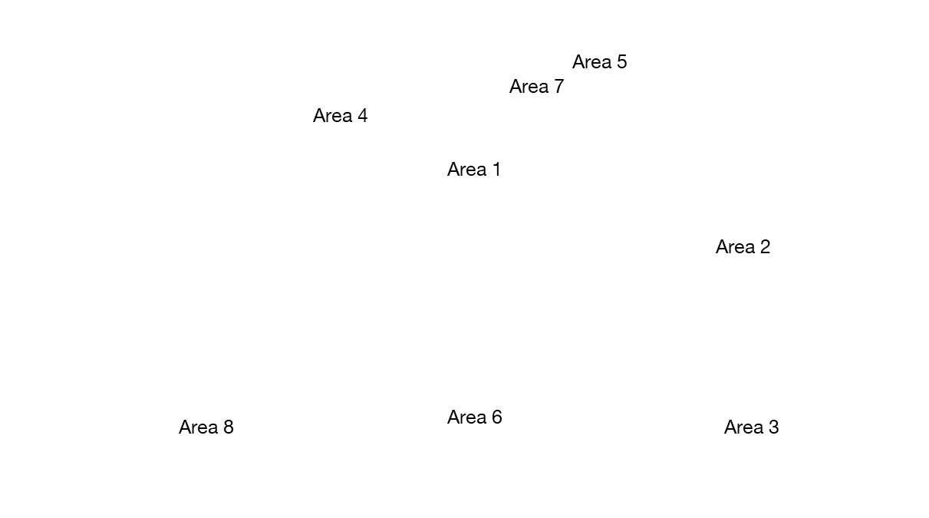
Cluster analysis + 1 comment box
Comments
Area description
Area description
Area description
Area description

Slide 7
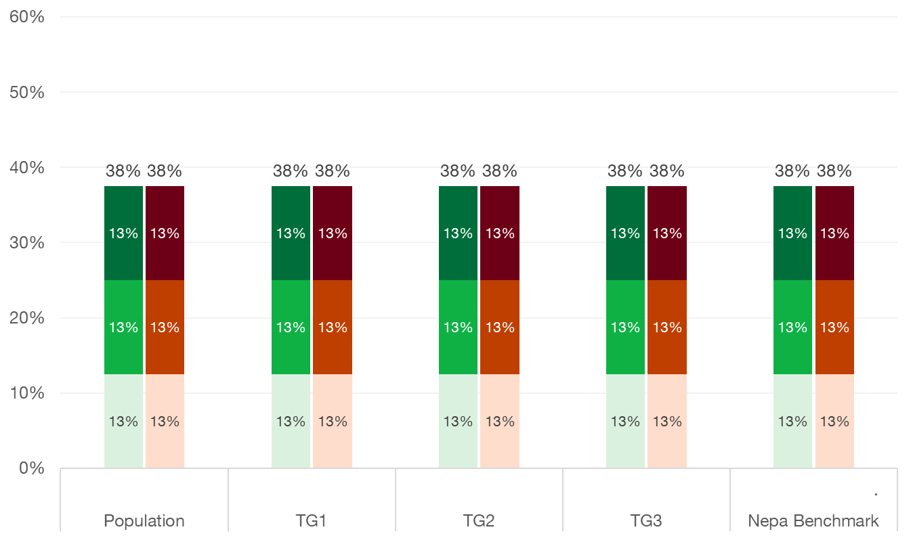
Overall impression
7 = Very positive
6
5
4 not shown
3
2
1 = Very negative

Slide 8
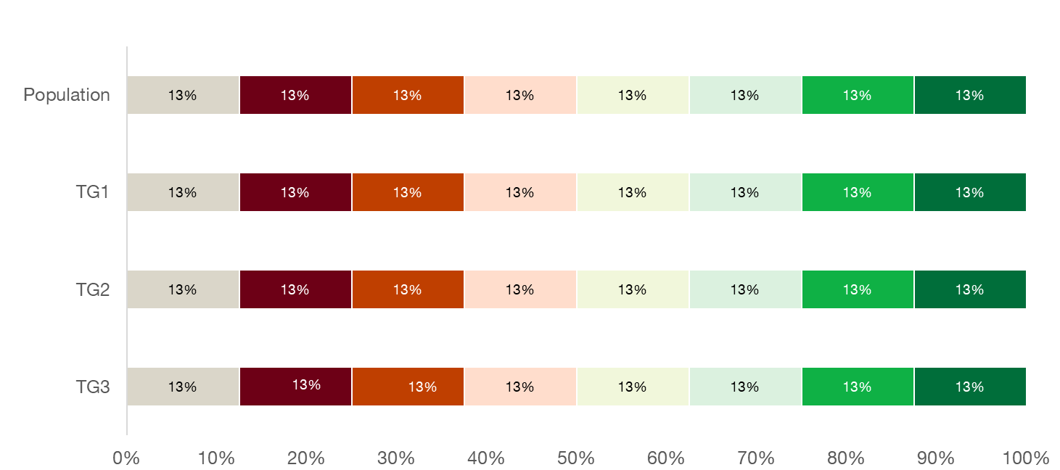
Positive/negative scale
38%
7 = XX
38%
6
5
4
38%
3
2
38%
1 = XX
Don’t know

Slide 9
Table for attributes (keep this formatting when coloring red/green H-L)
 | Brand 1 | Brand 2 | Brand 3 | Brand 4 | Brand 5 | Brand 6 | Brand 7 | Brand 8
Attribute 1 | 10% | 10% | 10% | 10% | 10% | 10% | 10% | 10%
Attribute 2 | 10% | 10% | 10% | 10% | 10% | 10% | 10% | 10%
Attribute 3 | 10% | 10% | 10% | 10% | 10% | 10% | 10% | 10%
Attribute 4 | 10% | 10% | 10% | 10% | 10% | 10% | 10% | 10%
Attribute 5 | 10% | 10% | 10% | 10% | 10% | 10% | 10% | 10%
Attribute 6 | 10% | 10% | 10% | 10% | 10% | 10% | 10% | 10%
Attribute 7 | 10% | 10% | 10% | 10% | 10% | 10% | 10% | 10%
Attribute 8 | 10% | 10% | 10% | 10% | 10% | 10% | 10% | 10%
Attribute 9 | 10% | 10% | 10% | 10% | 10% | 10% | 10% | 10%
Attribute 10 | 10% | 10% | 10% | 10% | 10% | 10% | 10% | 10%

Slide 10
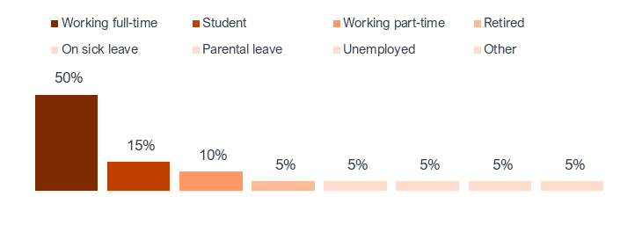
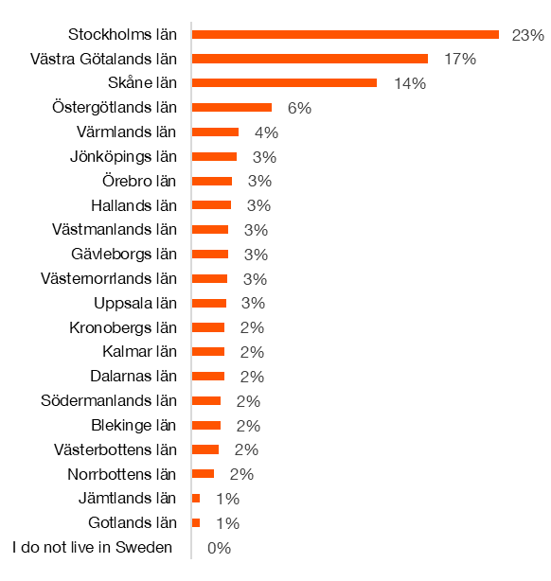


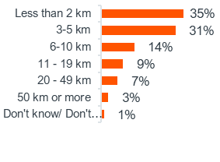
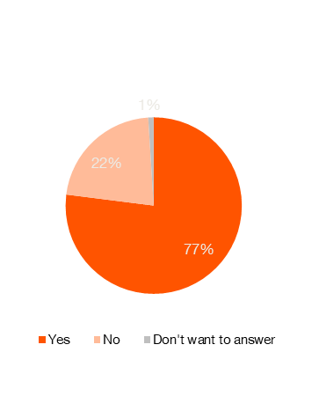
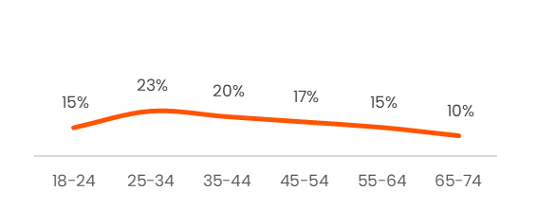
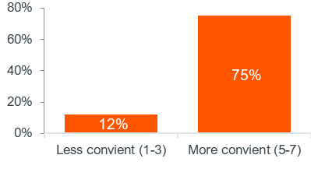
Profile scorecard
Gender distribution
Distance to purchase point
Occupation
Region
54%
46%
Age
Ease of reaching the nearest store:
Car owners

