Slide 1
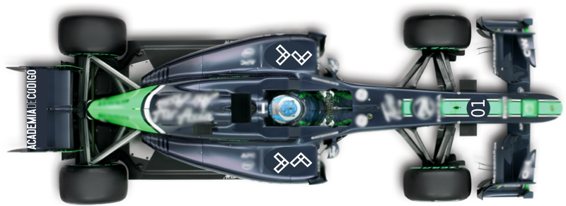



STREET RACER
You have 45 seconds to beat the clock &
get across the streets of down town Lisbon &
through the famous archway
Press
to begin
Use
to go left
Use
to go right
Don’t worry about accelerating, your foot is always to the floor.
Just try not to go off the street!

Slide 2
STREET RACER
You have 45 seconds to beat the clock &
get across the streets of down town Lisbon &
through the famous archway
Press
to begin
Use
to go left
Use
to go right
Don’t worry about accelerating, your foot is always to the floor.
Just try not to go off the street!

Slide 3
STREET RACER
Congratulations!!
Your time is:
Press
to race again

Slide 4
STREET RACER
Congratulations!!
Your time is:
Press
to race again

Slide 5
STREET RACER
GAME OVER!
You were too slow
Press
to race again

Slide 6
STREET RACER
GAME OVER!
You were too slow
Press
to race again

