Slide 1
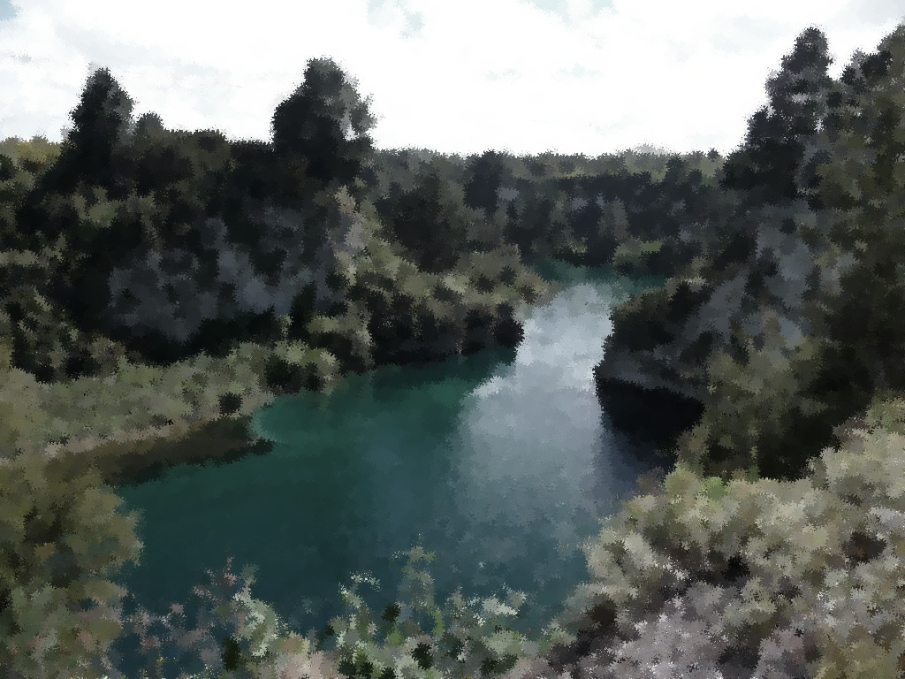
Te Noko (m) Mangimangi (m) Kawhena (f)
|
(1st Wife) Para = Rangiwhakatiatia (m) = (2nd Wife) Tekaha
| |
Terekounuku Nepe (m) Patara (m) Koto (f) Matiaha (m) = Te Awhipera Miller Aubrey
|
Nganiho (m) Mokopurangi (m) Te Whiupounamu (m)

