Slide 1
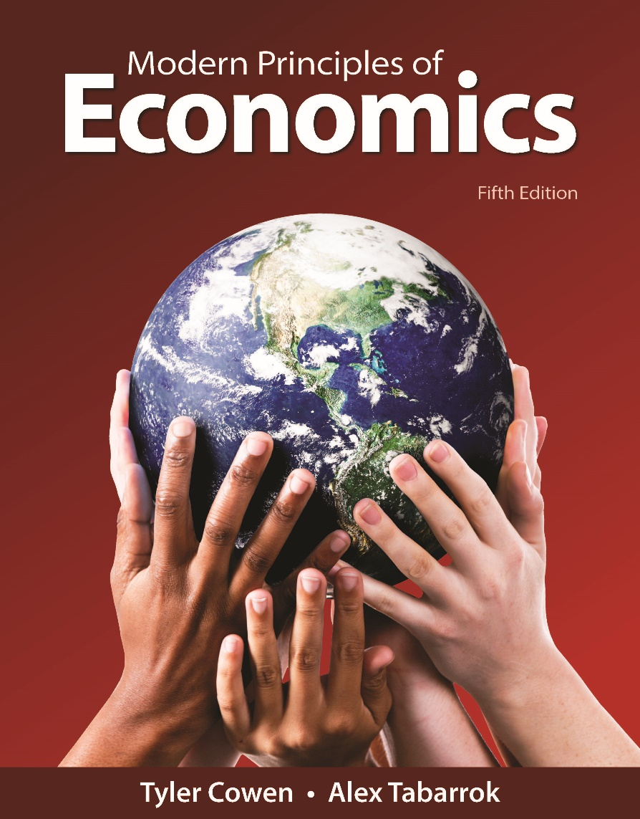
MODERN PRINCIPLES OF ECONOMICS
Fifth Edition
Chapter 19
Public Goods and the Tragedy of the Commons
© 2021 Worth Publishers. All Rights Reserved.

Slide 2
Outline
Four Types of Goods
Private Goods and Public Goods
Club Goods
Common Resources and the Tragedy of the Commons
Takeaway

Slide 3
Introduction (1 of 2)
Approximately 60 million years ago, asteroid Chicxulub smashed into the earth off the coast of modern-day Mexico, killing 99.9999% of all living organisms.
Markets provide all kinds of goods like food, clothing, and cell phones.
Even if everyone were convinced of the benefits of deflecting asteroids, the market will probably never provide asteroid deflection.

Slide 4
Definition (1 of 7)
Nonexcludable:
A good is nonexcludable if people who don’t pay cannot be easily prevented from using the good.

Slide 5
Definition (2 of 7)
Nonrival:
A good is nonrival if one person’s use of the good does not reduce the ability of another person to use the same good.

Slide 6
Introduction (2 of 2)
Asteroid deflection is a public good:
  Nonexcludable: Nonpayers can’t be excluded from enjoying the benefits.
  Nonrival: Many people can enjoy the benefits of the same asteroid deflection.
A pair of jeans is an example of a private good:
  Nonpayers can be excluded from consuming them.
  Only one person can wear them at a time.

Slide 7
Four Types of Goods
 | Excludable | Nonexcludable
Rival | Private Goods Jeans Hamburgers Contact lenses | Common Resources Tuna in the ocean The environment Public roads
Nonrival | Club Goods Cable TV Wi-Fi Digital music | Public Goods Asteroid deflection National defense Mosquito control
Notes:
Table 19-1: Four Types of Goods

Slide 8
Definition (3 of 7)
Private goods:
Are excludable and rival.
Public goods:
Are nonexcludable and nonrival.

Slide 9
Self-Check (1 of 3)
A fireworks display is an example of a:
public good.
private good.
common resource.

Slide 10
Self-Check (1 of 3) (Answer)
A fireworks display is an example of a:
public good.
private good.
common resource.
Answer:
A fireworks display is a public good because it is both nonrival and nonexcludable.

Slide 11
Private Goods and Public Goods (1 of 5)
Since private goods are excludable, there is an incentive to pay for, and thus to produce, them.
Private goods can therefore be provided by the market.
Excludability doesn’t result in inefficiency.
The only people who will be excluded from consuming a private good are the people who are not willing or able to pay what it costs to produce it.

Slide 12
Private Goods and Public Goods (2 of 5)
Since public goods are nonexcludable, it’s difficult to get people to pay for them voluntarily.
Markets will tend to underprovide public goods.
Public goods are also nonrival, which means that one person’s use doesn’t reduce another person’s ability to use the good.
The planet’s 7 billion people can be protected from an asteroid for the same cost as protecting 1 million people.

Slide 13
Definition (4 of 7)
Free rider:
Someone who enjoys the benefits of a public good without paying a share of the costs.
Forced rider:
Someone who pays a share of the costs of a public good but who does not enjoy the benefits.

Slide 14
Private Goods and Public Goods (3 of 5)
Because public goods are nonexcludable, some people will free ride.
If people free ride, the good will be underprovided by the market.
By taxing everyone to pay for the public good, government can make people better off.
Taxation means that some people will be turned into forced riders.
In principle, the government should produce the amount that maximizes total surplus.

Slide 15
Self-Check (2 of 3)
Someone who enjoys the benefits of a public good without paying some of the cost is called a:
public good consumer.
forced rider.
free rider.

Slide 16
Self-Check (2 of 3) (Answer)
Someone who enjoys the benefits of a public good without paying some of the cost is called a:
public good consumer.
forced rider.
free rider.
Answer:
Someone who enjoys a public good without paying the cost is called a free rider.

Slide 17
Definition (5 of 7)
Club goods:
Goods that are excludable but nonrival.

Slide 18
Private Goods and Public Goods (4 of 5)
Club goods (also called nonrival private goods) like television, music, and software are excludable but nonrival.
Markets can provide club goods, but they will be inefficient.
Some people who are willing to pay the cost (MC) but not the market price will be excluded.
Entrepreneurs try to find ways to:
  Turn public goods into club goods
  Profit from nonrival goods without relying on exclusion

Slide 19
Private Goods and Public Goods (5 of 5)
Some public goods, such as radio and television programs, are provided by markets.
Advertisers pay for the costs of the good, which is then given away for free.
Some nonrival goods, such as Google searches, are provided free even when they are excludable.
Other goods, such as Wi-Fi, are sold by private firms, paid for by advertising, given away to attract customers, or provided by local governments.

Slide 20
Definition (6 of 7)
Common resources:
Goods that are nonexcludable but rival.

Slide 21
Definition (7 of 7)
Tragedy of the commons:
The tendency of any resource that is unowned and hence nonexcludable to be overused and undermaintained.

Slide 22
Common Resources and Tragedy of the Commons (1 of 3)
Until they are caught, tuna are unowned and hence nonexcludable.
But tuna are not public goods: When one person consumes a tuna, there is less for others.
Without ownership, there is very little incentive to conserve.
Tuna are therefore being driven toward extinction.

Slide 23
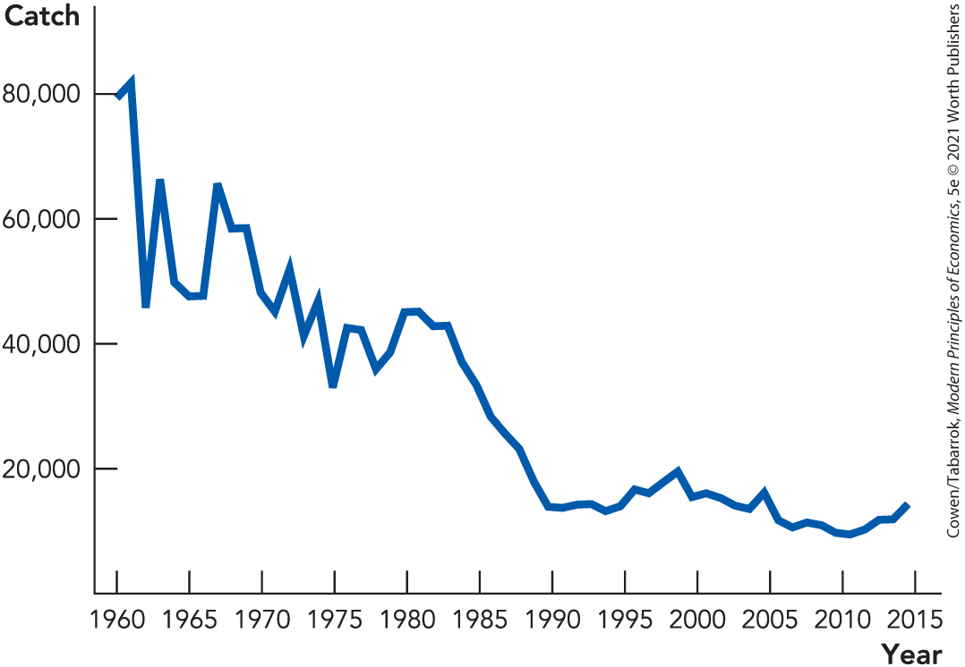
Common Resources and Tragedy of the Commons (2 of 3)
Since 1960, the tuna catch has decreased by 75%.
Notes:
Figure 19-1: Where’s the Catch?
Data from: Commission for the Conservation of Southern Bluefin Tuna.

Slide 24
Common Resources and Tragedy of the Commons (3 of 3)
The result of nonexcludability and rivalry is often overexploitation and undermaintenance.
When resources are unowned, users do not invest in maintenance because the benefits are mostly external.

Slide 25
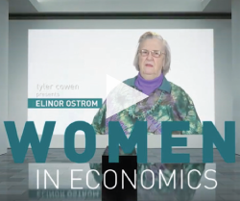
Solutions to Tragedy of the Commons (1 of 4)
Elinor Ostrom found that all over the world, groups have avoided the tragedy of overfishing or overgrazing through the enforcement of norms.
This is more difficult to do, though, when a lot of unrelated people have access to the common resource.
Elinor Ostrom
Winner of the Nobel Prize in Economics in 2009

Slide 26
Solutions to Tragedy of the Commons (2 of 4)
Command and control has been used to solve some tragedy of the commons problems.
In 1968, British Columbia limited the number of fishing boats to protect its salmon fishery.
Fishermen used “capital stuffing”—more powerful engines and better electronics for finding fish.
The value of the typical fishing boat tripled, but the salmon fishery continued to decline.

Slide 27
Solutions to Tragedy of the Commons (3 of 4)
In 1986, New Zealand tried individual transferable quotas (ITQs).
Each owner of an ITQ had the right to catch a certain tonnage of fish.
The sum of ITQs added up to the total allowable catch, and ITQs could be bought and sold.
The scheme was successful, leading to an increased fish catch.

Slide 28
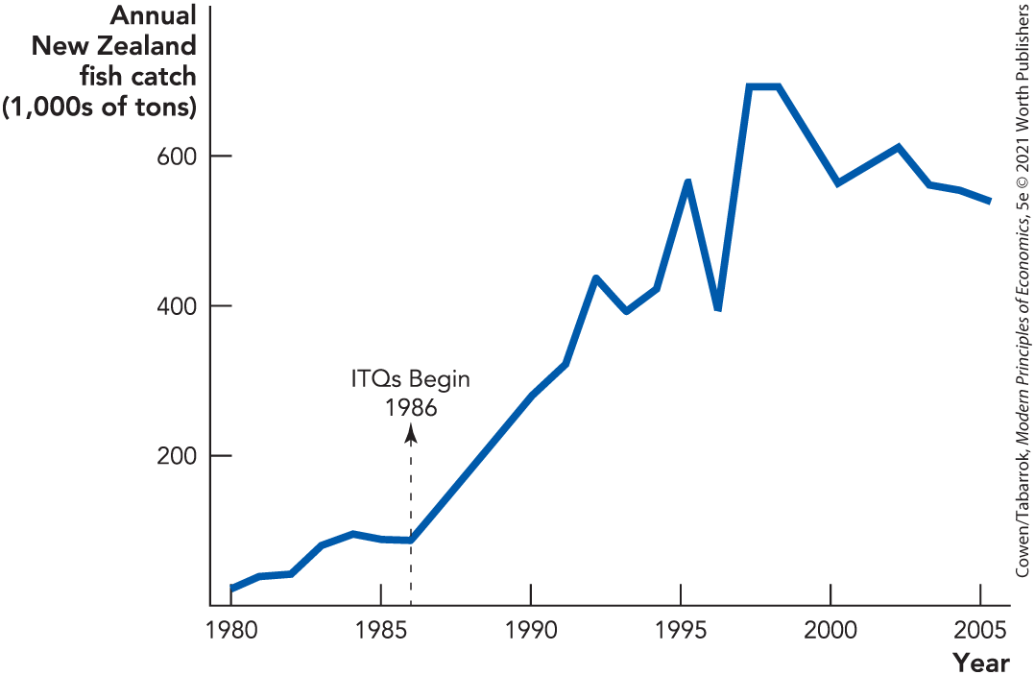
Solutions to Tragedy of the Commons (4 of 4)
Notes:
Figure 19-2: A Tragedy Prevented by Property Rights
ITQs: Individual transferable quotas.

Slide 29
Self-Check (3 of 3)
The tendency for common resources to be overused and undermaintained is called:
the tragedy of the commons.
command and control.
tradable allowances.

Slide 30
Self-Check (3 of 3) (Answer)
The tendency for common resources to be overused and undermaintained is called:
the tragedy of the commons.
command and control.
tradable allowances.
Answer:
This tendency is called the tragedy of the commons.

Slide 31
Takeaway (1 of 2)
Public goods are valuable but markets will often undersupply these goods.
Public goods are nonexcludable and nonrival; nonexcludability is usually the more important problem.
The benefit of providing public goods is an argument for government taxation and supply.

Slide 32
Takeaway (2 of 2)
A resource that is nonexcludable but rival will tend to be overused and undermaintained.
Sometimes there are creative solutions to the tragedy of the commons, such as instituting new property rights.

