Slide 1
Data infrastructure & Deployment process
Interview case June 2021
Patrick Gaspar

Slide 2
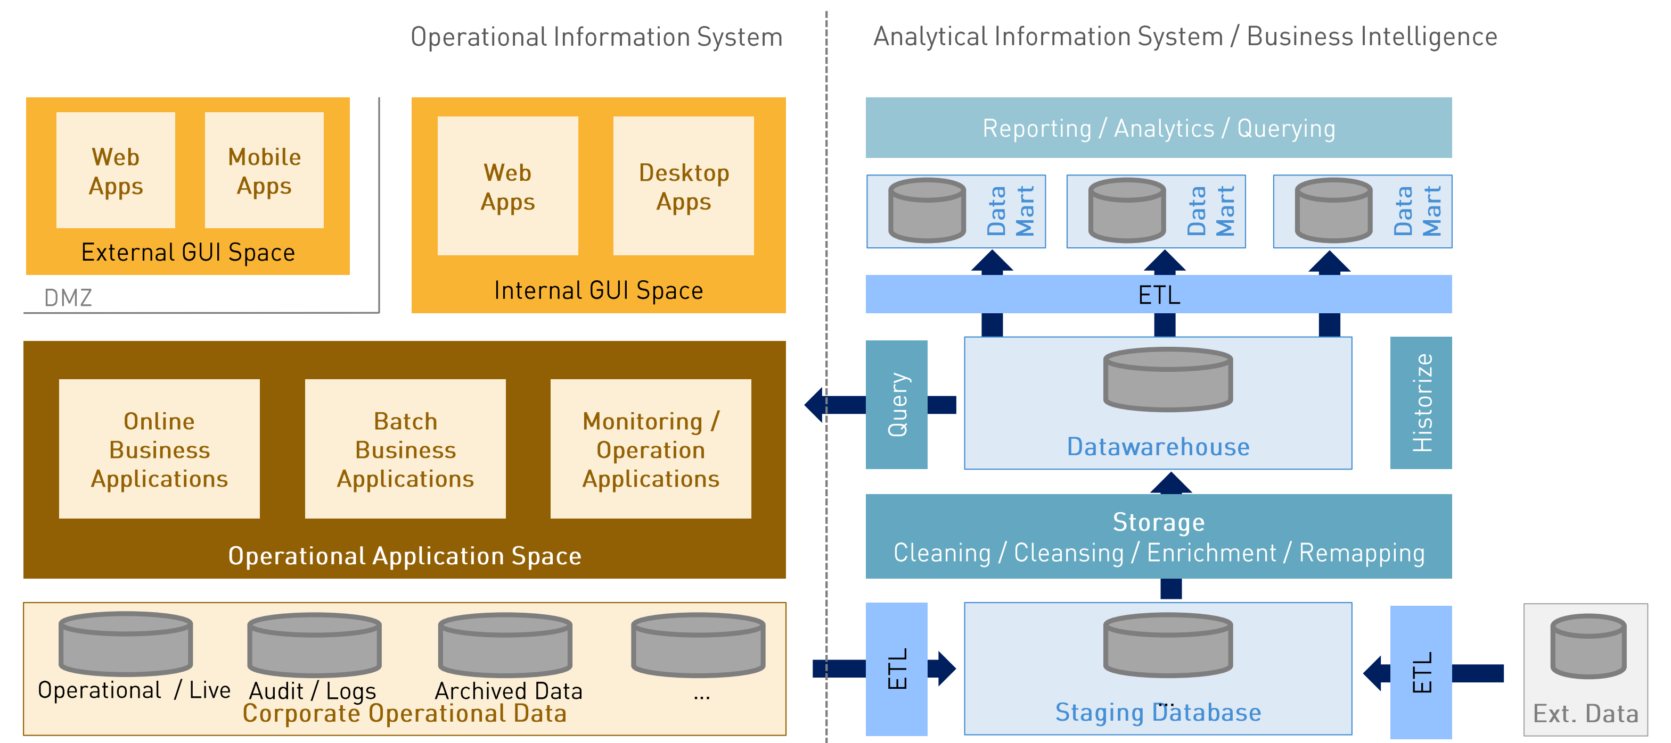
Architecture overview

Slide 3
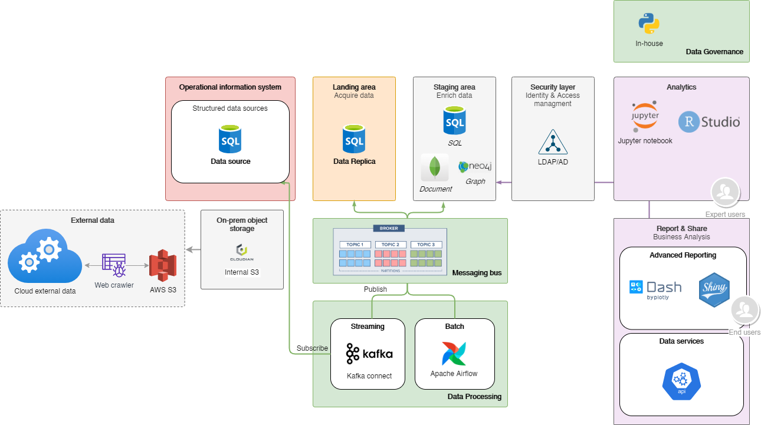
Data infrastructure pipeline

Slide 4
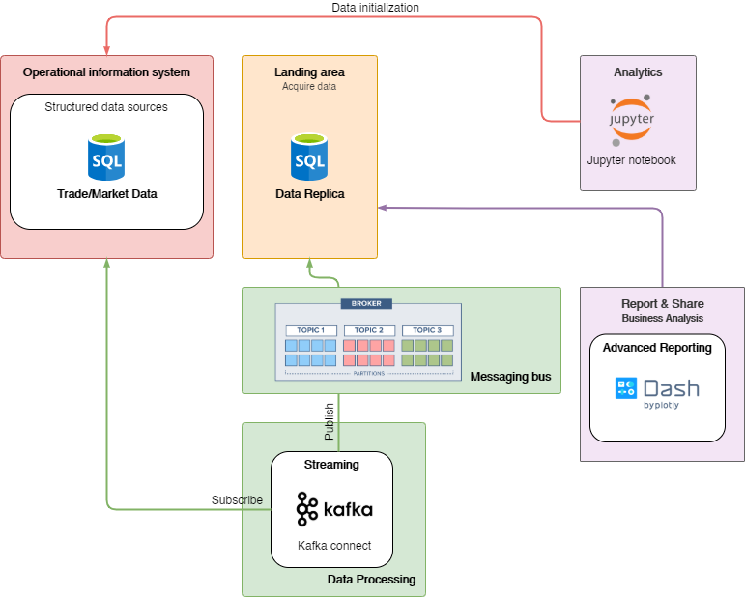
Demo
Infrastructure as code (Docker compose
Data loading/processing (Kafka)
Build and deploy Web app

Slide 5
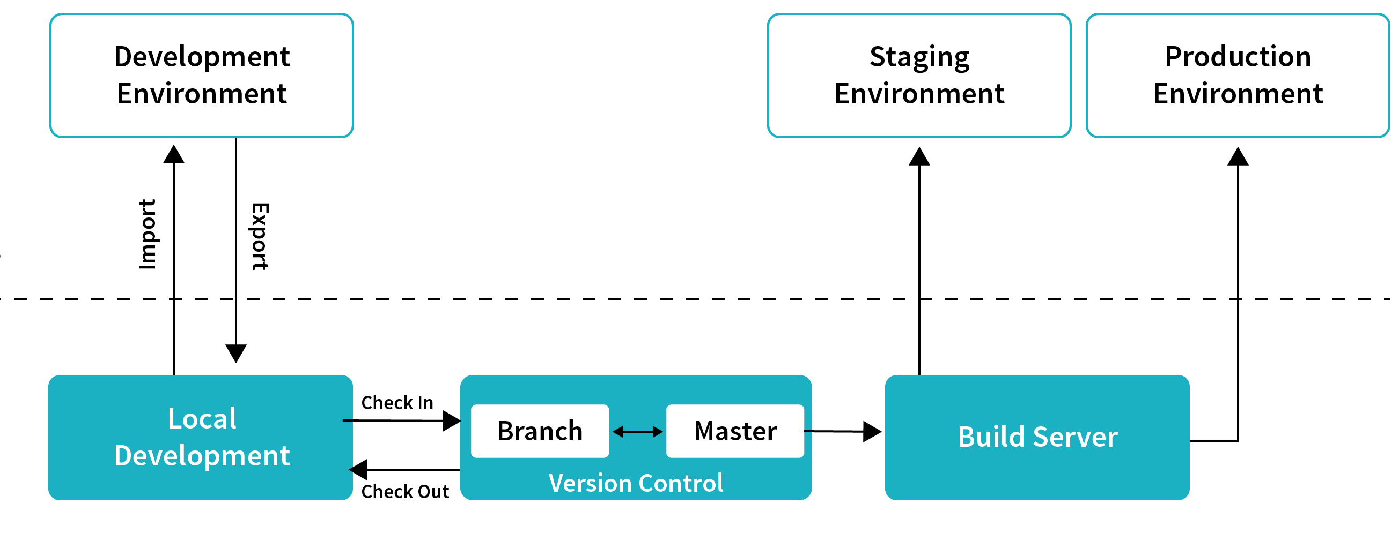
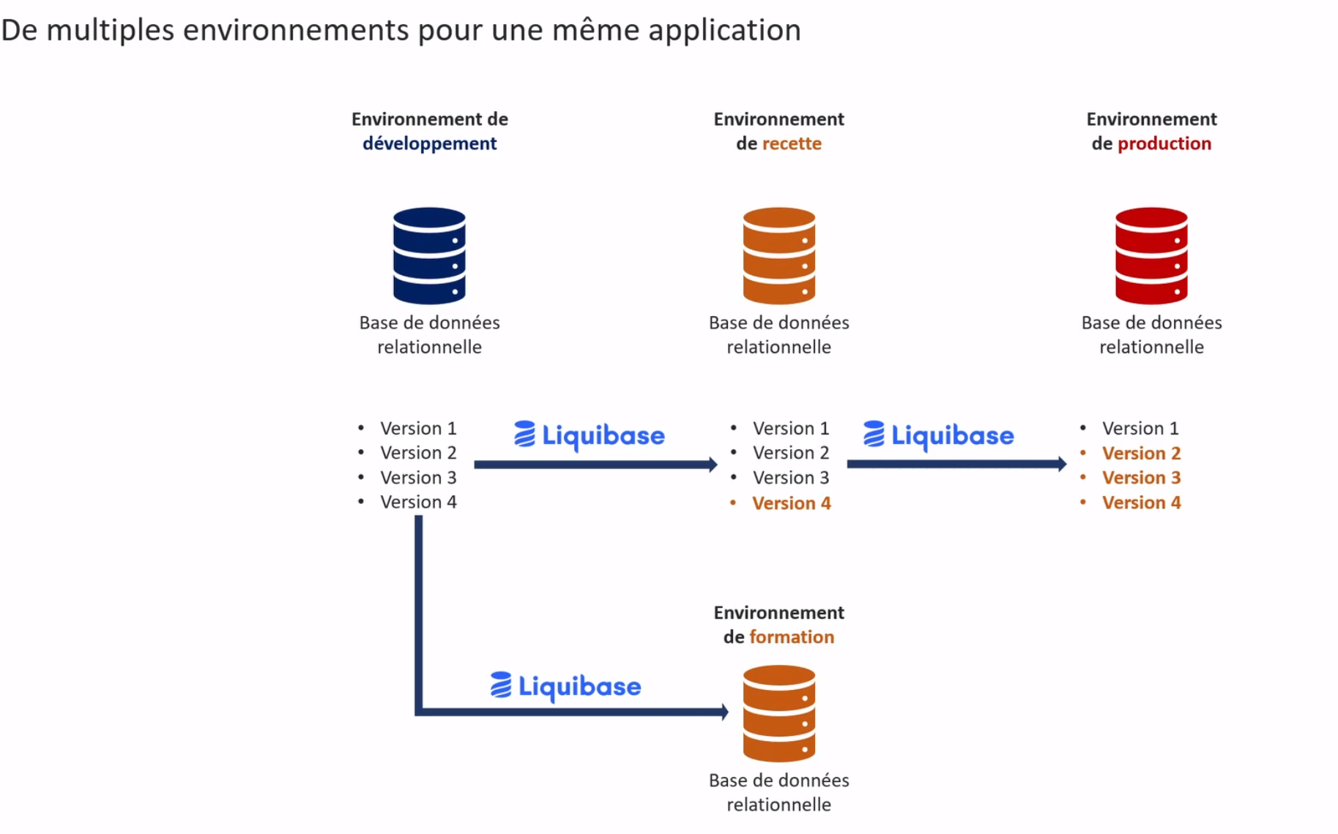
Deployment strategy
Data pipeline
Database staging

