Slide 1

Grover‘s search
Quantum alogorithm for inverting a function
Speakers: Anant Agnihotri and Gleb Neplyakh
Technical University of Munich
Faculty of Physics
Course: Quantum Computing with Superconducting Qubits
Munich, 04.Feb.2020

Slide 2
Contents
What is Grover's search?
How does it work?
Implementation of Grover‘s search (Qiskit)
Summar
Sources and further reading

Slide 3
What is Grover’s search?

Slide 4
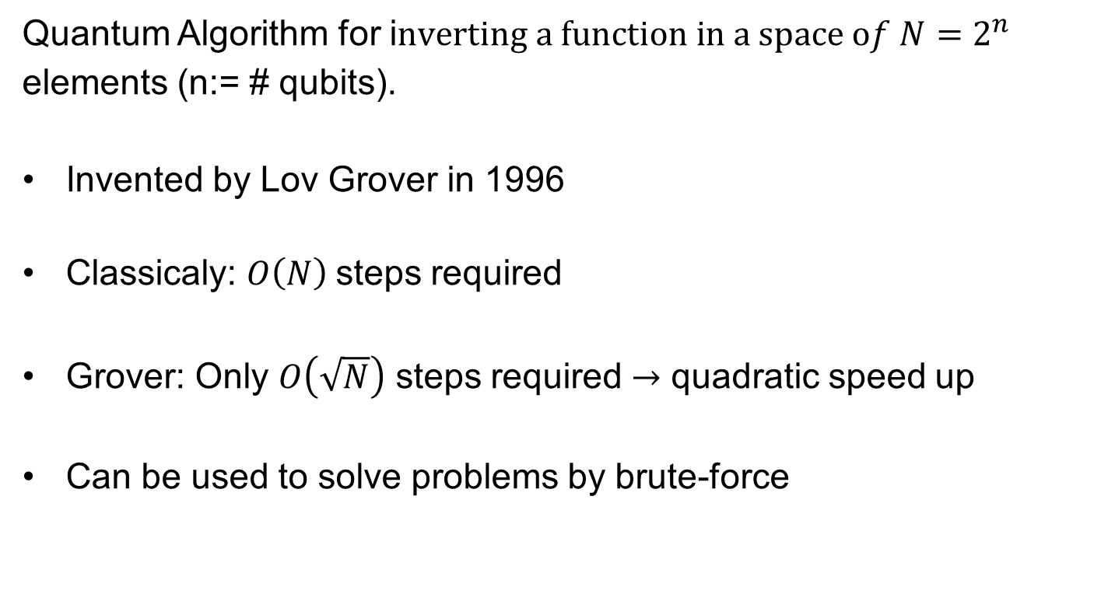
Introduction:
Quantum Algorithm for i$nverting a function in a space of N=2^{n}$ elements (n:= # qubits).
Invented by Lov Grover in 1996
Classicaly: $O\left(N\right)$steps required
Grover: Only $O\left(\sqrt{N}\right)$ steps required $→$ quadratic speed up
Can be used to solve problems by brute-force

Slide 5
Disclaimer
For simplicity, only the case where there is only a single solution to the inverse of a function.
For the general case, consult arXiv:quant-ph/9909040

Slide 6
How does it work?

Slide 7
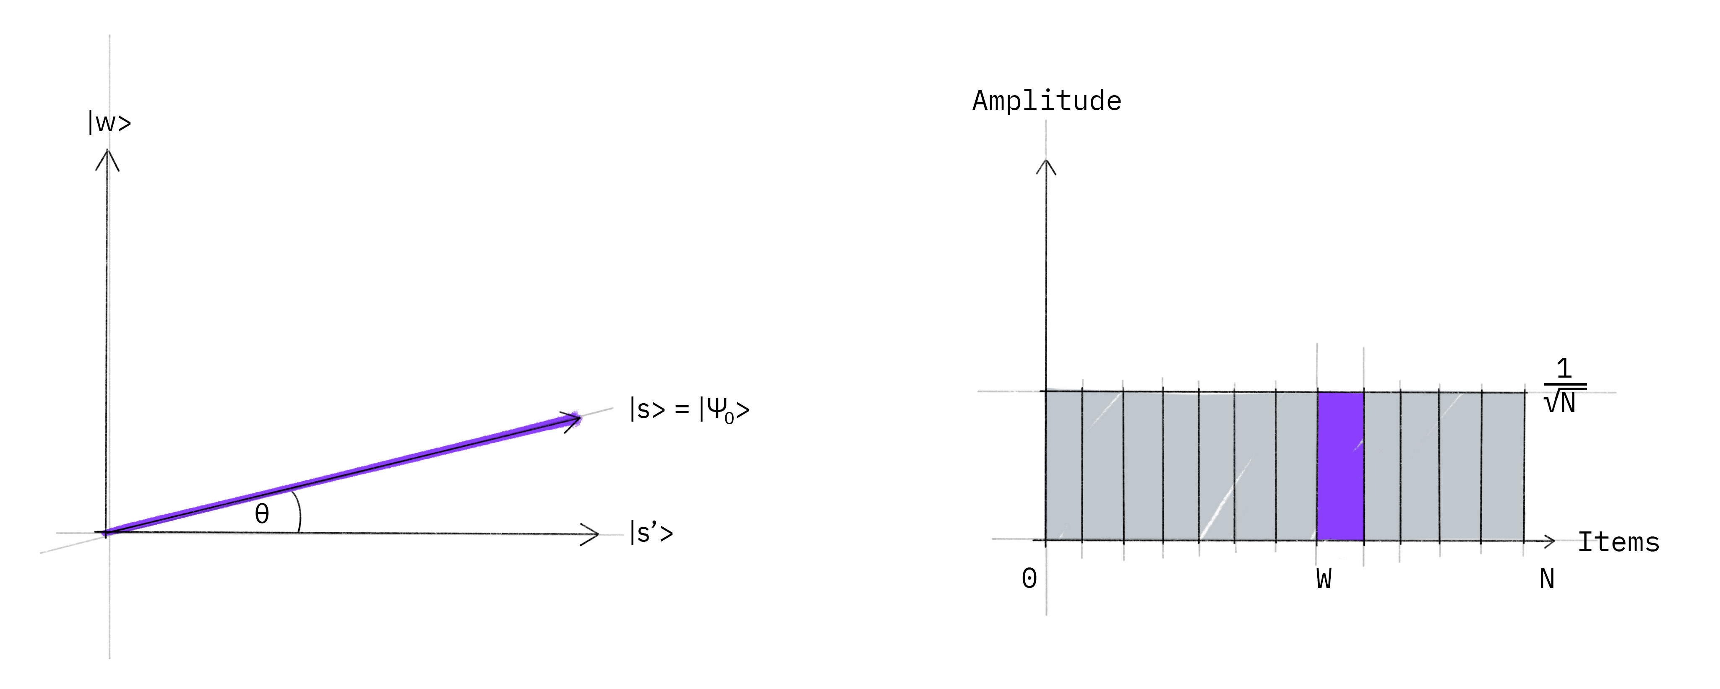
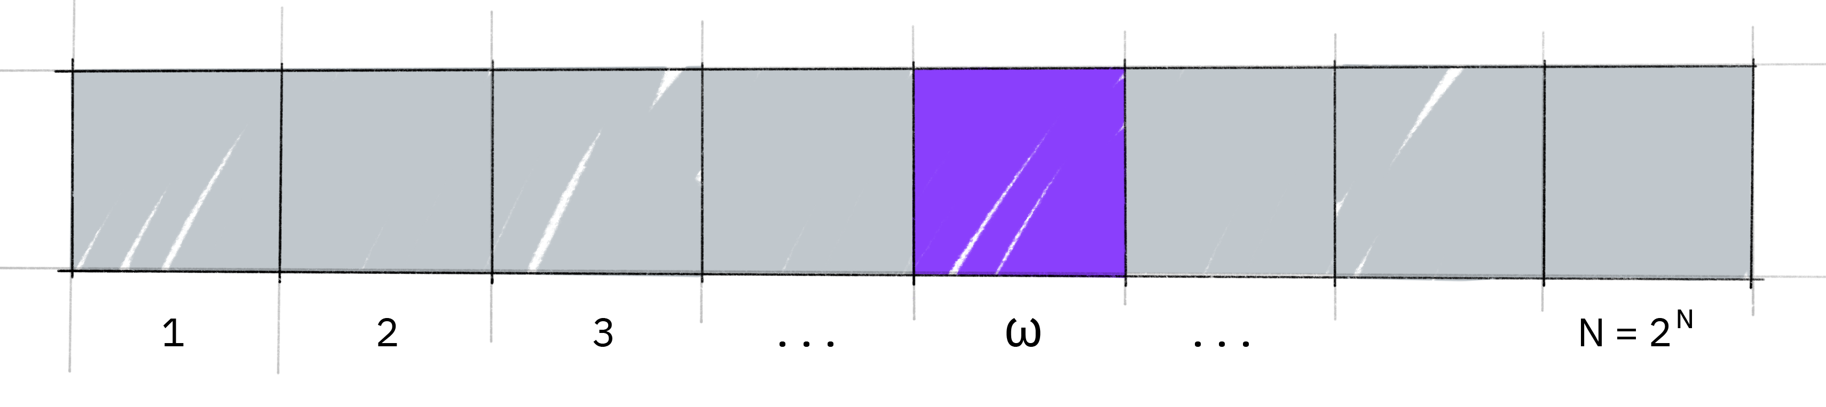
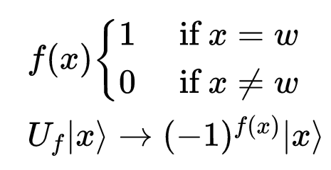


Defining the problem:
$$\left.|s\right\rangle ≔superposition state with N=2^{n} elements (n≔\#qubits)$$
$$\left.|⍵\right\rangle ≔state with f\left(x=⍵\right)=1 (winner states)$$

Slide 8
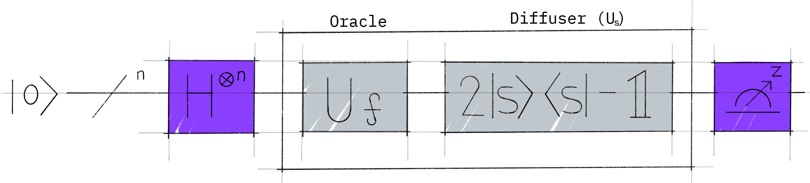

Working principle:
“Grover Operator”, apply t times
General Circuit:
Steps:
Initialize qubits in superposition state $\left.|ψ_{0}\right\rangle =\left.|s\right\rangle$
Apply Grover operator m-times (t→later)
Measure in z-basis

Slide 9
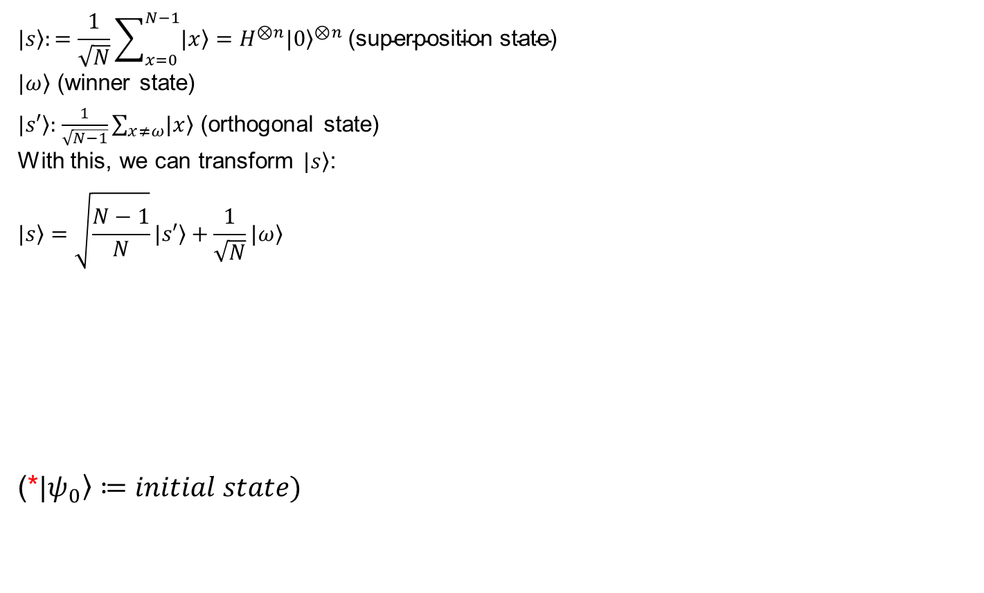
Useful basis for describing the problem:
$$\left.|s\right\rangle :=\frac{1}{\sqrt{N}}\sum_{x=0}^{N−1}{\left.|x\right\rangle }=H^{⊗n}{\left.|0\right\rangle }^{⊗n} \text{(}\text{superposition} \text{state}\text{)}$$
$\left.|ω\right\rangle$ (winner state)
$\left.|s′\right\rangle :$ $\frac{1}{\sqrt{N−1}}\sum_{x≠ω}{\left.|x\right\rangle }$ (orthogonal state)
With this, we can transform $\left.|s\right\rangle$:
$$\left.|s\right\rangle =\sqrt{\frac{N−1}{N}}\left.|s′\right\rangle +\frac{1}{\sqrt{N}}\left.|ω\right\rangle$$
(*$\left.|ψ_{0}\right\rangle ≔initial state)$
*

Slide 10
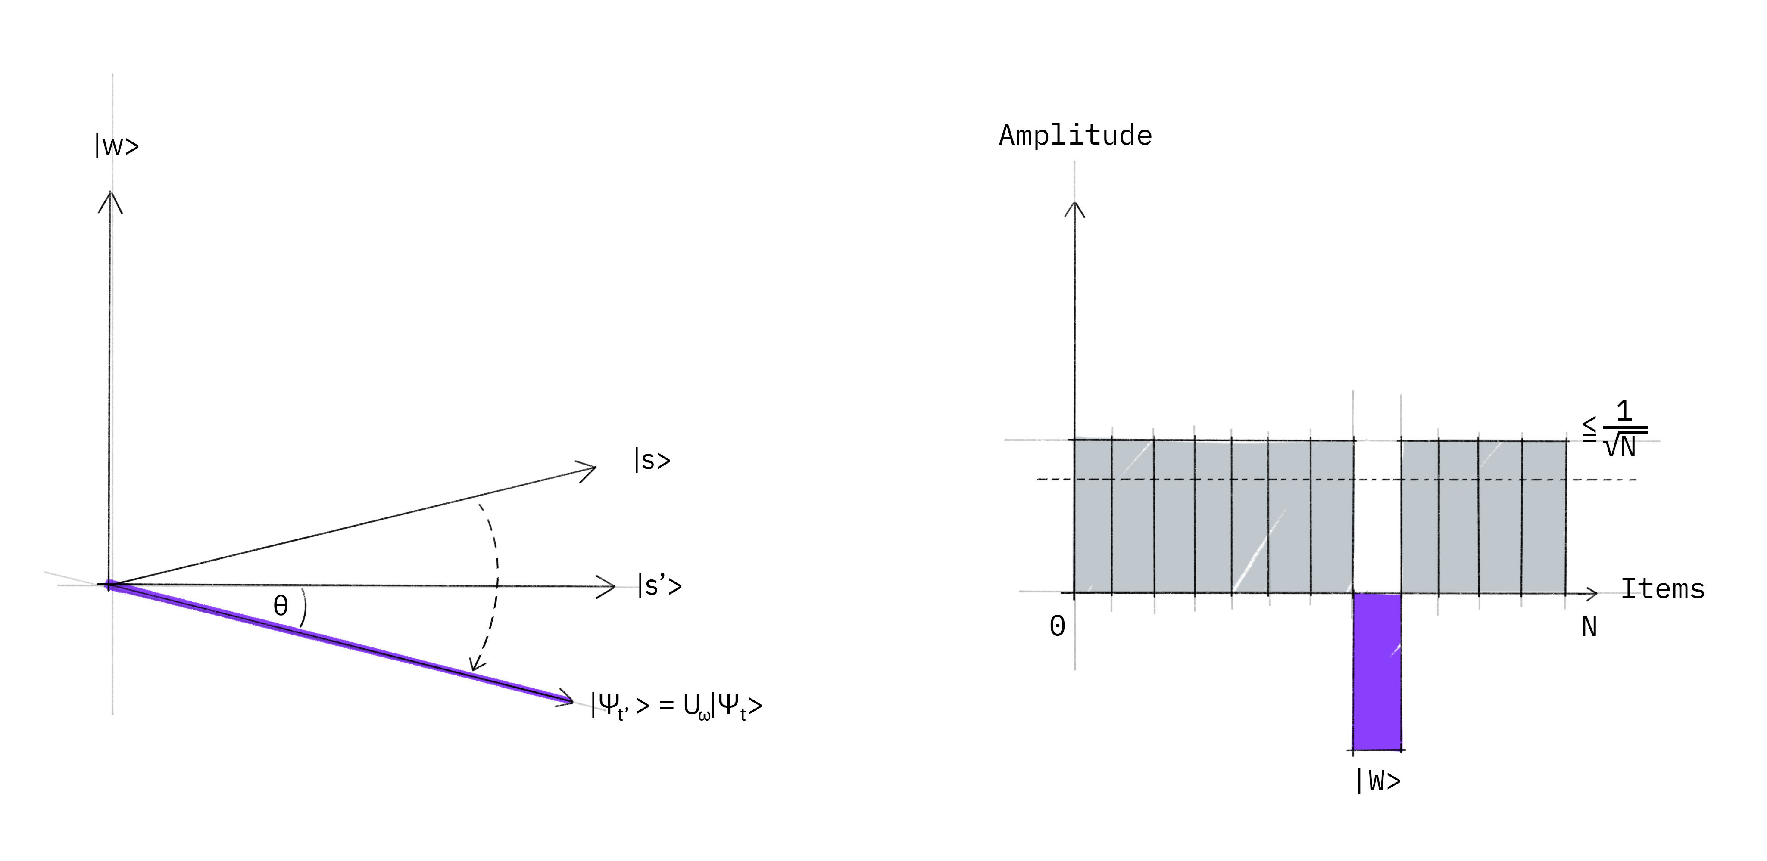

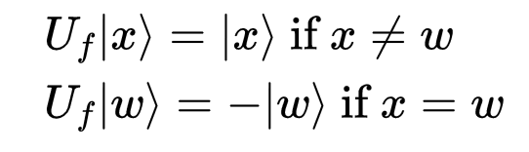
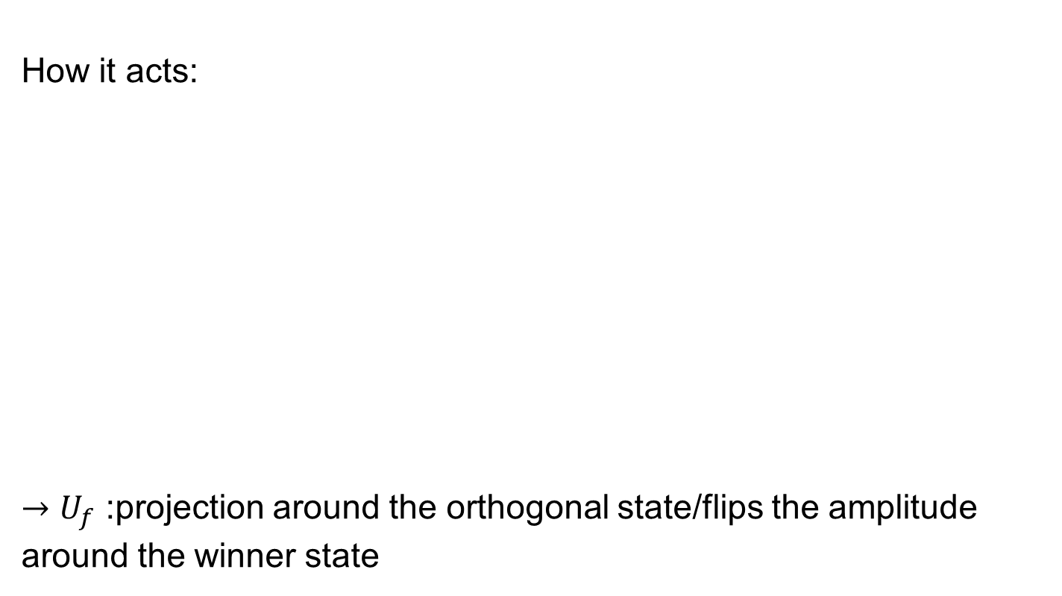
Oracle $U_{f}$:
How it acts:
$→U_{f}$ :projection around the orthogonal state/flips the amplitude around the winner state

Slide 11
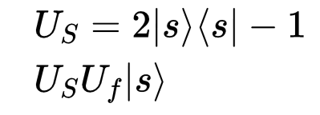
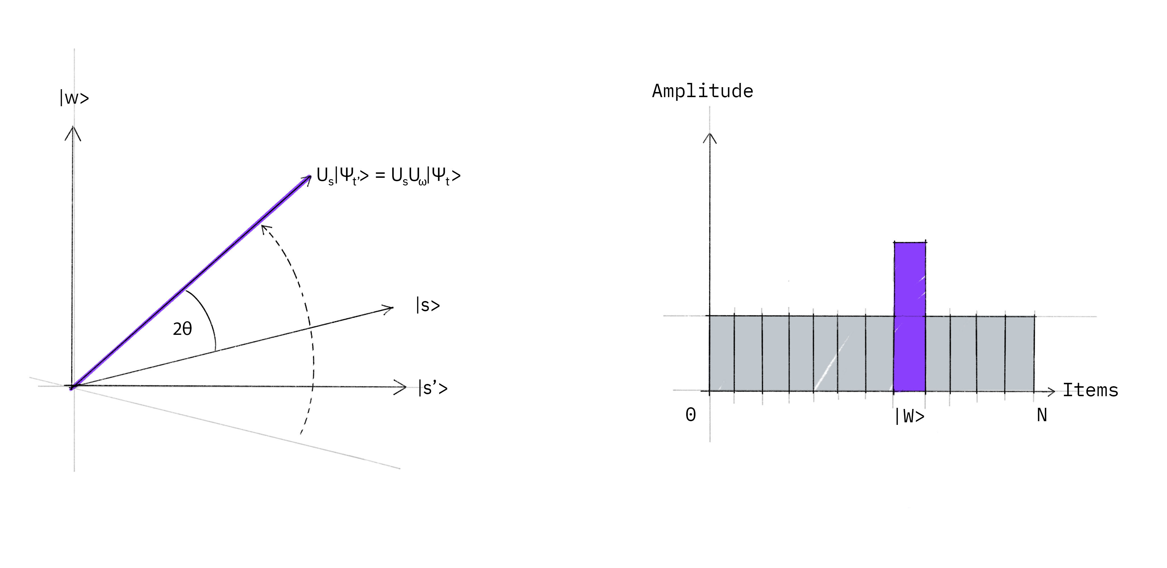

Diffuser $U_{S}$:
$→U_{s}$ :projection around the superposition state/inverts the amplitude around the mean value

Slide 12
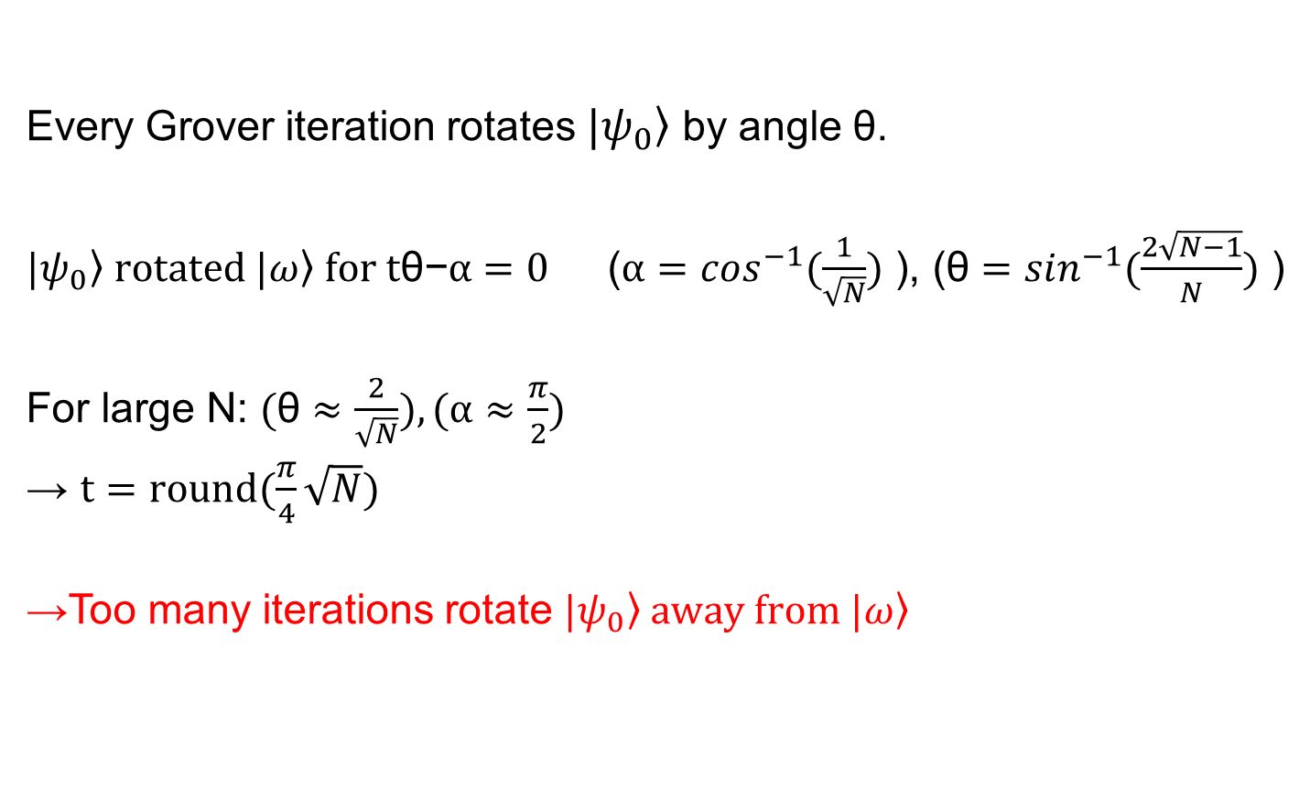
How many iterations?
Every Grover iteration rotates $\left.|ψ_{0}\right\rangle$ by angle θ.
$\left.|ψ_{0}\right\rangle rotated \left.|ω\right\rangle for \text{t}\text{θ}\text{−}α=0$ ($α=\cos^{−1}(\frac{1}{\sqrt{N}})$ ), ($\text{θ}=\sin^{−1}(\frac{2\sqrt{N−1}}{N})$ )
For large N: $(\text{θ}≈$ $\frac{2}{\sqrt{N}}),(α≈\frac{π}{2})$
→ $t=round(\frac{π}{4}\sqrt{N})$
→Too many iterations rotate $\left.|ψ_{0}\right\rangle away from \left.|ω\right\rangle$

Slide 13
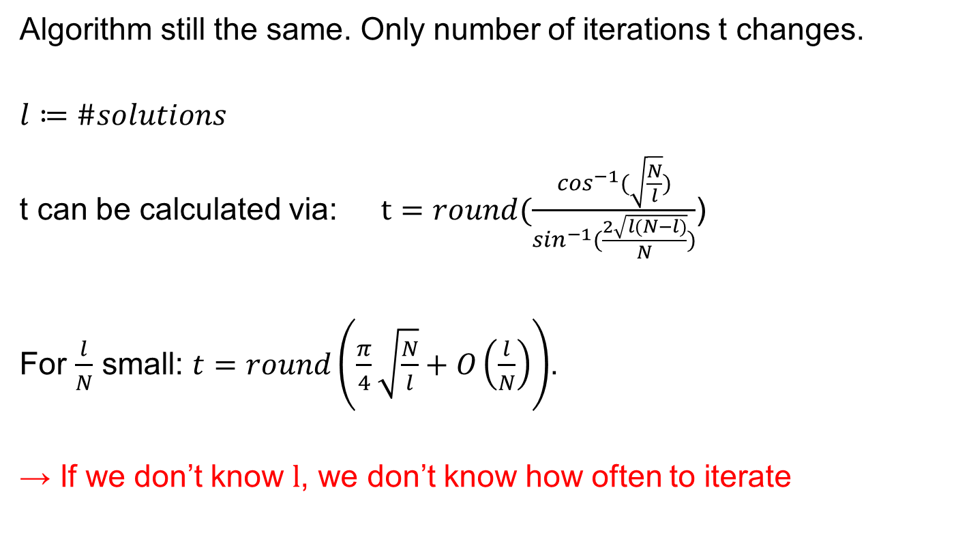
What if there are several solutions?
Algorithm still the same. Only number of iterations t changes.
$$l≔\#solutions$$
t can be calculated via: $t=round(\frac{\cos^{−1}(\sqrt{\frac{N}{l}})}{\sin^{−1}(\frac{2\sqrt{l(N−l)}}{N})}$)
For $\frac{l}{N}$ small: $t=round\left(\frac{π}{4}\sqrt{\frac{N}{l}}+O\left(\frac{l}{N}\right)\right)$.
→ If we don’t know l, we don’t know how often to iterate

Slide 14
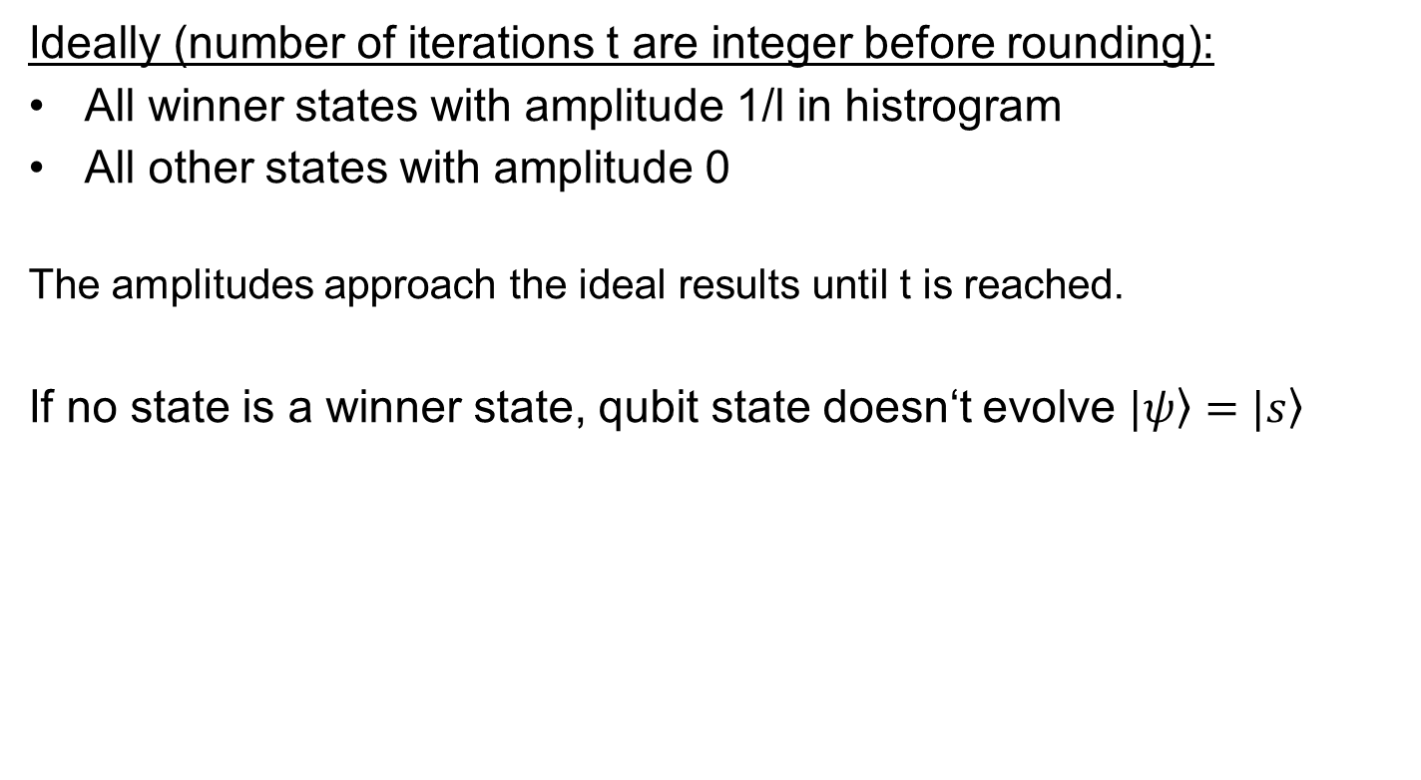
What are the final results?
Ideally (number of iterations t are integer before rounding):
All winner states with amplitude 1/l in histrogram
All other states with amplitude 0
The amplitudes approach the ideal results until t is reached.
If no state is a winner state, qubit state doesn‘t evolve $\left.|ψ\right\rangle =\left.|s\right\rangle$

Slide 15
Implementation of Grover‘s search (Qiskit)

Slide 16
Summary

Slide 17
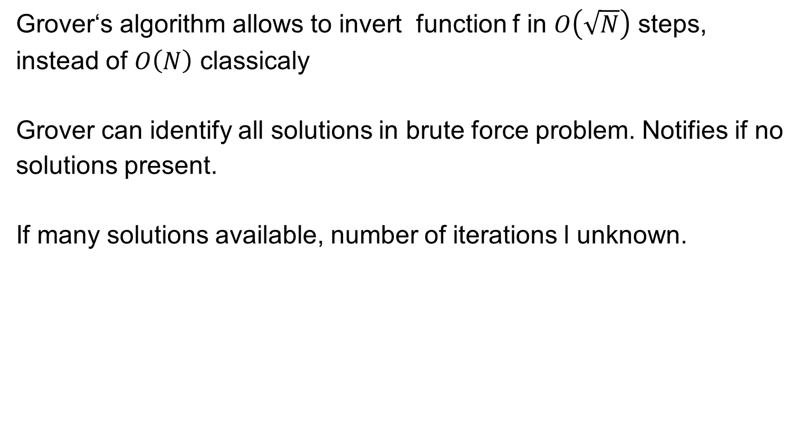
Summary:
Grover‘s algorithm allows to invert function f in $O\left(\sqrt{N}\right)$ steps, instead of $O\left(N\right)$ classicaly
Grover can identify all solutions in brute force problem. Notifies if no solutions present.
If many solutions available, number of iterations l unknown.

Slide 18
Sources and further reading

Slide 19
Sources and further reading:
Qiskit textbook: https://qiskit.org/textbook/ch-algorithms/grover.html (in depth tutorial, source of images)
Original paper: https://arxiv.org/abs/quant-ph/0109116
Generalization for l solutions: https://arxiv.org/abs/quant-ph/9909040

