Slide 1




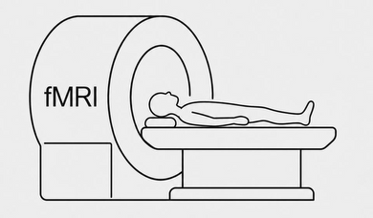




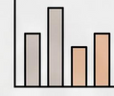
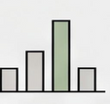

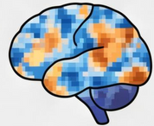
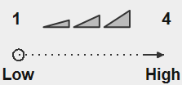



a
Real-world news click prediction
e
Example prompts and controls
Prior click history
Local Qwen / DeepSeek
Ranked candidate news
Article-only prompt
1
2
3
Input
1,000 users
Candidates from
nDCG@5 / MAP / AUC
[Target title + summary]
History before target impressions
3,000 target impressions
Instruction
b
News-reading fMRI task
Title + summary
How likely is an average reader to read
the full article?
Rating: 1–4.
95 participants
1
4
Output: General reading intention
Low
High
Personalized prompt
96 articles
fMRI during reading
Intention to read full article
Input
Trial
Fixation
News (fMRI)
Rating (1–4)
[News history]
c
News 1: r1; News 2: r2; …
LLM prediction of reading intention
[Target title + summary]
Instruction
Given this participant’s history, predict
Article only
Six model families
General prediction
their reading intention.
Rating: 1–4.
+
1
4
Output: Individual reading intention
Target
Personal history
Six model families
Individual prediction
History-score shuffle
d
Neural decoding and ROI associations
Personalized history ＆ shuffled rating intention
History item
Original
Shuffled
Ridge regression
1
2
3
4
N₁
r₁
r₂
Leave-one-trial-out cv
N₂
r₂
r₃
Single-trial beta maps
Predicted intention
N₃
r₃
r₁
ROI association:
ROI mean activity and measured reading intention
f
Behavior–model–brain RSA
g
Model–brain RSA computation
Behavior
Qwen hidden states
Last input token
Value
Self-ref.
Mentalizing
RSA
RSA
A / S / T
ROI / 6-mm searchlight patterns
Upper triangles
RSA
Spearman ρ
Per layer → mean
LLM
Brain
LLM RDM
Brain RDM
RDM comparisons · Spearman ρ
Raw ↔ Semantic-control · T−A / T−S
Notes:
Figure 1 study-design schematic. Panel a revised to distinguish earlier personal click history, target candidate-news input and ranked candidate-news output. 1,000 users and 3,000 target impressions are sample counts. The history precedes the earliest target impression. Rank labels are schematic, not experimental ranks. Platform metrics are nDCG@5, MAP and AUC. Panels b–g preserve the supplied Figure1_V2 layout and content. Text and paths are native editable objects. Source images remain individual raster assets. No quantitative results are added. Anatomical ROI images are preserved. Panel g is a schematic description; source Methods describe analysis of existing transformed performance tables, not a new encoding fit.
Panels f and g: methods schematics, not empirical heatmaps. Qwen2.5-7B-Instruct last input token before rating generation. Model RDM: cosine distance per layer; behavior RDM: absolute observed rating differences. Neural RDM: spatial Pearson distance across multivoxel trial patterns in the Value, Self-referential and Mentalizing ROIs or 6-mm searchlights. Spearman RSA per participant and per layer; mean across layers1–28, and mean of10 shuffled-history metrics. A=article only, S=within-person history article–rating pairing shuffle, T=true own history. Semantic-control: residual correlation after regressing ranked model and brain distances on ranked article semantic distance plus intercept. Panel f shows all three pairwise RSA relationships: model–behavior, model–brain, and brain–behavior. Its undirected edges represent analyses, not statistical significance, causal influence, or superiority of any ROI. Panel g expands the model–brain computation. Brain–behavior summary plot source: RSA_Qwen_searchlight_surface_v3/data/figure_source_data/Supplement_brain_behavior_v2.csv, supplied by the user; no coefficients, intervals, or tests recalculated. The supplied values do not show Value/Self/Mentalizing as the largest brain–behavior means. All RDM cells are schematic, not fitted to these results. Source: RSA_Qwen_searchlight_surface_v4 Methods–Results reader.

