Slide 1
MAX 3-SAT APPROXIMATION
By Robert Petro

Slide 2
Pseudocode
Start with an initial truth assignment (random variable assignment or any set initial assignment)
Repeat for the number of clauses in the CNF:
For each unsatisfied clause in the current variable assignment:
Choose a random literal from the unsatisfied clause
Flip the truth value of the chosen literal
Evaluate the number of satisfied clauses in the updated assignment
If the new assignment satisfies more clauses than the previous one:
Update the current assignment to the new assignment
Return the final variable assignment and the count of satisfied clauses

Slide 3
Runtime Analysis (big-O)
The runtime of the 7/8 approximation algorithm for the Max 3-SAT problem is O(m*n) where n is the number of variables and m is the number of clauses
The approximation ratio for this Max 3-SAT approximation is 7/8 meaning this algorithm satisfies 7/8 of the maximum number of clauses
Explanation:
The for loop that is iterating through the clauses runs through all m clauses and so this for loop runs m times
Then the clauses are evaluated and runs through n variables to assign and check that the clause is true this iteration loop and runs n times

Slide 4
Optimal vs Approximation
Input:
7 7
2 -4 -4
7 -5 4
-7 -6 3
2 5 3
5 3 2
-1 3 5
-2 6 -5
Outputs:
Exact: 7 clauses satisfied
[0, 0, 0, 0, 1, 0, 1]
Approximate: 6 clauses satisfied
[0, 0, 0, 0, 1, 0, 0]
Process
[0, 1, 0, 0, 0, 0, 0]
[0, 1, 0, 0, 0, 0, 1]
[0, 1, 0, 0, 0, 0, 0]
[0, 1, 0, 0, 0, 0, 0]
[0, 1, 0, 0, 1, 0, 0]
[0, 1, 0, 0, 1, 0, 0]
[0, 0, 0, 0, 1, 0, 0]

Slide 5
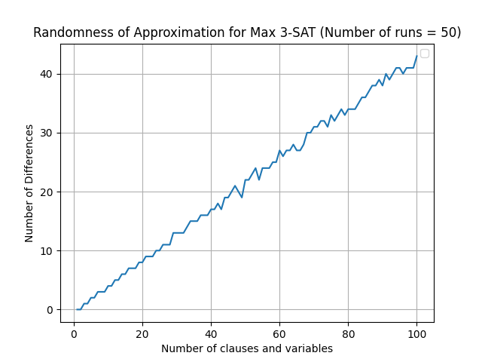
Randomness

Slide 6
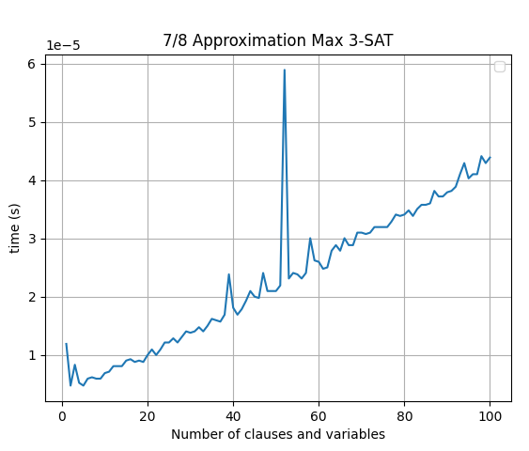
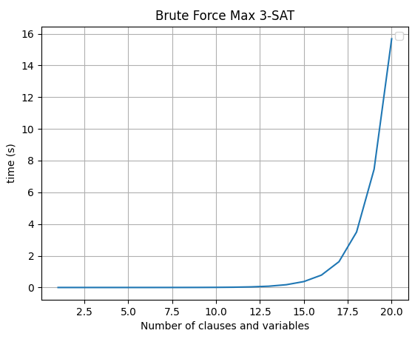
Runtime Analysis (Empirical)

Slide 7
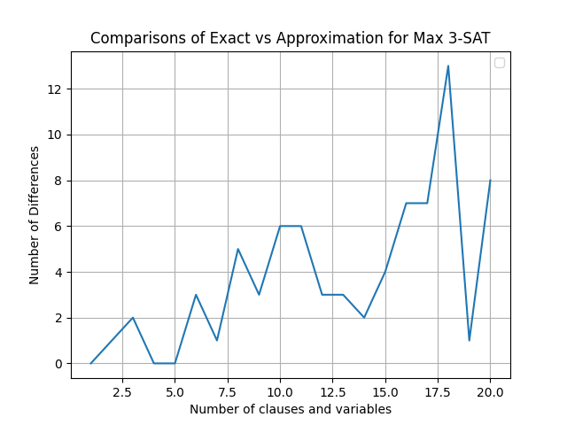
Comparison to Exact Solution

