Slide 1
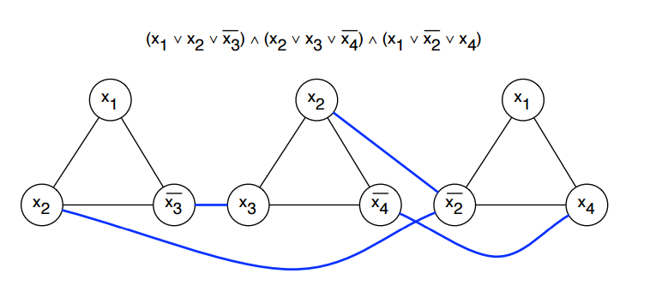
MAX 3-SAT
By Robert Petro

Slide 2
The Problem
Decision Problem:
Given a Boolean formula in CNF (conjunctive normal form) and an integer k, does there exist a truth assignment satisfying k or more clauses in the formula?
Optimization Problem:
Given a Boolean formula in CNF, Find a truth assignment that satisfies the maximum number of clauses in the formula

Slide 3
Inputs and Outputs
Input: The Max 3-SAT problems takes a Boolean formula in a 3-CNF (conjunctive normal form) with 3 variables per clause
Ex. Φ = (X₁ ∨ X₂ ∨ X₃) ∧ (X₁ ∨ -X₂ ∨ -X₃) ∧ (-X₁ ∨ X₂ ∨ -X₃)
It outputs a set containing the truth assignments for each variable that satisfies the largest number of clauses
Ex. {X₁,X₂,-X₃}

Slide 4
Why?
The Max 3-SAT has many practical applications ranging from termination analysis in term-rewrite systems to circuit-level prediction of crosstalk noise
This problem is important because many problems in the realm of NP-complete can be reduced into a Max 3-SAT problem.
This means that any improvements in the solve time of a Max 3-SAT can be then turned into improvements in any NP problem
One concrete application of the Max 3-SAT problem is scheduling
Given several jobs and times what is the max number of jobs that can be done for the given constraints
This can be reduced into a Max 3-SAT problem

Slide 5
Check is Polynomial
The certifier process can be run in polynomial time because the number of clauses to be checked by the certifier is bounded by the total number of clauses in the Max 3-SAT
Suppose the Max 3-SAT instance has m clauses. For each clause, the certifier only needs to perform a constant number of operations (checking three literals) to determine if the clause it is satisfied or not
Therefore, the overall time complexity of the certifier is polynomial in terms of the input size
O(m), where m is the number of clauses

Slide 6
Reduction
Consider an SAT formula with clauses that might have different numbers of literals (e.g., 1, 2, 3, or more)
To reduce this to MAX-3SAT
For each clause with more than 3 literals, create new auxiliary variables and split the clause into multiple clauses each containing exactly 3 literals
For clauses with fewer than 3 literals, add auxiliary variables to make them contain exactly 3 literals.

Slide 7
Reduction (continued)
Consider a 3SAT instance:(x1 ∨ x2 ∨ ~x3),(~x1 ∨ x2 ∨ x3),(x1)
The third clause (x1) needs padding to have three literals, so we add auxiliary variables:
(x1∨a∨b) where a and b are auxiliary variables
The first and second clauses already have exactly three literals.
The third clause (x1 ∨ a ∨ bx1 ​∨ a ∨ b) is now split into two clauses:
(x1 ∨ a ∨ c) and (x1 ∨ ~c ∨ b), introducing a new auxiliary variable c

Slide 8
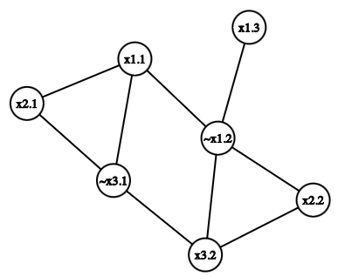
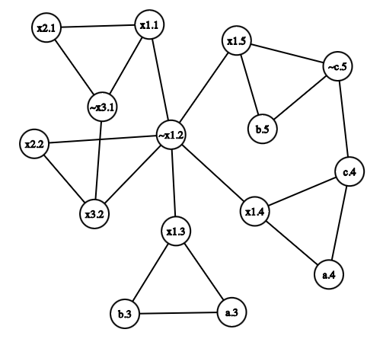

Reduction (Graphs)

Slide 9
Code Explained
The Best assignment is initialized to none
The Best score is initialized to 0
The code loops though an array of every Boolean assignment combination and for each run of the loop it evaluates the Boolean formula for the current Boolean assignment
After evaluating the Boolean formula, the code checks if the current Boolean assignment satisfies the most clauses and if so, it assigns the assignment to best assignment and the number of clauses satisfied to best score
After the loop runs it returns best assignment and best score

Slide 10
Runtime Analysis (big-O)
The runtime of the brute force algorithm for the Max 3-SAT problem is O(2^{n}) where n is the number of variables
Explanation:
An array of all possible truth value assignments is created in line 16 for the for-loop to iterate through
This array is 2^{n} elements long
Every truth value assignment is then iterated though and evaluated to find the max number of clauses it satisfies

Slide 11
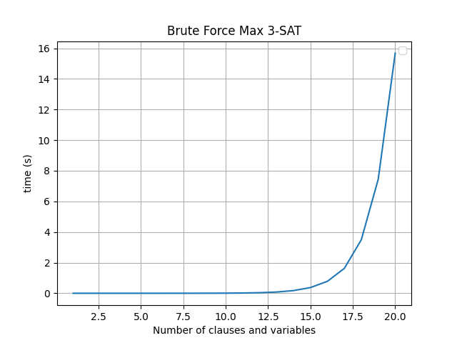
Runtime Analysis (Empirical)

