Slide 1
VeSPA
Embedded Systems
André Costa – A9208
Francisco Costa – PG53819

Slide 2
Agenda
-Instruction Fields;
-Branch;
-Datapath (update);
-Control Unit (update):
-State Machine;
-Control Signals;
-Memory Map;
-Memory IP (update);
-Test Benches:
-Memory IP TestBench (update);
-Alu test bench;
-Memory test bench;
-PC and IR test bench;
-Top level test bench;

Slide 3
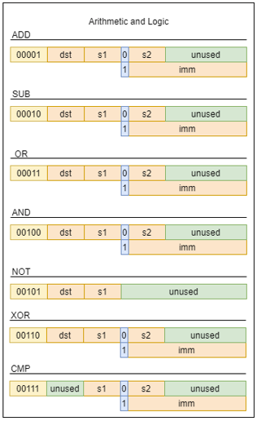
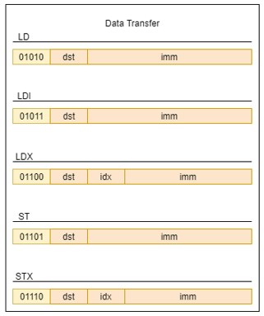
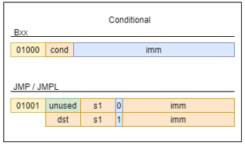
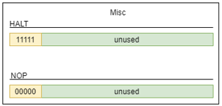
Instructions

Slide 4
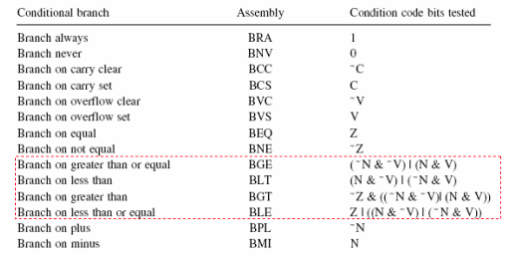
Branch

Slide 5
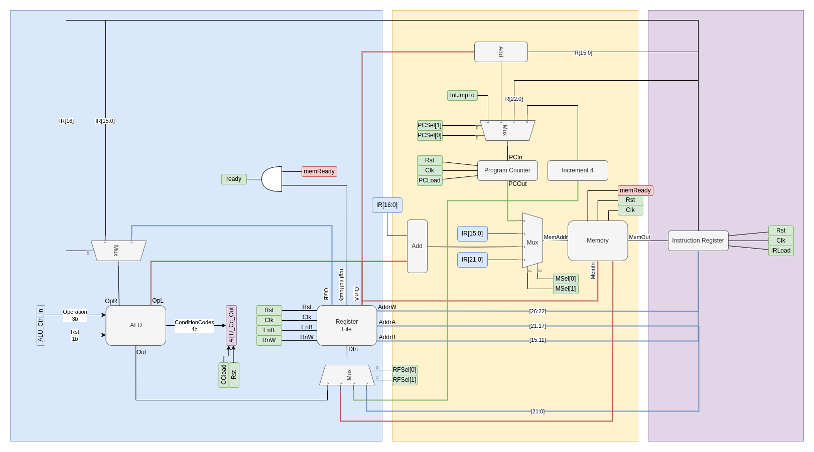
Datapath
Execute
Decode
Fetch

Slide 6
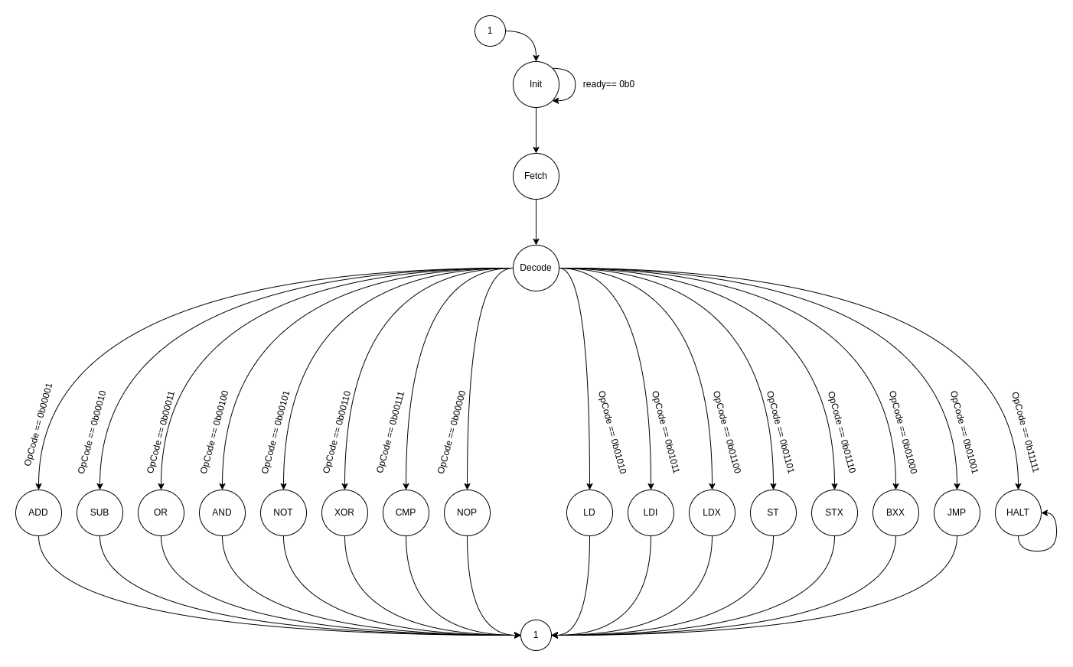
Control Unit State Machine

Slide 7
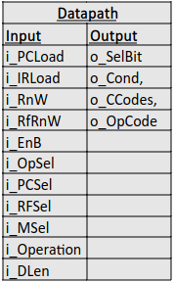
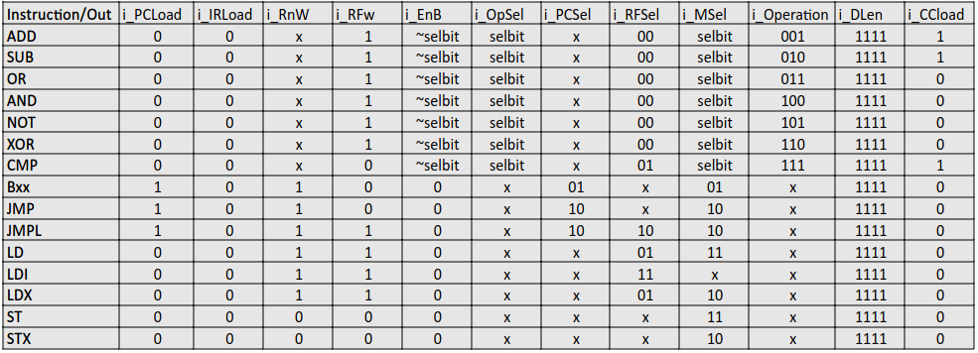
Control Unit

Slide 8
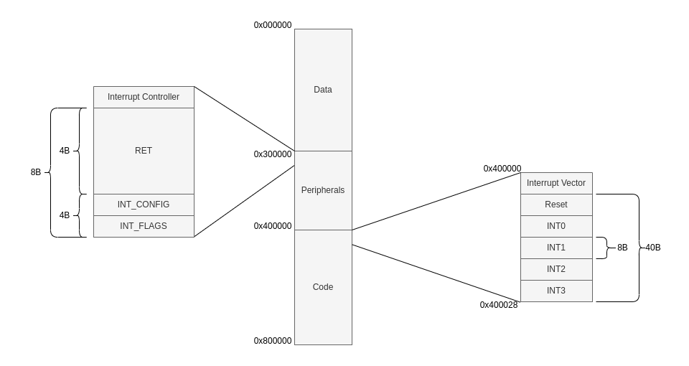
Memory Map

Slide 9
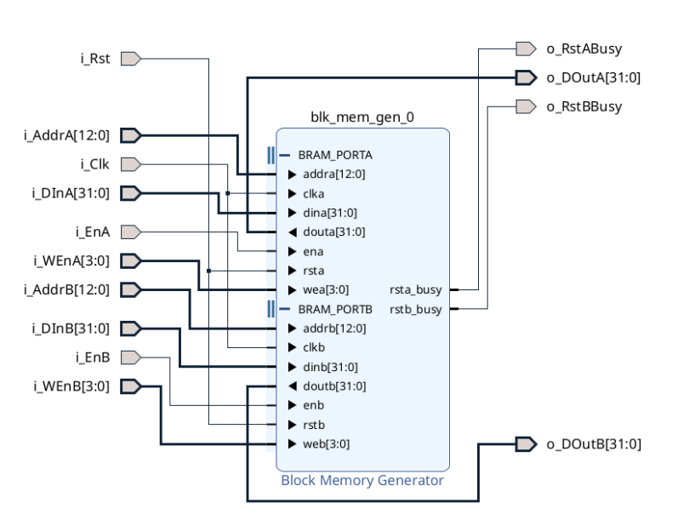
Memory IP

Slide 10
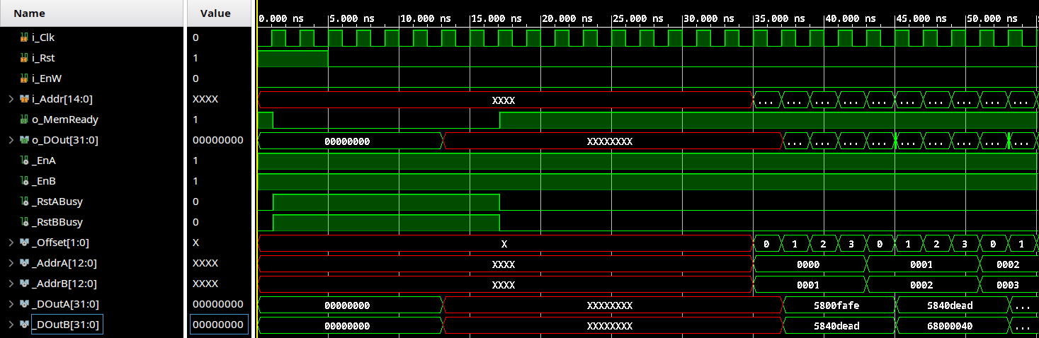
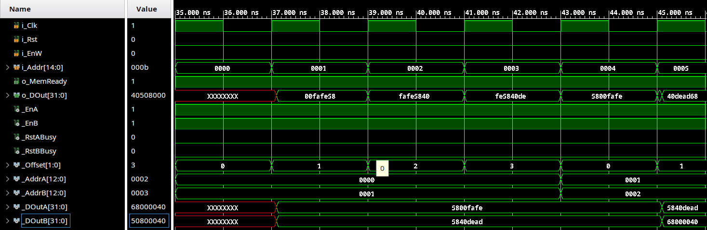
Memory IP TestBench

Slide 11
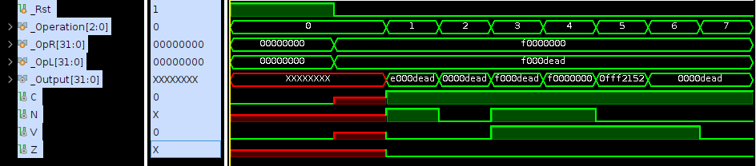
ALU Testbench

Slide 12
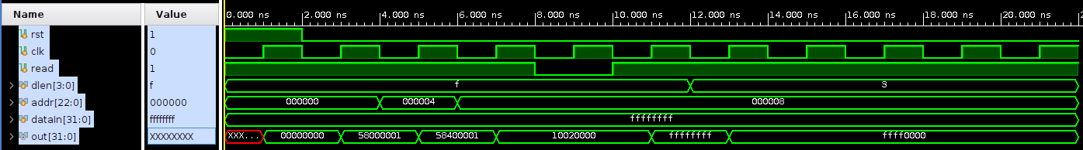
Memory testbench

Slide 13
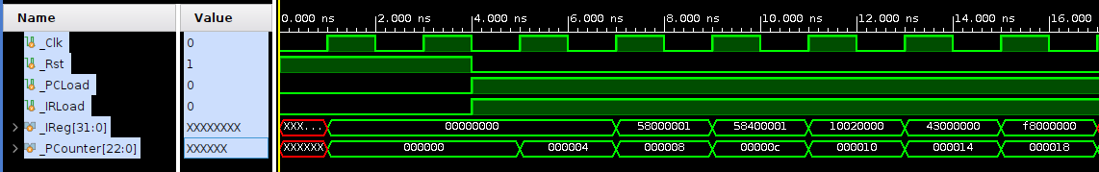
PC and IR testbench

Slide 14
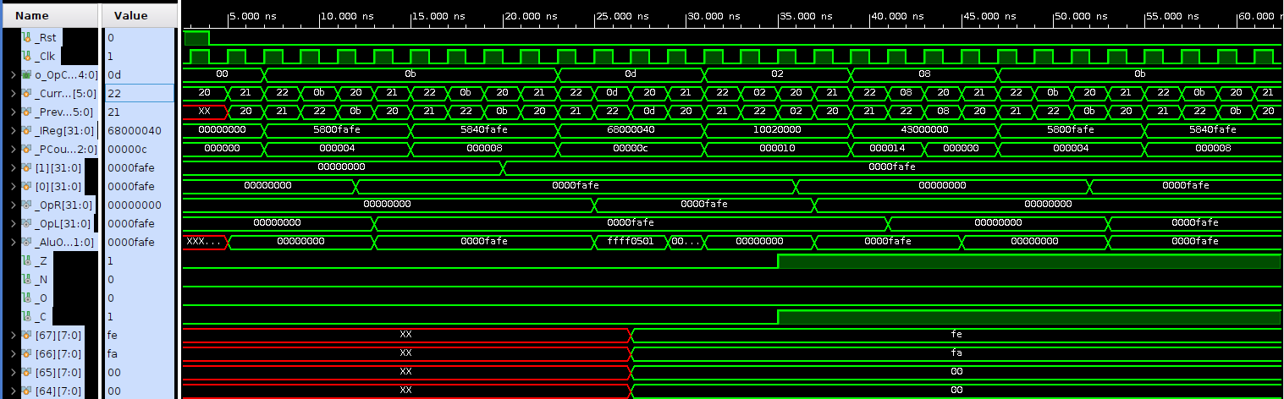
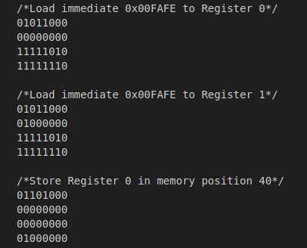
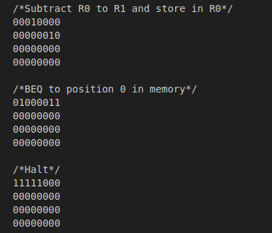
Top Level
Load Load Store SUB BEQ Load Load

