Slide 1
CS 193G
Lecture 1: Introduction to Massively Parallel Computing

Slide 2
Moore’s Law (paraphrased)
“The number of transistors on an integrated circuit doubles every two years.”
  – Gordon E. Moore
Notes:
Gordon Moore, co-founder of Intel
ca. 1965 in a paper

Slide 3

Moore’s Law (Visualized)
GF100
Data credit: Wikipedia
Notes:
Note different market demands will produce a deviation, e.g., Atom

Slide 4
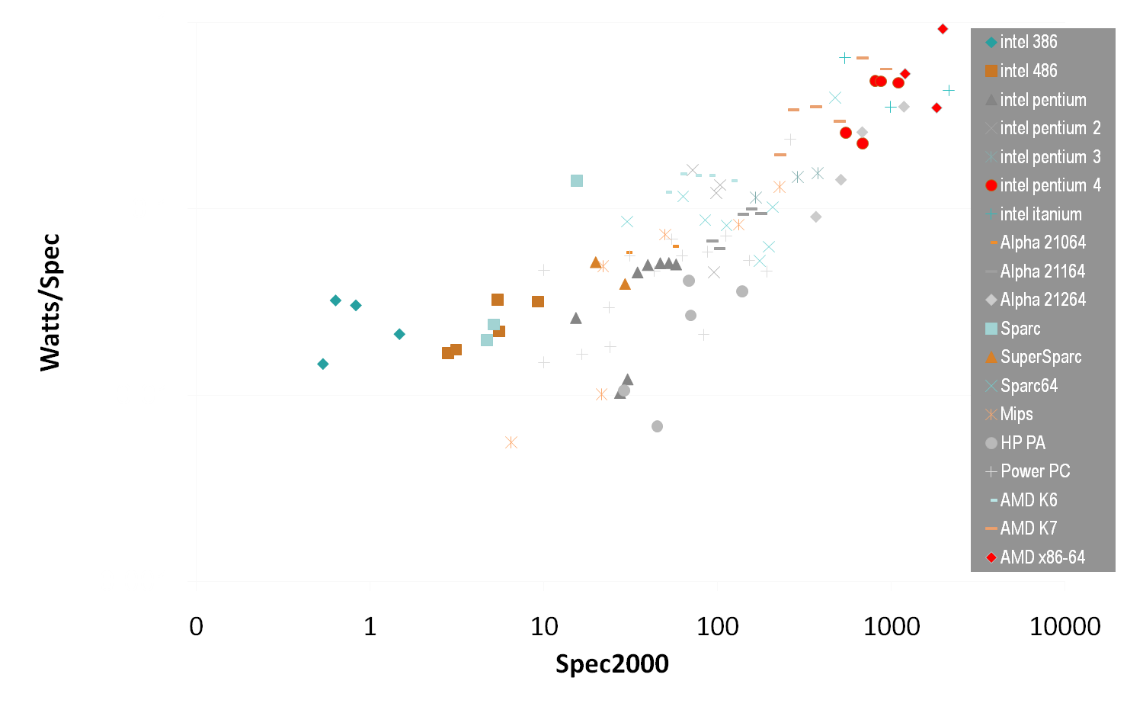
Buying Performance with Power
Power
Performance
(courtesy Mark Horowitz and Kevin Skadron)
Notes:
This graphs W/! (watts per bang) over several different single core CPU architectures
Y-axis graphs Watts per bench (lower is better)
With the progression of faster single core CPUs, this ratio has grown higher & higher.
You can buy performance with power, but unfortunately the ratio is not linear. Since the days of the 386, we’ve seen a trend of decreasing gains.
Spec2000: industry CPU benchmark, www.spec.org

Slide 5

Serial Performance Scaling is Over
Cannot continue to scale processor frequencies
  no 10 GHz chips
Cannot continue to increase power consumption
  can’t melt chip
Can continue to increase transistor density
  as per Moore’s Law
Notes:
The upshot of the power trend is that the epoch of serial performance scaling is over.
A glance across the CPU landscape reveals that single cores aren’t getting any faster: no architect has found a way to design 10 GHz chips.
We have to design underthe annoying constraint that the processor cannot melt once you flip the power switch.
So what can we do: transistors can continue to shrink, so we can increase transistor density. That is, we can fit more and more transistors onto a single chip.

Slide 6
How to Use Transistors?
Instruction-level parallelism
  out-of-order execution, speculation, …
  vanishing opportunities in power-constrained world
Data-level parallelism
  vector units, SIMD execution, …
  increasing … SSE, AVX, Cell SPE, Clearspeed, GPU
Thread-level parallelism
  increasing … multithreading, multicore, manycore
  Intel Core2, AMD Phenom, Sun Niagara, STI Cell, NVIDIA Fermi, …
Notes:
The challenge for architects is how to best utilize these additional transistors? The solution has been to embrace parallelism at all scales.
Traditionally, CPU architects have allocated additional transistors to logic which exploits instruction-level parallelism. The problem with this approach is that there are vanishing opportunities for ILP, both because of the limited application of ILP to general single-threaded code, and again, the power envelope.
Architects have also turned to data-level parallelism by introducing vector units and SIMD execution into chip designs. This has resulted in a proliferation of instruction set extensions such as SSE and Altivec, as well as entire platforms built around SIMD, such as Cell and various GPU architectures.
At an even coarser scale is thread-level parallelism. We see a proliferation of architectures here as well.
Niagara2 = 8 cores * 8 thread/core = 64 threads/chip

Slide 7
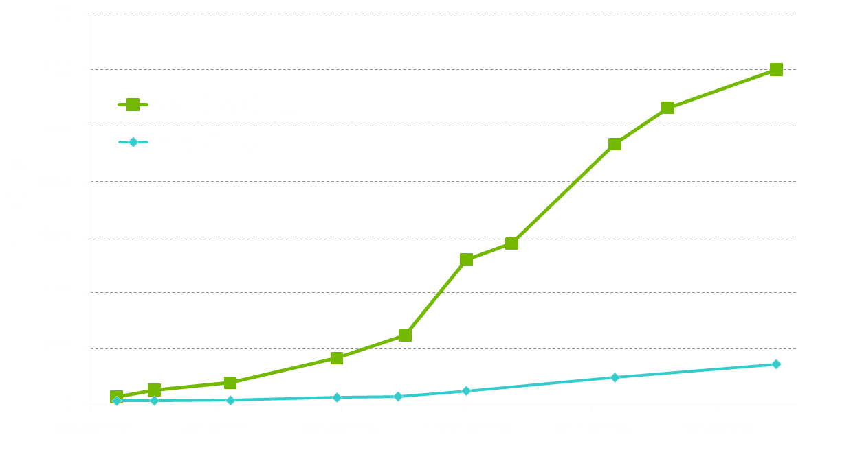
Why Massively Parallel Processing?
A quiet revolution and potential build-up
  Computation: TFLOPs vs. 100 GFLOPs
  GPU in every PC – massive volume & potential impact
T12
GT200
G80
G70
3GHz Xeon Quad
Westmere
NV40
3GHz Core2 Duo
NV30
3GHz Dual Core P4

Slide 8
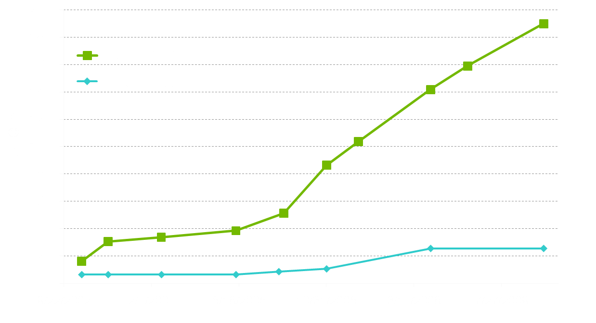
Why Massively Parallel Processing?
A quiet revolution and potential build-up
  Bandwidth: ~10x
  GPU in every PC – massive volume & potential impact
T12
GT200
G80
NV40
G70
3GHz Xeon Quad
Westmere
NV30
3GHz Core2 Duo
3GHz Dual Core P4

Slide 9
The “New” Moore’s Law
Computers no longer get faster, just wider
You must re-think your algorithms to be parallel !
Data-parallel computing is most scalable solution
  Otherwise: refactor code for 2 cores
  You will always have more data than cores –
  build the computation around the data
4 cores
8 cores
16 cores…
Notes:
The tide of commodity technology is rising in a different direction.
To first order, computers have stopped getting faster (higher clock speeds), they just get wider (more parallel)
If you work on an interesting problem, you *must* re-think your algorithms to be parallel
* Otherwise, if your serial algorithm isn't fast enough today it never will be fast enough
Data-parallel computing is the most scalable solution
* Another option is to tease your code apart, move this task (say I/O) to one core and that task (compute) to another core, oh wait now there's 4 cores, um, let's put mouse and keyboard handing on one core and split compute into database access and the linear algebraic solver, oops now there's 8 cores lets split up the solver into LU decomposition and .... you get the idea
* if your problem is of interesting size the data will always outnumber the cores, so organize the computation around the data

Slide 10








Generic Multicore Chip
Processor
Memory
Processor
Memory
Global Memory
Handful of processors each supporting ~1 hardware thread
On-chip memory near processors (cache, RAM, or both)
Shared global memory space (external DRAM)
Notes:
One instance of this idea is the current wave of multicore CPUs.
In this generic design, you’ve got a few processors which each support around one thread in hardware. Paired with each hardware thread, you’ve also got relatively lots of on-chip memory near the processors for local computation. Farther out, you’ve got a shared global memory space which the processors can communicate through to enable cooperation on

Slide 11
Generic Manycore Chip
Processor
Memory
• • •
Processor
Memory
Global Memory
Many processors each supporting many hardware threads
On-chip memory near processors (cache, RAM, or both)
Shared global memory space (external DRAM)
Notes:
Alternatively, a manycore parallel architecture replicates many processor cores, each hosting several lightweight hardware threads. Like a multicore architecture, each processor is paired with a dedicated on-chip memory, but per-thread memory resources are relatively smaller.
Because the on-chip memory is shared among a processor’s threads, it serves as a convenient venue for thread communication/cooperation
Again, the shared global memory space serves as a forum for inter-core communication/cooperation (threads in differing processors may communicate here)

Slide 12
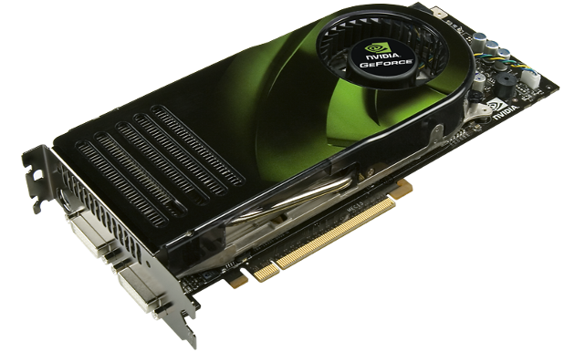
Enter the GPU
Massive economies of scale
Massively parallel
Notes:
In fact, manycore NVIDIA GPUs make parallel processing a commodity technology
GPUs are mass-market commodity products sold at tremendous economies of scale. We sell around 1 million GPUs per week! That’s about 100 per minute.
GPUs are massively parallel devices. Our high-end GPUs have 240 heavily multithreaded thread processors and support over 30,000 concurrent threads in flight.
Upshot: Massively parallel computing has become a commodity technology!

Slide 13
Why is this different from a CPU?
Different goals produce different designs
  GPU assumes work load is highly parallel
  CPU must be good at everything, parallel or not
CPU: minimize latency experienced by 1 thread
  big on-chip caches
  sophisticated control logic
GPU: maximize throughput of all threads
  # threads in flight limited by resources => lots of resources (registers, bandwidth, etc.)
  multithreading can hide latency => skip the big caches
  share control logic across many threads
Notes:
You may ask “Why are these design decisions different from a CPU?”
In fact, the GPU’s goals differ significantly from the CPU’s
GPU evolved to solve problems on a highly parallel workload
CPU evolved to be good at any problem whether it is parallel or not
For example, the trip out to memory is long and painful
The question for the chip architect: How to deal with latency?
One way is to avoid it: the CPU’s computational logic sits in a sea of cache. The idea is that few memory transactions are unique, and the data is usually found quickly after a short trip to the cache.
Another way is amortization: GPUs forgo cache in favor of parallelization. Here, the idea is that most memory transactions are unique, and can be processed efficiently in parallel. The cost of a trip to memory is amortized across several independent threads, which results in high throughput.

Slide 14
Enter CUDA
Scalable parallel programming model
Minimal extensions to familiar C/C++ environment
Heterogeneous serial-parallel computing
Notes:
How should a programmer make sense of all this? Enter CUDA -
Point of this slide is to decouple CUDA from GPUs. CUDA is a parallel programming model for the future, and a good way to write scalable code. GPUs accelerate it (enormously) but it is broader than a “language for GPUs”.

Slide 15
CUDA: Scalable parallel programming
Augment C/C++ with minimalist abstractions
  let programmers focus on parallel algorithms
  not mechanics of a parallel programming language
Provide straightforward mapping onto hardware
  good fit to GPU architecture
  maps well to multi-core CPUs too
Scale to 100s of cores & 10,000s of parallel threads
  GPU threads are lightweight — create / switch is free
  GPU needs 1000s of threads for full utilization

Slide 16
Key Parallel Abstractions in CUDA
Hierarchy of concurrent threads
Lightweight synchronization primitives
Shared memory model for cooperating threads

Slide 17
Hierarchy of concurrent threads
Parallel kernels composed of many threads
  all threads execute the same sequential program
Threads are grouped into thread blocks
  threads in the same block can cooperate
Threads/blocks have unique IDs
Thread t
Block b
t0 t1 … tB

Slide 18






CUDA Model of Parallelism
Block
Memory
• • •
Block
Memory
Global Memory
CUDA virtualizes the physical hardware
  thread is a virtualized scalar processor (registers, PC, state)
  block is a virtualized multiprocessor (threads, shared mem.)
Scheduled onto physical hardware without pre-emption
  threads/blocks launch & run to completion
  blocks should be independent

Slide 19

NOT: Flat Multiprocessor
Processors
Global Memory
Global synchronization isn’t cheap
Global memory access times are expensive
cf. PRAM (Parallel Random Access Machine) model

Slide 20





NOT: Distributed Processors
Processor
Memory
Processor
Memory
• • •
Interconnection Network
Distributed computing is a different setting
cf. BSP (Bulk Synchronous Parallel) model, MPI

Slide 21









Heterogeneous Computing
Multicore CPU

Slide 22
C for CUDA
Philosophy: provide minimal set of extensions necessary to expose power
Function qualifiers:
  __global__ void my_kernel() { }
  __device__ float my_device_func() { }
Variable qualifiers:
  __constant__ float my_constant_array[32];
  __shared__ float my_shared_array[32];
Execution configuration:
  dim3 grid_dim(100, 50); // 5000 thread blocks
  dim3 block_dim(4, 8, 8); // 256 threads per block
  my_kernel <<< grid_dim, block_dim >>> (...); // Launch kernel
Built-in variables and functions valid in device code:
  dim3 gridDim; // Grid dimension
  dim3 blockDim; // Block dimension
  dim3 blockIdx; // Block index
  dim3 threadIdx; // Thread index
  void __syncthreads(); // Thread synchronization
Notes:
With C for CUDA, our philosophy has been to provide the minimal set of extensions to the C programming language to enable the programmer to succinctly describe a parallel problem such that it can take advantage of the power of massively parallel platforms
__global__ keyword tags a function as an entry point to a program that will run on a parallel compute device – think of this as the program’s main() function
__device__ keyword tags a function to tell the compiler that the function should execute on the GPU
__constant__ declares a read-only variable or array that lives in the GPU’s memory space
__shared__ provides read-write access to a variable or array that lives in on-chip memory space. Neighboring threads in a block are allowed to communicate through such variables
To launch a program, you call a function declared with the __global__ keyword and configure the “shape” of the computation. It may be convenient to describe the computation as a 1D (working on a linear array), 2D problem (think of doing some work on the pixels of an image), or 3D (think of doing some work on the voxels of a volume grid)
While in a __global__ or __device__ function, threads need to know their “location” in the computation, and that is provided by built-in variables:
gridDim & blockDim specify the shape of the current launch configuration, and blockIdx and threadIdx uniquely identify each thread in the grid
Finally, the built-in function __syncthreads() provides a synchronization barrier for all threads operating in a block – all computation halts until all threads in a block have reached the barrier. This comes in handy when threads want to pass messages to each other to cooperate on a problem

Slide 23
Example: vector_addition
Device Code
// compute vector sum c = a + b
// each thread performs one pair-wise addition
__global__ void vector_add(float* A, float* B, float* C)
{
int i = threadIdx.x + blockDim.x * blockIdx.x;
C[i] = A[i] + B[i];
}
int main()
{
// elided initialization code
...
// Run N/256 blocks of 256 threads each
vector_add<<< N/256, 256>>>(d_A, d_B, d_C);
}

Slide 24
Example: vector_addition
// compute vector sum c = a + b
// each thread performs one pair-wise addition
__global__ void vector_add(float* A, float* B, float* C)
{
int i = threadIdx.x + blockDim.x * blockIdx.x;
C[i] = A[i] + B[i];
}
int main()
{
// elided initialization code
...
// launch N/256 blocks of 256 threads each
vector_add<<< N/256, 256>>>(d_A, d_B, d_C);
}
Host Code

Slide 25
Example: Initialization code for vector_addition
// allocate and initialize host (CPU) memory
float *h_A = …, *h_B = …;
// allocate device (GPU) memory
float *d_A, *d_B, *d_C;
cudaMalloc( (void**) &d_A, N * sizeof(float));
cudaMalloc( (void**) &d_B, N * sizeof(float));
cudaMalloc( (void**) &d_C, N * sizeof(float));
// copy host memory to device
cudaMemcpy( d_A, h_A, N * sizeof(float), cudaMemcpyHostToDevice) );
cudaMemcpy( d_B, h_B, N * sizeof(float), cudaMemcpyHostToDevice) );
// launch N/256 blocks of 256 threads each
vector_add<<<N/256, 256>>>(d_A, d_B, d_C);

Slide 26
Final Thoughts
Parallel hardware is here to stay
GPUs are massively parallel manycore processors
  easily available and fully programmable
Parallelism & scalability are crucial for success
This presents many important research challenges
  not to speak of the educational challenges

Slide 27
Machine Problem 0
http://code.google.com/p/stanford-cs193g-sp2010/wiki/GettingStartedWithCUDA
Work through tutorial codes
  hello_world.cu
  cuda_memory_model.cu
  global_functions.cu
  device_functions.cu
  vector_addition.cu

