Slide 1

Team Details
OUR SOLUTION
a.
Team name: NerdNinzas
BatchGuard AI
b.
Team leader name: Prabal Verma
Your factory, watched by an agent that explains every alarm and calls the right person.
c.
Problem Statement: Manufacturing: Intelligent Operations & Industrial Efficiency
Notes:
BatchGuard AI, for the Manufacturing theme. An agent for small and mid-sized factories that turns a machine manual into monitoring, diagnoses faults with evidence, and phones the right person.

Slide 2
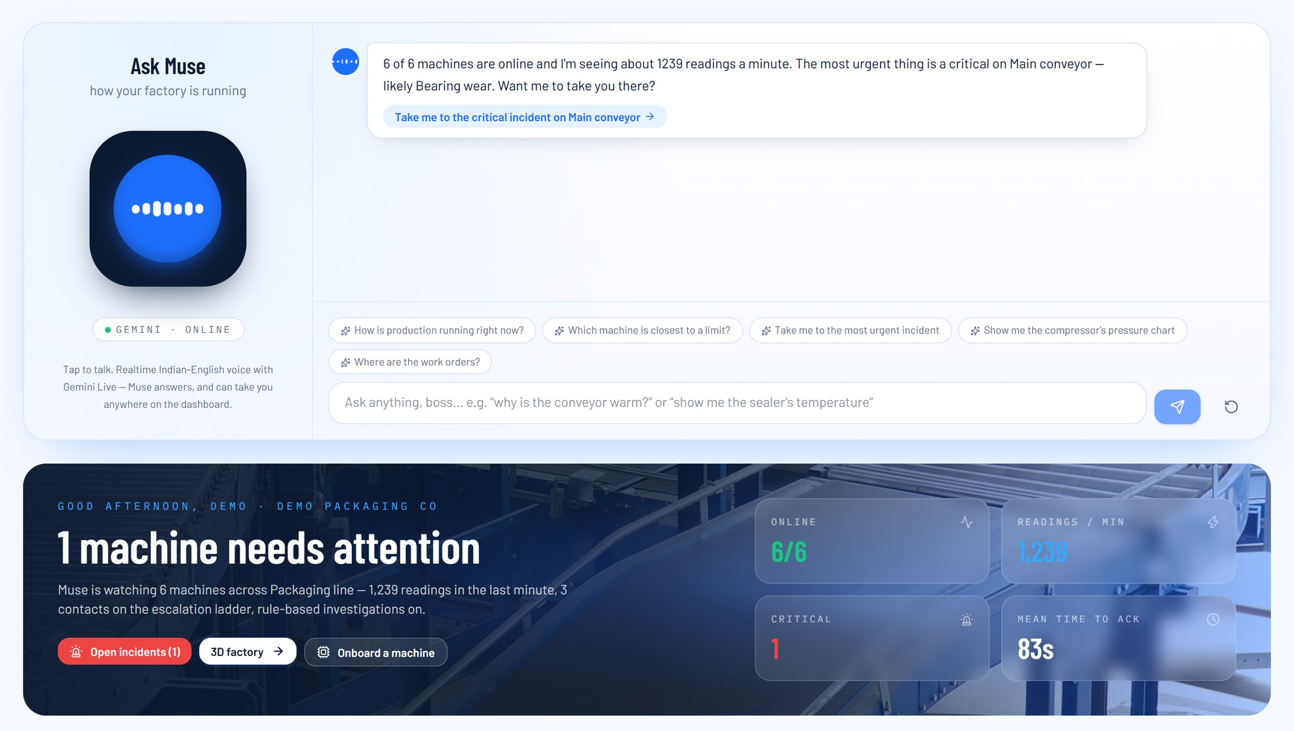
01 / BRIEF ABOUT THE IDEA
An AI plant manager who read every manual and never stops watching
Small factories run on old machines and one stretched maintenance lead. BatchGuard gives them Muse: an agent that turns a machine's PDF manual into live monitoring, works out what is going wrong from the data, and phones the right person before the line stops.
01
Reads
Upload the manual. Gemini pulls out every limit with the page it came from, and a person signs it off.
02
Watches
Machines post a reading every second. Limits, trends and anomalies are checked on each one, no LLM in the way.
03
Investigates
When something drifts, a Google ADK agent gathers evidence, tests three to five explanations and ranks them.
WHAT THE ON-CALL ENGINEER HEARS
04
Calls
If it turns critical, Muse rings the on-call engineer, reads a 20-second brief and takes the acknowledgement.
Muse Main conveyor vibration is climbing toward its limit. Most likely a worn bearing. Check the drive-end bearing first. Can you acknowledge?
05
Learns
Fixes, photos and verdicts go back into the history the agent reads next time.
Maintenance lead Acknowledged. I'm there in ten minutes.
Notes:
Open with the one-liner, then the five verbs. The phone call on the right is the moment judges remember.

Slide 3
01 / BRIEF ABOUT THE IDEA: THE PROBLEM
The know-how exists. It is stuck in a PDF and in one person's head
“
A bearing that has been warming for forty minutes gets noticed when the line stops. Then someone goes looking for the manual.
A TYPICAL BREAKDOWN
IN AN SME PLANT
01
No monitoring
02
Knowledge locked away
03
Found late, fixed slowly
SCADA, MES and condition-monitoring suites are priced and staffed for big plants. A shop with eight machines and one maintenance lead cannot buy, integrate or run them.
The manual says the bearing must stay under 85 °C and that heat plus vibration means wear. Nobody typed that into a system, and the one person who knows is on another shift.
Threshold alarms fire after the limit is crossed and never say why. Diagnosis is guesswork, and downtime runs to hours.
WHY NOW
BUILT FOR
Gemini reads a 60-page scanned manual into structured limits with page citations.
Google ADK makes a multi-stage evidence pipeline a days-long build, not a year.
SME plants with 5 to 50 machines
Maintenance leads who need to know what to check first
Gemini Live makes a natural phone call with tool use practical, in Indian English.
Cloud Run + managed data remove the ops work, so a plant costs about $100 a month.
Integrators setting up many plants
Notes:
Three truths for almost every SME plant. The quote is what actually happens today.

Slide 4
02 / OPPORTUNITIES: HOW IS IT DIFFERENT?
Others show you data. We tell you what is wrong and who is fixing it
INDUSTRIAL IOT PLATFORMS
PLC THRESHOLD ALARMS
“CHAT WITH YOUR PDF”
BATCHGUARD AI
Setting up a machine
Weeks of integration, priced per data point
Each limit hand-programmed
Minutes, but never connected to the machine
Minutes: upload the manual, verify, get a key
Sees the live machine
Yes
Yes, on the HMI
No
Every second, per-machine API, live stream
Warns before the limit
Through add-on analytics
Only after it is crossed
No
Trend, anomaly and a time-to-limit forecast
Explains why
Charts a person must interpret
Never
Knows the manual, not the data
Ranked causes, evidence for and against, manual page
Gets a person to act
Alerts and email
A horn or a banner
No
Email, then a phone call, then the next contact
Fits an SME
Specialist staff and licences
Cheap, but blind
Cheap
About $100 a month, nothing to run
Only BatchGuard closes the loop from a raw reading to a person on the phone who knows what to check.
Notes:
Four ways an SME can watch machines today, compared on what matters to a plant manager.

Slide 5
02 / OPPORTUNITIES: HOW IT SOLVES THE PROBLEM, AND OUR USP
Five things you will not find together anywhere else
HOW IT SOLVES THE PROBLEM
UNIQUE SELLING POINTS
1
Manual to monitoring in minutes
NO MONITORING
Any machine with a sensor or a PLC gateway posts readings to its own keyed endpoint. Cloud Run and managed Google data services mean there is nothing for the plant to operate.
Gemini reads the manual. A person verifies every limit before anything goes live.
2
Every number is checked
A guardrail matches each number in a report against stored readings, limits and manual pages, or marks it unverified.
KNOWLEDGE LOCKED AWAY
3
It picks up the phone
Gemini turns the manual into verified limits and knowledge passages, fault tables and maintenance intervals, that the agent cites by page.
Gemini Live calls the on-call engineer. Saying “acknowledged” stops the escalation and the shutdown timer.
4
You can talk to the factory
FOUND LATE, FIXED SLOWLY
Ask out loud how the line is running. Muse answers with live data and highlights the chart it means.
Deterministic checks flag drift on every reading. The ADK agent returns ranked causes with evidence and the first check, then phones the on-call contact.
5
It never goes blind
Detection needs no LLM, and a rule-based investigator takes over if Gemini is unavailable.
Notes:
Left: each SME problem and the mechanism that fixes it. Right: the five USPs.

Slide 6
03 / LIST OF FEATURES OFFERED BY THE SOLUTION (1 OF 2)
The monitoring loop: from a PDF manual to a phone call
1
2
3
4
5
6
Onboard from the manual
Per-machine telemetry API
Four detection layers
Time-to-limit forecast
Incident engine
Escalation ladder
Gemini 2.5 Flash reads the PDF with a strict JSON schema
Limits, units, sample rate, page, exact snippet, confidence
Nothing goes live until a person verifies it
Device key plus curl, Python and Node samples
POST /v1/telemetry with an X-Device-Key
Parameter and unit checked against the spec
Duplicates dropped by reading_id
Live server-sent events to every dashboard
Limits: warning and critical
Trend: critical projected within 10 min
Anomaly: |z| ≥ 3.5 against its own baseline
Staleness: a silent machine is an incident
Re-fitted every 5 s for each parameter
Projects time to warning and to critical
“Critical in 12 min” on cards and charts
Health score from 0 to 100
One open incident per machine
Five-minute cooldown per parameter
Two parameters in warning make it critical
Every alert attempt is logged
Warning: dashboard and email
Critical: plus a Gemini Live phone call
No answer in 2 min: the next contact
No ack in 5 min: Muse stops the machine
6.4 ms
median time to ingest and check a reading
22 s
from a bearing starting to fail to a warning
0
LLM calls anywhere in the detection path
Notes:
Six features in the order a reading meets them.

Slide 7
03 / LIST OF FEATURES OFFERED BY THE SOLUTION (2 OF 2)
What makes Muse more than an alarm
07
Investigation agent
08
Number guardrail
09
Fallback investigator
A six-stage Google ADK pipeline with seven read-only tools. The report has a summary, timeline, ranked causes, ordered checks with safety notes, missing data and a 20-second call script.
Any number the agent cannot trace to stored readings, limits, neighbours or manual pages becomes [unverified] and is listed.
If Gemini fails twice, a rule-based investigator with a fault-signature library writes the same report shape.
10
Phone escalation
11
Muse copilot
12
Photo evidence
Five call flows run on Dograh over a TeleCMI line. Transcript, recording and the extracted outcome update the incident.
Streaming chat and realtime Gemini Live voice. Ask for anything and Muse navigates there and spotlights it.
A technician's photo is read by Gemini vision against the ranked causes and can re-run the investigation.
13
Work orders
14
Live 3D factory and line builder
15
Observability and evaluation
A Kanban per machine. One click turns Muse's checks into orders, prioritised by severity.
A 3D hall that mirrors machine status, and a node editor whose upstream and downstream links drive cross-machine reasoning.
Latency by route, ingest rate, every agent tool call, and a blind test that scores detection delay and cause accuracy.
Notes:
The intelligence and the human side.

Slide 8
04 / PROCESS FLOW DIAGRAM (1 OF 3)
One reading's journey, from a sensor to someone's phone
DETERMINISTIC, EVERY READING, MILLISECONDS
AI, PER INCIDENT
PEOPLE
01
02
03
04
05
06
07
Onboard
Ingest
Detect
Open incident
Investigate
Escalate
Act and learn
Upload manual
Gemini extracts limits
Person verifies
Device key issued
POST /v1/telemetry
Checked against spec
Stored, streamed live
Pub/Sub to BigQuery
Limits
Trend to time-to-limit
Anomaly (z-score)
Staleness, forecast
One per machine
Five-minute cooldown
Severity ladder
Health score
Evidence in parallel
Hypotheses, evaluation
Checks, report
Number guardrail
Dashboard and email
Gemini Live call
Next contact at 2 min
Stop at 5 min if no ack
Ack spoken on call
Work orders
Photo evidence
Resolve with verdict
Photos and verdicts re-run the investigation
MEASURED ON THE PROTOTYPE: BEARING WEAR ON A CONVEYOR (MEDIAN OF RUNS)
12 s
First anomaly flagged
85 seconds of warning before the machine crossed its critical limit, on a fault compressed into two minutes
0 s
Bearing starts to fail
22 s
Warning, report and email
107 s
Critical limit crossed
Notes:
Stages one to four are deterministic and run on every reading. AI is only called once per incident.

Slide 9
04 / PROCESS FLOW DIAGRAM (2 OF 3)
Every reading gets the same checks. Severity decides who hears about it
A reading arrives
SEVERITY LADDER
Info
One anomaly, inside limits
Known parameter and unit?
NO
Rejected, with the reason
A dashboard event. No incident, no noise.
ADK investigation writes the report and call script
YES
Stored, streamed live, sent to BigQuery
Warning
A limit or a trend
Dashboard and email, plus the report when the agent finishes.
Past a warning or critical limit?
Incident engine: one per machine, 5 min cooldown, two warnings make a critical
YES
Limit signal
Critical
Critical limit, or two warnings at once
NO
Everything above, plus a Gemini Live call to contact #1, and the shutdown timer starts.
Trend reaches critical in 10 min?
YES
Trend signal with ETA
Emergency
No acknowledgement in 2 min, or an E-stop
Also on every reading: a z-score of 3.5 or more against the machine's own baseline logs an info event, and the forecast refreshes every 5 s.
Call the next contact every 2 min. No one in 5 min: Muse shuts the machine down.
Notes:
Left: the per-reading decision path. Right: the severity ladder.

Slide 10





04 / PROCESS FLOW DIAGRAM (3 OF 3): USE CASES
Who uses BatchGuard, and for what
BATCHGUARD AI
Onboard a machine from its manual
Verify extracted limits
Plant owner
manager, plant head
Stream telemetry with a device key
Watch the dashboard and 3D factory
Machine
PLC or gateway, 1 Hz
Get an email or a phone call
Acknowledge on the call
Maintenance lead
on-call technician
Investigate and ask Muse
Talk to the factory by voice
Muse
Upload photo evidence
Work orders, resolve with a verdict
AI agent on Vertex AI
Integrator
Wire the line, set contacts
Review observability and evaluation
sets up many plants
Notes:
Five actors around one system. Muse is an actor too: it starts investigations and calls on its own.

Slide 11


05 / WIREFRAMES AND MOCK DIAGRAMS
Four screens carry the whole journey
Drop conveyor-manual.pdf
CRITICAL
ACKNOWLEDGED
6/6
1
1,218
Main conveyor: vibration trend
Main conveyor
Ask Muse
#1 Bearing wear
STRONG
PARAM
WARN
CRIT
PAGE
OK
critical in 4 min
+
–
Muse calling Maintenance lead 00:18
motor_temp
p.12
Air compressor
#2 Overload / jam
“Main conveyor vibration is rising toward its limit. Likely a worn bearing. Check the drive-end bearing first.”
normal
WEAK
vibration
p.13
+
–
current
p.14
Sealer
normal
#3 Cooling fan
INCONCLUSIVE
belt_speed
p.15
+
–
“Acknowledged. Ten minutes.”
load
p.16
crit
Check first: IR-gun the drive-end bearing
Verified, go live
Work orders
Call on-call
ACKNOWLEDGED
ETA 10 MIN
01
Onboard
02
Overview
03
Incident
04
The call
Upload the manual, verify every limit
The live line, forecasts and Ask Muse
Ranked causes, evidence, checks
Muse phones the on-call engineer
Notes:
Low-fidelity wireframes of the core flow. The real screens follow.

Slide 12
06 / ARCHITECTURE DIAGRAM OF THE PROPOSED SOLUTION (1 OF 2)
Two Cloud Run services. Vertex AI does the thinking
Browser
Machines and PLC gateways
Dashboard, live stream, voice copilot
POST /v1/telemetry with a device key
GOOGLE CLOUD · ASIA-SOUTHEAST1
Cloud Run · frontend
Cloud Run · backend (FastAPI, always on)
Vertex AI
Next.js 16, React 19
3D factory, line builder
Scales to zero
Ingest and detection
Incidents and escalation
Gemini 2.5 Flash and Pro
Agent Development Kit
Gemini Live native audio
ADK agent runner
Muse copilot, Live relay
Also: Secret Manager · Cloud Logging · Cloud Build → Artifact Registry · Firebase Auth
Voice and email
SQLite hot path, SSE
Data
Firestore · Pub/Sub → BigQuery
Cloud Storage (manuals, photos)
Why this shape. Detection runs inside the backend on every reading. Only incidents reach Vertex AI, which keeps latency and cost low.
Dograh voice agents
On-call phone
Resend
Inbox
Gemini Live, TeleCMI SIP
email API
Notes:
Machines and browsers at the top, Google Cloud in the middle, the phone line and email at the bottom.

Slide 13
06 / ARCHITECTURE DIAGRAM OF THE PROPOSED SOLUTION (2 OF 2)
The investigation is a pipeline, not a prompt
TRIGGER
SequentialAgent batchguard_investigation
An incident opens or escalates. One run per incident at a time.
ParallelAgent gather
hypothesis_generator
evaluator
recommender
reporter
context_builder
FLASH
PRO
FLASH
FLASH
FLASH
Readings for every parameter, baselines, events, neighbours and past incidents, as a factual summary.
Three to five causes, each with what it explains and what it does not.
Evidence for, against and missing per cause, a support label, a ranking.
Checks in order, most telling first, each with a safety note and page.
A schema-checked IncidentReport and a call script under 20 seconds.
get_readings get_baseline get_events
get_line_neighbours get_past_incidents
retriever
FLASH
Up to three symptom queries. Manual passages, verbatim, with pages.
get_manual_sections
compute_correlation
get_baseline get_readings
output_schema=
IncidentReport
Every stage: numbers only from tools, cite manual pages, support is a label not a probability, and no stage can change a machine.
Number guardrail
Store and broadcast
Notify
Fallback
Each number is matched against recent readings, limits, manual pages and neighbour values within 0.5 %. Anything else becomes [unverified].
The report is saved, pushed live to every dashboard and mirrored to Firestore. The tool trace is kept per run.
A report-ready email goes out. The call script and first check fill the phone call.
If Gemini fails twice, a rule-based investigator uses the same tools and a fault-signature library.
Notes:
A Google ADK SequentialAgent. Each stage writes to session state, the next one reads it. Every tool is read-only.

Slide 14














07 / TECHNOLOGIES TO BE USED IN THE SOLUTION
Built on the Google Cloud stack the brief asked for
Gemini on Vertex AI
2.5 Flash reads manuals, gathers evidence, chats, reads photos and call outcomes. 2.5 Pro weighs the hypotheses.
ALSO ON GOOGLE CLOUD
Firestore
Secret Manager
Cloud Logging
Cloud Build and Artifact Registry
Firebase Authentication
Vertex AI
Agent Development Kit runs the six-stage investigation. Gemini Live native audio powers the voice copilot.
BigQuery
Stores every reading through a Pub/Sub BigQuery subscription, for long-window history and analysis.
Cloud Storage
Keeps uploaded manuals and datasheets, and technicians' photo evidence.
APPLICATION STACK
Frontend
Vision and image analysis
Gemini multimodal reads scanned manuals and photos against the ranked causes.
Next.js 16, React 19, TypeScript, Tailwind v4, three.js and React Three Fiber, React Flow, Recharts
Pub/Sub
The telemetry topic carries every reading from ingest to the warehouse.
Backend
Python 3.12, FastAPI, Pydantic, Google ADK, google-genai, NumPy
Dataflow
Next: windowed feature pipelines when a customer runs many sites.
Voice and email
Dograh, TeleCMI SIP, Resend
Cloud Run
Runs the frontend (scales to zero) and the backend (always on), built by Cloud Build.
● in the prototype ● planned
Notes:
Every suggested technology and how we use it. Dataflow is planned, not built.

Slide 15
08 / ESTIMATED IMPLEMENTATION COST
About $100 a month runs a plant. One hour of downtime costs more
≈ $100
MONTHLY BREAKDOWN, USD
Cloud Run backend
1 vCPU, 1 GiB, always on, Singapore
50 – 70
Cloud Run frontend
Scales to zero, mostly free tier
0 – 3
per plant, per month, on Google Cloud list prices
Vertex AI investigations
~60 runs, ~45k Flash + ~10k Pro tokens each
3 – 5
Vertex AI other calls
Manual extraction, chat, vision, call outcomes
2 – 5
Six machines, 21 parameters at 1 Hz (about 54 million readings), around 60 investigations, 40 call minutes and two hours of voice copilot.
Gemini Live audio
Voice copilot and phone agent, ~160 min
3 – 8
Pub/Sub and BigQuery
54M messages, ~11 GB stored
3 – 6
Firestore, Storage, Secrets, Logging
Small volumes
1 – 3
≈ $15 to 25
for each additional plant. One backend serves many plants.
Phone line and voice server
TeleCMI minutes, small VM for Dograh
15 – 30
Email
Resend free tier, 3,000 a month
0
$0
on servers, SCADA or MES licences. Existing PLCs post over HTTPS.
Total, first plant
80 – 130
Prices as of October 2026, before tax. Vertex AI Gemini 2.5 Flash $0.30 / $2.50 and 2.5 Pro $1.25 / $10 per million input / output tokens; Cloud Run instance billing, Tier 2 region. Cost levers: batch tier, context caching, committed-use discounts. Sensors cost extra only where a machine has no PLC or gateway.
Notes:
Monthly running cost for one plant at list prices. The always-on backend is most of it; the LLM is only called per incident.

Slide 16
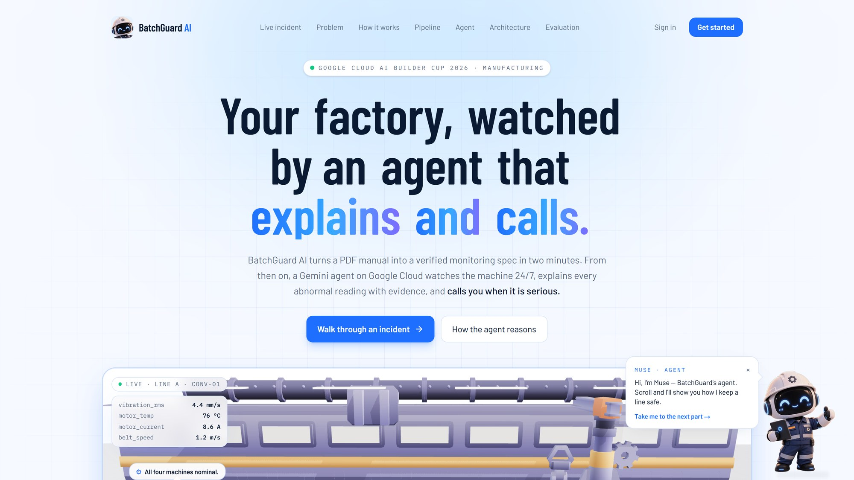
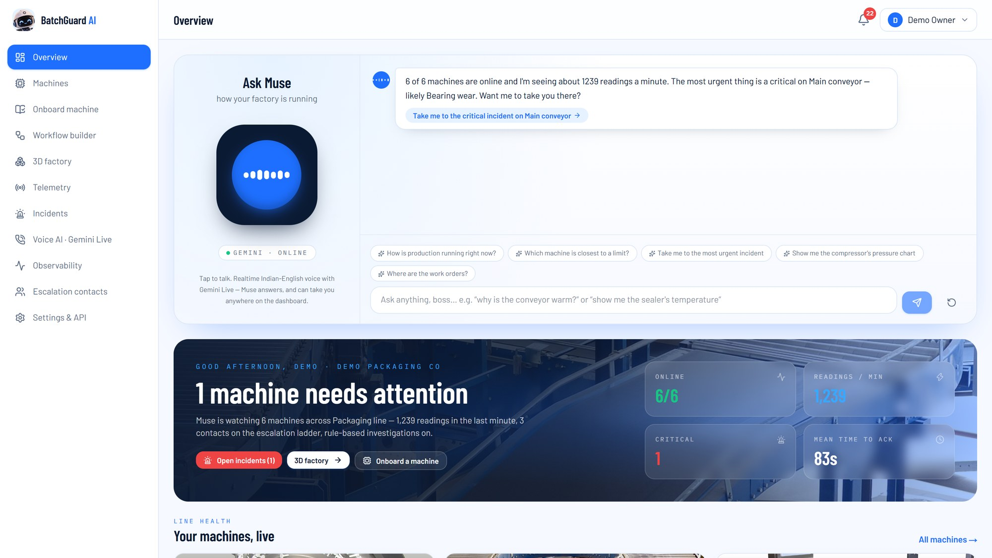
09 / SNAPSHOTS OF THE PROTOTYPE (1 OF 4)
The live prototype, running on Cloud Run
01
Landing page
02
Overview with Ask Muse
The story in one scroll: a live incident, the problem, how the agent reasons, the architecture and our evaluation, with Muse as the guide.
Muse opens with a summary built from live data. Below it: machine health, readings per minute, forecasts and open incidents.
Notes:
Left: the landing page with the 3D line. Right: the overview a plant owner opens every morning.

Slide 17
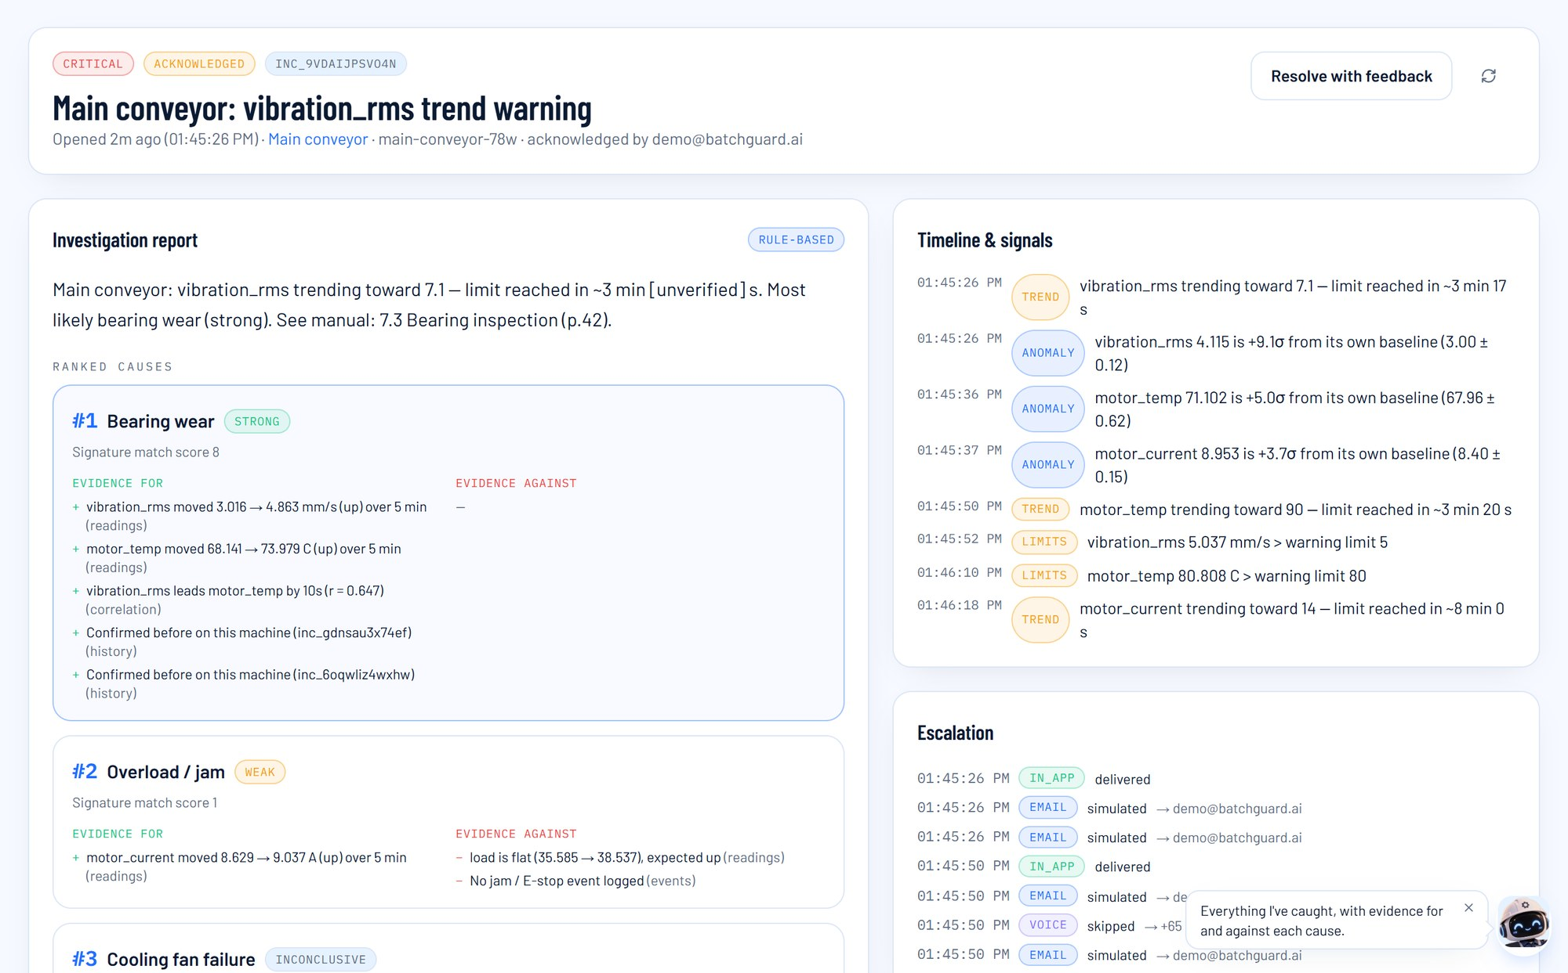
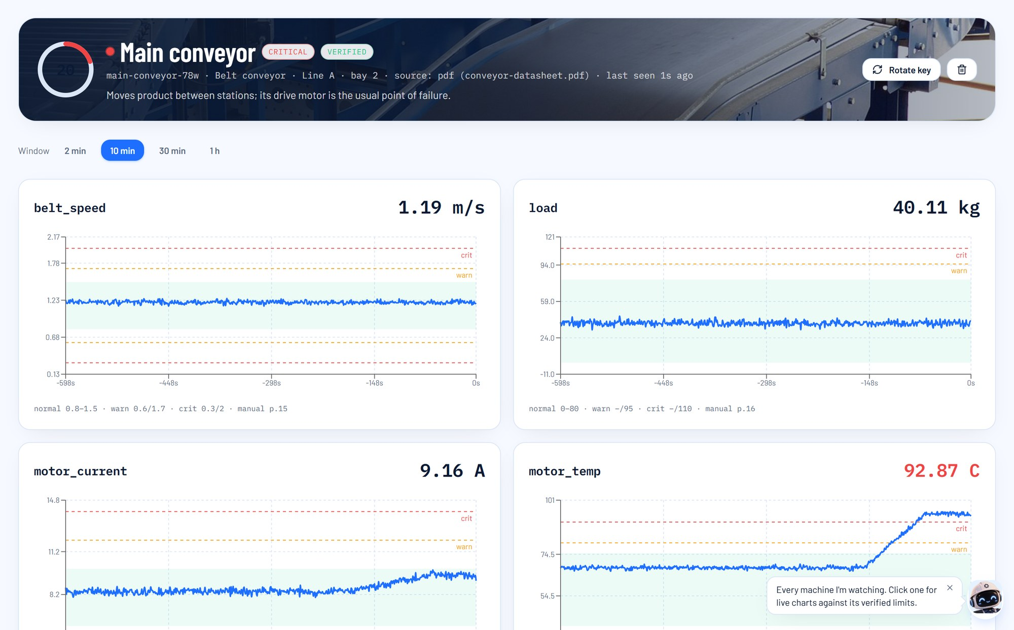
09 / SNAPSHOTS OF THE PROTOTYPE (2 OF 4)
An incident, investigated
03
Incident report
Ranked causes with evidence for and against, the manual page, the first checks, and every signal on a timeline.
04
Machine page
Every parameter against its verified bands, with the manual page and a time-to-limit forecast.
Notes:
A real incident from the demo line's bearing-wear cycle.

Slide 18
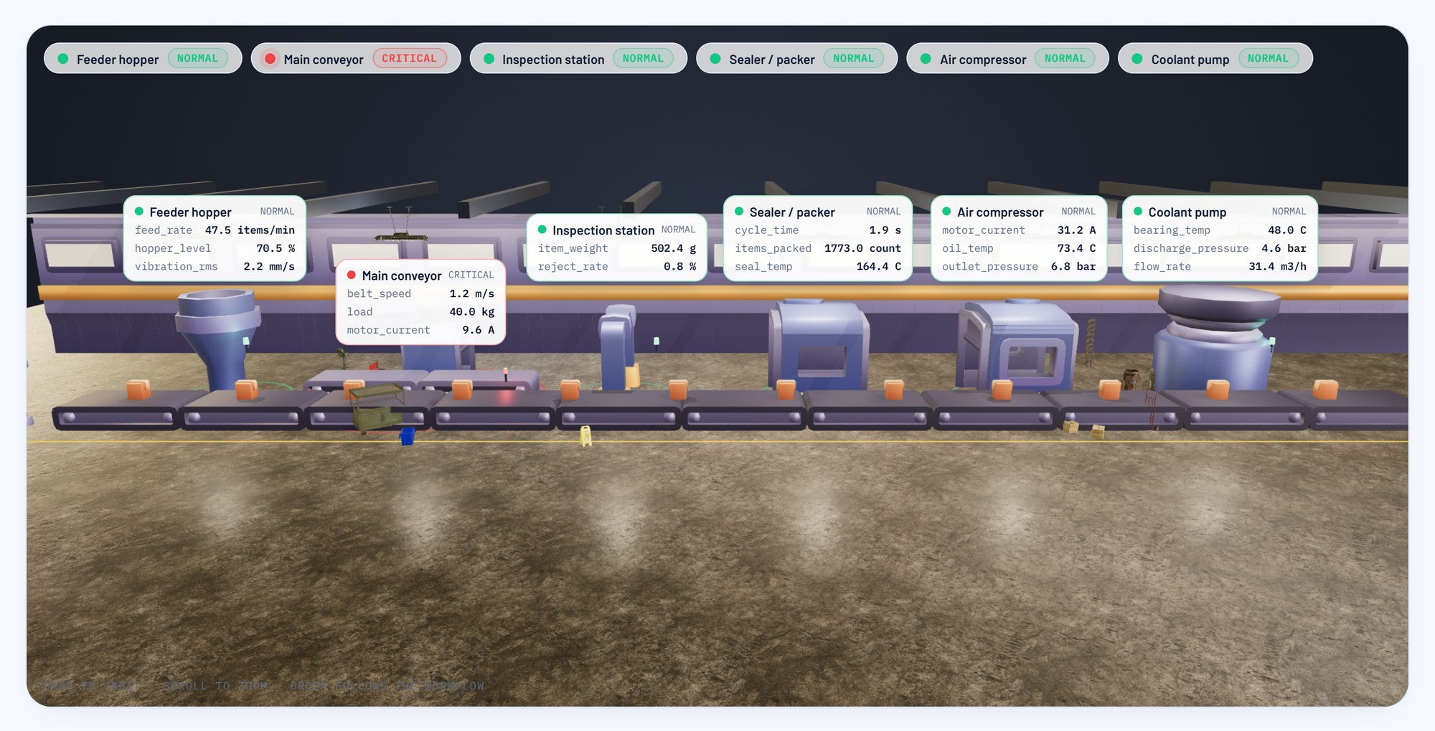
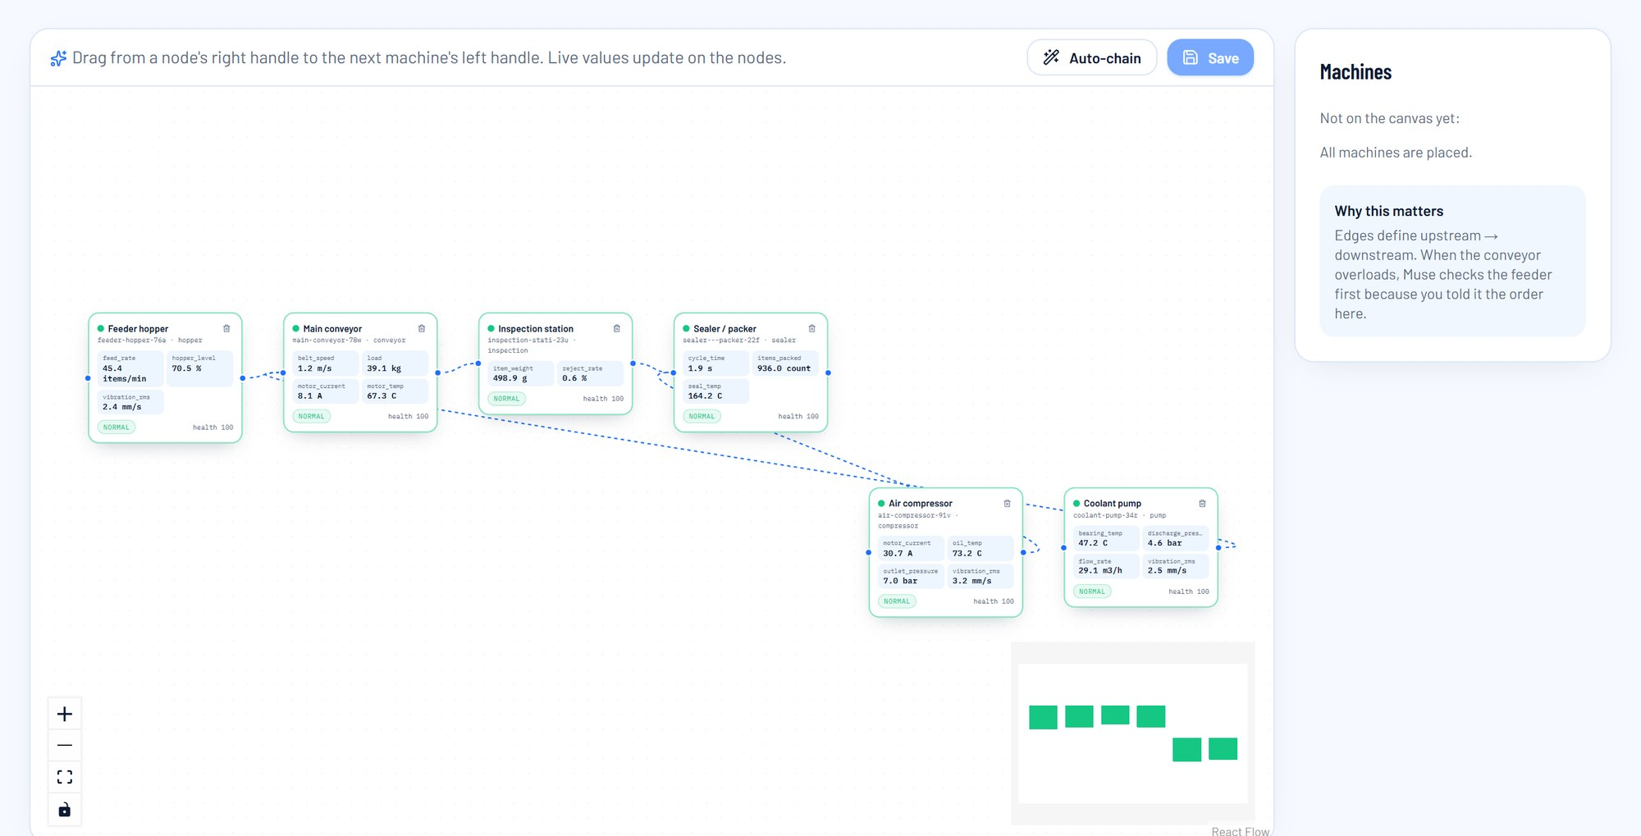
09 / SNAPSHOTS OF THE PROTOTYPE (3 OF 4)
The factory, live
05
3D factory
06
Workflow builder
A React Three Fiber hall with live readings over each machine. Colours follow normal, warning and critical.
Drag machines into a line. The links set what the agent checks across machines, like a feeder over-feeding the conveyor.
Notes:
The 3D hall mirrors each machine's status. The line builder tells the agent what feeds what.

Slide 19
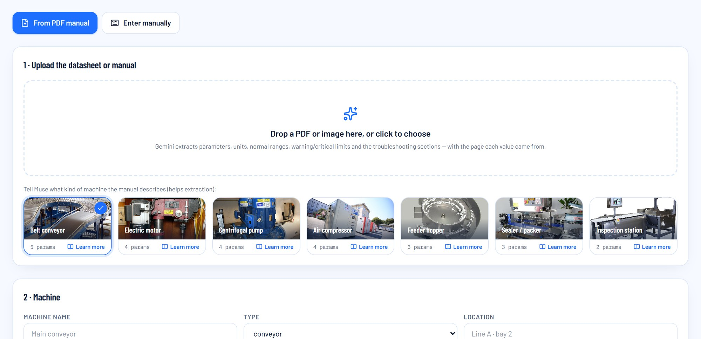
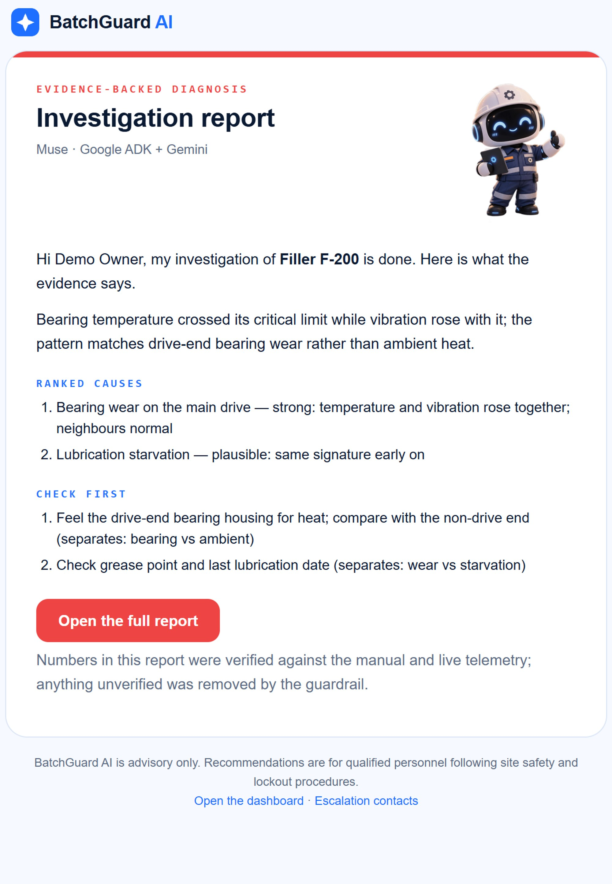
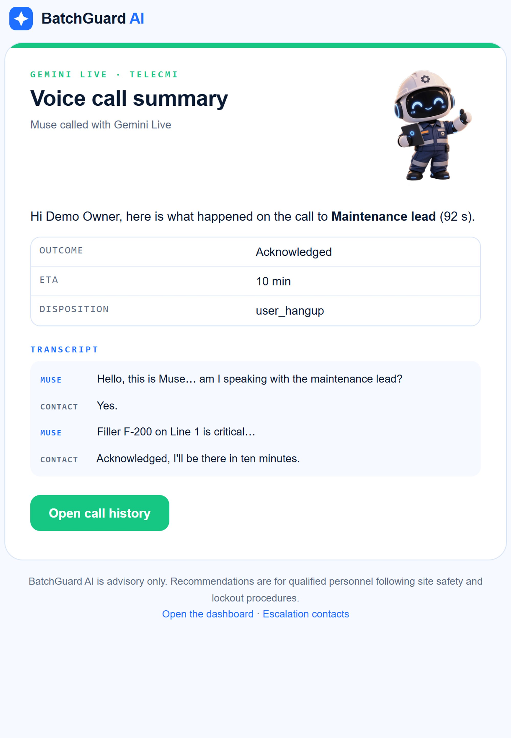
09 / SNAPSHOTS OF THE PROTOTYPE (4 OF 4)
Onboarding and the emails Muse sends
07
Onboard a machine
08
Report and call emails
Upload the manual or pick a machine type. Gemini fills in the parameters, limits, page and snippet. Verify each row, then copy the device key and code samples.
The likely cause, the first check, and what was said on the call.
Notes:
Onboarding starts from a PDF. Every alert, report and call ends up as a branded email.

Slide 20
10 / PROTOTYPE PERFORMANCE REPORT / BENCHMARKING (1 OF 2)
16 injected faults. All 16 caught. The right cause first in 13
16/16
13/16
8 s
77 s
0
faults detected
right cause ranked first (14/16 in the top three)
median time from fault to first signal
median warning before the critical limit
false incidents in 53 machine-minutes of normal running
DETECTION TIMELINE, SECONDS AFTER THE FAULT STARTS
first signal
incident
report
critical limit
fault ramps up over 120 s
hold
RIGHT CAUSE #1
Conveyor, bearing wear
2/2
Conveyor, cooling-fan failure
2/2
Conveyor, belt slip
limit not reached
2/2
Conveyor, jam or overload
2/2
Conveyor, sensor failure
0/2
Pump, bearing wear
2/2
Compressor, cooling failure
limit not reached
1/2
Sealer, heater degradation
2/2
0
30
60
90
120
150
180
Notes:
16 runs: 8 fault signatures, twice each, on fresh machines. 200 s of normal running, a 120 s fault ramp, a 60 s hold, at 1 Hz through the real API.

Slide 21
10 / PROTOTYPE PERFORMANCE REPORT / BENCHMARKING (2 OF 2)
Fast enough to run a whole plant on one small container
6.4 ms
5.7×
median ingest round trip at a plant's normal load
headroom: one container sustains ~120 readings/s, the demo plant needs 21
0.03 s
14/16
median from incident to finished report, fallback investigator, local run
runs where the trend layer raised the first warning, before any limit was crossed
About the Gemini path. On Cloud Run the six-stage ADK pipeline runs on Vertex AI, and each run's duration and tool calls appear on the Observability page. This benchmark ran on a laptop without Vertex credentials, so it measures detection and the fallback investigator.
16 machines, 5 parameters each, at 1 Hz: 80 readings a second, each validated, stored and run through detection.
WHAT THE TESTS TAUGHT US
Misses: sensor failure twice (a reading that drops to zero was read as belt slip) and one compressor run that blamed a belt it does not have. Fix: a step-change signature, and skip causes whose key parameter a machine lacks.
The guardrail marked 20 derived numbers (mostly ETA seconds) as [unverified] in 11 of 16 reports. It is strict on purpose; values our own tools compute will be whitelisted.
242 of 254 info events in normal running came from a counter (items_packed). They never open incidents, and counters will be excluded from the z-score check.
Notes:
Latency and throughput of the real ingestion path, report speed, and what the tests taught us.

Slide 22
11 / ADDITIONAL DETAILS AND FUTURE DEVELOPMENT
Next: more machines, more languages, earlier warnings
Next 3 months
3 to 9 months
9 to 18 months
OPC UA, Modbus TCP and MQTT gateway connectors
WhatsApp and SMS escalation; Hindi, Tamil, Bahasa and Japanese voice
The agent reads resolved incidents with confirmed causes as evidence
Postgres or AlloyDB for many tenants
Dataflow streaming features (rolling RMS, spectra) into BigQuery
Vertex AI remaining-useful-life models trained on BigQuery history
Camera-based visual quality inspection linked to reject rate
Work orders synced with SAP PM and IBM Maximo
Energy per unit, compressed-air leaks and idle power alerts
Benchmarks across sites for integrators and plant groups
Spare-parts demand forecast from failure history
Lock-out and tag-out checklists inside the call
Advisory by design
Keys and secrets
A person signs off
Built in JAPAC
Its one action is a protective stop when nobody acknowledges. An operator restarts.
Device keys are hashed and rotatable. Partner keys live in Secret Manager.
Limits go live only after verification. Auto-dial is off by default.
Indian-English voice today. Call flows and emails localise per plant.
Notes:
Three horizons, and the principles the product already follows.

Slide 23



12 / PROVIDE LINKS TO YOUR
See it running
GITHUB PUBLIC REPOSITORY
github.com/NerdNinzas/batchguard.ai
Next.js frontend, FastAPI and ADK backend, call flows, deploy script, IDEA.md and SOLUTION.md.
DEMO VIDEO
youtu.be/lxMaqhoitiU
Setup from a manual, a tour, then three live cases: all fine, a breakdown acknowledged by phone, and no answer until Muse shuts the line down.
FINAL PRODUCT
batchguardai.live
Sign in with demo@batchguard.ai / demo1234. Demo Packaging Co, six machines, live telemetry.
VIRTUAL FACTORY SIMULATOR
batchguard-sim.web.app
Streams real telemetry into the demo account. Turn the dials or inject a fault, and watch Muse react.
Notes:
Repo, demo video, the live product and the simulator that drives it. Faults are injected from the simulator, and the live product reacts.

Slide 24
Notes:
Thank you.

