Slide 1
A/B Test Analysis
What can we conclude from binary outcome A/B test results?
Abhi S, Mike S, Ramesh S, Ranjeet T

Slide 2
NW Binary A/B test Example
On a given page, a “success” if a visitor :
clicks a button
applies for card
is approved
Moves to another NW page
Change something which influences user action
Users in variant A see a Blue font
Users in variant B see Standard font
https://nerdwallet.atlassian.net/wiki/display/ABT/AB+Testing+Home for more real examples

Slide 3
What does A/B test Data look like?
 | Trials | Successes
A (Test) | N_{A} | M_{A}
B (Control) | N_{B} | M_{B}
This is for a Binary A/B test,
see later for non-(Binary A/B) tests.

Slide 4
Simple test for illustration of issues
Betting game based on a coin toss
Let’s say 10 trials, 7 losses : is it suspicious?
What if:
What do you conclude?
You lost (Behavior of Sample)
Was the coin fair? (Intrinsic property of Population)
Trials | Losses
10 | 7
100 | 60
1000 | 550

Slide 5
What metric?
Trials | Tosses Lost
10 | 7
100 | 60
1000 | 550

Slide 6
Difference from Expected number?
Trials | Tosses Lost | Diff. from Exp. Number
10 | 7 | 2
100 | 60 | 10
1000 | 550 | 50

Slide 7
Difference from Expected prob.?
Trials | Tosses Lost | Diff. from Exp. Number | Diff. from exp. probability
10 | 7 | 2 | 0.2
100 | 60 | 10 | 0.1
1000 | 550 | 50 | 0.05
Why do we care about lost tosses?
We don’t.
But what if we staked $1 per toss?

Slide 8
Money lost?
Trials | Tosses Lost | Diff. from Exp. Number | Diff. from exp. probability | $ Lost
10 | 7 | 2 | 0.2 | $2
100 | 60 | 10 | 0.1 | $10
1000 | 550 | 50 | 0.05 | $50
But we are also staking larger amounts ($5, $50 …) so …

Slide 9
% Loss?
Trials | Tosses Lost | Diff. from Exp. Number | Diff. from exp. probability | $ Lost | % Loss
10 | 7 | 2 | 0.2 | $2 | 40%
100 | 60 | 10 | 0.1 | $10 | 20%
1000 | 550 | 50 | 0.05 | $50 | 10%
Choice of metric (and design of test)
depends heavily on
what question you are asking!

Slide 10
Is the result significant?
Trials | Tosses Lost | Diff. from Exp. Number | Diff. from exp. probability | $ Lost | % Loss | z stat
10 | 7 | 2 | 0.2 | $2 | 40% | 1.2
100 | 60 | 10 | 0.1 | $10 | 20% | 2
1000 | 550 | 50 | 0.05 | $50 | 10% | 3
Is the loss (or gain) important enough?

Slide 11
Importance vs Significance
Let’s say we set 10% as a threshold for importance.
Large amounts of data can lead to significance,
but is result important enough to act on?
Trials | Losses | %Loss | Important | Significant | z stat.
10 | 7 | 40 | Y | N | 1.3
100 | 54 | 8 | N | N | <1
1000 | 555 | 11 | Y | Y | 3.3
10000 | 5200 | 4 | N | Y | 4
In case 4, you are certain (99.9%) the coin is loaded,
But is the amount you lost important enough to shoot your opponent?

Slide 12
Growth of Importance vs. Significance
The credibility increases as erf(sqrt(N))
So with large amounts of data it is easy to get significance
But for a fixed difference, the importance in relative terms decreases as 1/N
We are looking for
“credibility of an important enough result”

Slide 13
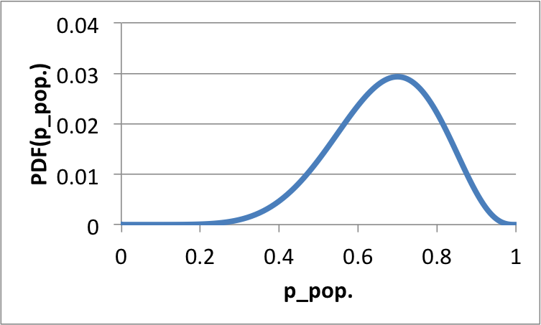
General problem: mathematical
From the observed sample behavior (7 of 10)
We want to know the intrinsic property of the population (as a distribution(p))
1
4
Credibility
Of metric M(p_pop.)
2
3
Threshold of Importance

Slide 14
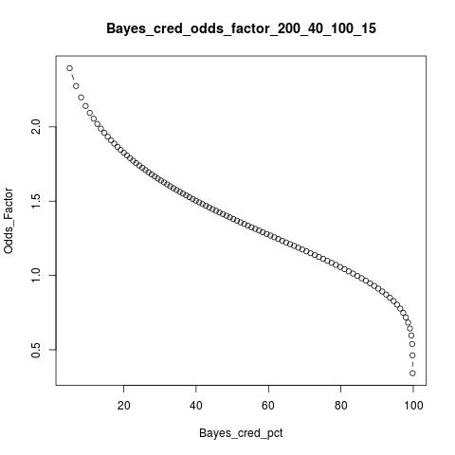
Goal: Threshold vs. Credibility
“… it is 75% likely that A is better than B by 15%”
So that PM etc. can make a decision
 | Trials | Successes
A | N_{A} | M_{A}
B | N_{B} | M_{B}

Slide 15
Goal: Threshold vs. Credibility
“… it is 85% likely that A is better than B”

Slide 16
Goal: Threshold vs. Credibility
“… it is less than likely that A is 1.5X better than B”
Doesn’t meet criteria to make a decision

Slide 17
Steps 1-3
Build the distribution of intrinsic probabilities for the population
Select a metric based on business needs
Calculate credibility vs importance threshold
(or vice versa)

Slide 18
Why a Bayesian approach rather than the Standard (Frequentist)?
“Standard” because frequently applied outside its domain of validity in an unexamined way (normality, sample size, non-linearity, phenomenology)
Philosophical differences
Numerical differences -> 0 for “large sample sizes”

Slide 19
Why not the Standard (Frequentist) Approach?
But differences are significant (and Frequentist is wrong) for small samples.
What do we mean by “large sample”? Is 1000 trials (Gallup magic number) enough? 10K? 100K?
Turns out number of trials is the wrong metric!
Key determinant is number of positives!
At NW, we have low-ish traffic and low CVR, which => Small amount of positive data.

Slide 20
Bayesian Approach
What intrinsic properties of the population are likely to produce this sample behavior?
NOTE: Flipped around from: What behavior is likely if the population has this intrinsic property?

Slide 21
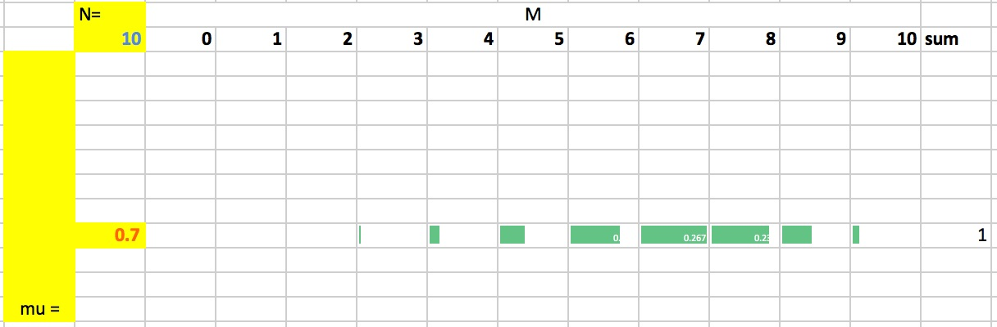
Usual: p(M|μ, N)
Given μ = 0.7 and N=10 trials, distribution of number of successes: Binomial(M) =
10^C_M * (0.7)^M * (0.3)^(10-M)

Slide 22
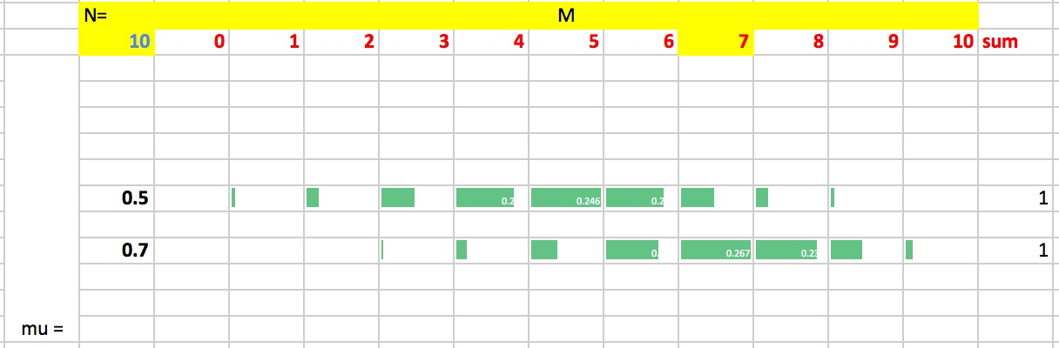
But …
You can get 7 successes from 10 trials from a fair coin as well
Is μ = 0.5 more likely or μ = 0.7 if we had 7 successes from 10 trials

Slide 23
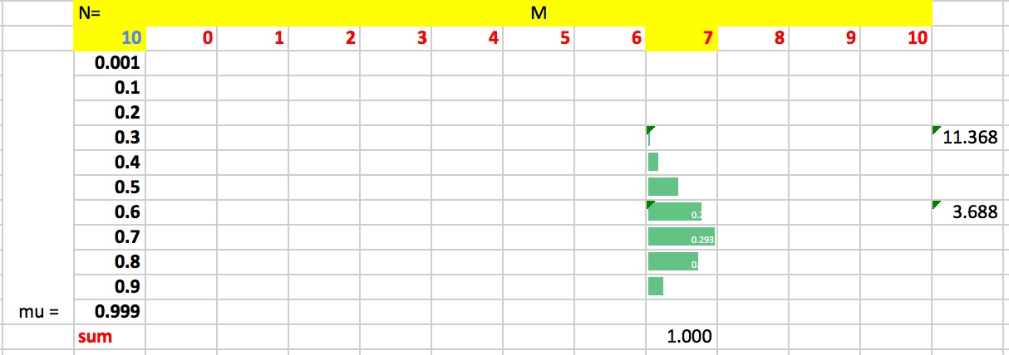
Inference: p(μ|N,M)
Given 7 successes from 10 trials, what is the distribution of μ:
Beta(μ) ≈ μ^7 * (1-μ)^3 (properties KNOWN!)

Slide 24
Repeat for A/B: Build the PDF
P(p_{A}| N_{A}, M_{A}) = beta distribution (A)
P(p_{A}, p_{B}) = beta(A)*beta(B)
This is a distribution on 2D probability space.

Slide 25
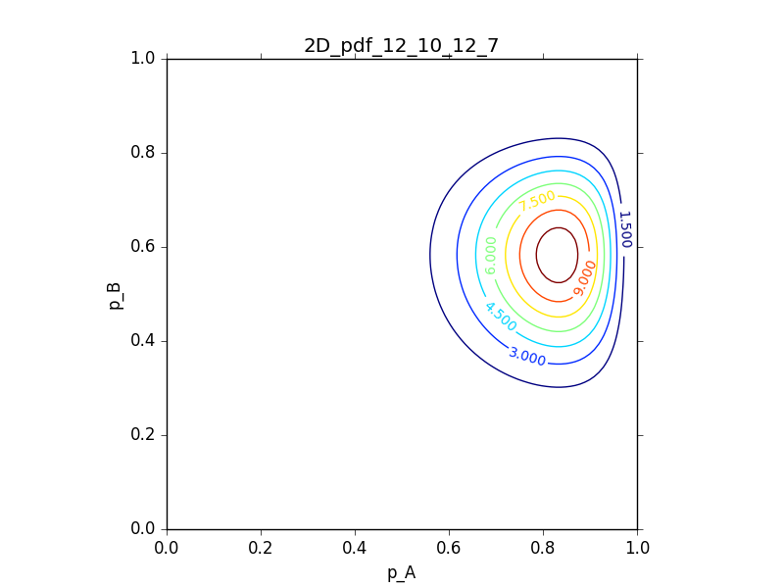
Which looks like

Slide 26
Which metric(p_{A}, p_{B})
Difference (standard, common, popular):
p_{A} – p_{B} > δ
δ = 0.2?
What if p_{B} = 0.01 (=> p_{A} =0.21!, unlikely)
Or if p_{B} = 0.85 (=> p_{A} = 1.05!, Errr…)
δ = 0.01
What if p_{B} = 0.50

Slide 27
Relative metric: Lift
Lift is another common metric
p_{A}/p_{B} -1 > λ
Very error-prone if p_{B} is small
p_{A} | p_{B} | δ | λ
0.1 | 0.05 | 0.05 | 100%
0.55 | 0.50 | 0.05 | 10%
0.95 | 0.90 | 0.05 | 5.5%

Slide 28
Choice of metric
Is increasing from 0.90 to 0.95 really that unimportant?

Slide 29
Choice of metric
Is increasing from 0.90 to 0.95 really that unimportant?
You’ve halved your losses
You’ve improved by 50% of room to improve

Slide 30
Choice of metric
Is increasing from 0.90 to 0.95 really that unimportant?
You’ve halved your losses
You’ve improved by 50% of room to improve
Whereas increasing from 0.05 to 0.10, you only increased 5/95 or 1/19th of room to improve!

Slide 31
Why these problems with difference and lift?
Probabilities are NOT numbers!
No algebra, no geometry

Slide 32
Criteria for metric
Account for Cost of failure as well as Benefit of success
Universality (threshold independent of result for Control)
Intuitively understandable (to people in Las Vegas)
Mathematically sound
“A is better than B” ⬄ “B is worse than A”

Slide 33
Metric: Odds Ratio
Why do gamblers think in terms of odds?
Expected winnings = p * Benefit from winning = p* $B
Expected losses = (1-p) * Cost of losing = (1-p)*$C
Benefit/Cost ratio = (p*$B)/((1-p)*$C)
To optimize this, don’t need to know $B or $C, only need odds = p/(1-p)
(Lots of odder nice mathy stuff)

Slide 34
Only cost-agnostic metrics!
Until we become cognizant of $ costs (and they are always there) of paid traffic
If simple it can still be cast as a function on probability space (but highly unlikely)
Really want to compare Approvals per unit Cost ~ ROI
Not simple probability comparisons
Even Parametric approaches are fraught with difficulties: e.g. variance is often undefined.

Slide 35
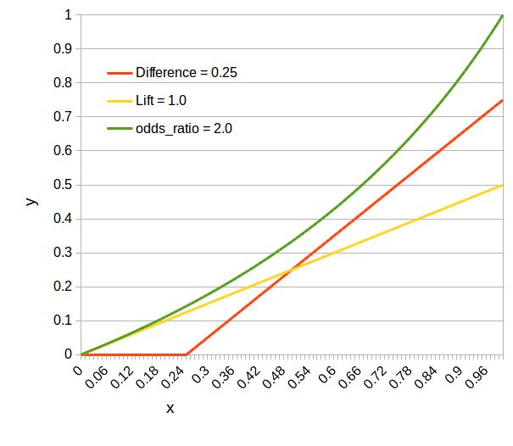
Comparison metrics M(p_{A}, p_{B})
Each metric M
Defines a family
of curves:
p_{B} =
M(p_{A}, threshold)
p_{B}
Importance Threshold
p_{A}

Slide 36
Combine with the PDF
p_{B}
p_{A}

Slide 37
Calculate Credibility
Integrate
p_{B}
p_{B} = M(p_{A,}threshold)
p_{A}

Slide 38
Integrate along y (analytical)
y= M(x)
p(x, y) = beta_{A}(x)*beta_{B}(y)
Integrate along y = beta.CDF(M(x))
x

Slide 39
Integrate along x (numerical)
Integrate along x :beta(x)* beta.CDF(M(x))

Slide 40
Integrate along x (numerical)
Integrate along x :beta(x)* beta.CDF(M(x))

Slide 41
Integrate along x (numerical)
Integrate along x :beta(x)* beta.CDF(M(x))

Slide 42
Plot/Nintegrate: No Problem

Slide 43
Plot/Nintegrate: Problem at large N

Slide 44
Plot/Nintegrate: Problem
No matter how many uniform-in-x integration intervals you choose, there is some N so that σ < dx.

Slide 45
Plot/Nintegrate: Solution
More points for plotting or integrating where “more stuff is happening” - purge the rest.
Region of interest is
between 0.65 and 0.75.
How do we find it pogrom-atically?

Slide 46
Choose uniform QUANTILES!

Slide 47
Do all that
To get:

Slide 48
Finally

Slide 49
Take-aways about A/B testing approach
Hypothesis (Have one, I insist!) => Comparison Metric
Decide on a threshold (before starting the test)
Construct distribution of population property
Calculate credibility as function of threshold

Slide 50
Technical Take-aways
Bayesian approach
No approximations
Odds as a metric
“Quantiles” for numerical integration or plotting

Slide 51
Other stuff
IGNORE following

Slide 52
Binary Outcome
Each trial has only two possible outcomes
Example: Coin Toss
Success or Heads = ‘1’
Failure or Tails = ‘0’
An experiment or test has many trials (say 10)
Possible outcomes of test are number of successes =
{0, 1, 2 … 9, 10}

Slide 53
Non-(Binary A/B) tests
A/B but not Binary outcome
Binary Outcome but not A/B
Number of pages visited by user after A or B
Session length after A or B
Value of items bought after A or B
Dimension is categorical
Metric is non-binary
Positive Survey Response after ‘n’ ad.s
Join social network or not after ‘n’ contacts
Metric is binary
Dimension is numerical
Non-Binary AND non-A/B
Engagement as a function of size of network

Slide 54
Numerical Integration or Plotting
Cute trick: Lesbegue Intervals:
Constructed from
Inverse CDF or Quantile function

Slide 55
Why psuedo-Bayesian?
We are not using any prior probabilities for the property of the population (μ).
E.g. which might arise from
knowing that most coins are fair, so highly unlikely that it is an unfair coin
Knowing that your opponent had been arrested and found with some loaded coins

Slide 56
One point about the Beta distribution
BETA.pdf(p_{A}; M_{A}+1, N_{A}-M_{A}+1)
What are those “+1”s doing in the argument?
Recall we are assuming no prior knowledge of a binary outcome, that means the effective prior is 50%-50%
We are effectively adding 1 Win and 1 Loss to the observed data.
Powerful method: Bayesian Noise reduction.

Slide 57
Comparison metrics M(p_{A}, p_{B})
Analytical +
Numerical
Integration
p_{B} = M(p_{A})
p_{B}
p_{A}

Slide 58
Why not the Standard (Frequentist) Approach?
N_{A}, M_{A} -> mean_{A} +/- SE(mean_{A})
z = (mean_{A} – mean_{B} – δ)/SE(A-B)
Then use normal or other assumption to calculate credibility or p-value
Problems:
Assumption of normality
Small N, M? Parametric approach breaks down
Non-linear metrics: ill-defined, approximations

Slide 59
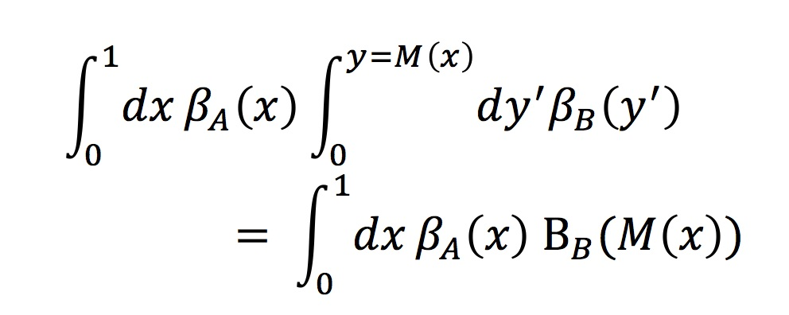
2D Integral
One dimension integrated analytically -> beta CDF
The other we have to integrate numerically
Reduced to a 1D Integral

