Slide 1
INTRODUCTION TO DATA SCIENCE – PHASE 2
Regression Analysis: Real-time Portugal 2019 Election Results
GROUP 18: Team members
Sai Krishna Are – 2310421
Vamsi Athota – 2310423
Saran Teja Mallela - 2315340
Likhitha Reddy Kesara - 2296664
Aditya Nidadavolu- 2293835
Preethi Kakarla - 2307250

Slide 2

Project overview
Introduction
Goal and Dataset
Road Map
Methodology
Insights
Conclusion

Slide 3
INTRODUCTION
The project's goal is to forecast the number of Members of Parliament that will be elected in Portugal in 2019 at the district and national levels.
Building Machine Learning Model: a. Scaling Dataset b. Splitting Dataset c. Evaluating Models d. Hyper- Parameter tuning
Model results observations and its visualizations

Slide 4
Phase 2 - ROADMAP
INSIGHTS AND VISUALIZATIONS
MODELLING TECHNIQUES
PERFROM MODEL STRUCTRE SELECTION
FROM DATA SET
AND VISUALIZATION
PROJECT REPORT
PERFORM VARIABLE SELECTION
ENSEMBLE
LASSO REGRESSION
BIDIRECTIONAL ELIMINATION
COMBINE TOP 3 MODELS

Slide 5
MACHINE LEARNING MODEL
DECISION TREE REGRESSION
LINEAR
REGRESSION
K-NEAREST
NEIGHBOURS
RANDOM
FOREST
SUPPORT VECTOR REGRESSION
MSE, MAE and RMSE metrics
plotted MSE vs K-values
Trained the model with best parameters we found
Linear
Non-Linear
Radial Basis Function
Chosen model
Make predictions recursively
Ascending order of Mean Squared Error for the 5 regression algorithms:
Random Forest < Decision tree < KNN < Linear < SVM(Linear) < SVM(Non-Linear)

Slide 6
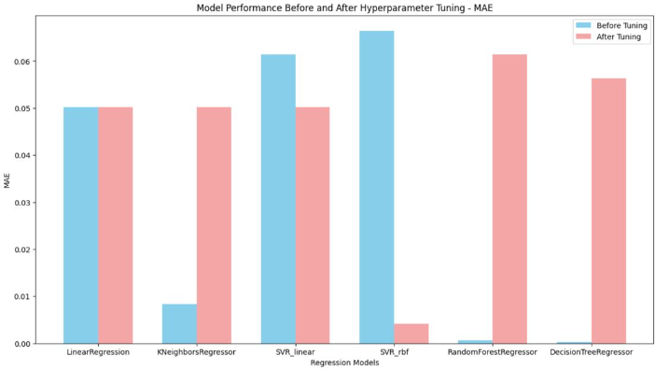
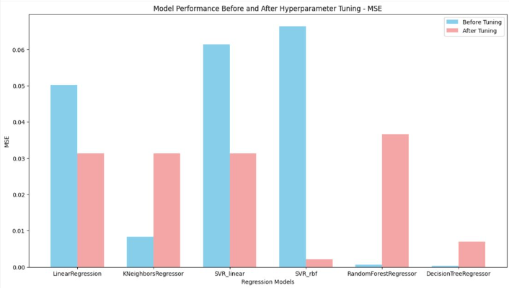
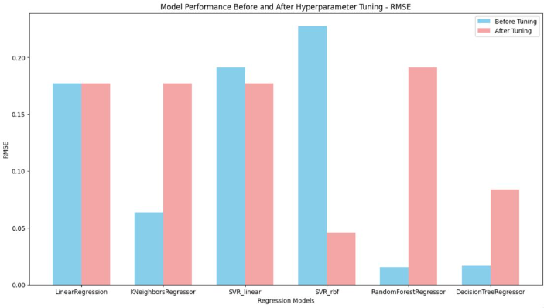
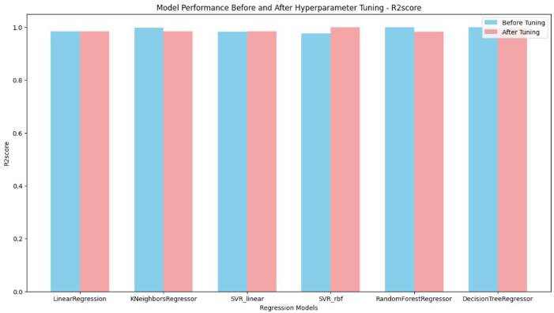
MAE, MSE, RMSE, R2 SCORE plots Before and after hyper-tuning

Slide 7
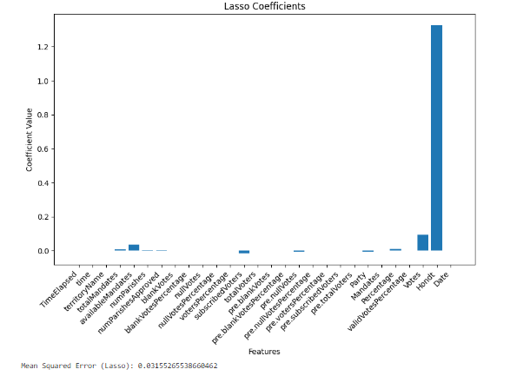
FIRST VARIABLE SELECION: LASSO
Reason for Selection:
Lasso Regression, a regularization method, enhances forecast accuracy by eliminating the weights of less important predictors, as demonstrated by a Mean Squared Error of 0.0315.
Through grid search, optimal parameters were identified, resulting in a model trained with nine key features, crucial for precision in forecasting.
7

Slide 8
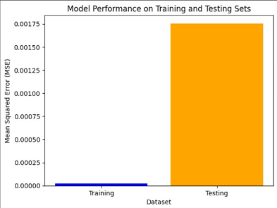
BI-DIRECTIONAL ELIMINATION
Bidirectional Wrapper Method :
It is a feature selection algorithm that combines both forward and backward selection methods to identify the best subset of features for a machine learning model.
It involves four steps.

Slide 9
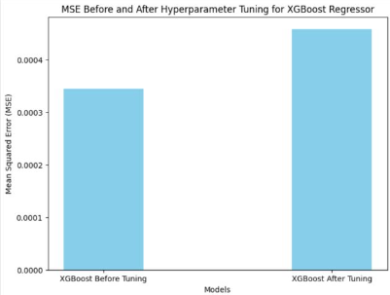
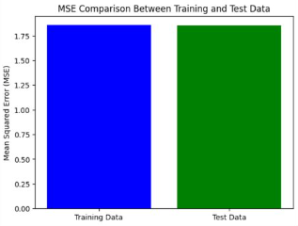
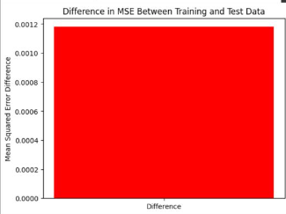
Models Compatibility
XGB REGRESSOR
Extreme machine learning

Slide 10
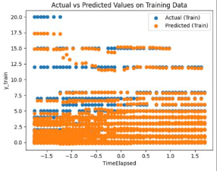
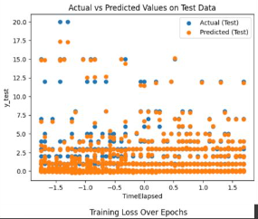
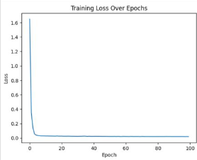
DEEP LEARNING MODEL WITH 2 LAYERS

Slide 11
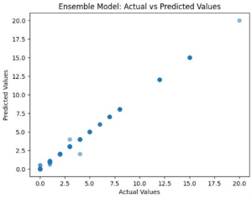
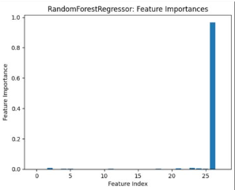
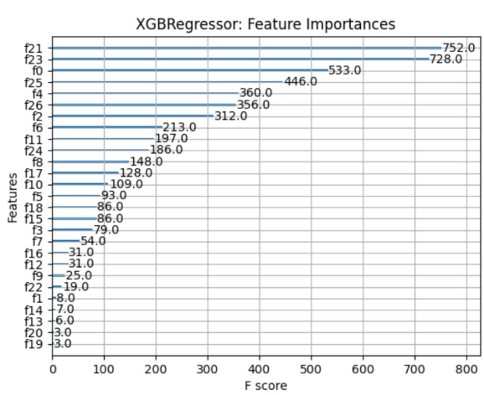
An ENSEMBLE Model
This machine learning method combines several models to increase the predictability and accuracy of the results.
We have used the models of RandomForest, DecisionTree and XGBRegressor and combined them.

Slide 12
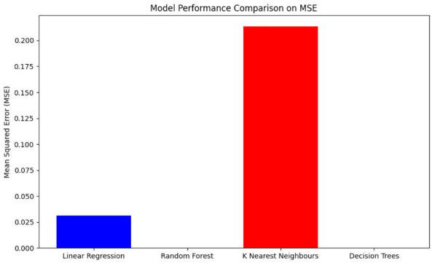
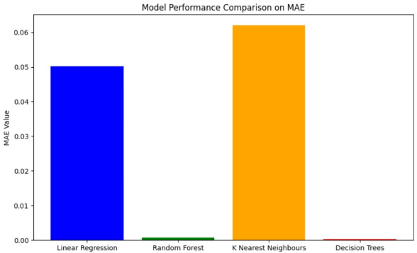
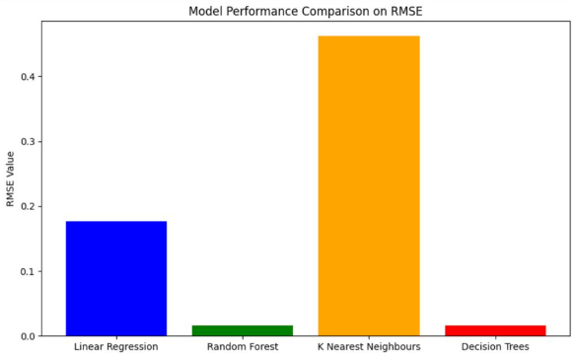
VISUALIZATIONS ON MSE, MAE, RMSE for each model

Slide 13
PROS & Cons
Pros
Cons
Regression Models: Provides insights into relationships with flexibility.
Lasso Regression: Effectively performs feature selection and prevents overfitting.
Bidirectional Elimination: Robustly refines feature selection iteratively.
Random Forest: Robust, handles non-linearity well, and provides feature importance.
Ensemble Modeling: Combines model strengths, enhances performance, and reduces reliance on a single model.
Regression Models: Susceptible to overfitting, assumes linear relationships, and sensitive to outliers.
Lasso Regression: May arbitrarily select variables, sensitive to outliers, and challenging parameter choice.
Bidirectional Elimination: Computationally expensive, depends on the starting point, and sensitive to noise.
Random Forest: Less interpretable, computationally intensive, and may not perform well on small datasets.
Ensemble Modeling: Increased complexity, requires careful tuning, and may not always outperform individual models.

Slide 14
CONCLUSION
Data Processing:
Employed various preprocessing techniques for dataset cleaning.
Regression Modeling:
Built models and optimized hyperparameters using cross-validation.
Variable Selection:
Used Lasso regression and Bidirectional Elimination on top-performing models.
Data Visualization:
Used MSE, MAE, RMSE for data visualization.
Ensemble Modeling:
Created an ensemble model with top 3 Models (RF, DTR, XGBoost).
Best Model Performance:
Random Forest outperformed, MSE: 0.00025, R2: 0.9998.
Conclusion:
Random Forest identified as the best Regressive algorithm for our dataset.

Slide 15

THANK YOU

