Slide 1

Google Play
Hagar Abd Allah
Nerdeen Muhammad
Nadeen Ahmed

Slide 2

Google play history
22 Oct. 2008
Initial release was 15 years ago (as Android Market)
6 Mar. 2012
12 years ago (as Google Play)

Slide 3
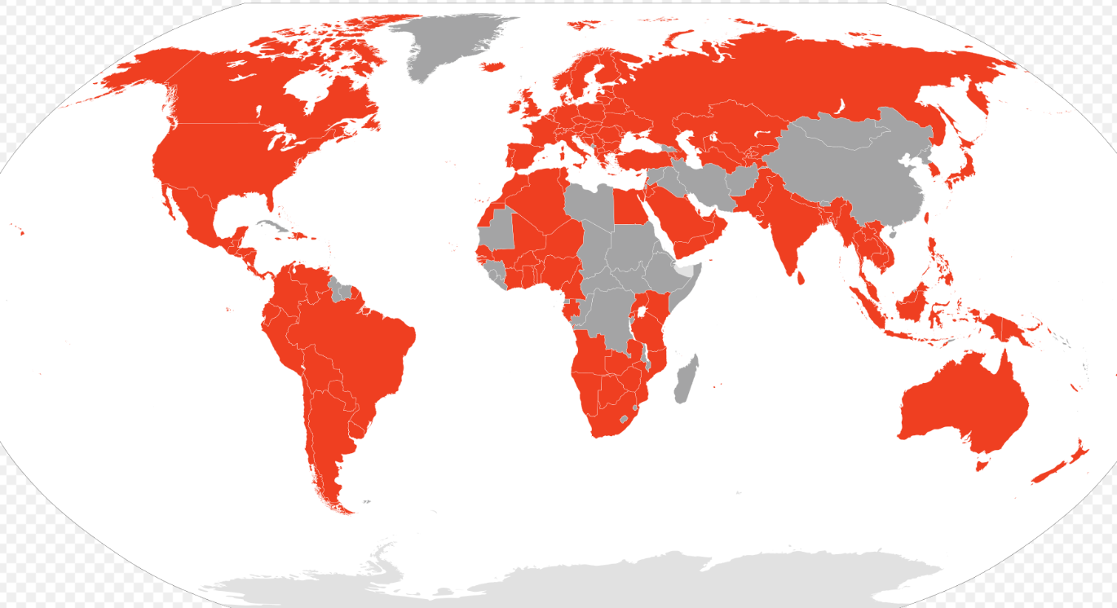
Global availability of Google Play

Slide 4
Google play business importance
Is a digital distribution service operated and developed by Google.
It is the official app store for certified devices running on the Android operating system and its derivatives.
Work on different platforms as Android, Android TV, Wear OS, ChromeOS, Web
users can browse and download applications developed with the Android software development kit and published through Google.
Google Play has also served as a digital media store, offering games, music, books, movies, and television programs

Slide 5
Google play analysis
There are more than 3 million mobile apps available in the Google Play Store.
Google play data was analyzed according to:
Category
Application
Sentiment

Slide 6
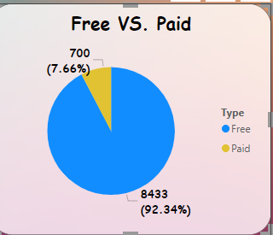
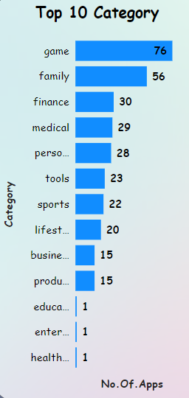
Category analysis
About 3 million ( 92 %) are free to download, while less than 3 thousand (7%) are paid apps.
These apps belongs to 49 categories

Slide 7
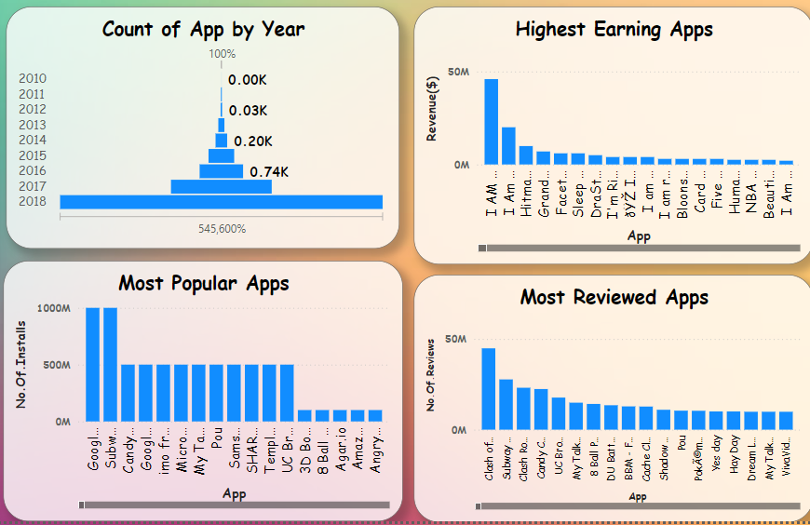
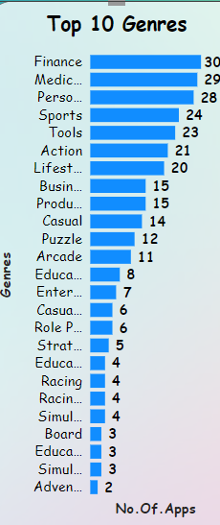
Application analysis
An app can belong to multiple genres
Apps then analyzed according to most popular apps, number of user reviews for the app, highest earning.

Slide 8
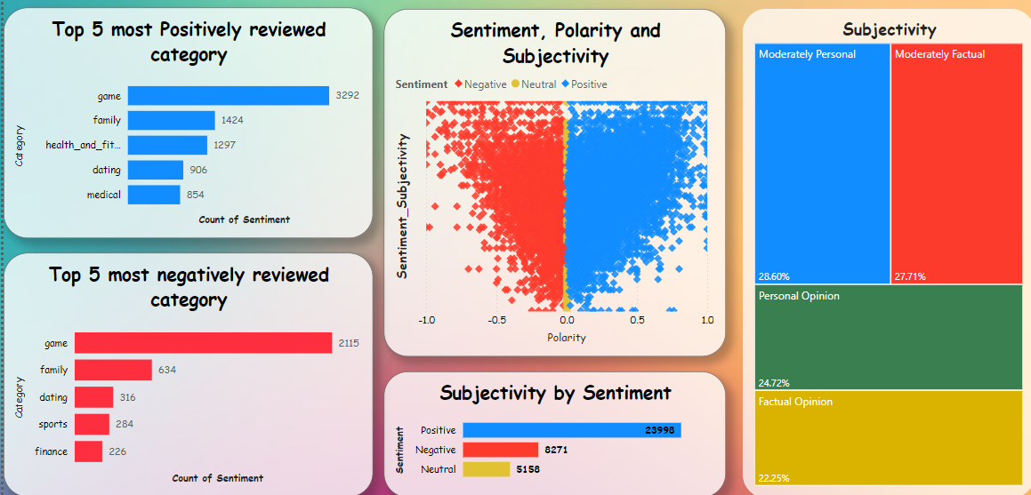
Sentiment analysis
Sentiment analysis: 0-0.25 ~ Factual opinion 0.25-0.5 ~ Moderately factual 0.5-0.75 ~ Moderately personal 0.75-1 ~ Personal opinion
Reviews analysis was done according to polarity and subjectivity as:
-1 indicates an extremely negative review,
1 indicates an extremely positive review, and
0 indicates a neutral review.

Slide 9

Business findings
Were divided to three main parts:
1- type of app versus update
2- Price versus rating
3- update year versus rating

Slide 10
References
Data is available at https://www.kaggle.com/datasets/lava18/google-play-storeapps?select=googleplaystore_user_reviews.csv
Statista
Apinvintive
Wikipedia

Slide 11
Thank you
Any questions

