Slide 1
BDA Project
Name : Shriyash Shingare
Roll No : PA62
PRN No : 1032181387

Slide 2
Detection of country of origin of an application
Introduction
Motivation
Implementation
Research paper
Conclusion

Slide 3
Introduction
Web Mining/Scraping
Search key terms using regex (regular expression)
Using saved featured data
I.city names
II.companies

Slide 4
Motivation
1.The motivation behind this seminar is that user could able to know the country of origin of an application.
2.exploration of different concepts like data mining/scraping techniques, generating processed data set, web drivers ,Text analysis etc.
3.Recent china application’s ban

Slide 5
Web Mining/Scraping
Technology used
Puppeteer library
Chromium driver
Nodejs
Regex
Search terms Used
App’s name
App’s headquarters
App’s parent company name

Slide 6
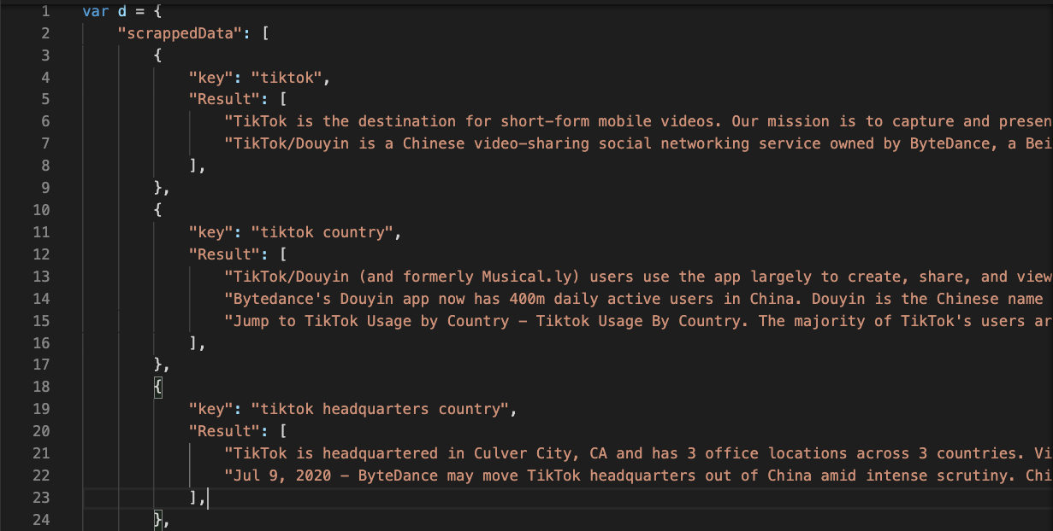

Slide 7
Country Detector
Use of featured data
Companies
Cities
Countries
Check which featured data matches the paragraph key words
Mainly in address,parent company,headquarter
Will return country code in every paragraph and priority
Will map all country code and return final country code

Slide 8
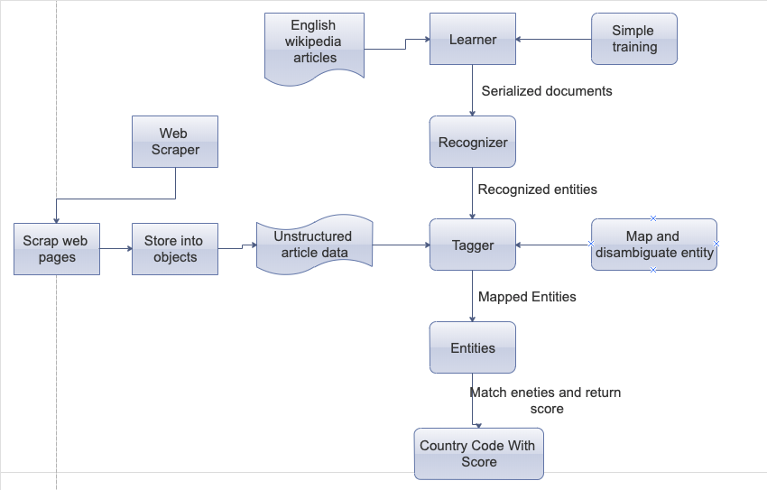

Slide 9
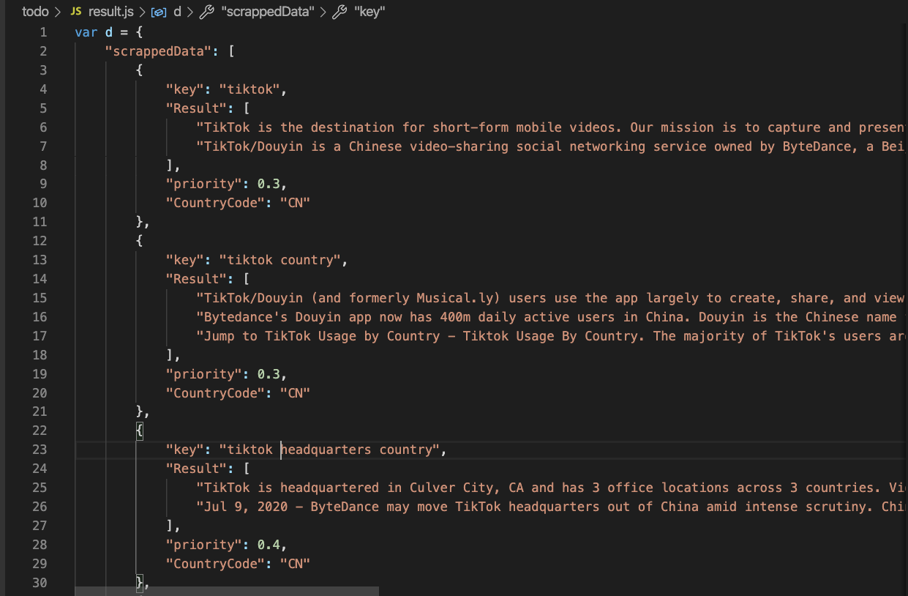

Slide 10
Research papers
1.Entity Recognition in Information Extraction Novita Hanafiah1,2 and Christoph Quix3,4 2.Preprocessing in Data Mining Reference work entry First Online: 02 December 2014
3. Fast Regular Expression Search Gonzalo Navarro1 and Mathieu Raffinot2 1 Dept. of Computer Science, University of Chile. Blanco Encalada 2120, Santiago, Chile
4.Web Scraping Chapter · May 2017 DOI: 10.1007/978-3-319-32001-4_483-1 CITATIONS 3 1 author: Bo Zhao University of Washington Seattle
5.COUNTRY OF ORIGIN VIA WEB MINING TECHNIQUES Markus Schedl, Cornelia Schiketanz, Klaus Seyerlehner Department of Computational Perception Johannes Kepler University Linz, Austria

Slide 11
Conclusion
Studied the puppeetter for web scraping
Used regular expression searching
Used text analysis techniques

Slide 12
Thank you!

Slide 13
Primary Requirement | Secondary Requirement

