Slide 1

CS234-Operating Systems
School of Computer Engineering and Technology

Slide 2

CS234-Operating Systems
Examination scheme: Marks-50 [Continuous Assessment]
Course Objectives:
1. To discuss a generic overview of operating systems.
2. To describe the concepts of process management.
3. To state the concepts related to synchronization of processes.
4. To explain the concepts of Memory Management and I/O management.
Course Outcomes: After completion of the course the students will be able to :-
1. Comprehend key mechanisms of the Operating System functions.
2. Demonstrate processor scheduling algorithms.
3. Explain solutions to process synchronization problems.
4. Assess memory management issues.
21/02/19
Operating systems
Notes:
MIT-WPU

Slide 3
Module 1 : Overview of Operating System
Operating System objectives and its evolution. Operating System structure: Layered, Monolithic, Microkernel Operating Systems. BASH shell scripting.
21/02/19
Operating systems
Notes:
MIT-WPU

Slide 4
What is an Operating System?
Computer System
  Hardware + Software
Hardware
  Central Processing Unit (CPU), Memory and I/O devices
Software
  Systems and Applications
Operating System?
  A program that acts as an intermediary between a user and hardware.
  A program that controls the execution of application programs.
Main objectives of an OS:
Convenience - To Make computer more convenient to use. Efficiency - To Allow resources to be used in an efficient manner. Environment- To execute user programs and make solving user problems easier and Permit effective application development
21/02/19
Operating systems
Notes:
MIT-WPU

Slide 5
Operating System Definitions
An interface between user & hardware
A program that controls the execution of application programs
Resource allocator – manages and allocates resources.
Control program – controls the execution of user programs and operations of I/O devices .
Kernel – the one program running at all times.It is the core part of the OS.
The term Kernel and OS can be used interchangeably.
21/02/19
Operating systems
Notes:
MIT-WPU

Slide 6
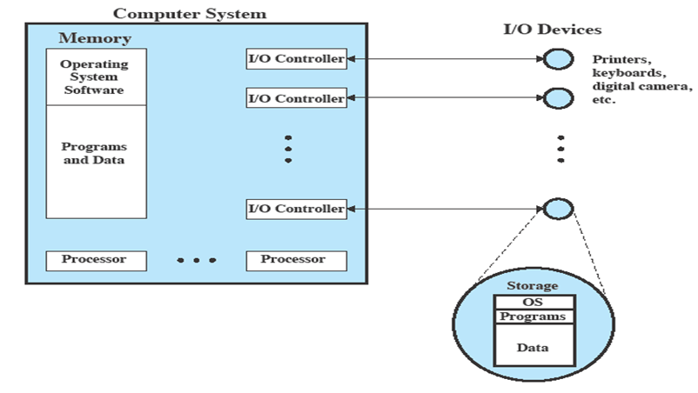
OS as Resource Manager
Operating System as Resource Manager
21/02/19
Operating systems
Notes:
MIT-WPU

Slide 7
Where OS are used?
Desktop and server computers
    DOS + Windows 95/98/ME
    Windows NT/2000/XP
    Free Unix variants: Linux, FreeBSD, NetBSD
    Commercial Unix: Solaris, HP-UX
    MacOS
Game Consoles
  Xbox
Cars
Digital Cameras
Personal and Digital Assistants
  PalmOS
  Windows CE
  Embedded Linux
Mobile phones
  Symbian OS
  Windows Mobile
  Android OS
MP3 players
Refrigerators
21/02/19
Operating systems
Notes:
MIT-WPU

Slide 8
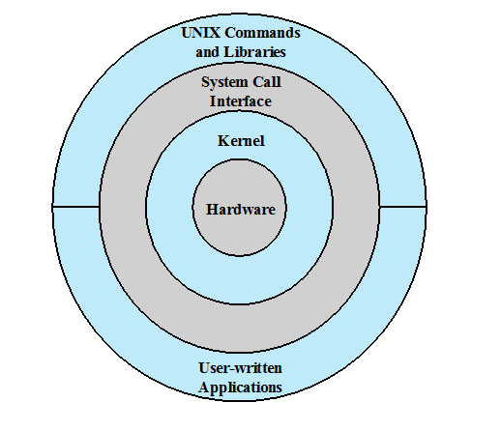
OS Layers and Views
General UNIX Architecture
21/02/19
Operating system
Notes:
MIT-WPU

Slide 9
System Calls
Programming interface to the services provided by the OS
Interface between a running program and the operating system kernel.
Categories
  Process management
  Memory management
  File management
  Device management
  Communication
Examples of System Calls of File Manipulations :
open()
read()
write()
close()
21/02/19
Operating systems
Notes:
MIT-WPU

Slide 10
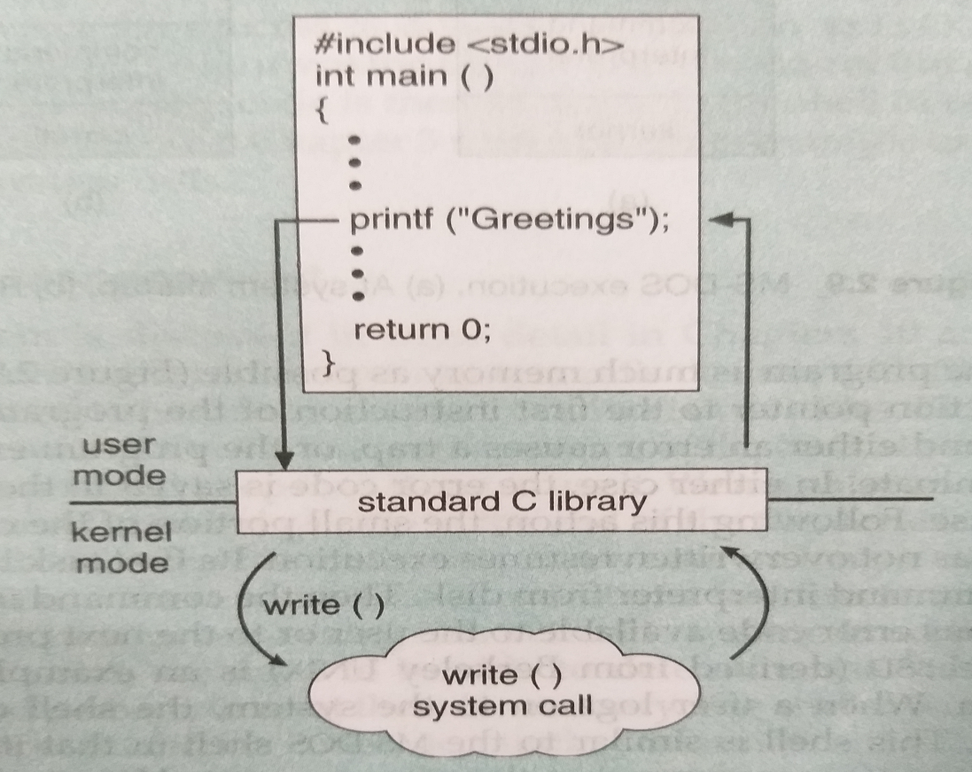
System call – print :Example
C program invoking printf() library call, which calls write() system call
21/02/19
Operating systems
Notes:
MIT-WPU

Slide 11
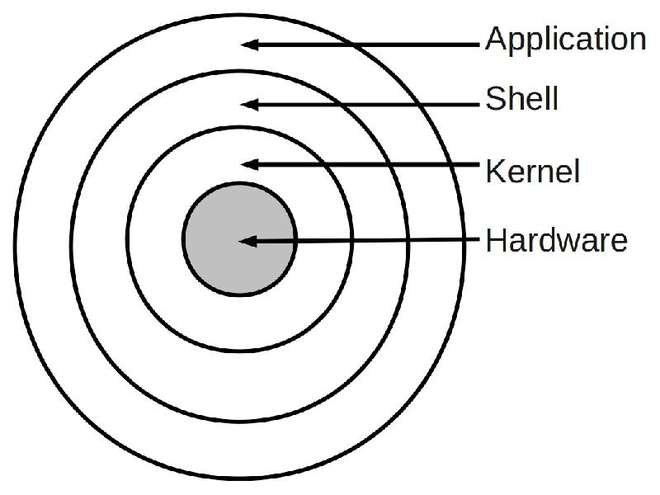
What is Shell ?
The “Shell” is simply another program on top of the kernel which provides a basic human-OS interface.
A shell is an interface layer between the User and the underlying OS.
  It is a command interpreter
  Enables users to run services provided by the UNIX OS
Functionality:
  Command Interpreter
  Interface
  Programming language
21/02/19
Operating system
Notes:
MIT-WPU

Slide 12
Most Commonly Used Shells
/bin/csh -- C shell
/bin/tcsh -- Enhanced C Shell
/bin/sh -- The Bourne Shell / POSIX shell
/bin/ksh -- Korn shell
/bin/bash -- Korn shell clone, from GNU
All Linux versions use the Bash shell (Bourne Again Shell) as the default shell.
To find all available shells in your system type following command
$ cat /etc/shells
( $ means terminal prompt )
To Check default Shell of your system
$ echo $SHELL
(SHELL is a pre-defined variable)
21/02/19
Operating systems
Notes:
MIT-WPU

Slide 13
What is Shell Script ?
A shell script is a series of command(s) stored in plain text file.
Why to a Write Shell Script ?
Shell script can take input from user or file and output them on screen.
Useful to create our own commands. Save lots of time.
To automate some task of daily life.
System Administration part can be also automated.
21/02/19
Operating system
Notes:
MIT-WPU

Slide 14
Practical examples where shell scripting actively used:
Monitoring your Linux system.
Data backup.
Find out what processes are eating up your system resources.
Find out available and free memory.
Find out all logged in users and what they are doing.
Find out if all necessary network services are running or not.
And many more…..
21/02/19
Operating system
Notes:
MIT-WPU

Slide 15
Create a script
Use gedit as text editors for shell scripting
Example:
$ gedit hello
and type the following inside it:
#!/bin/bash
echo “Hello World”
The first line tells Linux to use the bash interpreter to run this script as hello.sh.
bash comments start with a hash mark (#)
To prepare the file for running, just turn on its execute bit
Syntax to setup executable permission:
$ chmod +x your-script-name.
$ chmod 755 your-script-name.
21/02/19
Operating systems
Notes:
MIT-WPU

Slide 16
Run a script (execute a script)
Different ways to run the script :
bash your-script-name
sh your-script-name
./your-script-na
Example :
$ bash hello
$ sh hello
$ ./hello
Example (hello script)
#!/bin/bash
echo “Hello, world!”
Output:
$ chmod +x hello
$ ./hello
Hello, world!
21/02/19
Operating systems
Notes:
MIT-WPU

Slide 17
Variables in Shell
Variables are global within a script
Types of variable:
System variables - Created and maintained by Linux itself. This type of variable defined in CAPITAL LETTERS.
User defined variables (UDV) – Created and maintained by user. This type of variable defined in lower letters. To define UDV use following syntax:
variable name=value
Examples: (You must use $ followed by variable name when using value.)
vech=Bus
n=10
echo $vech
echo $n
mylang="Pennsylvania Dutch"
echo "I speak $mylang."
I speak Pennsylvania Dutch.
echo 'I speak $mylang.'
I speak $mylang.
21/02/19
Operating systems
Notes:
MIT-WPU

Slide 18
Input / Output
Use the read command to prompt for input from user
Syntax:
read var_name
Use of echo and printf command to
Syntax:
echo “Message” OR echo $ var_name
Example :
$ echo "Your first name please:"
$ read fname
$ echo "Hello $fname, Lets be friend!“
21/02/19
Operating systems
Notes:
MIT-WPU

Slide 19
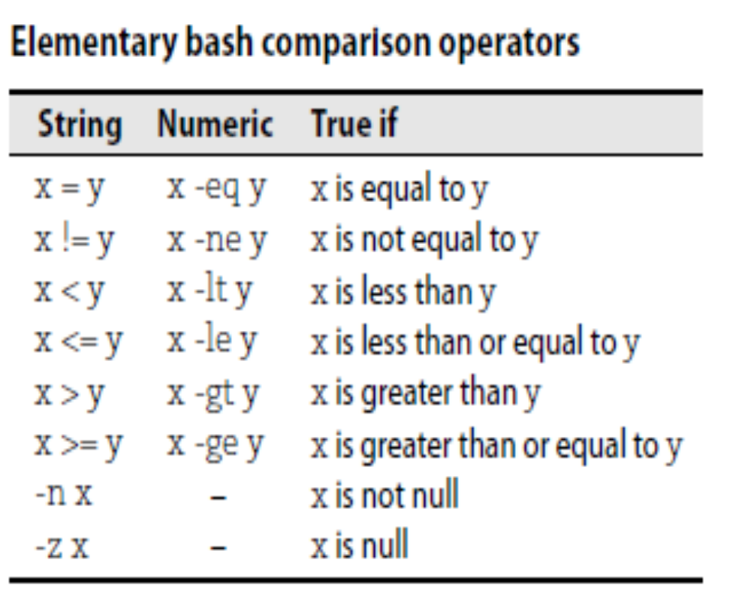
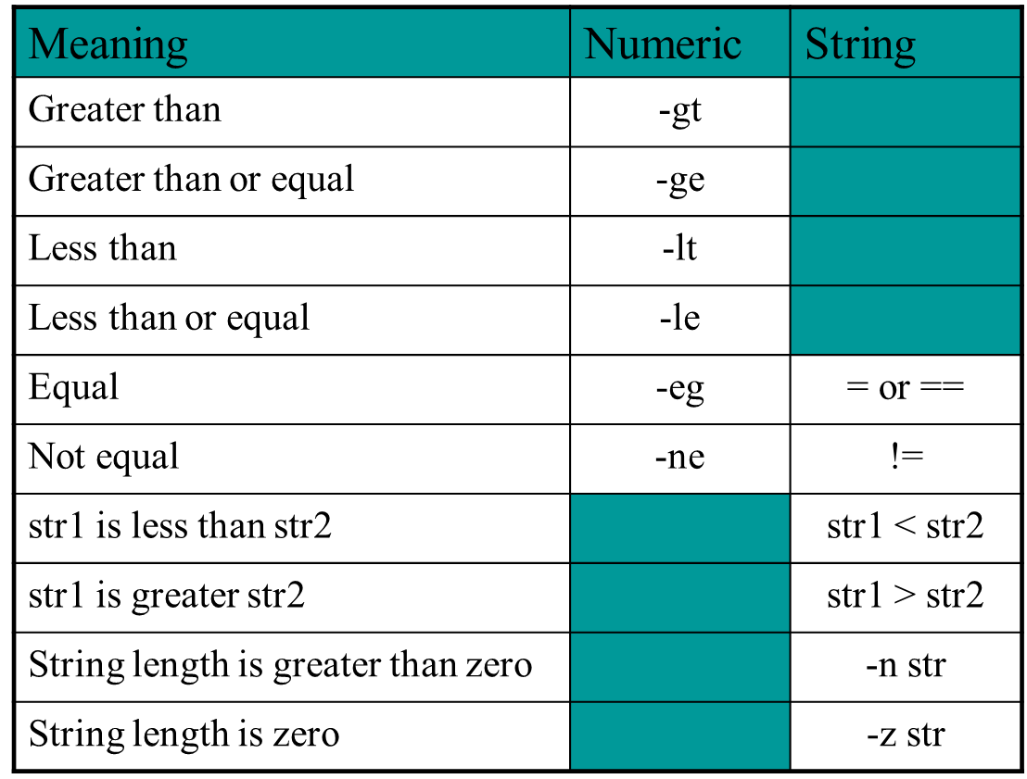
Bash Comparison Operator
21/02/19
Operating systems
Notes:
MIT-WPU

Slide 20
Conditional Control Statement: if
Syntax: if….fi
if condition
then
command1 #if condition is true
Fi
Syntax: if…else...fi
if condition
then
command1 # if condition is true
else
Command2 # if condition is flase
fi
Example:
$ gedit myscript.sh
read choice
if [ $choice -gt 0 ]
then
echo "$choice number is positive"
else
echo "$choice number is negative"
fi
21/02/19
Operating systems
Notes:
MIT-WPU

Slide 21
Loops in Shell Scripts
for Loop
Syntax:
for { variable name } in { list }
do
#execute one for each item in the list until the list is not finished and repeat all statement between do and done
done
while loop
Syntax :
while [ condition ] #space required
do
command1 command2 command3 .. ....
done
Example :
i=1; n=1
while [ $i -le 10 ]
do
echo "$n * $i =" `expr $i \* $n` i=`expr $i + 1`
done
Example :
for i in 1 2 3 4 5
do
echo "Welcome $i times"
done
21/02/19
Operating systems
Notes:
MIT-WPU

Slide 22
case Statement in Shell Scripts
Syntax:
case $variable-name in
pattern1) command…..;;
pattern2) command…..;;
pattern N) command….;;
.
*) command ;; #default case
esac
Example :
read var
case $var in
1) echo “One”;;
2) echo “Two”;;
3) echo “Three”;;
4) echo “Four”;;
*) echo "Sorry, it is bigger than Four";;
esac
21/02/19
Operating systems
Notes:
MIT-WPU

Slide 23
Functions in Shell Scripts
Function is series of instruction/commands.
Function performs particular activity in
shell.
Syntax:
function-name ( )
{
Function body
}
Example :
today()
{
echo “Today is `date`”
return
}
today
21/02/19
Operating systems
Notes:
MIT-WPU

Slide 24
OS Components / Functions
21/02/19
Operating systems
Notes:
MIT-WPU

Slide 25
OS Components / Functions
Process Management and CPU scheduling
Memory Management
File Management
I/O System Management
System Security
21/02/19
Operating systems
Notes:
MIT-WPU

Slide 26
Process Management
A process is a program in execution.
A process needs certain resources, including CPU time, memory, files, and I/O devices, to accomplish its task.
The operating system is responsible for the following activities in connection with process management.
  Process creation and deletion.
  Process suspension and resumption.
  Provision of mechanisms for:
Process synchronization
Process communication
21/02/19
Operating systems
Notes:
MIT-WPU

Slide 27
Memory Management
Memory is a large array of words or bytes, each with its own address.
It is a repository of quickly accessible data shared by the CPU and I/O devices.
Main memory is a volatile storage device. It loses its contents in the case of system failure.
The operating system is responsible for the following activities in connections with memory management:
  Keep track of which parts of memory are currently being used and by whom.
  Decide which processes to load when memory space becomes available.
  Allocate and deallocate memory space as needed.
21/02/19
Operating systems
Notes:
MIT-WPU

Slide 28
File Management
A file is a collection of related information defined by its creator. Commonly, files represent programs (both source and object forms) and data.
The operating system is responsible for the following activities in connections with file management:
  File creation and deletion.
  Directory creation and deletion.
  Support of primitives for manipulating files and directories.
  Mapping files onto secondary storage.
  File backup on stable (nonvolatile) storage media.
21/02/19
Operating systems
Notes:
MIT-WPU

Slide 29
I/O System Management
Control of Devices connected to Computer
I/O devices vary widely in their function and speed, so different methods are needed to control them.
Device drivers are required to provide an interface to I/O devices.
Also The I/O system consists uses buffering to take care of speed difference between I/O devices and processor.
21/02/19
Operating systems
Notes:
MIT-WPU

Slide 30
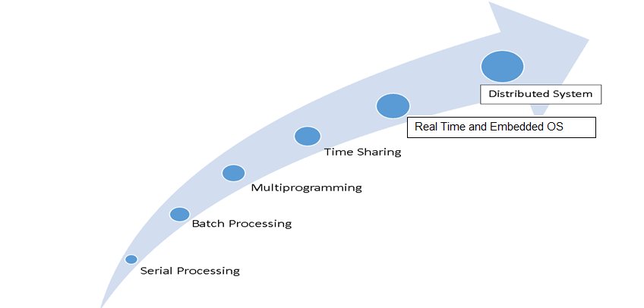
Evolution of Operating Systems
Reasons of OS Evolution
A major OS will evolve over time for a number of reasons
Hardware upgrades
New services
Fixes/Bugs: mostly security fixes!
21/02/19
Operating systems
Notes:
MIT-WPU

Slide 31
Serial Processing
Serial processing
  No operating system
  Programmer interacted directly with computer hardware
  Program was loaded via card reader, etc & output on printer
  Manual scheduling & setup was required
  Setup included loading the compiler, source program, saving compiled program, and loading and linking
Problems:
1. Scheduling:
  most installations used a hardcopy sign-up sheet to reserve computer time
  time allocations could run short or long, resulting in wasted computer time
2. Setup time
Considerable amount of time was spent just on setting up the program to run
21/02/19
Operating systems
Notes:
MIT-WPU

Slide 32
Simple Batch Systems
Simple batch system:
Batch similar jobs together
Good for large jobs needing very little interaction
First rudimentary operating system
Resident monitor
      initial control in monitor
      control transfers to job
      when job completes control transfers back to monitor
Problems/Overheads:
Slow Performance – I/O and CPU could not overlap, card reader very slow
Processor time alternates between execution of user programs and execution of the monitor
  Despite overhead, the simple batch system improves utilization of the computer
21/02/19
Operating systems
Notes:
MIT-WPU

Slide 33
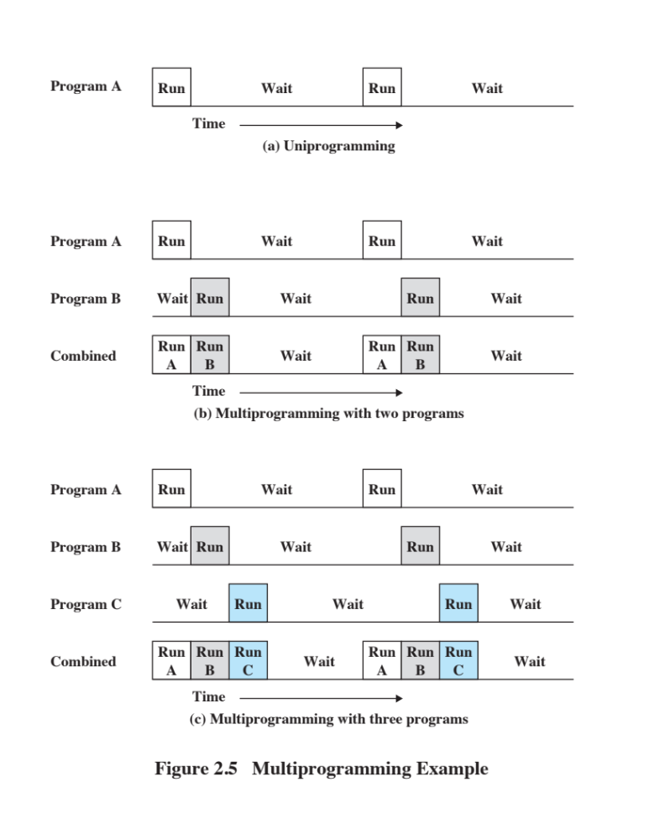
Uniprogramming
Processor must wait for I/O instruction to complete before proceeding
The processor spends a certain amount of time executing, until it reaches an I/O instruction; it must then wait until that I/O instruction concludes before proceeding
21/02/19
Operating systems
Notes:
Figure 2.5a illustrates this situation, where we have a single program, referred to as uniprogramming.
The processor spends a certain amount of time executing, until it reaches an I/O instruction.
It must then wait until that I/O instruction concludes before proceeding.
MIT-WPU

Slide 34

Multiprogramming
Several jobs are kept in main memory at the same time, and the CPU is multiplexed among them.
There must be enough memory to hold the OS (resident monitor) and one user program
When one job needs to wait for I/O, the processor can switch to the other job, which is likely not waiting for I/O
21/02/19
Operating systems
Notes:
This inefficiency is not necessary. We know that there must be enough
memory to hold the OS (resident monitor) and one user program. Suppose that
there is room for the OS and two user programs. When one job needs to wait for
I/O, the processor can switch to the other job, which is likely not waiting for I/O
( Figure 2.5b ).
MIT-WPU

Slide 35
Multiprogramming
Multiprogramming also known as multitasking
Memory is expanded to hold three, four, or more programs and switch among all of them
21/02/19
Operating systems
Notes:
Furthermore, we might expand memory to hold three, four, or more
programs and switch among all of them ( Figure 2.5c ). The approach is known as
multiprogramming , or multitasking . It is the central theme of modern operating
systems.
MIT-WPU

Slide 36
Time-Sharing Systems
Time Sharing systems:
Can be used to handle multiple interactive jobs
Processor time is shared among multiple users
Multiple users simultaneously access the system through terminals, with the OS interleaving the execution of each user program in a short burst or quantum of computation
21/02/19
Operating systems
Notes:
MIT-WPU

Slide 37
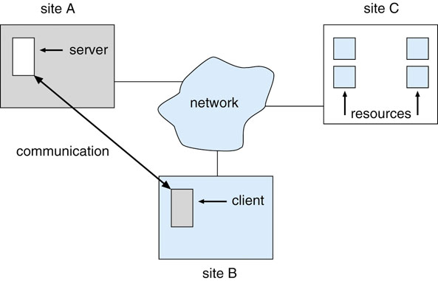
Distributed OS
Distributed OS
Distributed system is collection of loosely coupled processors interconnected by a communications network.
Processors variously called nodes, computers, machines, hosts.
Gives the impression there is a single operating system controlling the network.
Users not aware of multiplicity of machines Access to remote resources similar to access to local ones
Advantages :
Resource Sharing
Reliability
Communication
Computational Speed up
21/02/19
Operating systems
Notes:
MIT-WPU

Slide 38
Real-Time & Embedded OS
Rigid time requirements are placed on operation of a processor or flow of data
Often used as a control device in a dedicated application such as controlling scientific experiments, medical imaging systems, industrial control systems, and some display systems.
Well-defined fixed-time constraints and processing must be done within define constraints.
Real-Time systems may be either hard or soft real-time.
Example: washing machine, aeroplane
21/02/19
Operating systems
Notes:
MIT-WPU

Slide 39
Operating System Structure
21/02/19
Operating systems
Notes:
MIT-WPU

Slide 40
Operating System Structure
Operating systems tend to be complex, as it provides many services
  Support variety of hardware and software
  Operating system architectures help manage this complexity
  Organize operating system components
  Specify privilege with which each component executes
Modern O/S is large and complex and hence must be created carefully.
It should not only function properly but should get modified easily.
Common approach is to partition the task into small components.
Each of the component is well defined portion of system, with well defined inputs, outputs and function
21/02/19
Operating systems
Notes:
MIT-WPU

Slide 41
Operating System Structure
Monolithic
Layered Approach
Microkernels
21/02/19
Operating system
Notes:
MIT-WPU

Slide 42
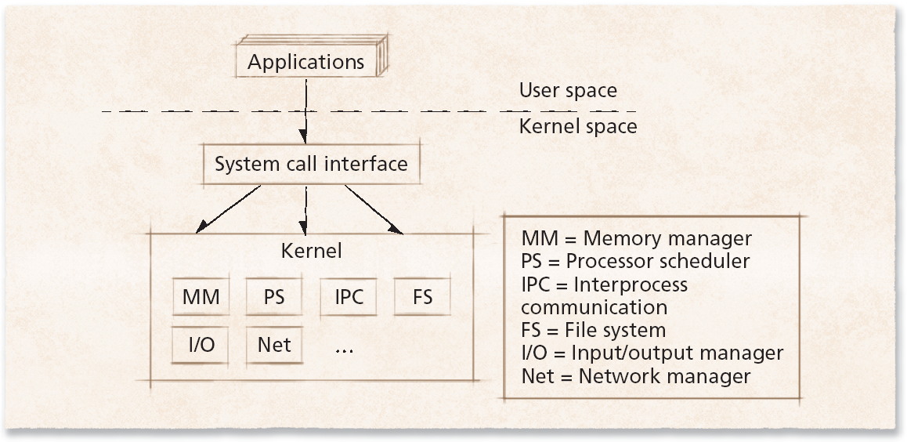
Monolithic Approach
Monolithic operating system
Every component contained in kernel
  Direct communication among all elements
  Highly efficient
  Problems:
    complexity
    new devices
    emerging technologies enabling
    protection
21/02/19
Operating systems
Notes:
MIT-WPU

Slide 43
Layered Approach
The operating system is divided into a number of layers (levels), each built on top of lower layers. The bottom layer (layer 0), is the hardware; the highest (layer N) is the user interface.
Typical O/S layer consists of data structures & set of operations which can be invoked by higher level layers.
With modularity, layers are selected such that each uses functions (operations) and services of only lower-level layers.
Simplifies debugging and system verification, since layers use functions and services of only lower level layers
Each layer hides the existence of certain data structures, operations and hardware from higher level layers, since they do not have to know how these operations are implemented
21/02/19
Operating system
Notes:
MIT-WPU

Slide 44
Layered Approach
Components are divided into layers
– grouping similar components
Each layer only interacts with:
– the bottom layer - requesting services – to top layer - answering requests
Higher level layer – Applications
Lowest level layer – hardware
Advantaged – good structure, well defined interface, ...
Disadvantages – can be slow, may be difficult to define layers.
21/02/19
Operating systems
Notes:
MIT-WPU

Slide 45
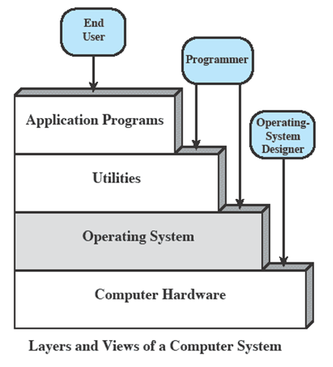
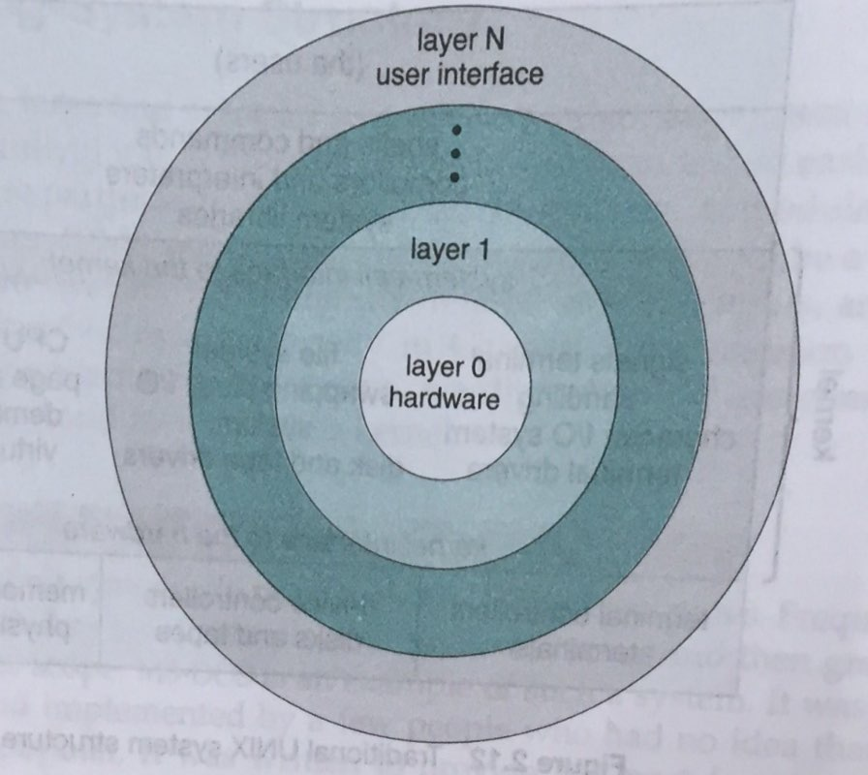
Layered Approach
21/02/19
Operating systems
Notes:
MIT-WPU

Slide 46
Difficulties with Layered Approach
No clear definition (from functionality point of view) of the layers
Memory management routines are above device drivers for disk space, it is obvious
Logically backing store should be above the CPU scheduler, but it is below CPU scheduler, it is not obvious.
Layered approach tends to be less effective
21/02/19
Operating systems
Notes:
MIT-WPU

Slide 47
Microkernel Approach
Kernel is modularized using microkernel approach
It removes all non essential components from kernel and implements them as system and user level programs.
It provides minimal process and memory management, in addition to communication facility.
Other O/S services are provided by processes, called as servers that run in user mode and are treated like any other application by microkernel. (e.g diff file organizations can be implemented as one service) Device drivers, file systems, virtual memory manager, windowing system, security services
  Provides communication between client program and various services that are running in user space.
  Communication is provided by message passing.
  Clients and services communicate by exchanging messages with microkernel and not directly.
21/02/19
Operating systems
Notes:
MIT-WPU

Slide 48
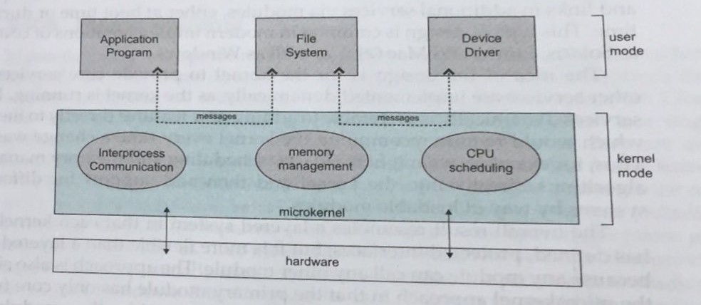
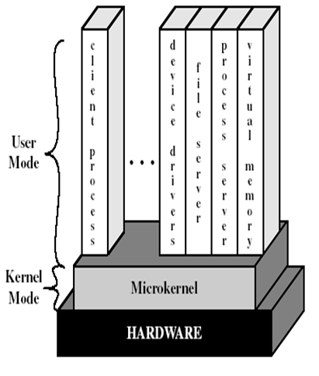
Microkernel Approach
21/02/19
Operating systems
Notes:
MIT-WPU

Slide 49
Microkernel Design: Benefits
Uniform Interface :Uniform Interface on requests made by process: Processes are not distinguished as user or kernel level, since services are provided by means of message passing
Extendibility: Ease of extending O/S
Flexibility :New services are added to the user space and no modification required at kernel level. Existing features can be subtracted to produce smaller and efficient implementation.
Kernel level modification are very few.
Portability O/S is easier to port from one H/W design to another
Provides more security and reliability, since most services are running at user level.
If service fails, rest of O/S remains unchanged
Examples: Tru64Unix, Apple MacOs
21/02/19
Operating systems
Notes:
MIT-WPU

Slide 50
References
Text Books:
1. William Stallings, Operating System: Internals and Design Principles, Prentice Hall, ISBN-10: 0-13-380591-3, ISBN-13: 978-0-13-380591-8, 8th Edition
2. Abraham Silberschatz, Peter Baer Galvin and Greg Gagne, Operating System Concepts, WILEY,ISBN 978-1-118-06333-0, 9th Edition
Reference Books:
1.Harvey M. Deitel, Operating Systems, Prentice Hall, ISBN-10: 0131828274, ISBN-13: 978-0131828278.
W. Richard Stevens, Stephen A. Rago, Advanced Programming in the UNIX Environment, Addison- Wesley Professional, ISBN: 9780321637734,3rd Edition.
2. Sumitabha Das, Unix concepts and applications ,McGraw Hill,ISBN-13-978-0-07063546-3,4th Edition.
Supplementary Reading:
Andrew Tanenbaum, Modern Operating Systems,Peasrson,4th Edition.
21/02/19
Operating systems
Notes:
MIT-WPU

