Slide 1

Operating Systems
DEPARTMENT OF COMPUTER SCIENCE AND ENGINEERING

Slide 2

Operating systems
Examination scheme: Marks-50 [Continuous Assessment]
Course Objectives:
To discuss a generic overview of operating systems.
To describe the concepts of process management.
To state the concepts related to synchronization of processes.
To explain the concepts of Memory Management and I/O management.
Course Outcomes:
After completion of the course the students will be able to :-
1. Comprehend key mechanisms of the Operating System functions.
2. Demonstrate processor scheduling algorithms.
3. Explain solutions to process synchronization problems.
4. Assess memory management issues.
OPERATING SYSTEMS
Notes:
MIT-WPU

Slide 3
Syllabus OS [ 2018-2019]--Trimester VI
Overview of Operating Systems
Operating System objectives and its evolution. Operating System structure: Layered, Monolithic, Microkernel Operating Systems. BASH shell scripting.
Process Management
Process: Concept of a Process, Process States, Process Control-creation, new program execution, termination.
Threads: Processes and Threads, Concept of Multithreading, Types of Threads, Thread programming Using Pthreads.
Scheduling: Types of Scheduling, Scheduling Algorithms: FCFS, SJF, Priority, Round Robin.
Concurrency Control
Process Synchronization: Principles of Concurrency, Requirements for Mutual Exclusion, Mutual Exclusion: Hardware Support, Operating System Support (Semaphores and Mutex).
Classical synchronization problems: Readers/Writers Problem, Producer and Consumer problem.
Deadlock: Principles of Deadlock, Deadlock Modeling, Deadlock Prevention, Deadlock Avoidance, Deadlock detection and recovery.
Memory Management, I/O and File Management
Memory Management: Memory Management Requirements, Memory Partitioning: Fixed Partitioning, Dynamic Partitioning, paging, segmentation, virtual memory.
File Management: Overview, File Organization and Access, File Directories, File Sharing, Record Blocking.
I/O Management: I/O Devices, Organization of the I/O Functions, I/O Buffering, Disk Scheduling.
OPERATING SYSTEMS
Notes:
MIT-WPU

Slide 4
Requirements of an Operating System
Interleave the execution of multiple processes to maximize processor utilization while providing reasonable response time
Allocate resources to processes
Support interprocess communication and user creation of processes
OPERATING SYSTEMS

Slide 5
Process
A program in execution
An instance of a program running on a computer
The entity that can be assigned to and executed on a processor
A unit of activity characterized by the execution of a sequence of instructions, a current state, and an associated set of system resources
OPERATING SYSTEMS

Slide 6
Continued…
In short, a process is an entity that consists of a number of elements.
Two essential elements of a process are:
  Program code
    May be shared with other processes that are executing the same program
  Set of code
    Data associated with that code
OPERATING SYSTEMS

Slide 7
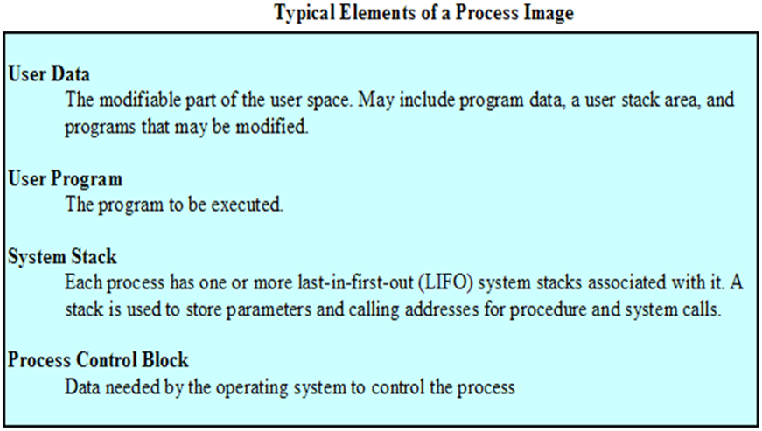
Process Image
OPERATING SYSTEMS

Slide 8
Process Elements
Identifier
State
Priority
Program counter
Memory pointers
Context data
I/O status information
Accounting information
OPERATING SYSTEMS

Slide 9
Process Control Block
Identifier
State
Contains the process elements
Created and manage by the operating system
Allows support for multiple processes
Priority
Program counter
Memory pointers
Context data
I/O status
information
Accounting
information
Figure Simplified Process Control Block
OPERATING SYSTEMS

Slide 10
Process States
Trace of Process
  Sequence of instruction that execute for a process
Dispatcher switches the processor from one process to another
OPERATING SYSTEMS

Slide 11
Example Execution
Address
Main Memory
Program Counter
0
8000
100
Dispatcher
5000
Process A
8000
Process B
12000
Process C
Figure Snapshot of Example Execution
at Instruction Cycle 13
OPERATING SYSTEMS

Slide 12
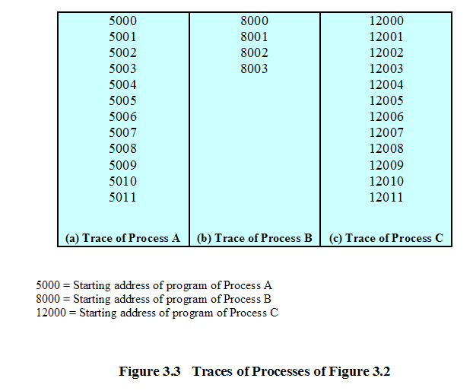
Trace of Processes
OPERATING SYSTEMS

Slide 13
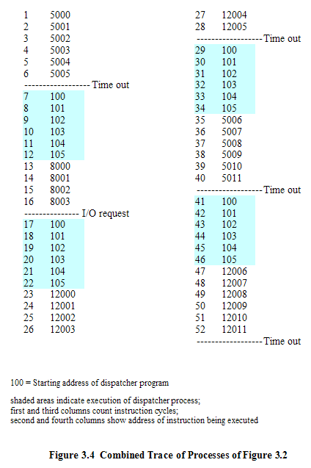
OPERATING SYSTEMS

Slide 14
Process Modes
There are two modes of operations :-
Kernel mode ( Privileged mode)..it can access its own data-structures as well as
the user mode data structures.
User mode : it can access only the user mode data structures.
User programs initially work in the User mode.
Whenever a system call is encountered the control switches to the kernel mode.
All interrupts are serviced in the Kernel mode.
When the system call is serviced the control returns back to the user mode
OPERATING SYSTEMS
Notes:
MIT-WPU

Slide 15
Process Management --- context switch
Requires the services of the kernel
For switching of context (environment) from Process A to process B, services of the kernel are needed. The kernel stores the execution environment (context) of process A and retrieves the environment(context) for process B for execution.
Every context switch is a mode switch.
Kernel mode
User mode
Process A
Process B
OPERATING SYSTEMS
Notes:
MIT-WPU

Slide 16
Context Switch
When CPU switches to another process, the system must save the state of the old process and load the saved state for the new process.
Context-switch time is overhead; the system does no useful work while switching.
OPERATING SYSTEMS

Slide 17

Context Switch
OPERATING SYSTEMS

Slide 18
Process Management – Mode switch
Kernel mode
User mode
Process A
Process A was executing in User mode and has now switched to the Kernel mode due to some system call.This is mode switch.
As, every context switch is a mode switch, every mode switch may/may not be a context switch.
Process A
OPERATING SYSTEMS
Notes:
MIT-WPU

Slide 19
Process Creation
Fork
System call fork() is used to create processes. It takes no arguments and returns a process ID.
The syntax for the fork system call
  pid = fork();
    In the parent process, pid is the child process ID
    In the child process, pid is 0
Sequence of operations for fork.
  1. It allocates a slot in the process table for the new process
  2. It assigns a unique ID number to the child process
  3. It makes a copy of the context of the parent process.
  4. It returns the ID number of the child to the parent process, and a 0 value to the child process.
OPERATING SYSTEMS

Slide 20
Fork
Purpose of fork() is to create a new process, which becomes the child process of the caller.
After a process is created, both processes will execute the next instruction following the fork() system call.
To distinguish the parent from the child, the returned value of fork() can be used:
fork() returns a negative value, the creation of a child process was unsuccessful.
fork() returns a zero to the newly created child process.
fork() returns a positive value, the process ID of the child process, to the parent
Returned process ID is of type pid_t defined in sys/types.h
Process can use function getpid() to retrieve the process ID assigned to this process
Unix/Linux will make an exact copy of the parent's address space and give it to the child. Therefore, the parent and child processes have separate address spaces.
OPERATING SYSTEMS

Slide 21
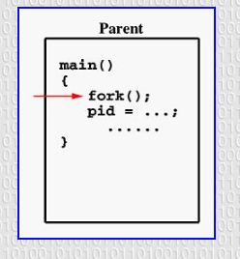
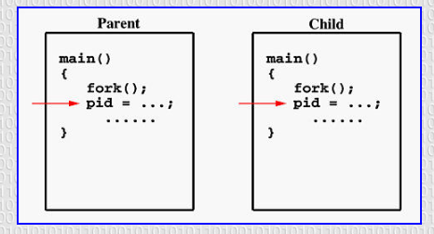
OPERATING SYSTEMS

Slide 22
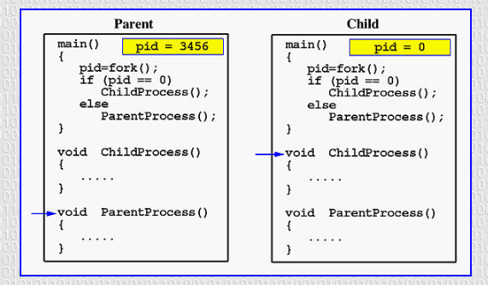
OPERATING SYSTEMS

Slide 23
Process Management—creating a Process in Unix(example)
#include<stdio.h>
#include<sys/types.h>
#include<unistd.h>
/* pid_t : is a long integer type data type...prototype in types.h */
pid_t num_pid;
main()
{
num_pid=fork(); /* return value of fork */
if(num_pid==0) /* this is child process */
{
printf("this is the child process id %d\n",getpid());
}
if(num_pid>0) /* this is parent process */
{
printf("this is the parent process id %d",getpid());
}
exit();
}
$cc program.c
$ ./a.out
$ this is the child process id 1001
$ this is the parent process id 1000
OPERATING SYSTEMS

Slide 24
Process Management – Parent/Child
Parent Process
The parent process has its unique ID
The parent process creates a child process by giving a call to fork() system call
Child Process
The child process has its unique ID
The child process gets created due to the fork() system call
The child is initially a duplication of the parent process. The child and parent do exist in separate address spaces.
The child inherits all data structures, Inter Procress communication(IPC) structures except pending
signals from the parent.
A client-server application can be built using the parent-child concept. Any IPC mechanism can be implemented
using the parent child relationship.
OPERATING SYSTEMS

Slide 25
Process Management
DESCRIPTION
Parent process: the original process, when it gives a call to fork() system call a child process is created.
Fork returns twice when called. Once it returns the id of the child to the parent.And it returns value 0 to the child process.
OPERATING SYSTEMS

Slide 26
Process Management
When a process terminates, all the information held in all data structures is released.
A process goes back to becoming a program and is stored on the secondary memory.
OPERATING SYSTEMS
Notes:
MIT-WPU

Slide 27
A Five-State Model
Not-running
  ready to execute
Blocked
  waiting for I/O
Dispatcher cannot just select the process that has been in the queue the longest because it may be blocked
OPERATING SYSTEMS

Slide 28
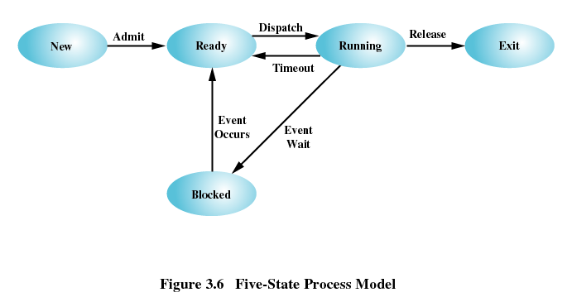
A Five-State Model
Running
Ready
Blocked
New
Exit
OPERATING SYSTEMS

Slide 29
State Transitions
Null -> New
New -> Ready
Ready -> Running
Running -> Exit
Running -> Ready
Running -> Blocked
Blocked -> Ready
Ready -> Exit
Blocked -> Exit
OPERATING SYSTEMS

Slide 30
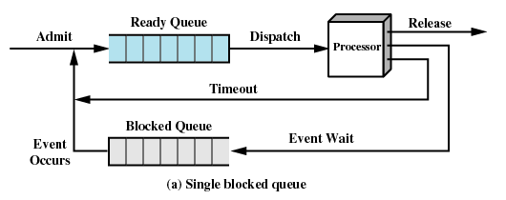
Using Two Queues
OPERATING SYSTEMS

Slide 31
Suspended Processes
Processor is faster than I/O so all processes could be waiting for I/O, thus processor could be in idle most of the time.
Solutions:
  Main memory expansion
  Swapping
    Swap the processes to disk to free up more memory
Blocked state becomes suspend state when swapped to disk
OPERATING SYSTEMS

Slide 32
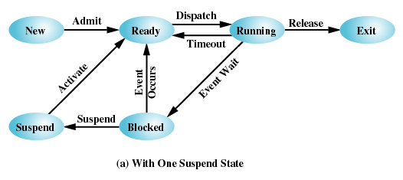
One Suspend State
OPERATING SYSTEMS

Slide 33
Process Management-- Threads
A thread is a part of a program.
It is an execution unit of the CPU.
All threads of the same process share the same address space.
All Threads have separate stacks and individual Thread IDs
Thread is a lightweight process because :The context switching between threads is inexpensive in terms of memory and resources.
OPERATING SYSTEMS
Notes:
MIT-WPU

Slide 34
Process Management-- Threads
Multithreading: Ability of an OS to support multiple, concurrent paths of execution within a single process.
It is also described as the interleaved execution of threads.
OPERATING SYSTEMS
Notes:
MIT-WPU

Slide 35
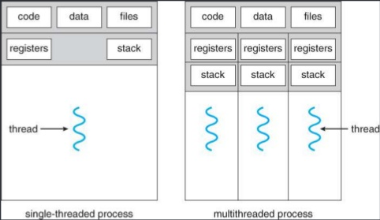
Process Management- ---
Threads, a diagrammatic representation
OPERATING SYSTEMS
Notes:
MIT-WPU

Slide 36
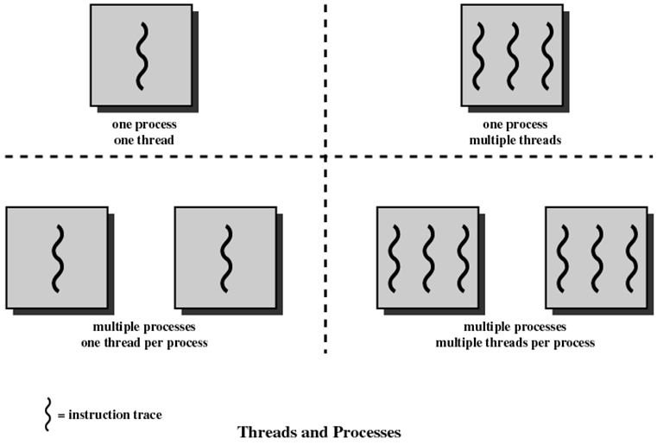
Process Management
Threads and processes diagrammatic representation
OPERATING SYSTEMS

Slide 37
Multithreading
Operating system supports multiple threads of execution within a single process
Examples:
  MS-DOS supports a single thread
  UNIX supports multiple user processes but only supports one thread per process
  Java run time environment supports one process with multiple threads
  Windows, Solaris, Linux, Mach, and OS/2 support multiple threads
OPERATING SYSTEMS

Slide 38

Process Management– Differences between threads and processes
Process | Threads
A process is a program in execution | A thread is a part of the process
A process has its own Process ID | A thread has its own thread ID
Every process has its own memory space | Threads use the memory of the process they belong to
Inter process communication is slow as processes have different memory address | Inter thread communication for threads within the same process is fast
The context switching is more expensive in terms of memory and resources. | The context switching is less expensive in terms of memory and resources . Majorly because threads of the same process share the same memory space.
OPERATING SYSTEMS
Notes:
MIT-WPU

Slide 39
Process Management—Thread basics
Thread operations include thread creation, termination, synchronization (join, blocking), scheduling, etc.
All threads within a process share the same address space.
Threads in the same process share: Process instructions
  Data
  Open files (descriptors)
  Signals
  Current working directory
  User and group id
Each thread has a unique: Thread ID
  set of registers
  stack for local variables, return addresses
  priority
OPERATING SYSTEMS
Notes:
MIT-WPU

Slide 40
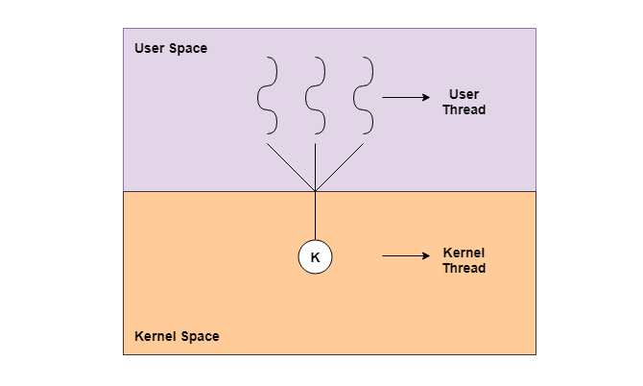
Process Management—Thread basics
Types of Threads :-
There are majorly two types of threads :-
  Kernel level threads
  User level threads
OPERATING SYSTEMS
Notes:
MIT-WPU

Slide 41
Process Management—Thread basics
User - Level Threads
User-level threads are implemented by users and the kernel is not aware of the existence of these threads
Kernel handles them as if they were single-threaded processes.
User-level threads are small and much faster than kernel level threads.
They are represented by a program counter(PC), stack, registers and a small process control block.
Also, there is no kernel involvement in synchronization for user-level threads.
User-Level threads are managed entirely by the user-level library
OPERATING SYSTEMS
Notes:
MIT-WPU

Slide 42
Process Management—Thread basics
Advantages of User-Level Threads
  User-level threads are easier and faster to create than kernel-level threads. They can also be more easily managed.
  User-level threads can be run on any operating system.
  There are no kernel mode privileges required for thread switching in user-level threads.
Disadvantages of User-Level Threads
  Multithreaded applications in user-level threads cannot use multiprocessing to their advantage.
  Entire process is blocked if one user-level thread performs blocking operation.
OPERATING SYSTEMS
Notes:
MIT-WPU

Slide 43
Process Management—Thread basics
Kernel-Level Threads
Kernel-level threads are handled by the operating system directly and the thread management is done by the kernel
Context information for the process as well as the process threads is all managed by the kernel.
Because of this, kernel-level threads are slower than user-level threads.
OPERATING SYSTEMS
Notes:
MIT-WPU

Slide 44
Process Management—Thread basics
Advantages of Kernel-Level Threads
Multiple threads of the same process can be scheduled on different processors in kernel-level threads.
The kernel routines can also be multithreaded.
If a kernel-level thread is blocked, another thread of the same process can be scheduled by the kernel.
Disadvantages of Kernel-Level Threads
A mode switch to kernel mode is required to transfer control from one thread to another in a process.
Kernel-level threads are slower to create as well as manage as compared to user-level threads.
OPERATING SYSTEMS
Notes:
MIT-WPU

Slide 45
Process Management—POSIX pthread
Portable Operating System Interface Standard (POSIX)
#include<pthread.h>
int pthread_create (pthread_t *tid, const pthread_attr_t *attr, void *(*func)(void*),void *arg);
0 : OK +ve : error
pthread_t *tid : Returns the thread ID which is of type pthread_t, i.e. long int.
const pthread_attr_t *attr : Thread attribute list
void *(*func)(void*) : A function that works as a thread.
void *arg : A list of arguments sent to the function
OPERATING SYSTEMS
Notes:
MIT-WPU

Slide 46
Process Management—POSIX pthread
Portable Operating System Interface Standard (POSIX)
#include <pthread.h>
void pthread_exit(void *retval);
The pthread_exit(); function terminates the calling thread and returns a value via retval that (if the thread is joinable) is available to another thread in the same process that calls pthread_join().
OPERATING SYSTEMS

Slide 47
Process Management—POSIX pthread
Portable Operating System Interface Standard (POSIX)
#include<pthread.h>
int pthread_join(pthread_t tid, void **status);
0:OK +ve:error
pthread_join() function shall suspend execution of the calling thread until the target thread terminates
On return from a successful pthread_join() call with a non-NULL status argument, the value passed to pthread_exit() by the terminating thread shall be made available in the location referenced by status.
OPERATING SYSTEMS

Slide 48
Process Management—POSIX pthread
Portable Operating System Interface Standard (POSIX)
#include<pthread.h>
pthread_t pthread_self(void);
Returns: thread ID of calling thread
The pthread_self() function returns the ID of the calling thread. This is the same value that is returned in *tid in the pthread_create() call that created this thread.
OPERATING SYSTEMS

Slide 49
Process Management--POSIX pthread
#include<pthread.h>
int pthread_detach(pthread_t tid);
Returns : 0:OK +ve: error
The pthread_detach() function marks the thread identified by thread as detached.
When a detached thread terminates, its resources are automatically released back to the system without the need for another thread to join with the terminated thread.
OPERATING SYSTEMS
Notes:
MIT-WPU

Slide 50
POSIX pthread
Need for linking –lpthread flag at the time of compilation
  -lpthread in essence tells the GCC compiler that it must link the pthread library to the compiled executable. pthread or POSIX Threads is a standardized library for implementing threads in C
OPERATING SYSTEMS

Slide 51
pthread example
main()
{ int arr[4],a[3],b[3],i,ans=0;
pthread_t thread1,thread2;
printf("enter 4 numbers\n");
for(i=0;i<4;i++)
scanf("%d",&arr[i]);
a[0]=arr[0]; a[1]=arr[1];
b[0]=arr[2]; b[1]=arr[3];
pthread_create(&thread1,NULL,(void*)add1,a);
pthread_create(&thread2,NULL,(void*)add2,b);
pthread_join(thread1,NULL);
pthread_join(thread2,NULL);
ans=a[2]+b[2];
printf("the result = %d\n",ans);
}
#include<stdio.h>
#include<pthread.h>
int add1(int a[3])
{
a[2] = a[1] + a[0];
printf("result from thread 1 is %d\n",a[2]);
}
int add2(int b[3])
{
b[2] = b[1] + b[0];
printf("result from thread 2 is %d\n",b[2]);
}
OPERATING SYSTEMS

