Slide 1

Operating Systems: Scheduling
DEPARTMENT OF COMPUTER SCIENCE AND ENGINEERING

Slide 2

Syllabus
Scheduling: Types of Scheduling, Scheduling Algorithms: FCFS, SJF, Priority, Round Robin.
Notes:
MIT-WPU

Slide 3
CPU Scheduler
Selects from among the processes in memory that are ready to execute, and allocates the CPU to one of them
CPU scheduling decisions may take place when a process:
  Switches from running to waiting state
  Switches from running to ready state
  Switches from waiting to ready
  Terminates
Scheduling under 1 and 4 is nonpreemptive
All other scheduling is preemptive
Notes:
MIT-WPU

Slide 4
Scheduling Criteria
By switching the CPU among processes, the Operating System can make the computer more productive.
Throughput – Number of processes that complete their execution per time unit
Turnaround time – amount of time to execute a particular process
Waiting time – amount of time a process has been waiting in the ready queue
Response time – amount of time it takes from when a request was submitted until the first response is produced, not output (for time-sharing environment)

Slide 5
Types of processor scheduling
Aim of the processor scheduling is to assign processor to processes over time, in a way that meets system objectives i.e. throughput, response time and processor efficiency.
Scheduling is broken down into three categories:
  Long term scheduling: is performed when a new process is created.
  Medium term scheduling: determines which process shall be allowed to compete for the CPU
  Short term scheduling: determines which ready process will be assigned the CPU when it next becomes available and actually assign the CPU to this process

Slide 6
New
Long term
scheduling
Long term
scheduling
Suspended
Ready
Running
Exit
short term
scheduling
medium term
scheduling

Slide 7
Scheduling Algorithms
FCFS (First Come First Serve)
SJF (Shortest Job First)
Priority scheduling
Round Robin scheduling

Slide 8
FCFS Scheduling: Characteristics
Selection Function: max(w), selects the process which is waiting in the ready queue for maximum time.
Decision Mode : Non-preemptive
Throughput: Not emphasized
Response Time: May be high, especially if there is a large variance in the process execution times.
Overhead: Minimum
Effect on Processes: Penalizes short and I/O bound processes.
Starvation: No

Slide 9
Example-1 of FCFS
Process Burst Time
P1 24
P2 3
P3 3
Suppose that the processes arrive in the order: P1 , P2 , P3

Slide 10
Example-1 of FCFS
The Gantt Chart for the schedule is:
P₁
P₂
P₃
0
24
27
30
Waiting time for P1 = 0; P2 = 24; P3 = 27
Average waiting time: (0 + 24 + 27)/3 = 17

Slide 11
FCFS Scheduling
Suppose that the processes arrive in the order : P2 , P3 , P1
P₂
P₃
P₁
0
3
6
30
Waiting time for P1 = 6; P2 = 0; P3 = 3
Average waiting time: (6 + 0 + 3)/3 = 3

Slide 12
Example-2 of FCFS
Process Arrival Time Burst Time
P1 0.0 7
P2 2.0 4
P3 4.0 1
P4 5.0 4
P1 P2 P3 P4
0
7
11
12
16
Average waiting time = (0 + 5 + 7 + 7)/4 = 4.75
Average Turnaround Time = (7+9+8+11)/4=8.75

Slide 13
Shortest-Job-First (SJR) Scheduling
Associate with each process the length of its next CPU burst. Use these lengths to schedule the process with the shortest time
Two schemes:
  nonpreemptive – once CPU given to the process it cannot be preempted until completes its CPU burst
  preemptive – if a new process arrives with CPU burst length less than remaining time of current executing process, preempt. This scheme is know as the
  Shortest-Remaining-Time-First (SRTF)
SJF is optimal – gives minimum average waiting time for a given set of processes

Slide 14
Example of Non-Preemptive SJF
Process Arrival Time Burst Time
P1 0.0 7
P2 2.0 4
P3 4.0 1
P4 5.0 4
P₁
P₃
P₂
P₄
0
3
7
8
12
16
Average waiting time = (0 + 6 + 3 + 7)/4 = 4

Slide 15
Shortest Job First Preemptive or Shortest Remaining Time
It is a preemptive version of SJF. In this policy, scheduler always chooses the process that has the shortest expected remaining processing time.
When a new process arrives in the ready queue, it may in fact have a shorter remaining time than the currently running process.
Accordingly, the scheduler may preempt whenever a new process becomes ready.
Scheduler must have an estimate of processing time to perform the selection function.

Slide 16
Shortest Job First Preemptive or Shortest Remaining Time: characteristics
Selection Function: minimum total service time required by the process, minus time spent in execution so far.
Decision Mode : Preemptive ( At arrival time)
Throughput: High
Response Time: Provides good response time
Overhead: Can be high
Effect on Processes: Penalizes long processes.
Starvation: Possible

Slide 17
Example of Preemptive SJF
Process Arrival Time Burst Time
P₁ 0.0 7
P₂ 2.0 4
P₃ 4.0 1
P₄ 5.0 4
P₁
P₂
P₃
P₂
P₄
P₁
0
2
4
5
7
11
16
Average waiting time = (9 + 1 + 0 +2)/4 = 3
Average turnaround time= (16+5+1+6)/4=7
Average waiting time = (9 + 1 + 0 +2)/4 - 3

Slide 18
Priority Scheduling
A priority number (integer) is associated with each process
The CPU is allocated to the process with the highest priority (smallest integer ≡ highest priority)
  Preemptive
  Nonpreemptive
SJF is a priority scheduling where priority is the predicted next CPU burst time
Problem ≡ Starvation – low priority processes may never execute
Solution ≡ Aging – as time progresses increase the priority of the process

Slide 19
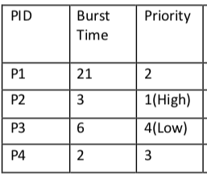
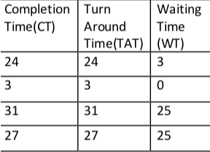
Non Preemptive Priority Scheduling
Consider 4 processes P1, P2, P3 and P4
32
32
26
26
26
24
We can represent this example using GANTT chart as below –
26
32

Slide 20
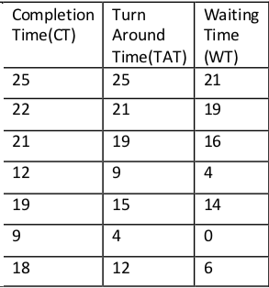
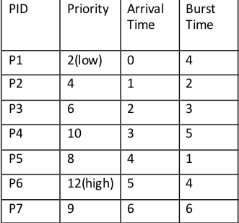
Preemptive Priority Scheduling
We can also represent this example using GANTT chart as below

Slide 21
Round Robin (RR)
Each process gets a small unit of CPU time (time quantum), usually 10-100 milliseconds. After this time has elapsed, the process is preempted and added to the end of the ready queue.
If there are n processes in the ready queue and the time quantum is q, then each process gets 1/n of the CPU time in chunks of at most q time units at once. No process waits more than (n-1)q time units.

Slide 22
Example of RR with Time Quantum = 20
Process Burst Time
P1 53
P2 17
P3 68
P4 24
P₁
P₂
P₃
P₄
P₁
P₃
P₄
P₁
P₃
P₃
0
20
37
57
77
97
117
121
134
154
162
Typically, higher average turnaround than SJF, but better response

Slide 23
Example: Round Robin (By Default preemptive: Time Quantum 2)
Process Arrival Time Burst Time
P₁ 0.0 7
P₂ 2.0 4
P₃ 4.0 1
P₄ 5.0 4
P1
P2
P1
P3
P2
P4
P1
P4
P1
0
2
4
6
7
9
11
13
15
16
Average waiting time = (9 + 3 + 2 +6)/4 =5
Average turnaround time =(16+7+3+10)/4=9
Notes:
MIT-WPU

