Slide 1
Zero to Mobile in 30 Minutes
nerdlandia.tech
Mark Aurit
Ed Cook

Slide 2
Zero to Mobile in 30 Minutes
About Us
Total years
Relevant years
Enterprise systems
… assumptions …

Slide 3
Zero to Mobile in 30 Minutes
Assumptions
Mobile apps - the rage

Slide 4
Zero to Mobile in 30 Minutes
Assumptions
Mobile apps - the rage
Time commitment

Slide 5
Zero to Mobile in 30 Minutes
Assumptions
Mobile apps - the rage
Time commitment
Cross-platform

Slide 6
Zero to Mobile in 30 Minutes
Assumptions
Mobile apps - the rage
Time commitment
Cross-platform
Inexpensive

Slide 7
Zero to Mobile in 30 Minutes
Assumptions
Mobile apps - the rage
Time commitment
Cross-platform
Inexpensive
Total solution

Slide 8
Zero to Mobile in 30 Minutes
the nerdlandia f-word
“an opinioned and complete set of tools based on best-of-breed open source technologies”

Slide 9

Zero to Mobile in 30 Minutes
demo

Slide 10
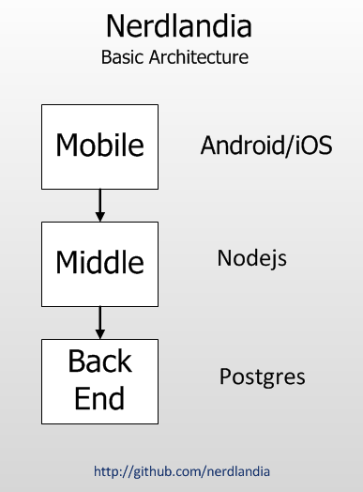
Zero to Mobile in 30 Minutes

Slide 11
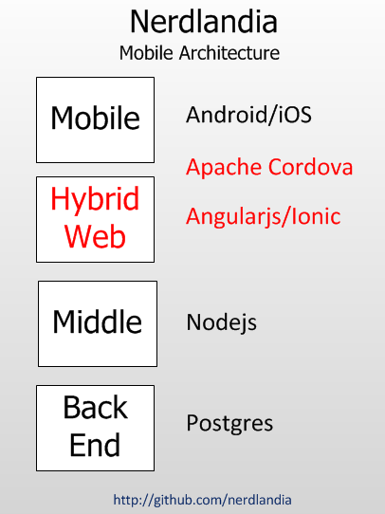
Zero to Mobile in 30 Minutes

Slide 12
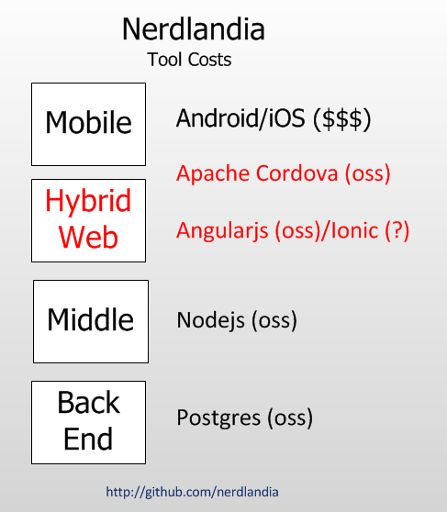
Zero to Mobile in 30 Minutes

Slide 13
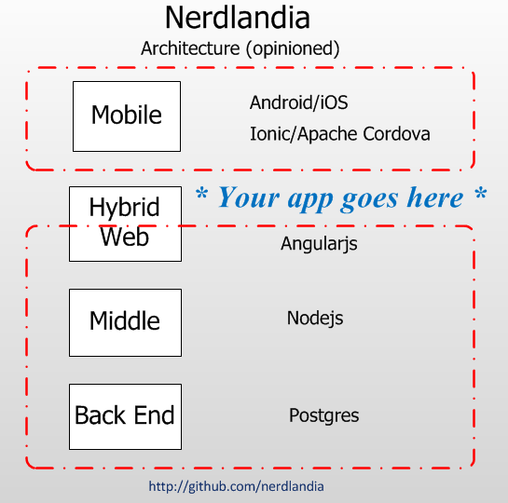
Zero to Mobile in 30 Minutes

Slide 14
Zero to Mobile in 30 Minutes
the nerdlandia framework
Opinioned
Complete
Open source
Best-of-breed

Slide 15
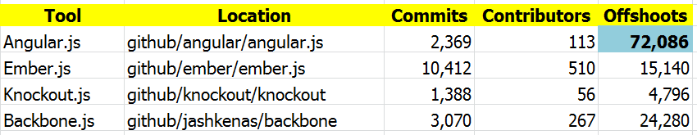
Zero to Mobile in 30 Minutes
Open source/Best-of-breed
“web frameworks”

Slide 16
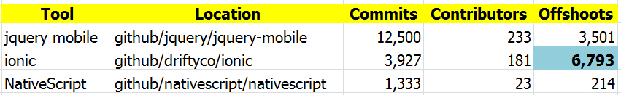
Zero to Mobile in 30 Minutes
Open source/Best-of-breed
“Mobile development”

Slide 17
Zero to Mobile in 30 Minutes
Can we go home now?
Discussed framework
Demo
Reviewed architecture
Provided source

Slide 18
Zero to Mobile in 30 Minutes
Our Services
3 separate “deep-dives”
Developers
Managers
Entrepreneurs

Slide 19
Zero to Mobile in 30 Minutes
Our Services
Training
Consulting
Development

Slide 20
Zero to Mobile in 30 Minutes
Developer Deep-Dive
Robust/powerful
Provide source and documentation
Support

Slide 21
Zero to Mobile in 30 Minutes
Manager Deep-Dive
Alternatives
Fitting into existing architecture
Tooling requirements
Employee-related issues

Slide 22
Zero to Mobile in 30 Minutes
Entrepreneur Deep-Dive
Hidden costs
When not to go mobile
Alternatives
Planning for success

Slide 23

Zero to Mobile in 30 Minutes
Thank you for your time!

