Slide 1
Computer Vision

Slide 2
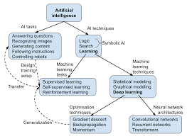
Natural Language Processing
• Natural Language Processing
• Computer Vision
• Robotics

Slide 3
Robotics
Neural Networks are computing systems inspired by the biological neural networks of animal brains. They consist of interconnected nodes, called neurons, that process and transmit information. Neural networks are used in various AI tasks, such as pattern recognition, speech recognition, and autonomous driving.
Machine Learning is a subset of AI that focuses on developing algorithms that can learn from data and make predictions or decisions without being explicitly programmed. It has applications in various domains, such as healthcare, finance, and transportation.

